Slide 1

ADJUSTED ANNUAL PERFORMANCE PLAN 2024/25
OFFICE OF THE PREMIER
Presentation to Oversight Committee on Office of the Premier and Legislature (OCPOL)
15 November 2024

Slide 2

PRESENTATION OUTLINE
Introduction
Legislative Mandate
OOP Vision, Mission and Impact Statement
Gauteng Planning Approach for the 7th Administration
Revised Annual Performance Plan 2024/25
-Programme 1
-Programme 2
-Programme 3
6. Budget

Slide 3
INTRODUCTION
Chapter 3 (section 3.3.4) and Chapter 4 (section 4.4.4) of the Revised Framework on Strategic Plans and Annual Performance Plans (2019) allows that Strategic Plans and Annual Performance Plans be revised and re-tabled
The Office of the Premier presents the revised Annual Performance Plan (APP) for the 2024/25 financial year, covering the remaining two quarters (Q3 and Q4) of this financial year.
This revision aligns with the latest developments and priorities of the 7th Administration, following the Government of National Unity formed after the 2024 elections.
These priorities respond to the emerging challenges and opportunities in the socio-political and economic landscape, ensuring that our province remains on track to meet the priorities and measures of success outlined in the Growing Gauteng Together 2030 (GGT2030) vision.
While this APP continues delivery against the 2020-2025 Strategic Plan, it reflects the updated focus areas of the 7th Administration as pronounced by the Premier in his State of the Province Address in August 2024 and aligns with the emerging Gauteng Medium-Term Development Plan (GMTDP).
This APP will guide us through the remainder of the financial year to ensure that Gauteng is well-positioned for economic growth, development, and social cohesion.

Slide 4
INTRODUCTION cont/…
As part of our efforts to realize the GGT2030 vision, we continue to pursue the implementation of the National Development Plan (NDP), alongside global and regional frameworks such as the UN 2030 Agenda for Sustainable Development, the African Union’s Agenda 2063, and the SADC Vision 2050.
These frameworks shape the strategic interventions required to drive growth, inclusivity, and sustainability in our province.
In summary, reasons for re-tabling the 2024/25 institutional plans Annual Performance Plans) are mainly due to the following:
  The 2024/25 adjustment budget (aligned to the 2020-2025 Strategic Plan ending in March 2025)
  Transition to the 7th Administration and the development of the Medium-Term Development Plan.
  Commitments outlined in the August SOPA and the priorities of the 7th Administration.
  BMT Strategic Plan Session inputs (19 – 20 September 2024).
  Branch engagements and inputs provided.

Slide 5
LEGISLATIVE MANDATE: OoP
The Office of the Premier derives its mandate primarily from the Constitution, the Public Service Act (PSA) and its regulations, the Public Finance Management Act (PFMA), policy directives and the overall mandate of government.
The most important provisions are as follows:
  The Premier has executive, policy, legislative, intergovernmental and ceremonial functions and responsibilities as defined in Chapter 6 of the Constitution of the Republic of South Africa.
  The Premier, as the political head of the Provincial Government, is also responsible for the implementation of Chapter 3 of the Constitution. Section 41(1) defines the relationship and principles underlying cooperation between the various spheres of government.
  Section 125(2) of the Constitution determines that the Premier exercises the executive authority of the province together with other members of the Executive Council (Exco). The Premier appoints these members and assigns their functions and responsibilities, and delegates powers to them.
5

Slide 6
LEGISLATIVE MANDATE: OoP (continues)
The Premier, together with the Exco, exercises executive power by:
    Implementing provincial legislation in the province;
    implementing all applicable national legislation;
    Administering national legislation in the province (if assigned by Parliament), national legislation outside the functional areas listed in Schedules 4 and 5, the administration of which has been assigned to the provincial executive in terms of an Act of Parliament;
    Developing and implementing provincial policy;
    Coordinating the functions of the provincial administration and its departments
    Preparing and initiating provincial legislation and
    Performing any other function assigned to the Provincial Executive in terms of the Constitution or an Act of Parliament.
    The Exco is the fulcrum upon which the Provincial Government revolves. The Premier and all members of Exco are accountable to the Provincial Legislature for the exercise of powers and the performance of functions allocated to them.
The Director-General, as the Head of the Provincial Administration, is also mandated to manage the Public Service. This entails administrative leadership, planning, monitoring, coordination and delivery in accordance with the Public Service Act, 1994 as amended, together with the regulations.
6

Slide 7
OOP VISION, MISSION & IMPACT STATEMENT
Vision
A liveable, equitable, inclusive and united Gauteng City Region
Mission
  Providing strategic leadership and direction to government and society
  Building a capable, ethical and developmental state
  Ensuring transformation and modernisation of the state
  Driving execution and delivery through enhanced policy coordination
  Ensuring effective communication and interfaces with community and key sectors of society
  Promoting transformation and inclusion of society in the economy
  Building social compacts to deliver Growing Gauteng Together (GGT 2030)
5-Year Impact Statement
  A liveable, equitable, inclusive and united Gauteng City Region
  A public service that inspires confidence and demonstrates the highest levels of service delivery to its citizens
7

Slide 8
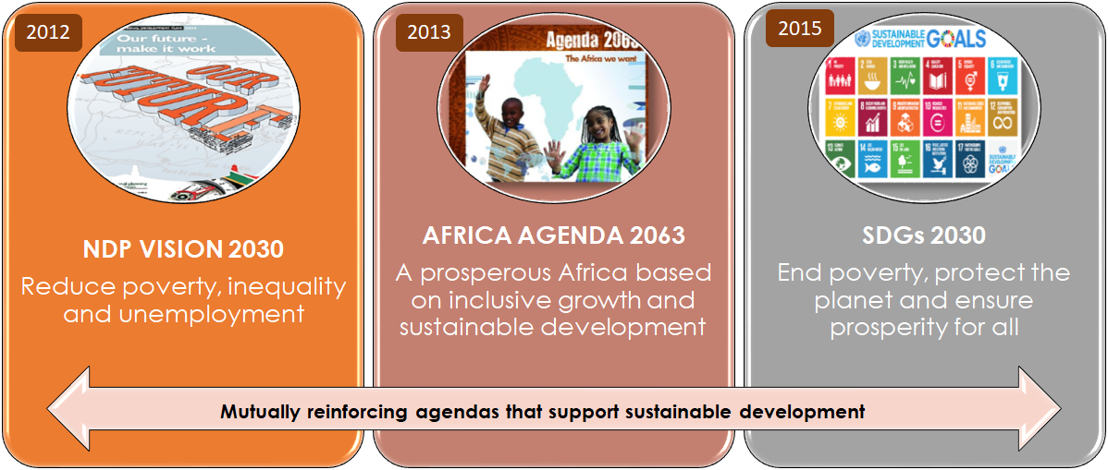
GAUTENG PLANNING APPROACH FOR THE 7th ADMINISTRATION
The NDP 2030 remains our long-term country plan towards 2030, and is aligned to our international commitments on the continent and globally:
  The GMTDP further integrates:
  Spatial planning
  District Development Model
  Climate change response
  Mainstreaming of gender, youth, and persons with disabilities
  and considers:
  Key evaluation and diagnostic analysis findings
  GNU and GPU Statement of Intent and priorities
8

Slide 9
DRAFT MEDIUM-TERM DEVELOPMENT PLAN 8 THEMATIC AREAS
The Office of the Premier through the Policy Research and Advisory Services led a comprehensive participatory process with GPG departments, entities and select stakeholders towards the development of the Medium-Term Development Plan (MTDP), informed by a detailed desk-based literature review and consideration of national processes.
The engagements were further enriched by the findings of the GPG 30-Year Review of Performance (1994-2024) and the GPG End of Term Review of Performance (2019-2024).
Seven workstreams, facilitated and co-facilitated by lead departments contributing to the GGT2030 priorities/strategic themes. These were constituted to consider key insights from past performance, possible future scenarios and to apply a prioritisation framework to identify priorities and interventions for the next medium-term plan.
The workstreams also assisted with formulating and/or confirming key outcomes and priority programmes, key metrics and interventions to be implemented.
The MTDP continues to support the NDP 2030 and GGT2030 vision and builds on the Statement of Intent of the Government of National Unity from which the priorities for the 7th Administration are drawn. Eight strategic themes inform the packaging of the MTDP, namely:
Economy, employment, and infrastructure
Education and skills
Health and wellness
Spatial transformation, human settlements and basic services
Safety, social cohesion and food security
State capacity and capability
Sustainable development
International and regional cooperation
9

Slide 10
GNU AND GPU MTDP STRATEGIC PRIORITIES, 2024-2029
The GNU and GPU MTDP strategic priorities for the 7th Administration are anchored on three (3) priorities, namely:
Inclusive economic growth and job creation
Reduce poverty and tackle the high cost of living
Building a capable and developmental state
The focus of the 7th Administration will be on:
Strengthening governance;
Enhancing public safety;
Supporting the development and revitalization of municipalities and townships.
This strategic approach is expected to:
  Drive meaningful progress and elevate the quality of life for Gauteng residents.
  To enhance the effectiveness of governance, and to strengthen the fight against crime, the community safety portfolio has now been moved to the Office of the Premier. This restructuring is aimed at streamlining efforts to combat crime and improve public safety.
  Additionally, the decision to establish the Department of Environment as a stand-alone entity underscores the commitment to address environmental and sanitation challenges whilst improving cleanliness across Gauteng.
10

Slide 11
DISTRICT DEVELOPMENT MODEL
The implementation of the District Development Model (DDM) will continue in the 7th Administration.
The model enables synergy between national, provincial, and local government priorities, and the implementation of immediate priority projects and actions as well as a long-term strategic framework for predictable, coherent, and effective service delivery and development.
It also enables the implementation of the National Development Plan (NDP 2030), The National Spatial Development Framework (NSDF), Integrated Urban Development Framework (IUDF) and the Medium-Term Development Plan (MTDP) by localising and synergising objectives, targets, and directives in relation to the 52 District and Metropolitan spaces (IGR Impact Zones)
The same approach will be implemented in Gauteng for:
  3 Metropolitan cities
  2 Municipal districts and
  6 Local municipalities
This helps with addressing the triple challenges of poverty, inequality, and unemployment in a spatially targeted and responsive manner.
11

Slide 12
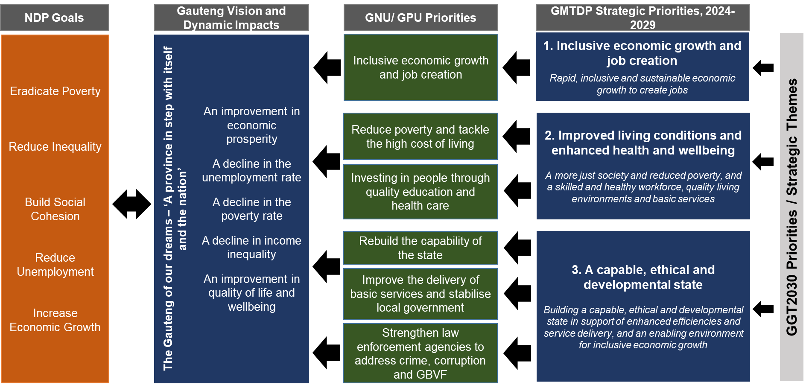
GAUTENG PLANNING APPROACH FOR THE 7th ADMINISTRATION
GAUTENG MEDIUM-TERM DEVELOPMENT PLAN 2024-2029
12

Slide 13
SUMMARY OF OOP STRATEGIC ROLE
The Office of the Premier, as the apex office of Gauteng, plays a pivotal role in leading, coordinating, and aligning efforts across government, society, and the economy.
Key institutional policies and strategies shaping the Office's approach over the 2025 to 2030 period to ensure the realisation of Gauteng's development priorities include:
The role of the OoP – Enabling collaborative governance
  The Office of the Premier enables responsive governance and coordinated service delivery across sectors and government spheres, underpinned by a governance model based on four interconnected roles in the diagram below:
13

Slide 14
AS THE APEX OFFICE:
THE OFFICE OF THE PREMIER ROLE – ‘VALUE CHAIN’
The work of Government
LEAD
Articulate the strategic agenda
Define and plug policy gaps
Realisation (enhanced delivery) of the strategic agenda
“Strategy informs Structure”
OVERSEE
Ensure accountability for implementation of the agenda
Intervene as required
COORDINATE
Prioritise and direct resources to the agenda
Establish an enabling environment, and align actors
STRATEGIC
ROLE
THREE GMTDP PRIORITIES
MOBILISE
Communicate the Agenda
Mobilise and secure commitment to the agenda
Technical Input – Analytics and Insights
ENABLING
Corporate Enablement, Governance, and Management

Slide 15
Revised Annual Performance Plan 2024/25

Slide 16
EXECUTIVE & ACCOUNTING OFFICER SUMMARY
The Executive Authority and Accounting Officer statements were revised to depart from the normal standard introductory statements of compliance to reflect and focus areas of the 7th Administration and aligns with the emerging Gauteng Medium-Term Development Plan (GMTDP).
The revision aligns with the latest developments and priorities of the 7th Administration.
Elevated Priorities for Gauteng’s Development (August 2024 State of the Province Address)
In alignment with the long-term GGT2030 vision and the GMTDP, the 2024 State of the Province Address highlighted elevated priorities for Gauteng’s development, focusing on:
  Inclusive Economic Growth and Job Creation
  Poverty reduction and tackling high cost of living
  Investing in people through quality education and healthcare
  Rebuilding the capacity of the state
  Improve delivery of basic services and stabilize local government, and
  Strengthen law enforcement
These priorities reflect a renewed focus on transforming Gauteng into a safer, more inclusive, and prosperous province.
16

Slide 17
REVISED APP 2024-25 OVERALL INDICATORS
The original APP 2024/25 consisted of 57 indicators and adjusted APP 2024/25 consists of 57 indicators
Programme 1
Removed one (1) indicator to Programme 3 and
Revised one (1) indicator and target.
Programme 2
Revised one (1) Technical Indicator Descriptor
Programme 3
Amended the first outcome under the Subprogramme: GEYODI and MVO, it was incorrectly captured as a skilled, capable, ethical, and developmental state. It will now be revised to align with the 5-year strategic plan for 2020/2025, reflecting the outcome of a growing and inclusive economy, jobs, and infrastructure where the indicator belongs
Revised one (1) indicator
Removed six (6) indicators
Introduced seven (7) new indicators
17

Slide 18
PROGRAMME 1

Slide 19
PROGRAMME 1 ADMINISTRATION
The Administration Programme is responsible for overall strategic management and support to the Premier and the Director-General in fulfilling their statutory and political mandates, the provision of financial management and support services, and the provision of security management services to the Office of the Premier.
The Administration Programme covers the work of the following subprogrammes:
Executive Council Secretariat Service – to provide strategic coordination and management of the Executive Council Programme.
Director-General Support – to provide efficient and effective administrative and corporate support to the Office of the Premier; and strategic management process support to the Premier and the Director-General in fulfilling their statutory and political responsibilities.
Financial Management - to render efficient and effective financial management, SCM, and risk management support to the Office of the Premier.
The Programme contributes specifically to the following Outcomes:
  Outcome 1: A skilled, capable, ethical and developmental state
  Outcome 2: A growing and inclusive economy, jobs and infrastructure
19

Slide 20
PROGRAMME 1 - REVISION SUMMARY
Adjustment under this programme included the removal of one (1) indicator to Programme 3 and revision of one (1) indicator and target.
The following indicator was removed:
Number of reports on vetting of officials in high-risk areas (SOPA).
Reason for removal: This indicator will now be tracked and monitored under Transversal Security Unit (IDS &IM) under Programme 3 which is transversally focused and has therefore been moved from Programme 1 which is internally focused.
The following indicator and target was revised:
Percentage preferential procurement spend on enterprises that are: Youth-owned.
Reason for revision: The National Youth Policy states the following on 30% youth preferential procurement spend: “Government, must use state procurement and implement and monitor a minimum requirement of 30% youth set-aside as part of the Framework for Preferential Procurement to advance the development of youth owned enterprises”
20

Slide 21
PROGRAMME 2

Slide 22
PROGRAMME 2 INSTITUTIONAL DEVELOPMENT
The Institutional Development Programme is responsible to:
Lead, facilitate, coordinate, and support a skilled, ethical, and performance orientated GCR.
Provide ICT-related auxiliary support to the Office of the Premier towards modernising the public service.
Support the Premier and EXCO with legal advice and support; and
Promote and facilitate effective communication between government and the people of Gauteng, and the enhancement of service delivery and responsiveness.
The Institutional Development Programme covers the work of the following subprogrammes:
Strategic Human Resources – to lead, facilitate, coordinate, and support a skilled, ethical, and performance-orientated GCR.
Information and Communication Technology (ICT) – to provide ICT leadership and guidance and ICT-related auxiliary support to the Office of the Premier towards modernising the public service.
State Law Advisory services– to support the Premier and Executive Council with legal advice and support and State law advisory services.
Communication Services – to promote and facilitate effective communication between government and the people of Gauteng.
Service Delivery Interventions – to develop and implement a province-wide, integrated, comprehensive, and sustainable service delivery response system to improve the quality of life of Gauteng residents, particularly the poor from ward to local/regional, to district/metro and provincial level.
Programme contributes specifically to the following Outcomes:
  Outcome 1: A skilled, capable, ethical and developmental state
  Outcome 5: Responsive engagement between government and the citizenry and deepened social cohesion.
  Outcome 6: Collaborative relations between sub-national governments enhanced.
22

Slide 23
PROGRAMME 2 – REVISION SUMMARY
Adjustment under this programme included: one (1) Technical Indicator Descriptions (TID) that was updated.
The following indicator TID was updated:
Percentage interventions in non-compliant GPG departments on hearings not held within 60 days from the date of precautionary suspension.
Reason for updating: To align with the new MPSA Directive.
23

Slide 24
PROGRAMME 3

Slide 25
EXECUTIVE AUTHORITHY STATEMENT – (P3)
ANNUAL PERFORMANCE PLAN: PROGRAMME 3 POLICY AND GOVERNANCE
The Policy and Governance Programme is responsible for:
Leading, facilitating, coordinating and supporting the active advancement of gender equality, women’s empowerment, youth development, and the rights of persons with disabilities, older persons and military veterans.
Support the Premier and the Executive Council with policy advice and support, international and intergovernmental relations, and integrated cooperative governance.
Lead, facilitate, coordinate and support the implementation of the Integrity Management Programme in the GCR.
Drive province-wide outcomes-based planning, performance monitoring and evaluation to improve government performance towards enhanced service delivery and GCR development impacts/outcomes.
Lead planning for sustainable development in the GCR.
The Policy and Governance Programme covers the work of the following subprogrammes:
GEYODI and MVO - to coordinate and support the active advancement of gender equality, women’s empowerment, youth development and the rights of persons with disabilities, older persons and military veterans.
Intergovernmental Relations, including Service Delivery and Integrity Management - to support the Premier and the Executive Council with policy advice and effective management of international relations and intergovernmental relations, including the implementation of the Integrity Management Programme in the GCR.
Cluster Management – to support the Premier and the Executive Council with policy advice, and to lead the strategic coordination and management of the Executive Council Subcommittee System, as well as for the support of the Leader of Government Business.
Planning, Performance Monitoring and Evaluation – to lead integrated planning for sustainable development in the GCR and to drive province-wide outcomes-based planning, performance monitoring and evaluation, and systems to improve government performance towards enhanced service delivery outcomes and GCR development impacts.
The Programme contributes specifically to the following Outcomes:
  Outcome 1: A skilled, capable, ethical and developmental state
  Outcome 2: A growing and inclusive economy, jobs and infrastructure
  Outcome 3: Inclusive quality education and healthcare and growing the skills needed for the economy
  Outcome 4: Spatial transformation and integrated planning
  Outcome 5: Responsive engagement between government and the citizenry and deepened social cohesion.
  Outcome 6: Collaborative relations between sub-national governments enhanced.
  Outcome 7: GCR energy sector reform.
25

Slide 26
PROGRAMME 2 – REVISION SUMMARY
Adjustments under this programme included: one (1) outcome amendment, one (1) indicator target was revised downwards, seven (7) new indicators and six (6) indicators were removed.
The following outcome was amended under the Subprogramme: GEYODI and MVO:
A skilled, capable, ethical and developmental State
Reason for change: The first outcome under the Subprogramme: GEYODI and MVO, was incorrectly captured as a skilled, capable, ethical, and developmental state. It will now be revised to align with the 5-year strategic plan for 2020/2025, reflecting the outcome of a growing and inclusive economy, jobs, and infrastructure where the indicator belongs.
The following indicator target was revised downwards:
Percentage of reported fraud and corruption forensic investigation cases finalised
Reason for change: Target revised due to the indicator being designed to take into consideration cases received from all sources of data. The Provincial Forensic Audits (PFA) has finalized the backlog cases on NACH (2014/15 – 2016/2017), which have been removed from the report, as a result, this has negatively impacted the high performance previously reported when the percentage extremely dropped below the target initially committed (from 92% to 80%). The change of a denominator in the TID is therefore the cause of the change of a target.
26

Slide 27
EXECUTIVE AUTHORITHY STATEMENT – (P3)
PROGRAMME 3 - REVISION SUMMARY
The following indicators were removed:
Indicator | Reason for removal
Number of reports on Rand value of net new investment facilitated | The indicator is under the ambit of the Gauteng Growth and Development Agency (GGDA) and 5-year target of the 6th Administration has been met.
Percentage of quarterly elevated priorities achieved in the Governance and Planning Cluster | Quarterly targets adjusted due to new delivery agreements being formulated for the new term of office.
Percentage of quarterly elevated priorities achieved in the Economic Cluster | Quarterly targets adjusted due to new delivery agreements being formulated for the new term of office.
Percentage of quarterly elevated priorities achieved in the Social Cluster | Quarterly targets adjusted due to new delivery agreements being formulated for the new term of office.
Number of reports on repositioning the GCR Energy Security Office | Replaced with the indicator Number of reports on the assessment reviews on the implementation of the Gauteng Energy Security Strategy
Percentage of GGT2030 targets achieved | Replaced with the indicator Number of the GPG-wide assessment reviews on the implementation progress of the departmental Annual Performance Plan programmes towards the medium-long term priorities.
27

Slide 28
EXECUTIVE AUTHORITHY STATEMENT – (P3)
PROGRAMME 3 - REVISION SUMMARY
The following are new indicators:
Indicator | Reason for new indicator
Number of reports on vetting of officials in high-risk areas (SOPA) | This indicator will now be tracked and monitored under Transversal Security Unit (IDS &IM) which is transversally focused.
Number of reports on the incomplete infrastructure | The Office of the Premier plays a critical role in ensuring a growing and inclusive economy, jobs and infrastructure in the province. Furthermore, this is one of the Premier’s priorities in the 7th Administration, hence the inclusion of this indicator in the Revised APP.
Number of Delivery Agreements between Premier and each MEC | New indicators to accommodate the new delivery agreement cycle for the 7th Administration.
Number of progress reports on Delivery Agreements | New indicators to accommodate the new delivery agreement cycle for the 7th Administration
Number of interventions to address identified areas of underperformance | New indicators to accommodate the new delivery agreement cycle for the 7th Administration.
28

Slide 29
EXECUTIVE AUTHORITHY STATEMENT – (P3)
PROGRAMME 3 - REVISION SUMMARY
The following are new indicators: cont/…
Indicator | Reason for new indicator
Number of reports on the assessment reviews on the implementation of the Gauteng Energy Security Strategy | The Office of the Premier plays a critical role in ensuring GCR energy sector reforms, but the implementation of the Energy Security Strategy is a mandate of COGTA. The Office of the Premier’s role is to track and monitor its implementation, hence the assessment reviews that will be conducted in order to intervene/unblock in areas of underperformance.
Number of the GPG-wide assessment reviews on the implementation progress of the departmental Annual Performance Plan programmes towards the medium-long term priorities | The indicator in its current form is incongruent with the role, responsibility and scope of the transversal programme performance monitoring and reporting function. Consequently, there is no scientific basis for the current target in terms of the percentage proportion concerning the level of departmental performance. For instance, if indeed the transversal performance monitoring unit was legally compelled to assume accountability for the departmental performance, the ideal target would have been 100% rather than 65% achievement of the planned outputs.
The latter is not withstanding the fact that the unit takes full responsibility for facilitating setting of the interventions to improve performance, including tracking implementation of the improvement plans, accordingly.
29

Slide 30
Budget

Slide 31
ALLOCATED BUDGET PER PROGRAMME: 2024-2025 AND MTEF
PROGRAMME | 2024/25 | 2025/26 | 2026/27
 | R’000 | R’000 | R’000
 | MTEF
1. Administration | 135 934 | 139 777 | 147 532
2. Institutional Development | 350 839 | 245 972 | 257 182
3. Policy & Governance | 184 761 | 194 080 | 202 604
TOTAL | 671 534 | 579 829 | 607 318
ECONOMIC CLASSIFICATION | 2024/25 BUDGET | % TOTAL PROGRAMME BUDGET | 2025/26 BUDGET | % TOTAL PROGRAMME BUDGET | 2026/27 BUDGET | % TOTAL PROGRAMME BUDGET
 | R’000 |  | R’000 |  | R’000
Compensation of employees | 391 446 | 58% | 402 216 | 69% | 420 721 | 69%
Goods & Services | 238 075 | 35% | 134 335 | 23% | 141 733 | 23%
Higher Education | 30 601 | 5% | 31 599 | 5% | 32 648 | 5%
Life Esidimeni | 0 | 0% | 0 | 0% | 0 | 0%
Transfer (Social contribution) | 0 | 0% | 0 | 0% | 0 | 0%
Capital assets | 11 412 | 2% | 11 679 | 2% | 12 216 | 2%
TOTAL | 671 534 | 100% | 579 829 | 100% | 607 318 | 100%

Slide 32
ALLOCATED BUDGET PER PROGRAMME: 2024-2025 AND MTEF
32
PROGRAMME 1: ADMINISTRATION | 2024/25 | % TOTAL PROGRAMME BUDGET | 2025/26 | % TOTAL PROGRAMME BUDGET | 2026/27 | % TOTAL PROGRAMME BUDGET
 | R’000 |  | R’000 |  | R’000
Compensation of employees | 91 969 | 68% | 96 001 | 69% | 100 421 | 68%
Goods & Services | 35 215 | 26% | 34 878 | 25% | 37 804 | 26%
Transfers | 0 | 0% | 0 | 0% | 0 | 0%
Capital | 8 750 | 6% | 8 898 | 6% | 9 307 | 6%
TOTAL | 135 934 | 100% | 139 777 | 100% | 147 532 | 100%
PROGRAMME 2: INSTITUTIONAL DEVELOPMENT
Compensation of employees | 204 717 | 58% | 205 105 | 83% | 214 540 | 83%
Goods & Services | 143 460 | 41% | 38 086 | 15% | 39 733 | 15%
Capital | 2 662 | 1% | 2 781 | 1% | 2 909 | 1%
TOTAL | 350 839 | 100% | 245 972 | 100% | 257 182 | 100%
PROGRAMME 3: POLICY AND GOVERNANCE
Compensation of employees | 94 760 | 51% | 101 110 | 52% | 105 760 | 52%
Goods & Services | 59 400 | 32% | 61 371 | 32% | 64 196 | 32%
Transfers | 30 601 | 17% | 31 599 | 16% | 32 648 | 16%
Capital | 0 | 0% | 0 | 0% | 0 | 0%
TOTAL | 184 761 | 100% | 194 080 | 100% | 202 604 | 100%

Slide 33

ALLOCATED BUDGET PER PROGRAMME: 2024-2025 AND MTEF
Office of the Premier is allocated R671 million in 2024/25 financial year, the budget then decreases to R579 million in 2025/26 due to reduced additional allocation for elevated priorities.
Compensation of employees (COE) in the Office of the Premier remains the main cost driver at 58% of the total budget. Personnel budget increased over the MTEF period due to the allowances and pay progression
The Goods and Services budget allocation continues to support the 6th administration planned outcomes and GGT 2030 priorities. Bulk of the allocation in 2024 is mainly for Brand Repositioning Campaign focusing on TISH Elevated Transversal Campaigns.
The budget for transfers and subsidies in 2024/25 accounts for 5% of the total budget. The budget for Tshepo 1 million was transferred to the Department of Education during 2023/24 adjustments budget
The budget for CAPEX amounts to R11.4 million in 2023/24 and increased to R11.6 million in 2024/25. CAPEX budget has been allocated to cater for the procurement of office furniture, computers as well as rental of G/FLEET vehicles
33

Slide 34
2024-25 ADJUSTED BUDGET
The Office of the Premier started with the adjustments budget process and it is due for submission on the 23rd October 2024.
The adjustments budget will mainly focus on enhancing service delivery and ensuring that the set targets are achieved. The revised APPs and operational plans will inform the adjustments budget compilation.
The adjustments will be based on the suggestions obtained from the provincial committee, as well as the 7th administration's proclaimed aims.
34

Slide 35
CONCLUSION
The Office of the Premier reviewed and adjusted the 2024/25 Annual Performance Plan by considering the following:
    The 2024/25 adjustment budget (aligned to the 2020-2025 Strategic Plan ending in March 2025)
    Transition to the 7th Administration and the development of the Medium-Term Development Plan.
    Commitments outlined in the August SOPA and the priorities of the 7th Administration
    Gauteng Audit Services (GAS) review and 2023/24 AG Audit Outcome on the audit of performance information
    Review of performance and budgets
    Analysis on persistently under achieving indicators of the APP 23/24
    Consideration to the Office of the Premier’s oversight role as the Centre of Government and its contribution and to lead on the Provincial Priorities, especially the Elevated Priorities
35

Slide 36
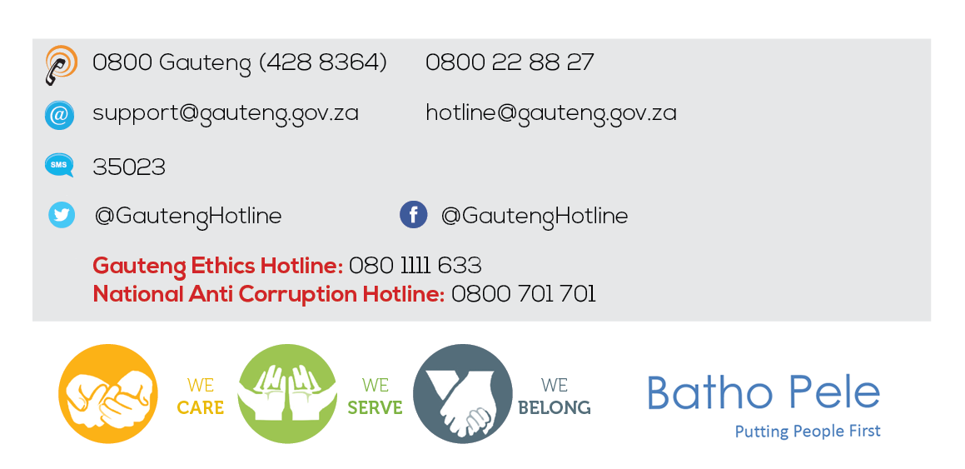
QUESTIONS …QUESTIONS …QUESTIONS
QUESTIONS…..QUESTIONS…..QUESTIONS
Thank You

