Slide 1
Separation of Powers and Overview of GPL Mandates
Members Orientation
26 - 28 June 2024

Slide 2
PRESENTATION OUTLINE
Introduction
Separation of Powers
Legislature Mandates
Spheres of Government
Cooperative Government
Powers, Privileges and Ethics
Order of Business in the House
House Documents
Roles and responsibilities of Presiding Officers

Slide 3
Introduction
The presentation provides an overview on the Separation of Powers Principle (Trias Politika).
Provides a high-level view of Legislature’s Constitutional Mandates of the legislature in line with principle of Separation of Powers .
Next we look at the Spheres of governmnet and the delineation of functions between the three spheres, in accordance with the Constitution.
Also provides information related to Powers, Privileges and Ethics and matters related to members’ conduct.
Lastly, we outline some matters related to proceedings in the House as well as the roles and responsibilities of presiding officers.

Slide 4
Separation of Powers
If men were angels, no government would be necessary. If angels were to govern men, neither external nor internal controls on government would be necessary.
- Persson, et al. 1997
“

Slide 5
Separation of Powers
Separation of powers - SOP- (trias politica) doctrine has evolved since its development by early philosophers, Locke, Motensqueiu and Madison.
The spirit of SOP is, amongst others, that of power sharing between arms of the state (government), such that not all power is vested in one arm (or person), thereby maintaining checks and balances and prevent abuse of power.
This division of functions between the legislative branch, the executive and judiciary envisages that each performs its distinct function, with the former being to make laws, the executive to implement the laws and the latter to adjudicate on the implementation of laws.

Slide 6
Separation of Powers cont...
So, if one arm of the state is responsible for making laws, the same arm will not be responsible for implementaing them.
Separation of powers between legislative, executive and Judiciary (bodies) helps to prevent abuse of power, but only with appropriate checks and balances in place.
In modern democracies, the role of the legislature is to perform three key functions, i.e. law making, oversight of the executive and representation.

Slide 7
Separation of Powers SA Context
Separation of powers between the legislative and executive arms of government is congruent with internationally accepted principles of good governance.
The Constitution of the Republic of South Africa provides for a democratic system of governance characterised by the principle of the separation of powers among the three organs of state, namely; the Legislature; Executive and Judiciary.
Section 43 of the Constitution provides that legislative authority of the national, provincial and local sphere of government is vested in Parliament (National Assembly and the National Council of Provinces), the Provincial Legislatures and Municipal Council respectively.

Slide 8
Spheres of Government
National
Local
Provincial
Parliament (National Assembly and National Council of Provinces)
Provincial Legislatures
Municipal Councils

Slide 9
Co-operative Government
Government in the Republic of South Africa is constituted by national, provincial and local spheres.
The spheres are distinctive, interrelated and interdependent. Other than the functional areas of concurrent national and provincial legislative competence, each sphere has its own area of competence. (see schedule 4 and 5)
The Constitution enjoins the spheres to refrain from intruding into each other’s terrain in the exercise of their powers and the performance of their functions.
Despite their being distinctive, the Constitution authorizes national and provincial executives to intervene in provincial administration and local government, respectively, within certain constitutional constraints.

Slide 10
Co-operative Government cont.
The Constitution enjoins all spheres of government to observe and adhere to the principles of co-operative government and inter-governmental relations set out in Chapter 3 and must conduct their activities within the parameters of that Chapter. These principles are:
All spheres of government and all organs of state within each sphere must –
  preserve the peace, national unity and the indivisibility of the Republic;
  secure the well-being of the people of the Republic;
  provide effective, transparent, accountable and coherent government for the Republic as a whole;
  be loyal to the Constitution, the Republic and its people;
  respect the constitutional status, institutions, powers and functions of government in the other spheres;
  not assume any power or function except those conferred on them in terms of the Constitution;
  exercise their powers and perform their functions in a manner that does not encroach on the geographical, functional or institutional integrity of government in another sphere; and

Slide 11
Co-operative Government cont.
h) co-operate with one another in mutual trust and good faith by –
      fostering friendly relations;
      assisting and supporting one another;
      informing one another of, and consulting one another on, matters of common interest;
      coordinating their actions and legislation with one another;
      adhering to agreed procedures; and
      avoiding legal proceedings against one another.

Slide 12
Co-operative Government cont.
Section 41 (2) requires that an Act of Parliament must be enacted to inter alia — establish or provide for structures and institutions to promote and facilitate inter-governmental relations; and provide for appropriate mechanisms and procedures to facilitate settlement of inter-governmental disputes. See example of the INTERGOVERNMENTAL RELATIONS FRAMEWORK ACT NO. 13 OF 2005.
It is applicable to the national, provincial and local government to the exclusion of Parliament and Provincial legislatures, courts and judicial officers etc.

Slide 13
Legislature Mandate
The Legislature derives its mandates from the Constitution, Section 104-124 of the Republic of South Africa.
Scrutiny & Oversight
Law Making
Public Participation
Co-operative Governances

Slide 14
The House and its Committees
The typical Committee system of the Legislative Sector in South Africa is, in the main, based on the Westminster Parliamentary System.
Committees are effective and powerful accountability mechanisms for the legislature and the actual work of the legislature is delivered through the Committee structure.
An effective committee system enables legislatures to retain its central supervisory position in the growing and often complex accountability processes.
It has evolved over the years since 1994 and currently it can be depicted as follows:

Slide 15
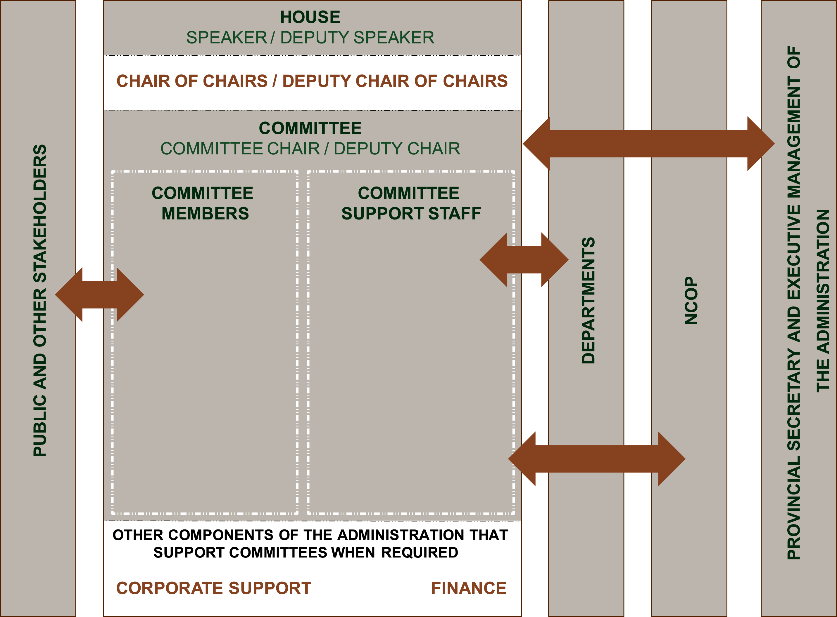
The GPL Committee System

Slide 16
The House and its Committees cont.
The panel in the center depicts the primary delivery “vehicle” for Committee work. It depicts the House at the top (Headed by the Speaker). The House dictates the mandate that the Committees of the House need to deliver on.
The Office of the Chairperson of Committees is a political office that is accountable to ensure that the Committees of the House deliver on their mandate.
The Office is also accountable for ensuring that oversight, public participation and NCOP interaction takes place. The Office is also expected to give strategic direction to the Committees with respect to their delivery expectations.

Slide 17
The House and its Committees cont.
Committees are headed by the Chairpersons of the respective Committees who remain accountable for the outputs of the Committee.
Nominated Members of the House allocated to each Committee support the Chairperson in executing their function.
The Administration from various business units provide the necessary technical/expert and other support to enable delivery of the Committee mandate.

Slide 18
The House and its Committees cont.
In order for Committees of the House to be able to effectively deliver on their work, it is necessary for interaction with:
      The public and other stakeholders
      Departments
      The Secretary to the Legislature and the Executive Management team of the administration.
These interactions happen at a number of different levels at various points in the delivery process.
The arrows in the schematic representation are meant to indicate interaction between the different components and their size and location are not meant to imply the extent of the interaction to any one part of the schematic.

Slide 19
The House and its Committees cont.
Currently most models in the Legislative Sector comprises an average of 18 to 20 different Committees.
These Committees are divided into two groups namely Standing Committees and Portfolio Committees.
Portfolio Committees consider bills, deal with departmental budget votes, and oversee the work of the departments. They are responsible for, and enquire and make recommendations about any aspect of the department, including its structure, functioning and policy.
Standing Committees are in-house/domestic committees dealing with the running of the legislature’s internal affairs, such as; Rules, Programming, Privileges and Ethics, Committee on Scrutiny of Subordinate Legislation (CSSL), Petitions and Standing Committee of Chairpersons (SCoC).
However, other standing committees are also charged with functions that have an external/ internal oversight focus, such as OCPOL and SCOPA.

Slide 20
Applicable legislation
Constitution of the Republic of South Africa: The Constitution is the supreme law of the country which stablishes all structures of government and state. Provincial legislatures are established through sections 103 to150.
Legislation: National and provincial legislation, e.g. Powers, Privileges and Immunities of Parliament and Legislatures Act (PPIPPLA), Financial Management of Parliament and Provincial Legislatures Act; Electoral Act, etc.
Standing Rules of the Gauteng Legislature- govern internal arrangements of the Legislature, as well as all processes and procedures of the House and its Committees.
Rulings: Rules of the House are interpreted and enforced. In doing so, the Presiding Officer delivers rulings based on matters of order and prudent decisions.
Precedent/convention: This refers to a practice that has been followed in the past, which has merit and which, as a consequence, has become the acceptable norm.

Slide 21
Powers, Privileges and Ethics
Section 117 of the Constitution guarantees members of provincial legislatures and provinces permanent delegates to the NCOP freedom of Speech in the legislature and in its committees, subject to its rules and orders;
Further these members and permanent delegates are not liable to civil or criminal proceedings, arrest, imprisonment or damages for—
(i) anything that they have said in, produced before or submitted to the legislature or any of its committees; or
(ii) anything revealed as a result of anything that they have said in, produced before or submitted to the legislature or any of its committees.
Other privileges and immunities of a provincial legislature and its members may be prescribed by national legislation. (see Powers, Privileges and Immunities of Parliament and Provincial Legislatures Act 4 of 2004).

Slide 22
Powers, Privileges and Ethics cont.
Salaries, allowances and benefits payable to members of a provincial legislature are a direct charge against the Provincial Revenue Fund. See also Chapter 14 of the Standing Rules.
Parliamentary privilege is described as the sum of the rights enjoyed by the House and its Members without which they could not discharge their functions during proceedings and which exceed those rights enjoyed by ordinary citizens, institutions and organisations.
The primary parliamentary privileges are the right of freedom of speech and the right to unfettered access to the House.
These privileges, amongst others, allow Members to attend and raise contentious issues in the House without fear of hindrance, prosecution or civil liabilities.

Slide 23
Powers, Privileges and Ethics cont.
The application of the rules and orders in the House should therefore allow Members the opportunity to fully express themselves in the House, while guiding debate and orderly processing of the business of the House:
  NB: According to the Constitutional Court: "By its very nature, Parliament is a body that functions through a deliberative process. Its decisions are the result of that process. Axiomatically, that process can only be meaningful if all members of Parliament are given room freely to make their points and express their opinions. Without freedom of speech in Parliament, products of the parliamentary system would be but a sham. That, in turn, would be pernicious to democracy itself.”

Slide 24
Powers, Privileges and Ethics cont.
“Immunizing the conduct of members from criminal and civil liability during . . . deliberations is a bulwark of democracy. It promotes freedom of speech and expression. It encourages democracy and full and effective deliberation. It removes the fear of repercussion for what is said. This advances effective democratic government.”
Democratic Alliance v Speaker of the National Assembly and Others (CCT86/15) [2016] ZACC 8; 2016 (5) BCLR 577 (CC); 2016 (3) SA 487 (CC) paras 1-2.]

Slide 25
Powers, Privileges and Ethics cont.
Members of Parliament and Legislatures are expected to, at all times, abide by the applicable codes of conduct and ethics.
  NB: Annexure 1 to The Standing Rules contains the Code of conduct and ethics. Its purpose is to, inter alia, outline the minimum ethical standards of behavior that South Africans expect of elected representatives including, upholding propriety, integrity and ethical values in their conduct. It’s applicable to all MPLs including MECs.

Slide 26
Order of Business in the House
The order of business is the basic outline of House proceedings on sitting days and is set out in the Order Paper.
The sequence of proceedings is outlined in the Standing Rules. However, the Standing Rules permit the Speaker to change the sequence of proceedings and he/she may also do so if agreed upon after consultation.

Slide 27
Normal House Sitting
Silent Prayer & Meditation
Announcements by the Speaker
Announcements & reports by the Premier
Tabling of reports
Formal motions and notices by the Chief Whip
Notices of Bills & Motions
Orders of the day

Slide 28
Normal House Sitting - Member Statements
Statements by Members, Members of the Executive, and explanations by Members – See Rule 81
Statements by Members - A Member, other than a Member of the Executive, may be recognised by the Presiding Officer to make a statement on any matter.
Statements by Executive Members - An Executive Member may make a “factual or policy” statement relating to government policy, any executive action or other similar matters of which the House should be informed. The Executive Member in question must request for an opportunity to make such a statement.
Explanations by Members - Members are allowed to make explanations in the House. This happens only when a material part of a Member’s speech has been misquoted or misunderstood. The Member afforded this opportunity may not, however, introduce any new matter, and no debate is allowed upon his/her explanation.

Slide 29
House Documents
ATC
Order Paper
Question Paper
Speaking List

Slide 30
Roles, Responsibilities of Presiding Officers
Presiding Officers / Office Bearers (See Rules 19-24)
  Presiding duties in the House are shared between the Speaker and the Deputy Speaker, Chairperson of Committees and Deputy Chairperson of Committees.
  The task of a Presiding Officer is to chair plenary meetings of the House. This entails maintaining order, interpreting and ensuring proper application of the rules and practices of the House, and in general ensuring the smooth conduct of proceedings.
Speaker
  The Speaker is the, as head of the legislature, representative of the House in its relations with the other arms of State – the Executive and the Judiciary – and with other outside bodies and persons. In this role the Speaker represents the authority of the House and protects its rights and privileges.
Deputy Speaker
  Assists the Speaker in performing his or her functions
  Presides over the House whenever necessary; and
  Acts as Speaker when the Speaker is absent or unable to perform their duties or when the position of Speaker is vacant.

Slide 31
Roles, Responsibilities of Presiding Officers cont.
Chairperson of Committees
  Represents the Committee of Chairpersons at the Programming Committee
  Implements policy in terms of coordination of the work of Committees
  Acts as Deputy Speaker when requested to do so.
Deputy Chairperson of Committees
  Assists the Chairperson of Committees in the performance of their duties.
Chief Whip
  Ensures the attendance of the House in consultation with other whips
  Arranges legislature business in the order paper…
  Undertakes political consultations amongst parties in the legislature.

Slide 32

Thank you
Q&A

Slide 33


