Slide 1
GAUTENG DEPARTMENT OF SOCIAL DEVELOPMENT 2022/23 FY PERFORMANCE MONITORING REPORT: ANALYSIS OF PERFORMANCE
SOCIAL DEVELOPMENT PORTFOLIO COMMITTEE
2023

Slide 2
Edit
Table Of Contents
Part A: Overview Of Department Performance.
Part B: 1. Non-financial Performance:
2. Governance And Administration
3. Areas of Significant Deviation from Planned Performance
4. Monitoring of NPOs
5. Extraordinary Issues
Part C: Financial Report

Slide 3
Purpose
To present departmental performance for the 2022/23 FY.

Slide 4
Edit
PART A
Overview of Department Performance
Non-financial performance report Technical analysis per programme/sub-programme

Slide 5
Edit
Rating Categories
The performance for the Department is disaggregated according to the threshold represented by the following ratings categories and definitions:
Rating Symbol | Rating Category | Value
 | Achieved | 100% and greater
 | Not Achieved: Good progress | 76% - 99%
 | Not Achieved: Fair progress | 51% - 75%
 | Not Achieved: Poor Progress | 26% - 50%
 | Not Achieved: Very Poor Progress | Less than 26%
 | Not targeted for the Q | No quarterly targets set for the quarter under review.

Slide 6
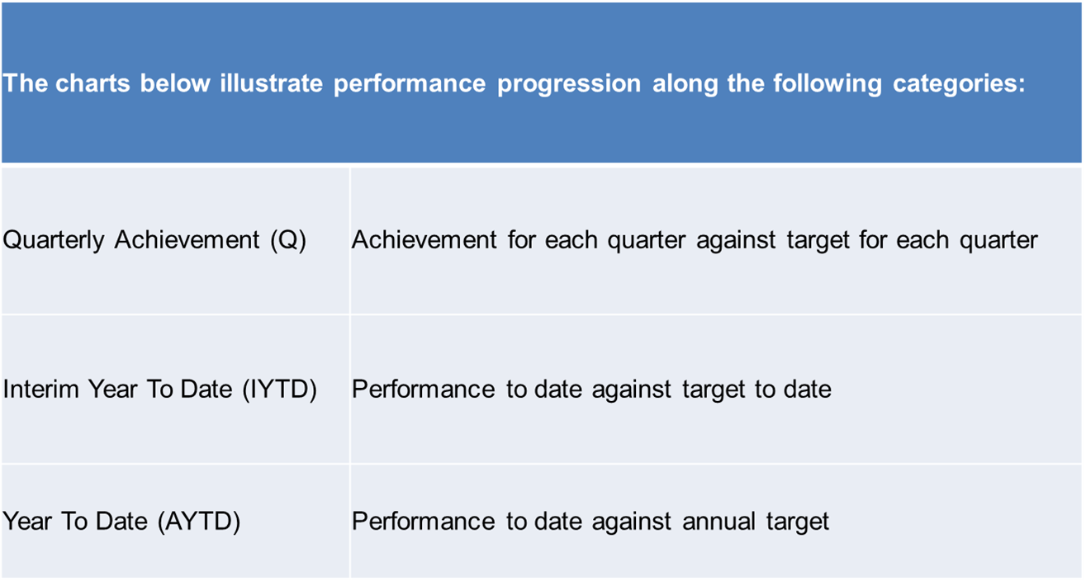
Edit
Legend

Slide 7
Edit
Overview Of Non-Financial Performance

Slide 8
Edit
GDSD 2013 – 2023 Performance Trend

Slide 9
Edit
Department Programme 1-5 Performance Overview

Slide 10
Edit
Achievement vs Weighted Performance

Slide 11
Edit
Non- Financial Vs Financial Comparison
Weighted Annual Non-Financial performance against Q4 financial expenditure

Slide 12
Edit
Departmental Achievement of National and Provincial Strategic Priorities
STRATEGIC LINKAGES |  | STRATEGIC PLANNING | STRATEGIC REPORTING
NDP/MTSF Priority | GGT Priority | Outcome as per approved Dept Strat Plan | Summarised Dept Performance during 2022/23FY
Priority 2: Economic transformation and job creation | Priority 1: Economy, Jobs & Infrastructure | Reduce hunger and poverty | National Priority 2 Of the 15 planned targets, the Department achieved 12 targets representing 80%; 2 target showed good progress representing 13%; 1 target showed fair progress representing 7%. Provincial Priority 1 Of the 10 planned targets, the Department achieved 7 targets representing 70%; 2 targets showed good progress representing 20%, 1 targets showed fair progress representing 10%,

Slide 13
Edit
Departmental Achievement of National and Provincial Strategic Priorities
STRATEGIC LINKAGES |  | STRATEGIC PLANNING | STRATEGIC REPORTING
NDP/MTSF Priority | GGT Priority | Outcome as per approved Dept Strat Plan | Summarised Dept Performance during 2022/23FY
Priority 4: Consolidating the social wage through reliable and quality basic services. | Priority 4: Safety, Social Cohesion and Food Security | Enhanced care and protection of poor and vulnerable groups Reduce hunger and poverty Reduce the demand for substances and harm caused by substances | National Priority 4 Of the 20 planned targets, the Department achieved 17 targets representing 85%; 1 target showed good progress representing 5%; 1 target representing 5% showed fair progress. and 1 target demonstrated very poor progress representing 5%. Provincial Priority 4 Of the 21 planned targets, the Department achieved 19 targets representing 90.48%%; 1 targets showed fair progress representing 4.76%; and 1 target demonstrated very poor progress representing 4.76%. .

Slide 14
Edit
National Priorities: 2022/23 FY

Slide 15
Edit
Provincial Priorities GGT 2022/23 FY

Slide 16
Edit
Part B:
Non-financial Performance
1. Programme Performance

Slide 17
Edit
Overview Of Non-Financial Performance: Prog 2

Slide 18
Edit
Care and Service to Older Persons
During the period under review :
20 088 (T:23 559) older persons were reached through services provided by funded community-based care and support facilities (home based; service centres and luncheon clubs) and
5 886 (T:6 526) older persons benefitted from residential facilities.
Elder abuse campaigns were held in the form of marches in all regions from 20 May 2022 to 10 June 2022 reaching 421 beneficiaries. The aforementioned events were followed by a Provincial Seminar to celebrate the World Elder Abuse Awareness Day benefiting 135 persons
A Choir Festival which is part of the priority active ageing programme was held on 7 October 2022 at Maropeng, in the West Rand to celebrate the International Day of Older Persons reaching 412 beneficiaries.
The Department hosted a successful National Active Ageing Event from 5 to 7 December 2022 whereby 8 provinces with 2000 older persons and officials.
An Engagement and Christmas Party attended by over 1200 older persons and Persons with Disabilities took place in Atteridgeville on 22 December 2022. The aim was to afford the aforementioned sectors the opportunity to present their challenges to the MEC.

Slide 19
Edit
Services to Persons with Disabilities
During the period under review the following were achieved:
Residential and assisted living care were accessed by 1 684 (T:1 980) Persons with Disabilities in government and NPO managed facilities;
Protective workshop programme aimed at socio-economic empowerment of persons with disabilities reached 3 907 (T:4 365) beneficiaries.
International Day for persons with Albinism was celebrated from 9- 15 June 2022 through media by 9 community radio stations in the 5 regions. In total 887 632 persons were reached.
A Provincial Albinism Conference held at Igugulethu CYCC on the 17-18 November 2022 reaching 42 persons as a follow up to the National Conference to elect a Gauteng Committee.
A Provincial Disability Sports Day was held on the 02 November 2022 reaching 190 people aimed at building the sport talent of persons with disabilities
A Provincial Disability Colloquium was held in Johannesburg on 14-16 November 2022 reaching 90 persons for development and ensuring that people with disabilities speak with one voice

Slide 20
Edit
HIV And AIDS & EPWP
During the period under review the following were achieved:
Nutritional support was provided to 155 697 (T:136 000) through food parcels to date and 33 578 (T:32 300) through cooked meals
109 240 (T:100 086) beneficiaries received psychosocial support services including Orphans and Vulnerable Children
7 222 (T:7 432) work opportunities were created through EPWP
World AIDS Day was commemorated across the province on 01 December 2022
Care and Support Programme
Comprehensive core package of services that include nutritional support, counseling, skills development, home and school visits, psychosocial support, educational support, access to treatment, and referrals was provided to:
Orphans, Vulnerable Children and Youth (OVCY)
Youth Headed Households
Children Living with HIV
Adults on ARVs supported
Beneficiaries with TB / showing signs thereof
Older Persons, who are primary Caregivers

Slide 21
Edit
Overview Of Non-Financial Performance: Prog 3

Slide 22
Edit
Care And Support To Families
During the quarter under review the following was achieved to ensure families perform the critical role of nurturing and caring for individual family members:
191 782 (T:119 660) family members participated in preservation programmes
2 777 (T:1 888) family members were reunited with their families
119 665 (T:54 315) families participated in parenting programmes
37 659 (T:38 478) families received crisis intervention services

Slide 23
Care And Support To Families
Education and awareness programmes
The International Families Day which is aimed at promoting the importance of the role of the family was celebrated in 5 regions reaching 395 persons from 13 to 31 May 2022 .
Two homeless shelters were launched in Benoni and Vanderbiljpark on 13 May 2022 and 31 May 2022 respectively reaching 205 beneficiaries.
These facilities were provided funding to procure container and park homes as they had to accommodate homeless people who had to be moved from temporary homeless shelters established during hard Lockdown in April 2020.
A service delivery blitz to assist homeless people to exit the systems combined with the sports day was held on 9 December 2022.
12 ID reissue and 3 ID first application were processed by the Department of Home affairs as well as
38 grant applications processed by SASSA; namely; 31 SRD grant, 2 Child Support and 5 disability.
The Department of Employment and Labour assisted 36 Homeless People with completion of employment seekers database form.

Slide 24
Edit
Child Care And Protection
During the period under review:
4 931 (T:5 965) children in need of care and protection were placed in foster care.
3 634 (T:929) children were reported as cases of child abuse.
4 336 (T:4 512) children were placed in CYCCs for developmental social welfare services.

Slide 25
Edit
Child Care And Protection
During the period under review:
The micro-management project has been initiated to mitigate the deviations of Foster Care Programme, as it relates to management of court orders. The project is attended by Provincial and Regional Management involved in the programme. The aim is to mitigate the lapsing of court orders.
The Independent Living workshop was held at the Midrand Conference Centre aimed to provide children and youth between the ages of 11 and 17 and 18 and 25 in CYCCs, an opportunity to gain skills and to transition successful towards living on their own into adulthood.
A Provincial Child Protection Session was held on 23 August 2022, focusing on the children presenting challenges and mitigations in relation to child and teenage pregnancy and related issues to the Department of Health; Department of Education and Department of Social Development for their response and implementation plan.
Adoption Training conducted for all Social Workers accredited to render Adoption Services within the Department.
Gauteng School Social Work Programme was showcased as best practice model during NDSD Integrated School Health Programme Consultative workshop held from 17-18 November 2022.

Slide 26
Edit
Overview Of Non-Financial Performance: Prog 4

Slide 27
Edit
Crime Prevention and Support
During the period under review the following were achieved:
Social crime prevention and awareness campaigns reached 2 956 944
(T:1 843 623) children and adults.
All children and adults in conflict with the law referred to the Department for further interventions were attended to:
1 968 (T:1 309) completed diversion programmes.
Secure care centers accommodated 835 (T:700) children in conflict with the law.
Social Crime Prevention awareness campaigns
Build up activities and information sharing sessions in five schools within Sedibeng Region on Gangsterism on 19-20 October 2022. 222 children and 80 parents were reached.
Anti-Gangsterism event in Sedibeng Region on 28 October 2022 and 150 people were reached.

Slide 28
Edit
Victim Empowerment
During the period under review the following were achieved:
The Department continues to create awareness against gender-based violence (GBV). On the 25th of each month awareness is created around Orange Day.
The Department has a Gender Based Violence unit that provides psycho-social counselling to adult victims of violence. This unit creates awareness based on the National GBV Strategy.
The Department funded 120 (T:108) facilities and shelters that provided psycho-social support to 62 649 (T:48 452) victims of violence and crime.
The programme of no violence against women and children including 16 days of activism reached 3 212 075 (T:1 338 729) beneficiaries.

Slide 29
Edit
Victim Empowerment
Calendar of events
A successful Trafficking in person event hosted on 5-6 October 2022.
Provincial International men's Day hosted on 17 November 2022 focusing on men's mental health, safe spaces for men, mentorship and rights of fathers.
Formed part of GPG Plenary for opening of 16 Days of Activism and supported event on 25 November in Soweto.
Orange Days visits to 2 shelters in Tshwane by HOD.
Mandela Day commemoration with NDSDS at Mali Martin 18 July 2022.
Attended 4 elevated regional Women’s day events on 12, 17, 18 & 19 August 2022.
Gauteng provincial GBV Summit held 30-31 August 2022 .

Slide 30
Edit
Substance Abuse Prevention and Rehabilitation
During the period under review
The Department continued to render substance abuse prevention and rehabilitation services in terms of the Prevention of and Treatment of Drug Dependency Act 70 of 2008 and the National Drug Master Plan to ensure that the demand and the harm caused by drugs is reduced.
5 791 417 (T:3 166 757) beneficiaries were reached through substance abuse prevention programmes.
The Ke-Moja coaches deployed in schools and communities to roll out the Ke-Moja Drug Prevention programme reached 1 514 773 (T: 1 177 203) children and youth; to date.
Substance abuse disorder treatment services were provided to 37 407 (T:28 076) users.
11 853(T:10 807) beneficiaries that completed treatment programmes are participating in after care programmes.

Slide 31
Edit
Substance Abuse Prevention and Rehabilitation
During the period under review
Kick It Season 2 was aired on SABC 1 from September until December 2021 it won the South African Film & Television Award (SAFTA) on 3 September 2022 for the Best Factual Educational Programme. Kick It Season 1 also won the same award in 2019.
Launched the GP Anti-Substance Abuse Helpline on 25 October 2022 with the Premier and the MEC.
Commemorated the 10th Ke-Moja award Ceremony on 26 October 2022.
Orientation training on substance abuse for 46 call centre operators on 28 October and 3 November 2022.
Hosted the Anti-substance Abuse Multi-stakeholder Engagement Dialogue on 10 November 2022,
Launched the festive season campaign with the National Department of Social Development on 22 November 2022 in Wedela.

Slide 32
Edit
Overview Of Non-Financial Performance: Prog 5

Slide 33
Poverty Alleviation And Sustainable Livelihoods
The Department through its funded organisations has:
Poverty reduction programmes were accessed by 1 716 360 (T:3 505 245) beneficiaries.
Distributed 1 100 128 (T:1 628 000) dignity packs for the year to date.
Enabled the participation of 66 058 (T:46 360) people in income generation programmes.
Distributed 285 813 (T:273 152) food parcels through foodbanks and
61 846 (T:12 726) persons received food through feeding programmes; to date.
16 777 (T:16 078) beneficiaries participated in the Welfare to work programmes; to date.
523 (T:575) cooperatives provide goods and services to the Department.
The department facilitated partnerships which led to the establishment of two community gardens with food relief beneficiaries as a response to increasing access to nutritious food.

Slide 34
Edit
Youth Development
During the period under review the following were achieved:
62 332 (T:39 743) work opportunities for youth have been created through the Youth Structures Programme EPWP and Job Centre Programme.
The programme has further enabled 74 361 (T:48 146) youth to participate in various skills development programmes through youth structures.
309 220 (T:89 423) youth participated in the youth mobilisation programmes.

Slide 35
Edit
Women Development
During the period under review the following were achieved:
The Department has established partnerships with various training institutions, development agencies, the private sector and other government agencies to train women in skills such as financial management, marketing, business development and procurement procedures.
22 236 (T:21 584) women participated in empowerment programmes; to date.
5 578 (T:5 429) women on child support grant were linked to economic opportunities.
The Department established and launched Hair and Beauty Academy in partnership with The Beauty Hub Academy NPO in Merafong on 8 December 2022. This is one of the Departments intervention strategies to accelerate, expand and strengthen youth/women development initiatives by linking social security beneficiaries to sustainable livelihoods opportunities.

Slide 36
Edit
Departmental Infrastructure/ Capital Projects
DEPARTMENT INFRASTRUCTURE / CAPITAL PROJECTS
Name of Project | Brief description of project | Start Date | End Date | Current Status | Challenges | Requests for Intervention
Devon Early Childhood Centre | Construction of Early Childhood Centre | 30 April 2018 | 24 March 2021 | Completed | None | None
Garankuwa CYCC Office Facility | Construction of Garankuwa CYCC office accommodation | 01 April 2014 | 26 March 2021 | Completed | None | None
Bantubonke Early Childhood Centre | Construction of Early Childhood Centre | 31 August 2017 | Not Available | Project On hold | Slow contractor work progress. The slow progress has contractually translated into default on the side of the contractor which the contractor has failed to remedy. This unfortunately has resulted in the termination of the services of the Contractor and delays in completion on the project. | A Catch-up plan is being developed and sourcing of a service provider to complete the facility has commenced and anticipated to be completed in the 4th quarter of 2023/24. More stakeholder engagements

Slide 37
Edit
Departmental Infrastructure/ Capital Projects
DEPARTMENT INFRASTRUCTURE / CAPITAL PROJECTS
Name of Project | Brief description of project | Start Date | End Date | Current Status | Challenges | Requests for Intervention
Bekkersdal Social Integrated Facility | Construction of Early Childhood Centre; community facility for older persons; and regional offices | 31 July 2017 | Not Available | Project On hold | Cashflow challenges and community interruption were contributed to the delays however , Major challenges were due to Poor inputs of the Professional Team that lead to delays to completion of the project and termination of contractual obligation between the Implementation Agent and the Service Provider. | A Catch-up plan is being developed and sourcing of a service provider to complete the facility has commenced and anticipated to be completed in the 4th quarter of 2023/24. It is to the benefit to the communities that the project be completed 2023/24 financial year.

Slide 38
Edit
Departmental Infrastructure/ Capital Projects
DEPARTMENT INFRASTRUCTURE / CAPITAL PROJECTS
Name of Project | Brief description of project | Start Date | End Date | Current Status | Challenges | Requests for Intervention
Ratanda Shelter | Construction of shelter for vulnerable women and children | 31 July 2017 | Not yet available | Planning stages | None | None
Sebokeng Inpatient Rehab centre | Construction of Inpatient Rehabilitation Centre | 31 July 2017
Soshanguve Inpatient Rehab centre | Construction of Inpatient Rehabilitation Centre | 01 October 2018
Tembisa Inpatient Rehab centre | Construction of Inpatient Rehabilitation Centre | 01 April 2018
Walter Sisulu CYCC (demolition and reconstruction) | Demolition of office accommodation and construction of new office accommodation | 31 July 2016

Slide 39
Edit
Human Resource Capacity
Human Resource Capacity
During the period under review 01 April 2022 to 31 March 2023
Total number of posts on the Dept. Structure as at the last day of the period under review | Total number of posts currently filled as at the last day of the period under review |  | Total number of vacant posts as at the last day of period under review
5 644 | 5 151 |  | 493
Total number of acting positions as at the last day of the period under review | Total number of terminations during the period under review |  | Total number of new appointments during the period under review
6 | 1 031 |  | 567
Total number of suspensions during the period under review | Summarized information on the GEYODI / HDI compliance for the period under review
No employee was placed on precautionary suspension for the period under review. | Females= 75% (3 852 out of 5 151) | Youth=36% (1 861 out of 5 151) | Persons with disabilities= 5% (251 out of 5 151)
 | Race
 | African | Coloured | Indian | White
 | 95.7% (4 931 out of 5 151) | 2.3% (120 out of 5 151) | 0.4% (18 out of 5 151) | 1.6% (82 out of 5 151)

Slide 40
Edit
Part B:
Non-financial Performance
2. Governance/ Administration

Slide 41
Edit
Resolution Management
Ref. No. | Date Received | Due Date | Detail / Title of Resolution | Progress to Date / Current Status | Date submitted to GPL
No ref number | 24th March 2022 | 29th April 2022 | Resolutions for responses on Social Development Committee oversight report on the third quarter report of the Department of Social Development for 2021/22 FY | Submitted the Response to Legislature. | 23rd April 2022
No Ref Number | 24th March 2022 | 31st May 2022 | Resolutions for responses on portfolio committee on social development Focused Intervention Study (FIS) report arising from the budget vote for 2021/22 FY “an investigation into the impact of municipal by-laws on the operations of NPOs and how the Department performs monitoring and evaluation function” | There has been delays in the submission of the responses due to the ECD migration from the Department of Social Development to Department of Education on the 1st April 2022. Hence the responsible Department to respond on the resolutions was not clear. | 13th July 2022

Slide 42
Edit
Resolution Management
Ref. No. | Date Received | Due Date | Detail / Title of Resolution | Progress to Date / Current Status | Date submitted to GPL
No Ref Number | 15th March 2022 | 29th April 2022 | Resolutions for responses on Social Development Portfolio Committee Oversight Report on the second adjustment appropriation bill - 2021 for the Gauteng Department of Social Development | Submitted to Legislature | 4th July 2022
No Ref Number | 25th May 2022 | 30th June 2022 | Committee’s oversight report on the detail of the Department of Social Development budget vote 06 of the Gauteng provincial Appropriation Bill [G001-2022] for the 2022/23 FY | Submitted to Legislature | 4th July 2022

Slide 43
Edit
Resolution Management
Ref. No. | Date Received | Due Date | Detail / Title of Resolution | Progress to Date / Current Status | Date submitted to GPL
No Ref No | 22 June 2022 | 29th July 2022 | Assessing the state of Service Centres and Luncheon Clubs during Covid-19 – the importance of Older Persons accessing Service Centres and Luncheon Clubs | Submitted to Office of the Premier(OOP) for consolidation and submission to GPL | via OOP on the 31st July 2022
No Ref No | 21st July 2022 | 30th Sept 2022 | Response on Portfolio Committee on Social Development Committee Report on the 2021/22 Sector Parliament for People with Disabilities | Delays in submission to GPL due to Departments not providing their inputs timeously. | 4th October 2022

Slide 44
Edit
Resolution Management
Ref. No. | Date Received | Due Date | Detail / Title of Resolution | Progress to Date / Current Status | Date submitted to GPL
No Ref No | 25 October 2022 | 28 October 2022 | Follow-up questions arising from the Annual report-2021/2022 | Submitted | 28 October 2022
No Ref No | 02 December 2022 | 09 December 2022 | Report of the Auditor General to The Gauteng Provincial Legislature on The Financial Statements and Performance Information of Gauteng Department of Social Development for the year ended 31 March 2022 | Submitted | 09 December 2022
No Ref No | 02 December 2022 | 31 January 2022 | Portfolio Committee on Social Development Oversight Report on the Second Quarterly Report of the Department of Social Development for the 2022/23 Financial Year | Still in process

Slide 45
Edit
Resolution Management
Ref. No. | Date Received | Due Date | Detail / Title of Resolution | Progress to Date / Current Status | Date submitted to GPL
No Ref No | 02 December 2022 | 31 January 2023 | Social Development Committee Oversight Report On The Annual Report of The Department Of Social Development For 2021/22 FY | Still in Process

Slide 46
Edit
Resolution Management
Reference Number | Date Received | Due Date | Detail / Title of Resolution | Progress to Date / Current Status | Date submitted to GPL
No Ref No | 28 March 2023 | 02 May 2023 | Finance Portfolio Committee Adopted Oversight Report on the 3rd Quarter Financial Performance Report of the Gauteng Provincial Government for the 2022/23 FY | Still in process | Still in process
No Ref No | 28 March 2023 | 31 May 2023 | Portfolio Committee on Social Development Oversight Report on the Third Quarterly Report of the Department of Social Development for the 2022/23 Financial Year | Still in process | Still in process
No Ref No | 28 March 2023 | 28 April 2023 | Standing Committee on Public Accounts Oversight Report on The Report of The Auditor-General of South Africa to The Gauteng Provincial Legislature on The Financial Statements of Vote 6: Gauteng Department of Social development for the year ended 31 March 2022 | Still in process | Still in process
No Ref No | 28 March 2023 | 28 April 2023 | Portfolio Committee on Social Development Adopted Focus Intervention Study report on the on the implications of termination of NPOs funding on the provision of service delivery | Still in process | Still in process

Slide 47
Edit
Resolution Management
RESOLUTION MANAGEMENT
Total number of Resolutions received from GPL during the Financial Year under review | 14
Total number of Resolutions responses due to GPL during the Financial Year under review | 10
Total number of Resolutions responded to and submitted back to GPL during the Financial Year under review | 8

Slide 48
Edit
Petitions Management
PETITIONS MANAGEMENT
Reference Number | Date Received | Due Date | Detail / Title of Petition | Progress to Date / Current Status | Date submitted to GPL
(PP10D/03/22/SD) | 12 January 2023 | 3rd February 2023 | Referral of a petition: Unfair withdrawal of funding: operation Geleza | Response was submitted to the MEC’s office on the 2^{nd of} February 2023 | MEC’s office to give progress
Total number of Petitions received from GPL during this Quarter |  |  |  |  | 1
Total number of Petitions responses due to GPL during this Quarter |  |  |  |  | 1
Total number of Petitions responded to and submitted back to GPL during this Quarter |  |  |  |  | 0

Slide 49
Edit
Auditor–General & PSC Requests
Auditor – General REQUESTS FOR INFORMATION RECEIVED DURING THE PERIOD UNDER REVIEW]
 | Total number of AGSA Requests for Information received from AGSA during this Quarter | 53
 | Total number of AGSA Requests for Information due during this Quarter | 51
 | Total number of AGSA Requests for Information responded to and submitted back to AGSA during this Quarter | 49
PSC REQUESTS FOR INFORMATION
Public Service Commission REQUESTS FOR INFORMATION RECEIVED DURING THE PERIOD UNDER REVIEW]
 | Total number of PSC Requests for Information received from the PSC during this Quarter | 1
 | Total number of PSC Requests for Information due during this Quarter | 1
 | Total number of PSC Requests for Information responded to and submitted back to the PSC during this Quarter | 1

Slide 50
Edit
Departmental Achievement on Actual GEYODI Empowerment
GENDER
Indicator | Male | Female | Undisclosed | LGBTQIA+ | Youth | Persons with Disabilities | Total
HIV/AIDS programmes | 582 579 (33%) | 1 196 527 (67%) | 131 (0%) | 0 (0%) | 351 848 (20%) | 14 895 (1%) | 1 779 237
Victim Empowerment Programme | 298 819 (11%) | 955 098 (34%) | 1 549 922 (55%) | 979 (0%) | 162 445 (6%) | 6 478 (0%) | 2 804 818
Poverty Alleviation and Sustainable Livelihoods | 1 085 920 (43%) | 1 414 095 (57%) | 4 201 (0%) | 0(0%) | 822 542 (33%) | 19 190 (1%) | 2 504 216
Women Development Programme | 0(0%) | 47 926 (100) | 0(0%) | 0(0%) | 45 362 (95%) | 143 (0%) | 47 926
16 Days of Activism | 32 2180 (9%) | 440 696 (13%) | 2 731 292 (78%) | 402 (0%) | 304 087 (9%) | 5 714 (0%) | 3 494 570
Grand Total | 2 289 498 (22%) | 4 054 342 (38%) | 4 285 546 (40%) | 1 381 (0%) | 1 686 284 (16%) | 46 420 (0%) | 10 630 767

Slide 51
Edit
Departmental Achievement on Actual GEYODI Empowerment
YOUTH
Indicator | Male | Female | Undisclosed | LGBTQIA+ | Youth | Persons with Disabilities | Total
All beneficiaries in Child & Youth Care Centres | 2 164 (50%) | 2 177 (50%) | 2(0%) | 0(0%) | 117 (3%) | 504 (12%) | 4 343
Youth Development Programme | 29 419 (12%) | 35 968 (15%) | 170 420 (72%) | 0(0%) | 235 807 (100%) | 236 (0%) | 235 807
Crime Prevention Programme | 319 586 (7%) | 358 093 (8%) | 3 963 866 (85%) | 0(0%) | 149 794 (3%) | 6 937 (0%) | 4 641 545
Substance Abuse Prevention, Treatment & Rehabilitation | 2 078 166 (18%) | 2 481 370 (21%) | 7 274 477 (61%) | 0(0%) | 1 684 383 (14%) | 24 923 (0%) | 1 1834 013
Grand Total | 2 429 335 (15%) | 2 877 608 (17%) | 11 408 765 (68%) | 0(0%) | 2 070 101 (12%) | 32 600 (0%) | 16 715 708

Slide 52
Edit
Departmental Achievement on Actual GEYODI Empowerment
DISABLED
Indicator | Male | Female | Undisclosed | LGBTQIA+ | Youth | Persons with Disabilities | Total
Services to Persons with Disabilities | 64 602 (0%) | 75 844 (0%) | 22 288 759 (100%) | 0(0%) | 54 910 (0%) | 72 007 (0%) | 22 429 205
SENIOR CITIZENS
Indicator | Male | Female | Undisclosed | LGBTQIA+ | Youth | Persons with Disabilities | Total
Services to Older Persons | 92 805 (3%) | 243 440 (8%) | 2 733 865 (89%) | 0(0%) | 29 566 (1%) | 28 732 (1%) | 3 070 110

Slide 53
Edit
Governance/ Administration
Performance on foster care placements is due to compliance with Lockdown regulations. Inability to acquire relevant reports from Psychologist & Psychiatric services from DoH, NDSD, as well as relevant legal documents from prospective foster parents for submission to Courts. The achievement of the target is also dependent on the courts. The Department will continuously monitor the foster care implementation plan which includes the engagements with the NDSD and other stakeholders.
Performance on the provision of dignity packs and school uniform was affected by delays in Supply Chain Management processes. In addition, the Con-Court ruling contributed to low performance. The Department will resolve SCM issues and fast track implementation.

Slide 54
Edit
Challenges
Challenge | Consequence | Recommendation
Recruitment of designated groups. | Applicants not meeting the requirements of the adverts. | Relax the requirement of the post Advertise in designated groups. Community media/ centres on entry level posts (Salary Level 1-6).
Implementation of IJS systems (Probation Case Management (PCM) and Child and Youth Care Application (CYCA) | Discrepancies in the statistics submitted to Parliament at the end of each quarter. | Escalation of the matter to National Child Justice Forum.
Implementation of Section 87(6) of the Child Justice Act 75 of 2008. | Failure to expunge records for children who attended diversion programs. | Implementation of Circular 97 by uploading the compliance reports on PCM for expungement of records by NDSD.
Impact of current economic situation, unemployment especially amongst men and how this can be a trigger for Gender based violence. This also has an impact on funding. | Increase in Gender based violence and femicide Rise in fuel hampers NPOs to render effective services. | Creation of job opportunities for men older than 35 (All government departments). Amend current funding criteria to be in line with current demand rise in costs of electricity and fuel. Furthermore, Boards of Governance to make a concerted effort to raise funds from other donors, other than DSD.
Need for implementation of prevention programs by all Victim Empowerment NPOs and DSD staff. | In the absence of behaviour change programs, the challenge of GBV will be perpetuated. | The Service Level Agreement (SLA) should include the rendering of groupwork/behaviour change programs.

Slide 55
Edit
Challenges
Challenge | Consequence | Recommendation
Dependency on Municipal compliance documents to register Child Youth Care Centres (CYCCs). | Conditional Registration (12 months) of CYCCs. Uncertainty on the stability of children in CYCCs. | Engagement with Municipalities (IGR). Municipalities to issue compliance documents with clear conditions.
Varied interpretations of the NGHC Order on Foster Care | Re-curing Foster Care Backlog. | Engagements with Department of Justice and Constitutional Development.
Load shedding | Interruptions of workflow affects production levels. Increase in crime when there is loadshedding. | This is for the attention of the National Government. Provincial office to procure generations or Uninterrupted Power Supplies (UPS’s).
Harsh economic realities. Increased unemployment | Impacts negatively on persons older than 35 years who are deprived of youth opportunities/ | National and provincial governments to make concerted effort to create sustainable inclusive employment programmes.
Financial mismanagement of NPOs | Service delivery is interrupted by non-compliant NPOs | Need to strengthen NPO monitoring processes and open criminal cases to retrieve funds.

Slide 56
Edit
Part B:
Non-financial Performance
3. Areas of Significant Deviation from Planned Performance

Slide 57
Edit
Indicators Showing Performance Below 80%
Performance Indicator | 2022/23 Target | 2022/23 Actual | Reason for Deviation | Mitigating measure | % Achieved Annual
Number of children with valid foster care orders. | 46 426 | 35 526 | Target: Not Achieved Performance is due to the delays in some of the courts in issuing out the court orders and the designated CPOs and not concluding the foster care cases. | The Department will continuously monitor the foster care management plan, including engagements with the courts and Designated Child Protection Organisations (DCPOs). | 77%

Slide 58
Edit
Indicators Showing Performance Below 75%
Performance Indicator | 2022/23 Target | 2022/23 Actual | Reason for Deviation | Mitigating measure | % Achieved Annual
Number of written supervision contracts between social work supervisors and supervisees signed. | 1 778 | 1 215 | Target: Not Achieved Performance is due to delays in signing the contracts between supervisors and supervisees. | The Department will continue to motivate and capacitate social work supervisors and supervisees to sign contracts. | 68%
Number of contracts awarded by the Department to HDI/SMME companies. | 47 | 35 | Target: Not Achieved Performance is due to 1 tender was finalised late in December and could not be awarded as planned. 2 tenders are at final evaluation stage, 2 tenders are at the beginning of the evaluation stage | Arrangement of tenders have commenced as per the guidelines issued by National Treasury on 31 May 2022 | 74%
Number of dignity packs distributed | 1 628 000 | 1 100 128 | Target: Not Achieved Performance is due to delays in SCM processes which impacted on the implementation of dignity packs initiatives. | The Department will continue to implement the programme within the allocated budget. | 67.5%

Slide 59
Edit
Indicators Showing Performance Below 50%
Performance Indicator | 2022/23 Target | 2022/23 Actual | Reason for Deviation | Mitigating measure | % Achieved Annual
Number of people benefitting from poverty reduction initiatives | 3 505 245 | 1 714 231 | Target: Not Achieved Performance is due to delays in SCM processes which impacted on the implementation of poverty reduction initiatives. | The Department will resolve SCM issues and fast track implementation. | 49.0%

Slide 60
Edit
Indicators Showing Performance Below 25%
Performance Indicator | 2022/23 Target | 2022/23 Actual | Reason for Deviation | Mitigating measure | % Achieved Annual
Number of school uniform packs distributed | 185 000 | 5 000 | Target: Not Achieved Performance is due to delays in SCM processes which impacted on the implementation of school uniform project. In addition, the Constitutional High Court ruling contributed to low performance. | The Department will resolve SCM issues and fast track implementation. | 3%

Slide 61
Edit
Part B:
Non-financial Performance
4. Monitoring Of NPOs

Slide 62
Edit
Monitoring Of NPOs
The Department capacitated 1 663 (T:800) NPOs

Slide 63
Edit
Part B:
Non-financial Performance
5. Extraordinary Issues

Slide 64
Edit
Extraordinary Issues
There were no extraordinary issues detected during reporting period.

Slide 65
Edit
Key Success Stories
Over 320 homeless people benefit from Department funded Manger Care Centre “Homelessness cannot be eradicated completely, but what remains critical is to have a well-functioning integrated System” | The Gauteng Department of Social Development officially opened the Manger Care Centre, a shelter for homeless people at Brentwood, in Benoni, Ekurhuleni. The centre has given lifeline to over three hundred and twenty (320) homeless beneficiaries since the advent of the Covid-19 pandemic that has left many people living on the streets devastated. The project, which was established in July 2021, has restored hope for homeless people and provided skills in clothing and textile, carpentry and upholstery, and various agricultural projects that will ensure that beneficiaries become self-reliant after exiting the shelter.
Former Beauty Hub Student Applies Skills Development Program To Grow Own Hair Salon “My reasons for joining The Beauty Hub were to improve my skills and grow my business” | A graduate of the Gauteng Department of Social Development beauty hub training program, 30-year-old Philisile Sibiya, recently founded her salon, Philly’s Hair Clinic in Emndeni, Soweto. Sibiya started hairdressing in 2014 as a self-taught hairdresser but felt she needed professional insight about the different types of hair. Fortunately and soon enough she was referred to “The Beauty Hub” by a friend in 2021 on the skills development program funded by Sustainable Livelihoods Directorate. Sibiya is currently doing trade tests on hairdressing. Her salon, the Philly’s Hair Clinic specializes in hair, with clientele of all ages and genders, while offering makeup services as an expansion of her business. She currently employs one person whom she has been grooming from the age of sixteen and stated that “The goal is to create employment for more young people who are interested in this field of work.”

Slide 66
Edit
Key Success Stories
Bokamoso gave Mhlongo hope for the future. “This is what I have always wanted to do, to have my own business and to be able to employ other young people who are unable to find jobs”. | 29 years old Lindiwe Mhlongo, a mother of three from Small Farm in Evaton, recently graduated from an artisan’s program offered by the Gauteng Department of Social Development in partnership with Bokamoso Centre of Excellence. Mhlongo said she is grateful that the centre gave her much hope for the future; adding that it also made it possible for her to become a qualified bricklayer. She said she was looking forward to utilizing her skill to benefit herself and others. “I heard about Bokamoso from one of my friends that there is a skills programs at the centre where they assist mostly young people and the programs are accredited”, she added.
Gauteng Government continues with efforts to fight against poverty. “The level of unemployment in our community is high, this opportunity will create employment and empower others”. | According to a household survey conducted by the Gauteng Department of Social Development in Muldersdrift, it was found that food security and nutrition were some of the major challenges facing this community. This led to the creation of a Community Nutrition Development Centre (CNDC). The centre is the initiative of Gauteng Departments of Social Development and Agriculture, Rural Development and Environment in partnership with the Non-Profit Organization, Umnotho for Empowerment funded by Social Development. The Centre is run by Umnotho, it was launched on the 18th of July 2022, and it provides nutritious meals 5 days a week to disadvantaged community members. “I had never thought that one day I will be co-owner of a farming business”. These were the words of 23-year-old Nancy Madzinga from Video Informal Settlement in Muldersdrift, West Rand. Madzinga was speaking at an event where the Gauteng Provincial Government handed over a huge farm to Thusanang Vegetables Farming cooperative, which Madzinga is a member. “We are grateful to both Gauteng Departments of Social Development and Agriculture, Rural Development and Environment in partnership with the Umnotho for empowering and giving us the space’’ added Madzinga.

Slide 67
Edit
PART C
Financial Performance
Financial Report

Slide 68
Edit
DEPARTMENTAL EXPENDITURE AS AT 31 MARCH 2023 : ECONOMIC CLASSIFICATION
Programme Name | 2022/2023 |  |  | 2021/2022
 | Final Appropriation | Actual Expenditure | (Over)/ Under Expenditure | Final Appropriation | Actual Expenditure | (Over)/Under Expenditure
 | R’000 | R’000 | R’000 | R’000 | R’000 | R’000
Administration | 805 493 | 800 070 | 5 423 | 767 712 | 767 712 | -
Social Welfare Services | 1 048 013 | 1 048 013 | - | 1 004 446 | 1 004 045 | 401
Children and Families | 1 951 449 | 1 935 055 | 16 394 | 2 677 198 | 2 589 094 | 88 104
Restorative Services | 885 181 | 793 442 | 91 739 | 794 349 | 794 349 | -
Development and Research | 846 901 | 842 649 | 4 252 | 904 852 | 870 366 | 34 486
Total | 5 537 037 | 5 419 229 | 117 808 | 6 148 557 | 6 025 566 | 122 991

Slide 69
Edit
REASONS FOR DEVIATION - SUMMARY PER PROGRAMME
Programme 1: Administration - R5 423 000
The under spending in this Programme is affected due to vacant posts not being filled by end of the financial year.
Programme 2: Social Welfare Services
The Programme has spent 100 percent of the budget allocation for the 2022/23 financial year.
Programme 3: Children and Families - R16 394 000
Vacant posts not filled by the end of the financial year and delays in the implementation of infrastructure projects (upgrade, rehabilitation, and new construction) contributed to the under spending in the Programme.
Programme 4: Restorative Services - R91 739 000
The programme budget was under spent due to delays in the filling of vacant posts and the NPOs budget for the expansion of bed capacity for in-patient treatment centres, diversion programmes and victim empowerment was not spent in full by the end of the financial year.
Programme 5: Development and Research - R4 252 000
The under-spending in this Programme is affected by vacant posts not filled by end of the financial year.

Slide 70
Edit
CONDITIONAL GRANT AS AT 31 MARCH 2023
Conditional grant budget was spent in full by end of the financial year

Slide 71
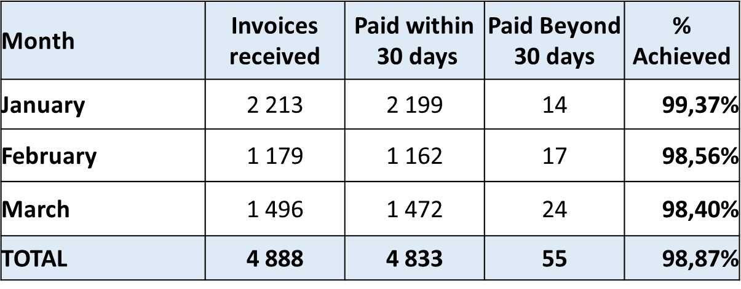
Edit
PAYMENT OF INVOICES WITHIN 30 DAYS

Slide 72
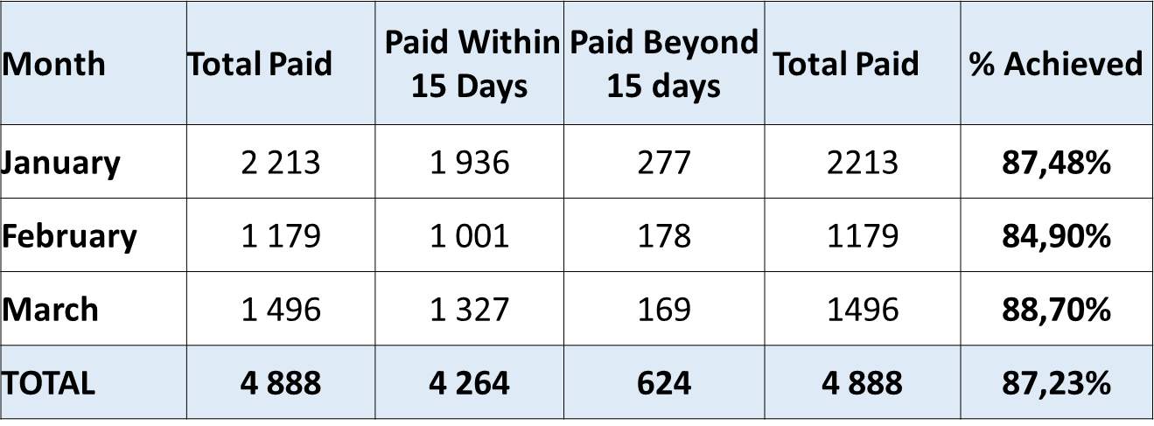
Edit
PAYMENT OF INVOICES WITHIN 15 DAYS

Slide 73
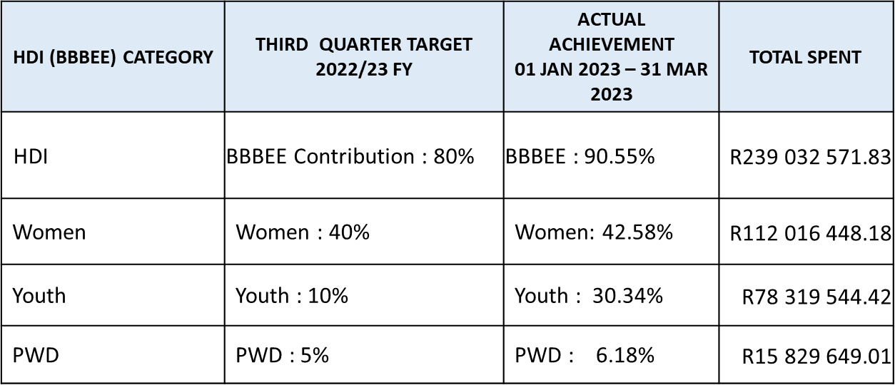
Edit
PREFERENTIAL PROCUREMENT SPEND: 01 JANUARY 2023 - 31 MARCH 2023

Slide 74
Edit
TOWNSHIP ECONOMY REVITILISATION SPEND: 01 JAN 2023 – 31 MARCH 2023

Slide 75
Edit
Recommendation
It is recommended that the Portfolio Committee note the GDSD 2022/2023 performance report as presented.

Slide 76
Edit

