Slide 1
AGRICULTURAL PRODUCT STANDARDS AMENDMENT BILL
BRIEFING TO THE SELECT COMMITTEE ON LAND REFORM, ENVIRONMENT, MINERAL RESOURCES AND ENERGY
DATE: MAY 2023

Slide 2
Contents
Status quo of the Agricultural Product Standards (APS) Amendment Bill
Shortcomings/weaknesses of the APS Act
Measures introduced to solve shortcomings/weaknesses of the APS Act
Process followed to date
Amended sections and their purpose

Slide 3
1. Status quo of the APS Amendment Bill
21 February 2023- Hon. Minister (DALRRD) participated in the National Assembly for the Second reading of the APS Amendment Bill.
APS Amendment Bill was adopted by the National Assembly and sent to the National Council of Provinces for their considerations.

Slide 4
2. Shortcomings/ weaknesses of the APS Act
Key deficiencies which necessitated the amendment of the APS Act are as follows:
2.1 Definition for “Management control system”
2.2 Auditing of management control system
2.3 Setting of fees by Assignees

Slide 5
3. Measures introduced to solve shortcomings/ weaknesses of the APS Act
Insertion of new and substitution of existing definitions, inter alia “audit”, “management control system” and “sell”.
Provide for auditing of management control systems.
Provide for active participation by affected stakeholders in the determination of fees for Assignees.

Slide 6
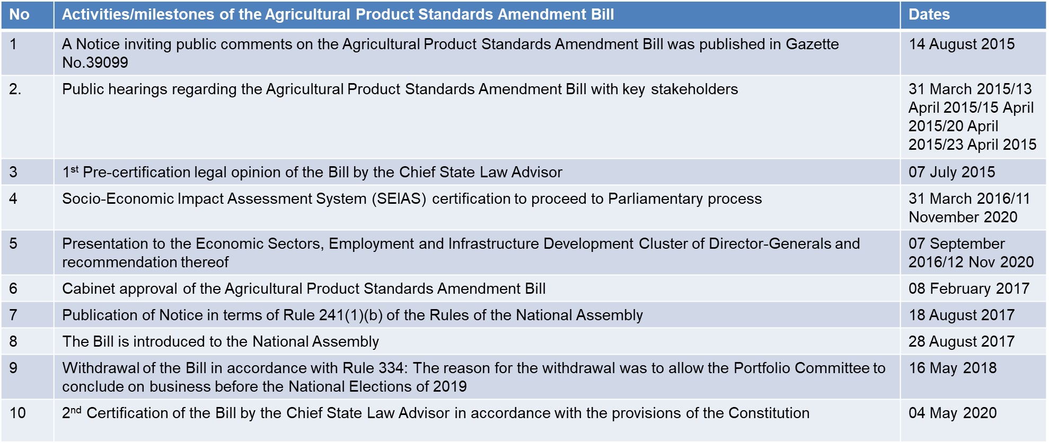
4. Process followed to date

Slide 7
4. Process followed to date
No | Activities/milestones of the Agricultural Product Standards Amendment Bill | Dates
11 | Call for public comments by Portfolio Committee with due date of 30 September 2022. | 30 September 2022
12 | Written submissions were received from the affected stakeholders (AGBIZ, Consumer Goods Council of South Africa, Primerio, Red Meat Industry Forum, Tiger Consumer Brands Limited, The National Chamber of Milling, South African Fruit and Vegetable Canners Association/South African Fruit Juice Association, Grain SA, PEPSICO, South African Organic Sector Organization, Perishable Products Export Control Board, and SAMPRO). | 30 September 2022
13 | Affected Stakeholders were given opportunity to present their submissions. | 01 November 2022
14 | DG presented DALRRD response to public comments on the APS Bill to the Portfolio Committee on Agriculture, Land Reform and Rural Development and affected stakeholders | 08 November 2022
15 | Acting DDG also presented tabulated format response to public comments on the APS Bill. | 08 November 2022
16 | Portfolio Committee on Agriculture, Land Reform and Rural Development approved the APS Amendment Bill. Portfolio Committee to present the APS Amendment Bill to the Cabinet. | 22 November 2022
17 | Honourable Minister (DALRRD) participated in the National Assembly for the Second reading of the Agricultural Product Standards Amendment Bill. APS Amendment Bill was adopted by the National Assembly and sent to the National Council of Provinces for their consideration. | 21 February 2023

Slide 8
5. Amended sections and their purpose
Section to be amended | Gaps/ challenges that will be addressed through the amendments | Amendments that will be made | What it will read like when amended | The benefit / impact of the amendment
Section 1 | Lack of provision for different methods of enforcement under the Act | Insertion of definitions | “audit” means an examination of the management control system in order to determine whether activities and related results comply with the claims associated with the product | To make provision for the auditing of a system

Slide 9
5. Amended sections and their purpose
Section to be amended | Gaps/ challenges that will be addressed through the amendments | Amendments that will be made | What it will read like when amended | The benefit / impact of the amendment
Section 1 | Alignment with a reconfigured Cabinet portfolio | Substitution and insertion of definitions | “department” means the Department of Agriculture, Land Reform and Rural Development” “Director-General” means the Director-General of the Department; “Minister” means the Cabinet member responsible for agriculture; | Clearer interpretation

Slide 10
5. Amended sections and their purpose
Section to be amended | Gaps/ challenges that will be addressed through the amendments | Amendments that will be made | What it will read like when amended | The benefit / impact of the amendment
Section 1 | Regulations relating to production methods such as free range, organic, etc. | Substitution of definitions | “Management Control System” means prescribed method of production which may be claimed through the use of a name, word, expression, reference, particulars or indication in any manner, either by itself or in conjunction with any other verbal, written, printed, illustrated or visual material; | Elimination of deceptive claims or labelling

Slide 11
5. Amended sections and their purpose
Section to be amended | Gaps/ challenges that will be addressed through the amendments | Amendments that will be made | What it will read like when amended | The benefit / impact of the amendment
Section 1 | Interpretative challenges | Substitution of the definition | “sell” includes to offer, advertise, keep, expose, transmit, convey, deliver or prepare for sale, or exchange or to dispose of to any person in any way for a consideration and ‘sold’ ‘selling’ and ‘sale’ shall have a corresponding meaning” | Harmonise the definition with other legislation dealing with food i.e. FCD Act.

Slide 12
5. Amended sections and their purposes
Section to be amended | Gaps/ challenges that will be addressed through the amendments | Amendments that will be made | What it will read like when amended | The benefit / impact of the amendment
Section 2 | Designation of an assignee for the management control system and the emphasis on their independence | Amendment of section 2 of the Act by substitution in subsection 3 for paragraph (a). | The Minister may, for the purposes of the application of the Act or certain provision thereof designate as assignee a person, undertaking, body, institution, association, or board – having a particular knowledge of the product concerned; or | Designation of appropriately qualified and independent assignee

Slide 13
5. Amended sections and their purposes
Section to be amended | Gaps/ challenges that will be addressed through the amendments | Amendments that will be made | What it will read like when amended | The benefit / impact of the amendment
Section 2 | Designation of an assignee for the management control system and the emphasis on their independence | Amendment of section 2 of the Act by substitution in subsection 3 for paragraph (a). | (ii) having a particular knowledge of the relevant management control systems, with no direct or indirect personal or financial interest. | Designation of appropriately qualified and independent assignee

Slide 14
5. Amended sections and their purpose
Section to be amended | Gaps/ challenges that will be addressed through the amendments | Amendments that will be made | What it will read like when amended | The benefit / impact of the amendment
Section 3 | Transparency and accountability in the setting of fees | The insertion after subsection (1A) of the principal Act | “(1B) Any fee determined in terms of subsection (1(A)(b)(ii) shall be calculated on a cost recovery basis, and shall only come into effect if -- the assignee concerned, within a specified period, has submitted a business plan and budget setting out the powers and duties to be exercised and performed by the assignee and the expected costs associated therewith to the executive officer for consideration; | The affected stakeholders will be able to participate in the determination of fees

Slide 15
5. Amended sections and their purpose
Section to be amended | Gaps/ challenges that will be addressed through the amendments | Amendments that will be made | What it will read like when amended | The benefit / impact of the amendment
Section 3 | Transparency and accountability in the setting of fees | The insertion after subsection (1A) of the principal Act | (b) the executive officer, within a specified period, has invited written comment on the business plan and budget of such assignee from interested parties or individuals who are directly affected by the actions of that assignee; and | The affected stakeholders will be able to participate in the determination of fees

Slide 16
5. Amended sections and their purpose
Section to be amended | Gaps/ challenges that will be addressed through the amendments | Amendments that will be made | What it will read like when amended | The benefit / impact of the amendment
Section 3 Section 3A | Transparency and accountability in the setting of fees Lack of alternative method of inspection or enforcement | The insertion after subsection (1A) of the principal Act Substitution for the heading [Inspection] | (c) the executive officer, after consideration of the comments received in terms of paragraph (b), has in writing approved the business plan and budget of the assignee for a specified period, not exceeding 12 months, set out in such approval.” (a)“3A. Audit or inspection, grading and sampling for quality control; | Transparency and openness Lower cost of compliance

Slide 17
5. Amended sections and their purpose
Section to be amended | Gaps/ challenges that will be addressed through the amendments | Amendments that will be made | What it will read like when amended | The benefit / impact of the amendment
Section 3A | Lack of alternative method of inspection or enforcement | Substitution in subsection 2 for paragraph (c) | (c) The relevant person referred to subsection (1) may audit the management control system, and demand from the owner or custodian of the product, material, substance or other articles in question, or from the person supervising such management control system, any formation or explanation regarding management control system , product, material, substance or other article in question | Lower cost of compliance

Slide 18
5. Amended sections and their purpose
Section to be amended | Gaps/ challenges that will be addressed through the amendments | Amendments that will be made | What it will read like when amended | The benefit / impact of the amendment
Section 3A | Lack of alternative method of inspection or enforcement | Substitution in subsection (4) for the following subsection | (4) In the case of action under subsection (1)(b), (c), (d) or (e), or subsection (2)(c) by the relevant person referred to in subsection (1), the owner of the product in question shall pay the prescribed fees or amount determined by the assignee, as the case may be for such action. | Lower cost of compliance

Slide 19
5. Amended sections and their purpose
Section to be amended | Gaps/ challenges that will be addressed through the amendments | Amendments that will be made | What it will read like when amended | The benefit / impact of the amendment
Section 15 | Lack of a provision allowing for regulation in respect of Management Control System and auditing | Insertion in subsection (1) after paragraph d Substitution in subsection (1) for paragraph (g) | (dA) management control systems; (g) Audit or inspection fees that have been determined by the assignee. | Allowance of the relevant regulations to be made in terms of section 15 of the principal Act.

Slide 20
THANK YOU

