Slide 1
Reigniting the Sedibeng Economy
Progress update on the Vaal SEZ
Presentation to Portfolio Committee
Oversight Visit to Sedibeng District – Saul Tsotetsi Community Hall - Sebokeng
9 June 2023
Xola Sithole – Vaal SEZ CEO

Slide 2
Introduction
The purpose of this presentation is to provide a comprehensive overview on the developments within the Southern Development Corridor (SDC).
This summarises the work done so far by the National Government (dtic), the Gauteng Provincial Government (GPG), the various local municipalities that make up Sedibeng District Municipality.
Our targeted commitment is to focus on enhancing inclusivity of the economy in the district, whilst improving its competitiveness.
This is the driving force behind the Transformation, Modernization and Re-industrialization programme which has been adopted as the guiding vision GGT 2030.

Slide 3
Context and Background
Over several years, the region has been suffering from an extremely severe, contraction in economic activities resulting in serious socio-economic challenges.
There are spatial disparities caused by limited investment into the corridor. As such, Sedibeng region is characterized by dilapidated and ageing infrastructure as well as underinvestment in strategic production sectors.
The region has traditionally been South Africa’s heavy industrial, manufacturing and engineering hub. However, over the years the region has experienced a decline and de-industrialisation of the steel industry, causing undesired falling output and company closures.
This trend mirrors the general decline of manufacturing and the steel industry in South Africa over the years.
The triple crises of inequality, poverty and unemployment poses a huge challenge as the number of unemployed people in the region increased in the last few years.

Slide 4
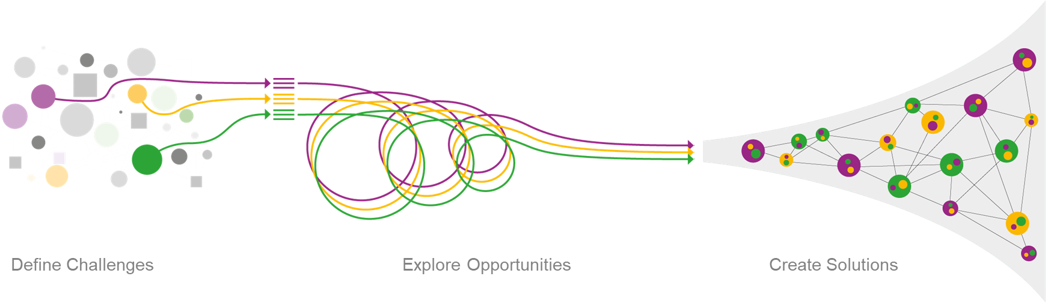
Vaal SEZ business case
Develop a multi-sector, multi-site Special Economic Zone in the Vaal Region (Sedibeng District), that attracts suitable investments at scale – transitioning the regional economy onto a sustainable low carbon intensity path
Regenerate the area, support new economic activity, and build on the historic competitive strengths and skills base of the area
Strategic partnership with major corporations like Sasol and Arcelor Mittal as they embark on their decarbonisation journeys
Build a socially cohesive society, with sustained economic growth that results in the creation and retention of quality jobs, and sustainable opportunities for SMEs

Slide 5
Strategic rationale
Decarbonisation
Support existing businesses in transitioning to a low carbon path, becoming more competitive
New Green Technologies
Take advantage of the economic opportunities that green hydrogen and other green technologies offer
Vaal region is a historic cluster of steel related industries and mining
Marked industry decline since the 1990’s resulting in economic decay and intractable social ills
Sustainable growth for the region requires a focus on both reducing carbon intensity of production, and embracing the economic potential of new green technologies
These interventions will mitigate the impact of climate change, enhance competitiveness, and drive industrial development, innovation and economic diversification

Slide 6




Priority interventions
The major catalytic interventions that will spur the rejuvenation of the Sedibeng Economy are the Vaal SEZ, the Vaal Aerotropolis, and Vaal River City
The Vaal SEZ is a multi-site, multi-sector Special Economic Zone, spanning all three local municipalities, that is in the process of designation
The Vaal Aerotropolis combines an airport, a logistics hub, and an airport city
The Vaal River City is a Smart City project aimed at transforming the banks of the Vaal River and extends between the Vaal River and Sharpeville
the Minister has approved an Equity Equivalent Investment Programme (EEIP) application for Citibank to the value of R1,4bn – a large portion of this amount is to be set aside for use across all these projects to advance BBBEE, localisation, and SME development

Slide 7
DDM Perspective
It is critical to link the development of SEZs to the District Development Model approach through:
  One Plan with the SEZ as a catalyst or core enabler to the One Plan of the District and Local Municipalities
  Integrated budgeting for infrastructure development and improvement
  Integrated institutional arrangements with a defined role for the Districts and Municipalities in the SEZ’s governance structure
  Integrated implementation approach
  Integrated stakeholder and community engagements
The desired end-goal is an SEZ programme that catalyses coherent & structured regional development, reindustrialization, diversification, growth in key sectors, innovation, a transformed economy, and job creation
“By far unemployment is the biggest challenge. The Gauteng government has ambitious plans to revitalise Sedibeng by developing agriculture, by developing logistics, tourism and industries as well. These plans are pivoted around the Vaal SEZ which we have heard has the potential of creating up to 170 000 jobs over the next few years.” – President Cyril Ramaphosa at the Sedibeng Presidential Imbizo, 12 August 2022

Slide 8
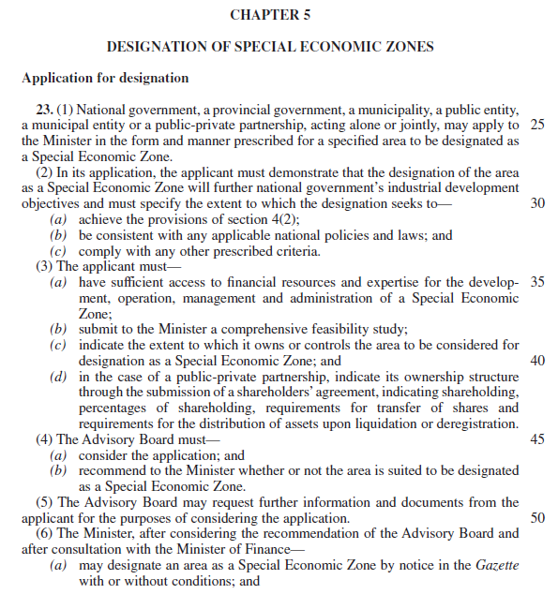
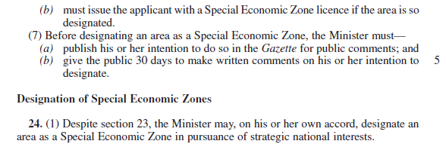
Roadmap to SEZ Designation
Concept Note to secure dtic co-funding to establish a PMU and conduct a Feasibility Study and develop a Business Case
Completed
Pre-Feasibility Study
Completed
Feasibility Study
Completed
Business Case and SEZ Designation Application
Completed
Appraisal of Application by the dtic and SEZ Advisory Board
WE ARE HERE
Recommendation for SEZ designation by the SEZ Advisory Board to the Minister
Approval and issue of SEZ Designation Licence by the Minister – with concurrence of the Minister of Finance

Slide 9










Regional Investment Hub
The Vaal SEZ has established its new offices in Vanderbijlpark (14 Chopin St)
This Investment Hub will host other key entities such as the DDM Office, LED resources, and DFIs (IDC, NEF, Sefa, DBSA) and other investment promotion agencies (InvestSA, GGDA) for the purpose of seamless coordination of the economic revitalisation plan for the Sedibeng District
Large corporates from within the Sedibeng District have pledged to provide, at no cost, project management resources to support the establishment of the Vaal SEZ
These are temporarily facilities, and the Head Office and local offices will move to the SEZ sites once the buildings have been constructed over the next two years

Slide 10



Priority investments
There are 3 primary investments (Batch 1) that are being prioritised for breaking ground within 2023
These 3 in nearing financial close and the selected sites need to be serviced in time to land them when they are ready to break ground
In addition to these, there is a pipeline of 10 investments (Batch 2) that are undertaking bankable feasibility studies and are likely to reach financial close over the next 12-18 months
The total estimated investment value for Batch 2 exceeds R20 billion
INVESTMENT | DESCRIPTION
 | Emfuleni – Project Phoenix – Fuel Cell Manufacturing (R750m Phase 1, R2bn over 5 years)
 | Lesedi – Composite LPG Cylinders Manufacturing, Storage & Distribution (R1,1 bn)
 | Lesedi – Expansion of existing logistics business (R100m)

Slide 11


Priority Investments – Jobs & Exports
Investment | Description | Job Creation |  | Export Potential | Export Potential
 |  | Operational | Construction | Total Export Value / Annum | Destination Countries
 | Solid Oxide Fuel Cell (R750 million Phase 1 R3,5 billion over 5 years) | 450 | 1750 | Circa $100 million | 25% of products will be exported to: Europe, Zambia, Lesotho, Nigeria
 | Composite LPG Cylinder (R1,1 billion) | 547 | 550 | Circa $9 million | 20% of products will be exported to: Botswana, Zimbabwe, Namibia, Lesotho, Zambia
 | Transport Hub Services (R 100 million) | 38 | 50 | Not Applicable | Not Applicable

Slide 12
Additional priority investments
Below is a brief description of some of the investments (Batch 2) that are being pursued for maturing onto the Vaal SEZ sites. They are a various stages of development and are expected to reach financial close over the next 12-18 months.
INVESTMENT | DESCRIPTION | MUNICIPALITY
MTP Aviation | Heidelberg Aerodrome | Lesedi
Aselsan | Manufacture of two-way radios | Lesedi
Paramount | Aerospace integration centre | Lesedi
MD Helicopters | Manufacture of helicopter blades | Lesedi
Kachila | Manufacture of aerospace and defence instrumentation | Lesedi
Afristarch | Manufacture of starch from maize | Midvaal
MTM Energy | Gas-to-power plant | Midvaal
Blue Africa | Boat building park | Emfuleni
Libalele Energy | Green energy | Midvaal
MTech Powder | Manufacture of aluminium powders | Emfuleni

Slide 13
Socio-Economic Impact
Investment in the Vaal SEZ is expected to make substantial impact in terms of employment opportunities in the region and the contribution to the Gross Domestic Product.
During construction period in PHASE 1, the project is expected to create about 4,302 direct jobs and 1,305 indirect jobs. An additional 5,902 direct jobs will be created during the operational stage.

Slide 14
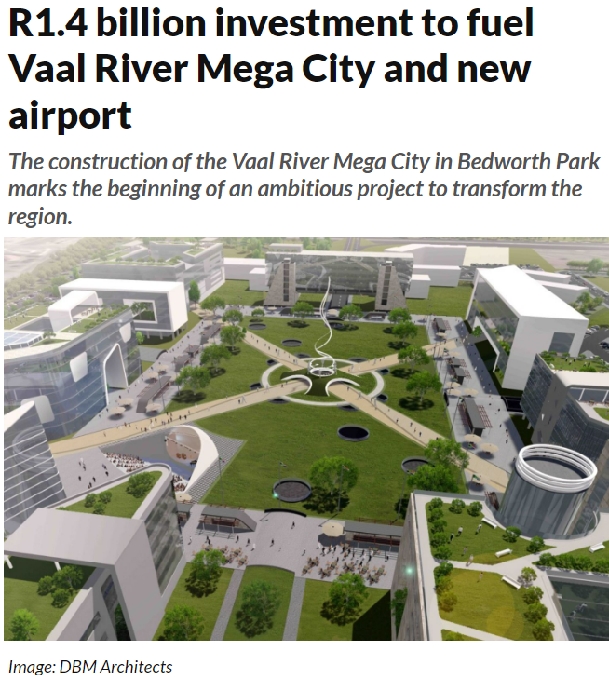
Other strategic projects
DESCRIPTION
VAAL RIVER CITY A flagship project aimed at transforming the Vaal River banks and extends between the Vaal River and Sharpeville VRC will capture the historical legacy of our country, through cultural themes, historical artwork, cultural sites and architecture that represents this history Actualise the concept of a River City contributing to broad restructuring of South African cities and towns
VAAL AEROTROPOLIS A PPP partnership project for the management, development and operation of Vaal Aerotropolis Brand and precinct, Vaal Airport , managed, developed and operated by MTP Aviation Solutions Home of Vaal International Airport A 50-minute drive from Johannesburg city centre To be built around a 60-year masterplan, which utilises approximately 6350 ha greenfield site
the Minister has approved an Equity Equivalent Investment Programme (EEIP) application for Citibank to the value of R1,4bn. The funds will be utilised across the Vaal Aerotropolis and Vaal River City projects to advance localisation, SME development, and BBBEE

Slide 15
Support required - Province
AREA | DESCRIPTION
GDARD (Gauteng Dept of Agriculture and Rural Development) | Consent for Mitochondria site-specific EIA can be included in the Emfuleni portion of Vaal SEZ EIA as one EIA or conducted in parallel if not in the same document Shorten the Scoping Report approval to 5 working days (vs 30) Shorten the EIA Report approval to 5 working days (vs 30)
GDRT (Gauteng Dept Roads and Transport) | Early approval of TIA Reports as part Town Planning Process Early approvals of design drawings

Slide 16
Support required - Emfuleni
AREA | DESCRIPTION
Electrical | Determine and agree an interim solution whereby the substation does not have to be built now, if this is possible. (Mitochondria demand currently 1MW)
Town Planning | Agreement that Regulation 92 exemption can be granted in order that the breaking of ground can occur before the full Town Planning process is complete (before proclamation of Township)
Roads & Stormwater | Early approval of Traffic Impact Assessment Report (TIA) Speedy approval of Design Drawings
Water & Sanitation | Early approval of Civil Engineering Scheme Reports Speedy approval of Design Drawings

Slide 17
Support required - Lesedi
AREA | DESCRIPTION
Environmental | EIA in place
Electrical | Speedy approval of Design Drawings for internal bulks
Town Planning | Township has been proclaimed previously Formalised agreement that Regulation 92 exemption can be granted in order the breaking of ground can occur before the full Town Planning process is complete (before rezoning, subdivision and consolidation complete). Indication of this has been given verbally
Roads & Stormwater | Speedy approval of Design Drawings of internal roads
Water & Sanitation | Speedy approval of Design Drawings of internal water and sanitation drawings

Slide 18
Support required – Midvaal
AREA | DESCRIPTION (KOOKFONTEIN SITE AS PRIORITY)
Town Planning | Agreement that Regulation 92 exemption can be granted in order that the breaking of ground can occur before the full Town Planning process is complete (before proclamation of Township)
Roads & Stormwater | Early approval of Traffic Impact Assessment Report (TIA) Speedy approval of Design Drawings
Water & Sanitation | Early approval of Civil Engineering Scheme Reports Speedy approval of Design Drawings
Zwaartkopjes Site (Rand Water) | The Rand Water Site is outside the Urban Edge Support is required to accelerate the process to incorporate it within the Urban Edge

Slide 19
Support required – Other
AREA | DESCRIPTION
ESKOM | Early approval of Electrical Reports as part Town Planning Process Early approvals of design drawings
SANRAL | Early approval of TIA Reports as part Town Planning Process Early approvals of design drawings
Sedibeng District Municipality | Add Heidelberg Ext 24 and Airport site (a portion of the remainder of the farm Langlaagte 186) to the Vaal River Spatial Development Framework

Slide 20
Conclusion (1 of 2)
To respond effectively to the challenges of underdevelopment in the region we need to act decisively and urgently to resolve some of the most pressing problems:
Address infrastructure problems, governance challenges and service delivery issues.
Infrastructure rollout interventions:
  Extending Government program of fixing the Roads Network across the district.
  Support and accelerate the program led by the private sector to fix roads, street lights and traffic lights.
  Support all strategic bulk infrastructure requirements especially those that seek to comply with the SEZ, Vaal Aerotropolis and phase 1 of the Vaal River City Development.
We need to capacitate the DDM Office in Sedibeng for the purpose of seamless coordination of the economic revitalisation plan for the District.
Work with Eskom, DWS, Rand Water and other relevant role players to mobilise resources to address the Energy and Water & Sanitation problems.

Slide 21
Conclusion (2 of 2)
To respond effectively to the challenges of underdevelopment in the region we need to act decisively and urgently to resolve some of the most pressing problems:
Support the Township Enterprise Development Zones as the core instrument to promote Township Economy. Government is working with the IDC to rollout a pilot program (preferably in Sharpeville) to provide funding for township backyard businesses.
Broadband/fibre rollout to all key and major townships to create universal access to connectivity.
Ensure a fully functional Vaal SEZ Board that meets regularly to resolve bottlenecks and continued support from the Political Steering Committee to ensure that we achieve our objective of a coherent & structured regional development.
Support the SEZ’s programme of stakeholder engagement to secure buy-in and inform communities, entrepreneurs, and designated groups about the opportunities that the revitalisation of the Sedibeng economy presents.

Slide 22
Thank you
Reigniting the birthplace of industrialisation in South Africa

