Slide 1
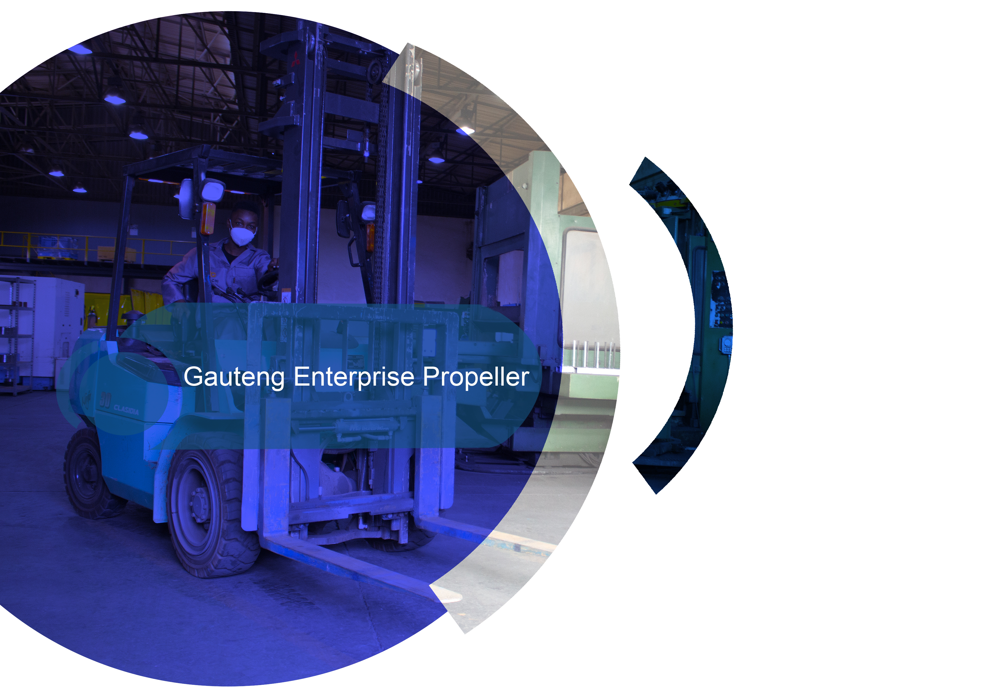


Slide 2

OVERVIEW OF GEP OFFERING
REGIONAL OPERATIONS MANAGER – SELLO MANOTO

Slide 3

OUR MANDATE
Promote Entrepreneurship, Mobilize Resources and Facilitate an integrated approach to Entrepreneurial Development and Support in GP
Provide Financial and Business Development Support
for the Growth and Sustainability of SMMEs
Facilitate investment in high-impact business
enterprises that transform the structure and competitiveness of industrial sectors in the province

Slide 4
OUR CLIENTS AND CRITERIA
TO QUALIFY
Based in GP
SA Owned Businesses
Start-ups and Existing Businesses
Viability of Business
COMPLIANCE
Be Registered With CIPC
Be Compliant With SARS
Submit all required documents
INFORMAL TRADERS
Be registered with the Municipal authority

Slide 5

FINANCIAL SUPPORT
Financial support loans with reduced interest rates and repayment holiday for qualifying small enterprises (enterprises in good standing)
Start-up Finance
Contract Finance
Growth Finance
Franchise Finance GEP

Slide 6






NON- FINANCIAL SUPPORT
Facilitating CIPC registrations
Support in development of business plans
Business development support interventions
Assisting in Project preparation
Conducting due diligence
Provision of Post investment and aftercare services to supported SMMEs

Slide 7

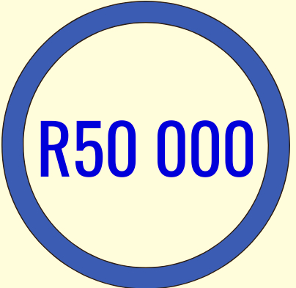

BUSINESS DEVELOPMENT AND SUPPORT (BDS)
Marketing Tools
Financial Management Systems
Quality Management Systems
Training, Mentorship
Business Advice
Up to R50 000 in Grants

Slide 8
The Sedibeng Regional Office has assisted Small Enterprises (SMMEs and Cooperatives) with various Business Development Interventions:
Business Development Interventions – Planning, technical support and capacity building interventions
Grant Funding
- Township Business Renewal Program (TBR) - procurement of equipment
- Community Fund – procurement of stock and working tools
- Cooperatives Assistance Program (CAP) – procurement of stock and equipment for Coops
- Informal Traders Support – procurement of stock and working tools

Slide 9
REGIONAL PERFORMANCE 2022/23 FY
Business Development Support
297 Small Enterprises were assisted with various Business Development interventions such as Quality Management Systems, Safety Files, Financial Management Systems, Business Plans, Marketing tools and training in various aspects of business skills to a total value of R 4 852 700,00.
Grant Funding
TBR
A total of 88 small enterprises were assisted with purchases of equipment to the value of R 4 228 474,00.
CAP
A total of 11 co-operatives were assisted with purchases of stock/equipment to the value of R 171 528,00.
.

Slide 10
Grant Funding (continued)
Community Fund
- A total of 47 small enterprises were assisted through purchasing of stock/equipment to the value of R 705 000,00
Informal Traders Support
- A total of 62 informal traders were assisted through purchasing of stock/equipment to the value of R 304 756,65

Slide 11
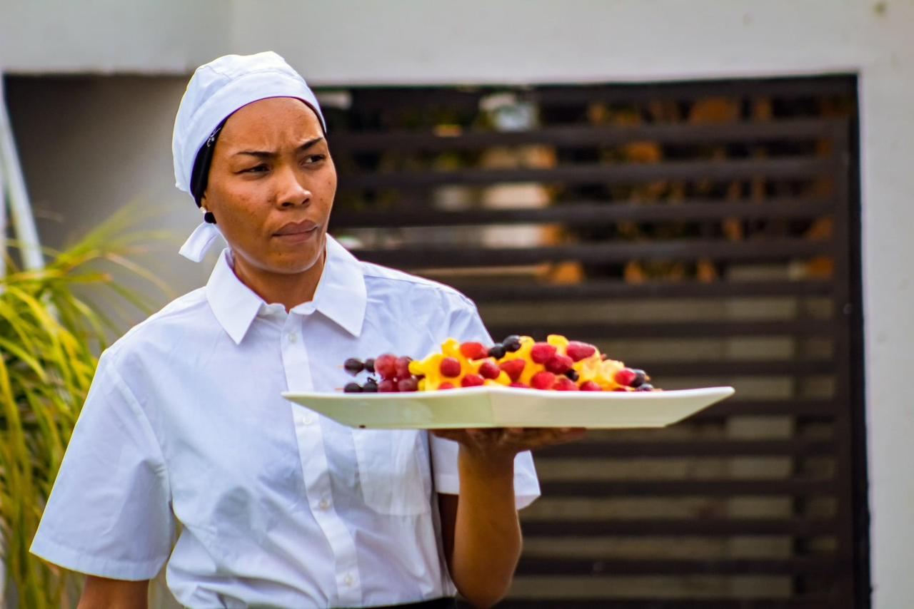
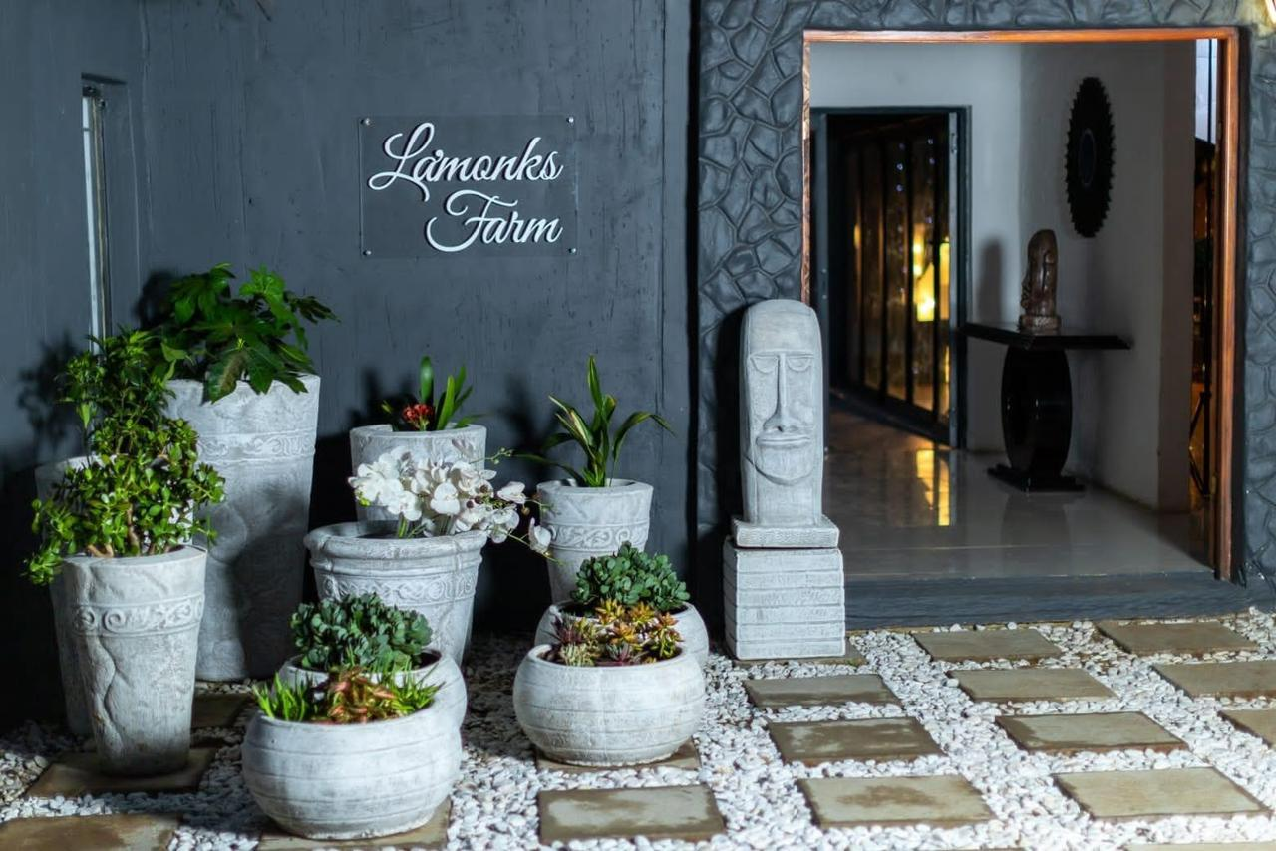
Success stories
La Monkz (Pty) Ltd is 100% black owned by Ms. Botlenyane Tladi. The business was registered in 2013 and started to operate in 2015. It is a 3 Star accommodation with eleven (11) guest rooms. The owner host also host events, provides catering and spa services at the premises. Seven (7) people are employed in the business.
Business Challenges
On the 04th November 2022 an assessment was conducted on the business and the following challenges were discovered:
Lack of additional equipment
Lack of an electronic financial management system

Slide 12
GEP Interventions
In December 2022 the business benefitted through TBR Project with equipment of R50 000.00.
In February 2023 the business benefitted through training on Electronic Financial Management System and a laptop computer.
Outcome
The owner is now able to record credible financial records because due to the purchased Electronic Financial Management System.
The additional equipment also assisted the business to improve capacity.
Employment creation
The business currently employs six (6) employees excluding the owner.

Slide 13
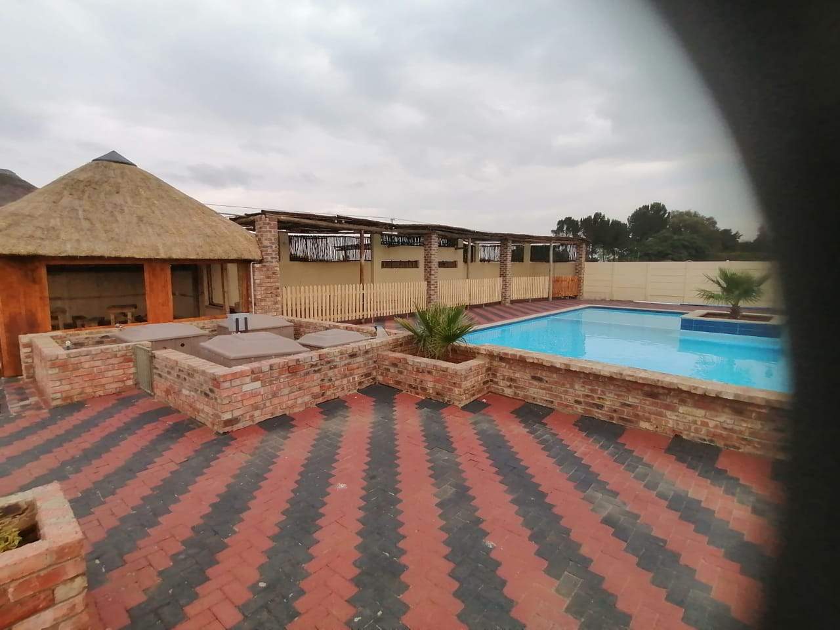
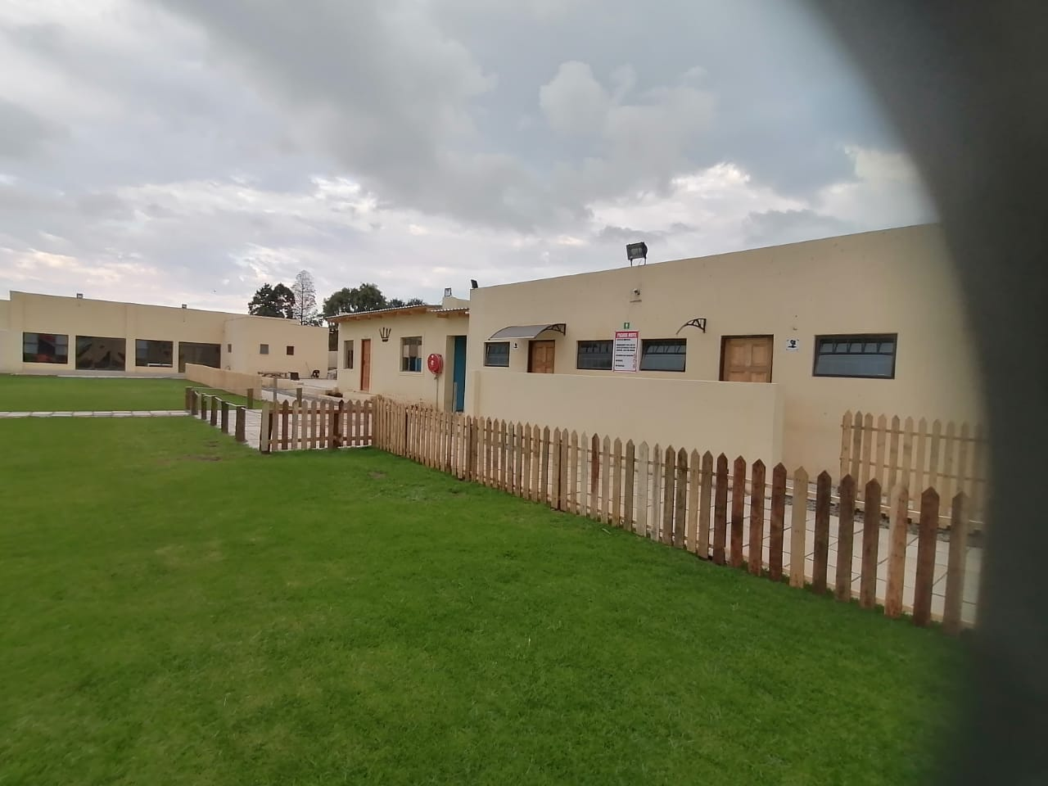
Kgalala Trading Enterprise t/a Kgalala Palace
Kgalala Trading Enterprise CC, owned by Mr. John Hoyane was registered in 2006. The SMME offers construction services and an entertainment facility. The business completed a number of projects in Construction for Public Institutions. The owner expanded his business offerings in 2018 with an entertainment facility which is trading as Kgalala Palace. The target market for the business include local community, Corporates and Public institutions. The owner uses social media platforms to market his services. The business is also in possession of marketing tools such as; business logo, car wrap, business cards, business profile and banners.

Slide 14
Business Challenges
Kgalala Palace had challenges with exposure.
GEP Interventions
In November 2019, the business was assisted with a Health and Safety Management System.
In October 2022, the business was assisted with a Food Safety Management System.
In February 2023, the business was also assisted with Marketing tools whereby two (2) signage-boards were erected on the premises.
Outcomes
The signage-board enhanced the exposure of the business and, more people were attracted to the business. This led to an increase in sales due to more bookings which ultimately increase the business turnover.
Jobs created
The business started with three (3) employees and the number has increased to a total of twelve (12) employees.

Slide 15
CHALLENGES: INADEQUATE BUDGET
The budget allocated for SMME developmentt is far lower that the demand for GEP non-financial support services.
This results in a number of complaints by SMMEs who have applied but could not be assisted.

Slide 16


APPLY ONLINE
www.gep.co.za

Slide 17
WHERE
WE ARE
HEAD
OFFICE
SEDIBENG
REGIONAL OFFICE
6th Floor, 124 Main St,
Johannesburg
36 Merriman Street
Vereeniging
MedScheme Building

