Slide 1
THE MEETING OF THE STANDING COMMITTEE ON PUBLIC ACCOUNTS WITH GAUTENG MUNICIPAL PUBLIC ACCOUNTS COMMITTEES GAUTENG PROVINCIAL TREASURY SUPPORT PROVIDED TO MPAC date:30 MAY 2023

Slide 2
Table of Content
Background – Establishment and Appointment of the MPAC.
Support provided to MPACs.
MPAC Responsibility as per MFMA
Challenges
Future support to be provided to Municipal Public Accounts Committees
Municipal Finance Hands-On Support Programme (MFHSP)

Slide 3
Establishment and Appointment of MPACs
The municipal council, is tasked, in section 79A (3), to determine the functions of the municipal public accounts committee (MPAC), which must include the following:
Review the Auditor-General’s reports, comments of the management committee, the audit committee and make recommendations to the municipal council.
Review internal audit reports, together with comments from the management committee and the audit committee; and make recommendations to the municipal council.
Initiate and develop the oversight report on annual reports contemplated in section 129 of the Local Government: Municipal Finance Management Act (MFMA).
Attend to and make recommendations to the municipal council on any matter referred to it by the municipal council, executive committee, a committee of the council, a member of this committee, a councillor and the municipal manager.
And on its own initiative, subject to the direction of the municipal council, investigate, and report to the municipal council on any matter affecting the municipality.

Slide 4
Support Provided to MPAC by GPT
2015
2016
10 August 2015 - Workshop in Sedibeng Region on dealing with UIF & W expenditure.
September 2015 - Workshop to all MPACs in Gauteng municipalities in collaboration with AGSA, SALGA, COGTA and Provincial Legislature on:
MPAC Good Practice Guide,
Accountability & Oversight,
Municipal Regulations on Financial Misconduct
17 Feb 2016 - Workshop was conducted for Emfuleni MPAC members to assist with preparation of oversight report on Annual Report.
22 April 2016 - Workshop was conducted for Lesedi MPAC members to assist with dealing with UIF & W Expenditure report
21 October 2016 - Workshop was conducted for all MPAC members and support staff in Emfuleni LM on dealing with UIF & W expenditure and oversight report on Annual Report.
22 September 2016 - Workshop was conducted for all MPAC members and support staff in all the Metros on dealing with oversight report on Annual Report and interrogation of AGSA report.
18 November 2016 - Workshop on how to perform Financial Oversight as per MFMA Circular 32 was conducted for all MPAC members and support staff in West Rand district.

Slide 5
Support Provided to MPAC by GPT
2017 & 2018
2 August 2017 - Workshop was conducted for all councillors and MPAC members in Sedibeng district on Financial Oversight and UIF & W expenditure.
10 October 2017 - Workshop on for West Rand Region MPAC members on how to interrogate UIF & W Expenditures.
8 February 2018 - Workshop was conducted for Lesedi MPAC members on UIF & W expenditure and oversight report on an Annual Report.
14 February 2018 - Workshop was conducted for Emfuleni MPAC members on preparing the oversight report on the Annual Report
10 – 11 October 2018 – Workshop was conducted for West Rand Region MPAC members and support staff based on MPAC Toolkit & Guide and Municipal Regulations on Financial Misconduct and
08 to 09 November 2018 – Workshop was conducted for Sedibeng Region MPAC members and support staff based on MPAC Toolkit & Guide and Municipal Regulations on Financial Misconduct.

Slide 6
Support Provided to MPAC by GPT
2019 & 2020
20 February 2019 - Workshop was conducted for Sedibeng MPAC members on the preparation of oversight report on the Annual Report.
6 March 2020 - Workshop was conducted for West Rand Region (DC Board members, Internal Audits and MPAC support staff) on Financial Misconduct Regulation.
22 October 2020 – Presented GPT’s Annual Report Assessment findings to Emfuleni LM MPACs to assist in preparation of the oversight report on the Annual Report.
27 November 2020 - Workshop was conducted for all delegated municipalities and Metros (MPAC members, DC Board members, Internal Audits and MPAC support staff) on Financial Misconduct Regulations and role clarification on dealing with UIFW Expenditures.

Slide 7
Support Provided to MPAC by GPT
2021 & 2022
20 July 2021 – Mogale City MPAC training on dealing with UIFW Expenditures
20 August 2021 – Provincial Wide MPAC training on the role of MPAC and DC Boards in dealing with UIFW Expenditures.
24 – 25 August 2021 – In collaboration with SALGA and COGTA provided an MPAC training to Sedibeng Region on Roles and responsibilities of MPAC, DC Boards, Risk and Audit committees and the UIFW Expenditures.
NEW MPAC Members
March and April 2022 - Through SALGA Induction programme provided training to all MPACs members on:
Dealing with UIF&W Expenditures (Clarification of the responsibilities of MPAC & DC Boards)
Annual Report Framework and dealing with the annual report through the oversight report.
05 April 2022 – Sedibeng DM MPAC training on Annual Report Assessment
1 September 2022 – West Rand Region MPACs and Section 80 committees
8 September 2022 – Sedibeng Region MPAC and Section 80 committees

Slide 8
MPAC Responsibility – initiate Oversight Report
Progress on adoption of delegated municipalities 2021/2022 Oversight report
Municipality | Date Oversight Report Adopted | Approval Status | Published on Website
Sedibeng DM | 31 March 2023 | Approved with reservations | Yes
Emfuleni LM | 25 April 2023 | Unknown (Report tabled on the 25th May 2023) | No
Midvaal LM | 31 March 2023 | Approved without reservations | Yes
Lesedi LM | 30 March 2023 | Approved without reservations | Yes
West Rand DM | 23 March 2023 | Approved with reservations | Yes
Mogale City LM | Unknown | The chairperson will be appointed in the council meeting of 31 May 2023 and only then the OR will be tabled for adoption | No
Merafong City LM | 30 March 2023 | Approved with reservations | No
Rand West City LM | 30 March 2023 | Approved with reservations | Yes

Slide 9
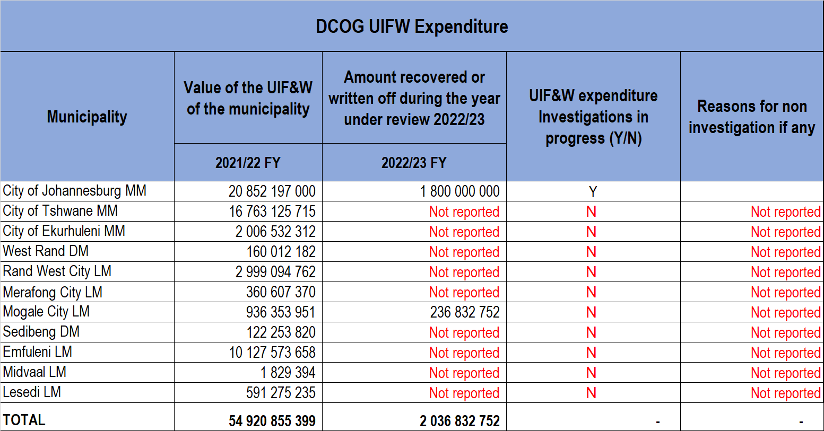
Top five UIFW Expenditure Contributors

Slide 10
CHALLENGES
Municipalities still struggling to process the Historical Unauthorised, Irregular, Fruitless and Wasteful Expenditures.
No processing of unauthorised expenditures in some municipalities.
MPACs are supposed to investigate if the reasons provided by administration pertaining to irrecoverability of UIFW Expenditures are sufficient for these expenditures to be written off.
DC Boards established but not functional to investigate allegation of financial misconduct.

Slide 11
POSSIBLE INTERVENTIONS /RECCOMENDATIONS
In order to have relationships that enhance the functionality of the MPACs and treasuries in promoting and supporting effective oversight and accountability in municipalities, the MPAC should:
Invite the Provincial Treasury (as observers) to its meetings where it discusses:
the Auditor-General’s report and the municipal budget implementation;
reviews the municipal budget implementation; and
reviews municipal compliance to the MFMA.
Inform the Provincial Treasury of the outcomes of its findings especially where the municipality is in contravention of the MFMA.

Slide 12
Municipal Finance Hands-On Support Programme

Slide 13
Approach and Scope
GPT have identified the need to procure the Services of general advisors to provide professional services and complementary support to the GPT as part of its Municipal Finance Hands-on Support Programme (MFHSP)
MFHSP is designed provide support to improve financial, revenue and expenditure management in delegated municipalities.
Support local municipalities in ensuring the maintenance and strengthening of sound financial governance.
These efforts are made towards strengthening the oversight, monitoring and support to municipalities
MFHSP also support the municipalities with the implementation of mSCOA
The MFHSP provides hands-on support on technical financial management and provide institutional capacity
This is mainly achieved through the placement of Technical Advisors to municipalities

Slide 14
Current Status of the Programme
The mSCOA Technical Advisors are providing support in the following support areas:
The implementation of the mSCOA,
Implementation plan
capacity building in implementation of mSCOA
Provide hands-on operational support to capacitate municipal officials to compile mSCOA compliant budget
Support municipalities to transact and report in the mSCOA environment.
The Financial Management Technical Advisors are providing support in the following support areas:
Institutional support in the Budget and treasury office.
Supply chain management.
Asset management.
Accounting and Audit.
Budget and Revenue management.

Slide 15
Placement of Advisors
No | Name & Surname | Contract Commencement Date | Focus Area | Municipality Deployed
1 | Charl Wennum | 01 September 2022 | mSCOA Technical Support | West Rand Region
2 | Knowledge Nkala | 01 September 2022 | mSCOA Technical Support | Sedibeng Region
3 | Peter Wilson | 01 December 2022 | Financial Management Technical Support | Emfuleni LM
4 | Sabata Makoele | 01 December 2022 | Financial Management Technical Support | Rand West City LM
5 | Dipuo Kodisang | 02 January 2023 | Financial Management Technical Support | Mogale City LM
6 | Bheki Mahlangu | 02 May 2023 |  | Lesedi LM
7 | Oscar Machimbirike | 02 May 2023 |  | Sedibeng DM
8 | Takalani Nekhofhe | 02 May 2023 |  | West Rand DM
9 | Emmanuel Nyakopoto | 02 May 2023 |  | Merafong City LM
 | Esther Chinyai | 02 May 2023 |  | Midvaal LM

Slide 16
MSCOA TA Support
Appointment of two (2) MSCOA technical advisors through the MHSP
The MSCOA TAs are providing technical support to both Sedibeng and West Rand Region
The MSCOA technical support to municipalities:
Submission of In-Year Reporting data strings M04 – M06
Improve credibility of monthly data strings through analysis process
Issuing of Gauteng Province mSCOA Circular to guide municipalities on mSCOA implementation
Supported and capacitated the officials on correction of errors in Debtors break down per categories on mSCOA Data strings
Supported and capacitated the officials by scheduling Steering Committee meetings including the system vendor

Slide 17
SCM MFIP TA SUPPORT
NT through the MFIP deployed of the TA to GPT
The TA support all Gauteng delegated municipalities on SCM issues
technical support provided to municipalities:
Reviewed the Progress on implementation of Procurement plans.
Supported and capacitated the officials of the municipality to address the RFIs and COMAFs of the AG on SCM matters.
Support to Municipalities on SCM policy interpretation during the audit
Preparations for Municipal Policy Review for PPR 2022 incorporation.

Slide 18
MFHSP: Mogale City
OPCA Issues: Assisted the municipality in clearing AGSA audit findings on Property, Plant and Equipment as well as investment property
Trade Payables: Assisted the municipality in drafting the Eskom debt relief application
Budgeting: Review In Year Monitoring (M09-2023) assessment
SCM Issues: Reviewed municipality’s contract register,
Budget Management: Developed strategic plan for obtaining funded budget

Slide 19
MFHSP: Rand West City
Reviewed the municipal revenue value chain and make the following recommendations:
Turnaround times for replacement of meters needs to be improved;
Customer query logging system needs to be implemented i.e. customers must be allocated a reference number for all calls/queries logged at one stop;
BTO should consider entering into a Service Level Agreement with technical department and it should be managed by both CFO and EM: Technical.
Once the policies are revised there is a need to workshop all municipal employees, councilors and the community on these policies and why they are necessary for the financial health of the municipality and provision of services by the municipality.
Meter reading equipment software update seem to create a challenge for meter readers. A control over the update of software is important to manage unnecessary work stoppages;

Slide 20
MFHSP – TASK IMPLEMENTATION: Emfuleni
UIF&W
Circular 122 requirements
Prioritized support on this high-level concerns
Functionality of Disciplinary Board (Circular 68)
Preparation of UIF&W Reduction Strategy (Circular 111)
Population of UIF&W Register / reconciliation
Audit Action Plans
Development of Audit action plans Circular 113: Web-enabled system
Interventions
Section 63 intervention. ( Dept of Water & Sanitation to assist)
Assist with RFP re-draft
Budgets

Slide 21
Thank you
Address : 75 Fox Street, JHB, 2017
Contact : +27 11 227 9001
Email : owen.witbooi@gauteng.gov.za

