Slide 1
BRIEF OVERVIEW OF THE SUPPORT TO THE GOVERNANCE SUPPORT TO BE PROVIDED (MPAC)
30 MAY 2023

Slide 2
A RECAP: SALGA’S CONSTITUTIONAL, LEGISLATIVE & POLICY MANDATE
CONSTITUTIONAL OBJECTS OF LOCAL GOVERNMENT
- Provide democratic and accountable government for local communities;
- Ensure the provision of services to communities in a sustainable manner;
- Promote social and economic development;
- Promote a safe and healthy environment; and
- Encourage involvement of communities & community organisations in matters of LG
WHITE PAPER ON LG, 1998
SALGA to play a leading supportive role in the wholesale transformation of LG to be developmentally oriented
SALGA to make a strong contribution to the development of municipalities, through:
- Provision of specialised services to strengthen capacity of LG;
- Research and information dissemination;
- Facilitate shared learning between municipalities;
- HR & Leadership development.
MUNICIPAL SYSTEMS ACT, 2000
SALGA must seek to:-
- develop common approaches for local government as a distinct sphere;
- find solutions for problems that relate to local government generally;
- enhance co-operation; mutual assistance & sharing of resources between municipalities;
- Facilitate compliance with the principles of cooperative governance & IGR.
CONSTITUTION OF RSA, 1996
Provides that OLG will have a national organisation & provincial organisations to:
- Consult with the national or a provincial government;
- Designate 10 representatives to participate in the NCOP;
- Nominate 2 persons to the FFC.
IGR FRAMEWORK ACT, 2003
- National & Provincial IGR Structures - full membership and participation for SALGA on behalf of LG (PCC, MinMECs, PCFs, etc)

Slide 3
A RECAP: SALGA’S CONSTITUTIONAL role and mandate
Represent, promote and protect, the interests of local government in the intergovernmental system
Transform local government to enable it to fulfil its developmental role
Enhance the role and status of its members and be a consultative body of local government
Enhance the role and status of municipalities
Develop common approaches for local government as a distinct sphere of government
Enhance cooperation, mutual assistance and sharing of resources among members
Find solutions for problems relating to local government generally
Ensure the full participation of women in organised local government, including striving for equal gender representation in all SALGA’s governance structures
Increase knowledge sharing and improve the communications capacity as well as vertical and horizontal connectivity of organised local government and municipalities
Be the National Employers’ Association representing all municipal members and, by agreement, associate members
Regulate the relationship between its members and their employees within the meaning of section 213 of the Labour Relations Act 66 of 1995, as amended
Encourage the settlement of disputes among its members and between them and their employees or trade unions through co-operative governance or labour law principles
Affiliate with and participate in the affairs of any international organisation, that will serve the interests of the members
To ensure that South African local government plays a critical role in furthering Africa’s development at regional, continental and international levels
Do such lawful things as may appear to be in the interest of the organisation and its members which are not inconsistent with the objects or any matter specifically provided for in this constitution

Slide 4
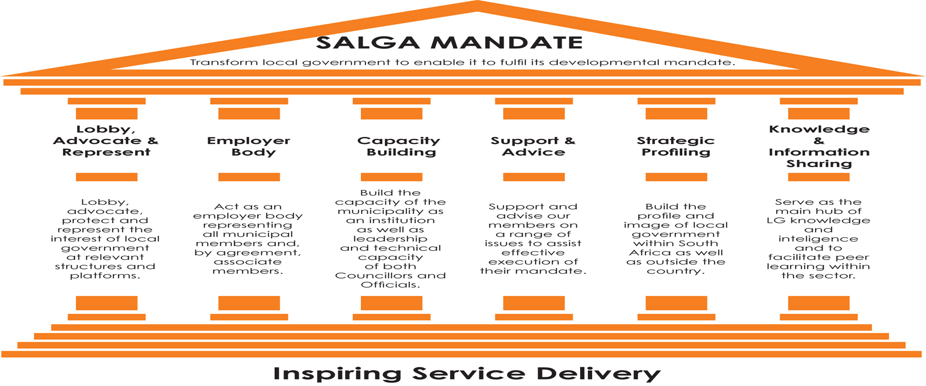
SALGA MANDATE

Slide 5
KEY INTERLINKING CHALLENGES
FACING THE SECTOR
Capabilities, Governance & Leadership
Fiscal Policy & Financial
Management
Weakening municipal governance and leadership characterised by poor oversight, limited consequence management, instability at senior management levels, and a lack of skills undermine service delivery and transformation at the local sphere
Increase of municipalities in financial distress due to many factors like: increase in the cost of services (tariffs), decrease in revenue collection, supply chain management inefficiencies, and irregular, fruitless and wasteful expenditure , low revenue bases, high levels of unemployment & poverty.
Spatial Transformation & Inclusion
Service Delivery & Infrastructure
Spatial transformation and inclusive communities undermined by depressed economic conditions, increasing impact of climate change, regressing social cohesion, poor coordination in planning, access to land, bulk services, limited decentralisation in housing delivery, transport challenges and safety and security
Increase in coverage of basic services but under pressure from widening funding gap for infrastructure, poor life cycle asset management, maintenance and effective project implementation, as well as lack of technical capabilities.
5

Slide 6
PURPOSE STATEMENT
Purpose
Strengthen Governance, Leadership and Institutional Capabilities for developmental local government through:-
Effective representation of the LG Sector as Employer Body
Mobilisation of sector intelligence through integrated Research, KM & Learning
Strengthening oversight and accountability for effective, accountable and transparent leadership of municipalities
Enabling sustainable use of ICT in municipalities
Building a competent, capable and professionalized sector
Strengthening municipal efficiencies with the introduction of ICT and other innovations
The centres of learning & excellence are anchored in the Municipal Capabilities & Governance cluster, whilst being treated with some independence. E.g. a separate budget, have the guidance of an external Advisory Board and may have unique branding under the SALGA Brand (i.e. SCLG).
The centres of excellence underpin the entire SALGA operation as an integrated platform for the creation, analysis, production, management and use of knowledge and intelligence and provides the platform for the custodianship of LG Intelligence & Innovation

Slide 7
INCLUSIVE GOVERNANCE
Inclusive Governance thematic thrust
7
Development of mechanisms to support trust and accountability in local government, increase public participation in governance and provide support, advice and build capacity for enhance governance.
Key outcomes:
To stabilize and capacitate the new administration and councils;
To maintain a robust financial management and governance culture;
Leading by example and ensure that consequence for accountability failures are affected;
Instill a culture of performance management, transparency, and integrity; and
Continuously to foster relations with key stakeholders such as community organisations to promote active citizenry.

Slide 8
CHALLENGES & OFFERINGS
Key Challenges
Ineffective political and administrative leadership
Unethical leadership
Weakened oversight due to political infighting at council level and interference in administration
Inadequate consequences for poor performance and transgression
Weakening municipal governance and leadership characterised by poor oversight, limited consequence management
SALGA Solutions
Strengthen inclusive governance mechanisms to increase accountability and trust in LG
Performance management solutions and consequence management frameworks
Facilitate support to review the UIF&W Reduction Strategy
Facilitate support on undertaking Consequence and Accountability Management
Clarify roles and responsibilities
Capacitating Oversight Structures
Ethics and integrity management
Anti-corruption awareness
Delivery of skills development products in leadership and governance
Coalition Governance
8

Slide 9
The current realities & problem statements
Most municipalities are not implementing Section 32 of the MFMA correctly or not at all.
MPACs’ reports are not tabled in council for conclusion and resolution, which resulted in the amounts attributed to UIF&W either static or increasing (inadequate investigations).
Most municipalities have not established Disciplinary Boards to deal with financial misconduct.
Municipalities internal processes, reporting and control measures do not seem to be effective to mitigate the risk of non-compliance in-year. How is the internal audit unit used to assist with mitigating non-compliance?
What actions have been taken to hold relevant officials that were responsible for the transgressions accountable for their actions?

Slide 10
POSSIBLE SOLUTIONS

Slide 11
SCLG PROGRAMME OFFERING
Core Programmes | Continuous Programmes | Products and Services
Integrated Councillor Induction Leadership in Municipal Governance Media and Stakeholder Engagement Women Leadership Development Leadership Impact and Innovation | Local Labour Forum Training for Employer Representatives Performance Management Training Job Task Evaluation Training Back to Basics Leadership Development Local Links (Seminar Styled) Conversations Senior Managers Development | Leadership Competency Model Online Assessment Tool Municipal Leadership Competency Assessment Centre Online Communities of Practice e-Learning Services –LinkedIn Learning Facilitator Accreditation
Annual Local Government Seminars
Annual Local Government Labour Law Annual Local Government Performance Management Annual Local Government Talent Management

Slide 12
KEY SUPPORT INTERVENTIONS
Consequence management, oversight and accountability support;
Good Governance Maturity Assessment Report;
Implementation of the Municipal Governance Training;
Support on the roles and responsibilities of (internal structurers and functionaries), ethics management and anti corruption practices;
Annual Local Government Governance and Performance Management Seminar

Slide 13
TOWARDS KEY INTERVENTIONS TOWARDS THE DESIRED FUTURE
Measuring the council in its collective form should entail assessing:
Oversight (effectiveness of the council and its structures in terms of oversight)
Operational efficacy of the council in terms of:
Constitutional and legislative mandate
Implementation of Audit Committee’s recommendations and Implementation of Auditor-General’s recommendations including investigating the Unauthorised, Irregular, Fruitless and Wasteful expenditure (Reduction strategy)
Public participation and petitions management
Political stability leads to good financial accountability
Integrity management system
Digital members’ interest disclosure system
Promotion of ethical conduct through implementation of a Municipal Integrity Management Framework and the Local Government Anti-corruption Strategy
Open procurement
transparent public procurement system to promote ethical and accountable business practices

Slide 14
RECCOMENDATIONS
Developmental local government calls for a political leadership which creates opportunities to account to communities;
Increased accountability ensures that the actions of the Council reflect the aspirations of the community, increases the legitimacy of the Council and deepens local democracy.
Municipalities ought to establish Disciplinary Boards that will investigate financial misconduct;
Synergize the relationship between the Internal Audit Unit, Audit Committee, Municipal Public Accounts Committee and the Disciplinary Board (accountability continuum)
Partnership with civil society to strengthen public oversight;
Improved records management an accountability tool;
Develop ethics management programmes and structures (Ethics Committee) for municipalities (ethics awareness);
Intensify the fight against fraud, corruption and maladministration (multi-stakeholder approach).
Professionalize local government and build the capacity of the sector.

Slide 16
Thank you!

