Slide 1
DEPARTMENT OF COOPORATIVE GOVERNANCE, URBAN PLANNING AND TRADITIONAL AFFAIRS
COGTA SUPPORT TO GAUTENG MUNICIPAL PUBLIC ACCOUNTS COMMITTEES
30th MAY 2023

Slide 2
TABLE OF CONTENTS
Support Plans and Programmes to MPACs on UIF&W
Support to MPACs on Clean Audits
Legislative Background and Role of the Municipal Public Accounts Committees (MPACs)
Challenges of MPACs
Recommendations
Overview of Functionality of MPACs
Support to MPACs on Anti-Corruption Measures
Implementation of the District Development Model

Slide 3


RSA Constitution (1996) & White Paper on Developmental Local Government (1998)
Constitution (1996)
(S152) The objects of local government are:
to provide democratic and accountable government for local communities;
to ensure the provision of services to communities in a sustainable manner;
to promote social and economic development;
to promote a safe and healthy environment; and
to encourage the involvement of communities and community organisations in the matters of local government.
Outcomes
Provision of household infrastructure & services
Creation of livable, integrated cities, towns and rural areas
LED
Empowered communities

Slide 4
DEPARTMENTAL MANDATE
The Department of CoGTA derives its mandate from the Constitution of the Republic of South Africa, 1996:
    Section 139: provides that the Provincial Executive may intervene if a municipality fails to fulfil an executive obligation.
    Section 152: provides for democratic and accountable government for local communities
    Section 154: provides for support and strengthening the capacity of municipalities to manage their own affairs, exercise their powers, and perform their functions.
    Chapter 12: provides for the recognition of the institution of traditional leadership.
    The Department’s mandate is further articulated in other pieces of secondary legislation and policy documents, which include the following:
White Paper on Local Government, 1998
Municipal Systems Act 32 of 2000
Local Government Structures Act 117 of 1998
Municipal Finance Management Act, 2003
Intergovernmental Relations Framework Act 13 of 2005
Traditional Leadership and Governance Framework Act No. 41 of 2003
Municipal Property Rates Act (No. 6 of 2004)
Disaster Management Act (No. 57 of 2002)
Municipal Demarcation Act (No. 27 of 1998)

Slide 5
COGTA VISION, MISSION AND OUTCOMES
VISION
MISSION
IMPACT
4 OUTCOMES
0
Sustainable, Smart, Inclusive Cities and Communities in the Gauteng City Region.
To drive an effective system of cooperative governance to build sustainable municipalities, inclusive communities and the institution of Traditional Leadership in the Gauteng City Region.
Resilient and Sustainable Communities Through Service Delivery
Improved municipal performance in line with B2B pillars
Safe, spatially integrated cities and communities with inclusive growth
Effective Systems of Cooperative Governance
Strengthened institution of Traditional Leadership

Slide 6
IMPLEMENTATION OF THE DISTRICT DEVELOPMENT MODEL

Slide 7
RDP & White Paper: LG provision of services as economic driver.
Constitution: LG center of governance & promotes Integrated Development Planning
Section
152
Provide democratic
& accountable government for local communities
Section
153
Developmental
duties of
municipalities
Section
154
The national government and provincial governments, by legislative and other measures, must support and strengthen the capacity of municipalities to manage their own affairs, to exercise their powers and to perform their functions.
“The 1st priority is meeting basic needs of people, jobs, land, housing, water, electricity, telecoms, transport, clean & healthy environment, nutrition, healthcare and social welfare”
RDP
Administer, budget & plan:
priority to basic needs
Promote social & economic development of community
Participate in national and provincial development programmes
Services provision
in sustainable manner
Promote social & economic development
Promote safe & healthy environment
Encourage involvement
of communities
7

Slide 8
WHAT PROBLEMS ARE DDM TRYING TO SOLVE?
Weak sector dept involvement in IDPs
No real long-term
approach
Need for shift
from alignment
Planning & budgeting
Poor integration
Lack of coherence
Poor inter-sphere
collaboration
Deficient strategic
focus of plans
IGR mechanisms
not optimally utilised
No real joint planning
Poor service delivery &
Development impact
Implementation across govt
GDS & SDF not having broad buy-in
Limited localisation
of NDP & MTSF
No coherent performance mgt
Fragmented plans across govt

Slide 9

OBJECTIVES OF THE DISTRICT DEVELOPMENT MODEL
A Solve horizontal & vertical Silos
Narrow distance between people and government
Deliver Integrated Services and M&E
Inclusive and gender responsive budgets and programmes based on people and community needs
Youth empowerment
Maximising impact
Facilitate for Local Economic Development
Sustainable development, accelerate initiates to promote poverty eradication, employment & equality
Inculcate Long Range Planning

Slide 10
CRITICAL FEATURES OF THE DISTRICT DEVELOPMENT MODEL

Slide 11
DISTRICT DEVELOPMENT MODEL AS A GAME CHANGER
  DISTRICT DEVELOPMENT MODEL
  Introduces new IGR planning, budgeting and implementation paradigm and discipline (spatial targeting and budgeting towards common long term outcomes)
District geographic spaces point of achieving country’s developmental outcomes and integration;
District state of development provides baseline and unit of analysis for informing all spheres of government plans and budgets;
Strategic response to socio-economic impact of Covid-19;
Stimulate new thinking, new socio-economic paradigms, new and bold solutions and alternative;
Fundamentally change conditions
  People
  Economy Poverty, unemployment and inequality
  Space
Develop resilience and prosperity of the Country.

Slide 12




TO ACHIEVE THESE NEEDS:
Good Governance
RDP
+
Transformative & Effective Service Delivery &
and Vibrant Communities
Resilient, Cohesive, Sustainable, Connected
Sound Financial Management
=
+
Ethical, Effective Leadership & Administration
7 months since the DDM launch. We intended to return earlier, but were interrupted by COVID-19.

Slide 13
FOCAL AREAS OF THE DDM ONE PLANS
People development:
Poverty levels, unemployment, child and women headed households, youth, culture, health
Economic positioning:
Economic performance, diversification, beneficiation, comparative advantages, green economy
Integrated service provisioning:
Integrated and sustainable service delivery, 4IR, innovation
Infrastructure engineering:
Integrated infrastructure delivery, human settlements, water, sanitation, electricity, waste management
Governance:
Accountability, audit performance, financial performance, vacancies, ward committees, stability of the administration
Spatial Restructuring and Environmental Sustainability:
Spatial integration, human settlements, climate change

Slide 14
The implications of the DDM on municipal financial management, governance, and accountability

Slide 15
KEY ACHIEVEMENTS ON FOCUS AREAS- S139(1)(b)
REPRIORITISATION: CORE TO EFFECTIVE DDM IMPLEMENTATION
Within the implementation process, the DDM is implemented through two interrelated processes to be followed by the whole of government. These processes entail spatialisation and reprioritisation:
  Spatialisation – the process of translating development priorities and objectives into spatial locations (district and metropolitan areas) and according to local spatial and place-making logic of these areas manifesting in physical and integrated impacts on people’s lives and the places they live in.
  Reprioritisation – the process of reviewing and changing existing plans and budgets and undertaking future planning and budgeting to realise the desired physical and integrated impacts over the long-term.
  The DDM implementation therefore refers to the spatial framing of development priorities and objectives and the review and reprioritisation of plans, budgets and programmes by each sphere, sector department and state entity that takes place within the prescripts of the Government Planning, Budgeting and reporting cycle.
  DPME and NT play a crucial role in terms of mandated functions to ensure coherent fit and configuration of the MTSF and Budget Guidelines to enable DDM implementation.
15

Slide 16
KEY ACHIEVEMENTS ON FOCUS AREAS- S139(1)(b)
IMPACT OF ECONOMIC RECOVERY PLANS AS PART OF DDM ONE Plans
Additionally, DCOG issued Circular No 1 of 2020 which directed districts and metropolitan municipalities to develop and implement Economic Recovery Plans as a programme of action to mitigate the effects of COVID-19 in the economy.
Subsequently, district and metropolitan municipalities were requested to ensure that the Economic Recovery Plans are incorporated into the DDM One Plans. Thus the development and incorporation of the Recovery Plans into the One Plans further shapes how financial management is to be undertaken by municipalities
To this effect, municipalities are expected to reprioritize and align their budgets as part of giving effect to Economic Recovery Plans
16

Slide 17
KEY ACHIEVEMENTS ON FOCUS AREAS- S139(1)(b)
IMPACT OF STRATEGIC LINKAGES TO ONE PLAN CONTENT AND IDPs
From a content perspective, Governance and Financial Management is one of the DDM One Plan Pillars. It requires that the process by which leadership and management is exercised, in particular, that planning, budgeting, procurement, delivery, financial and performance management takes place in an effective, efficient, accountable and transparent manner.
Joint planning and implementation as one of the key founding principles of the DDM – effective joint planning facilitates integrated budgeting across the three spheres of government in order to realise maximum impact within a specific metro or district space
The DDM One Plans, as long-term strategic plans, are given effect through IDPs which are medium term strategic plans developed by each municipality. To ensure the effective implementation of each of the 5 One Plans in Gauteng, each municipal IDP – along with accompanying budget, must therefore be aligned to the One Plan in its region/metro space. This is particularly key for DDM One Plan projects that are driven by municipalities – but also in enabling the efficient implementation of DDM projects being implemented by the other two spheres and state entities
17

Slide 18
KEY ACHIEVEMENTS ON FOCUS AREAS- S139(1)(b)
SUMMARY
Municipal financial management is impacted by DDM as it now has to be undertaken as part of the umbrella of joint planning and guided by key strategic projects and programmes included in the relevant DDM One Plan
Moreover, municipalities – as key partners in the DDM implementation process, ought to undergo a process of reprioritizing their budgets to align with the relevant DDM One Plans projects in their areas – in consultation with provincial treasuries and key stakeholders
Annual municipal budgets must give effect to the IDPs and projects and programmes driven by the respective municipality – as captured in the appropriate district/metro One Plan
Budgetary processes are to be undertaken in a consultative fashion guided by the DDM key principle of joint planning and integrated budgeting
18

Slide 19
OVERVIEW OF FUNCTIONALITY OF MPACS

Slide 20
BACKGROUND: LEGISLATIVE FRAMEWORK
According to the MFMA Section 32 (4) The accounting officer must promptly inform the mayor, the MEC for local government in the province and the Auditor-General, in writing, of—
(a) any unauthorised, irregular or fruitless and wasteful expenditure incurred by the municipality;
(b) whether any person is responsible or under investigation for such unauthorised, irregular or fruitless and wasteful expenditure; and
(c) the steps that have been taken—
(i) to recover or rectify such expenditure; and
(ii) to prevent a recurrence of such expenditure.

Slide 21
LEGISLATIVE BACKGROUND AND ROLE
The Municipal Public Accounts Committees (MPACs) are established in terms of section 79(A) of the Local Government: Municipal Structures Amendment Act, Act No. 3 of 2021 which states:
  (1) A municipal council must establish a committee called the municipal public accounts committee.
The MPAC serve as oversight committee over the executive obligation of the Municipal Council. Their main function is to assist the Municipal Council to hold the municipal executive and administration accountable for the implementation of laws, regulations, policies and the budget.
Section 129 of the MFMA requires a Municipal Council to consider the annual report of its municipality and municipal entities and adopt an oversight report containing the council’s comments on the annual report. MPACs are required each year to produce such an oversight report on the municipality’s annual report.
Furthermore, the committee is required to investigate and report to a Municipal Council on any other matter as mandated by a Municipal Council including investigations on unauthorised, irregular, fruitless or wasteful expenditure i.o.f Section 32 of the Municipal Finance Management Act (MFMA), Act No. 56 of 2003.

Slide 22
BACKGROUND: LEGISLATIVE FRAMEWORK
Section 131 of the MFMA states that:
“A municipality must address any issues raised by the Auditor-General in an audit report. The mayor of a municipality must ensure compliance by the municipality, with this subsection;
The MEC for local government in the province must-(a) assess all annual financial Statements of municipalities in the province and the audit reports on such statements and any responses of municipalities to such audit reports, and
Report to the provincial legislature any omission by a municipality to adequately address those issues within 60 days”.
Determine whether municipalities have adequately addressed any issues raised by the Auditor-General in audit reports; and

Slide 23
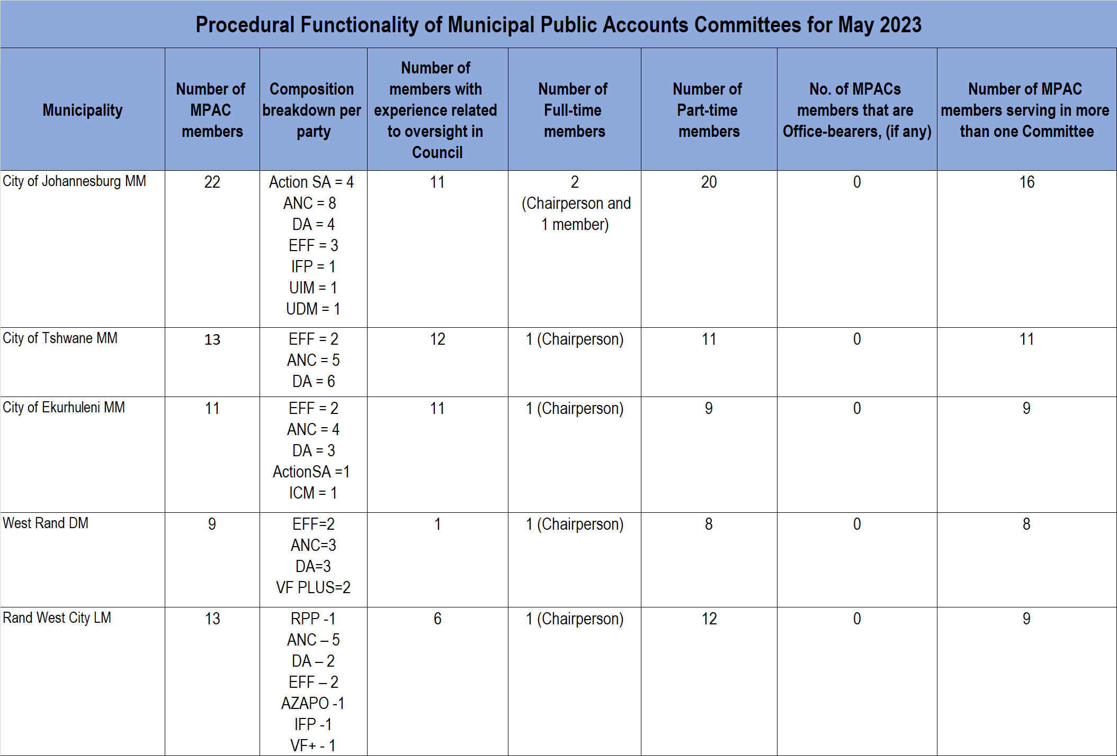
OVERVIEW ON THE ESTABLISHMENT OF MPACS

Slide 24
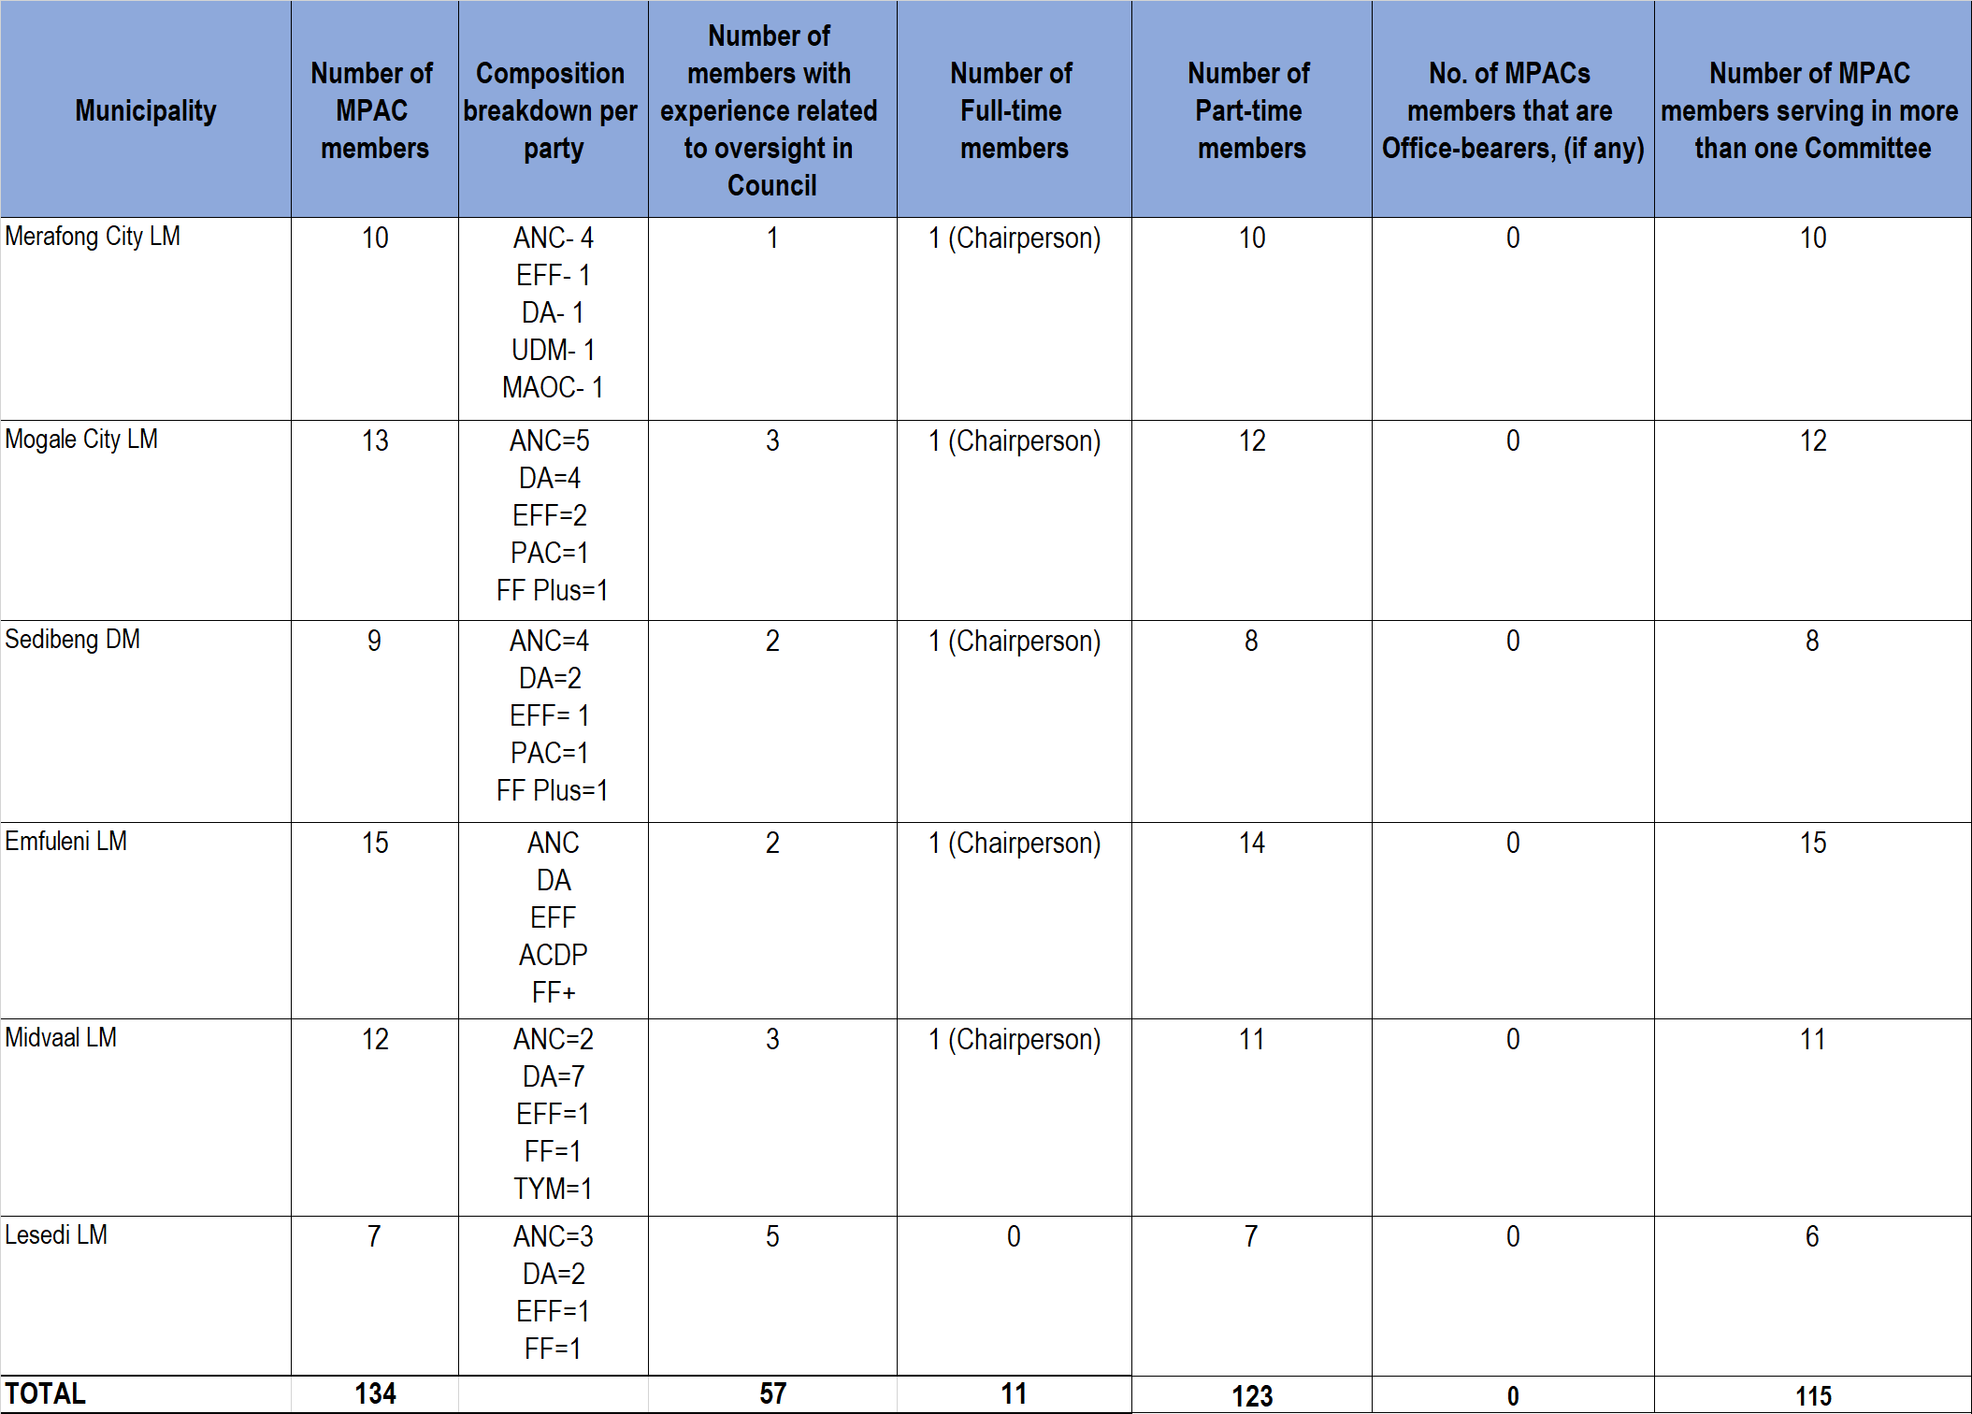
OVERVIEW ON THE ESTABLISHMENT OF MPACS

Slide 25
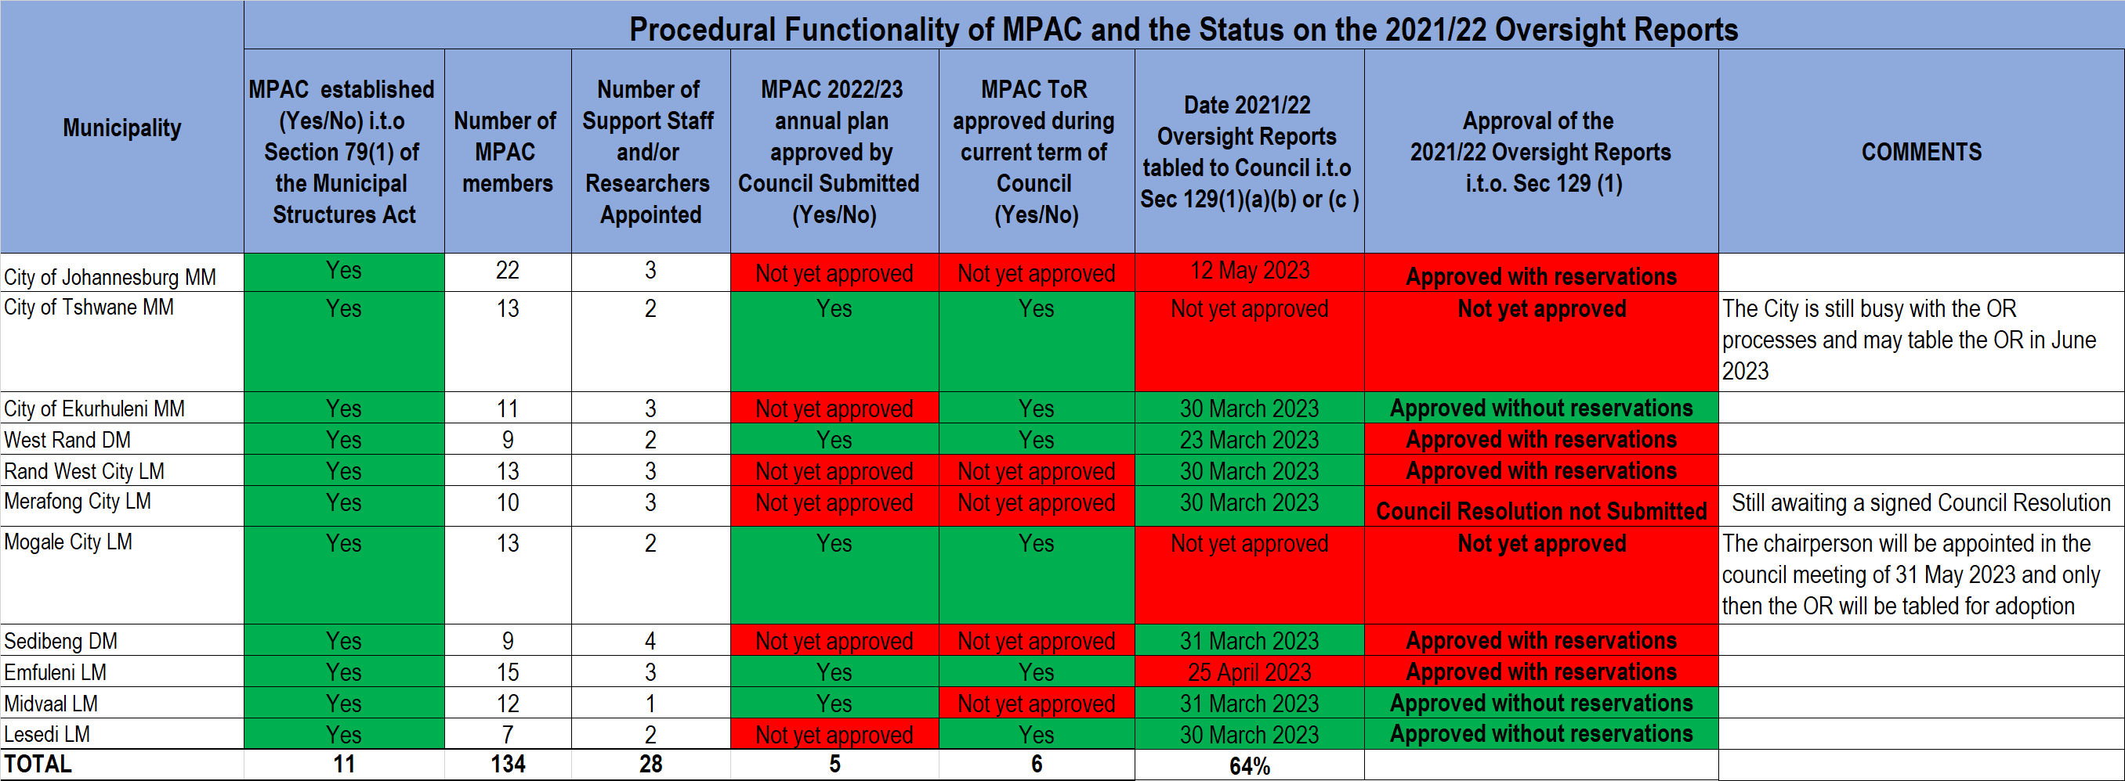
MPAC PROCEDURAL FUNCTIONALITY & 2021/22 OVERSIGHT REPORTS
Rand West City LM and Merafong City LM’s Annual Reports have not been approved as the MPAC Committees have not been established.
Sedibeng DM, Emfuleni LM and CoT are still busy with the OR hearings.

Slide 26
SUPPORT TO PREVENT THE GROWTH OF UIF&W EXPENDITURES

Slide 27
UIF&W EXPENDITURE SUPPORT
The project is designed to assist municipalities to put controls in place for the identification, prevention and reporting of unauthorised, irregular, fruitless and wasteful expenditure. The initiative entails assessing the state of controls in the municipal finance environment and developing plans to address the gaps identified in the assessment report. Areas addressed are:
Processes in place to identify, prevent, reduce and report on unauthorised, irregular, fruitless and wasteful expenditure. These include policies, Standard Operating Procedures, UIF&W registers and reports (to ensure completeness, accuracy and fair presentation) and any innovative tools that will assist in strengthening the control environment.
Development of the UIF&W Expenditure Reduction Strategy in compliance with the National Treasury circular 68.
Municipal financial management processes and procedures.
Municipal Audit Outcomes in order to address material findings in the area of unauthorised, irregular, fruitless and wasteful expenditure in order to improve the areas of qualification raised by the Auditor General.
Support and strengthen the municipal capability to implement consequence management and recoveries through supporting Municipal Public Accounts Committees.
Provide on-the-job training and workshops to identified municipal officials as well as MPAC (Municipal Public Accounts Committee) Members.

Slide 28
Progress on the provision of Professional Services to Randwest and Tshwane to prevent Unauthorised, Irregular, Fruitless and Wasteful (UI&W) Expenditure is as follows:
Completed the status quo assessment of the UIF&W control environment and developed a detailed implementation plan to address the gaps identified in the assessment with activities and clear timelines developed in both municipalities.
Developed the UIF&W reduction strategies for submission to National Treasury.
Developed and completed templates for UIF&W Expenditure registers that are compliant with MFMA circular 68.
Policies and Standard Operating Procedures developed in line with relevant legislation.
Compliance checklist – Updated the compliance checklist for tenders and quotations in line with applicable legislation.
Investigations case registers were assessed as part of the reduction strategies in order to identify cases that could possibly be referred for forensic investigation. Cases have been clarified and categorised per level of importance and recommendations made on steps to taken forward to address the issues.
Developed Contract registers completed in the two municipalities.
Trained MPACs and MPAC support staff on the controls developed and their role in preventing the growth of UIF&W.

Slide 29
SUPPORT TO MUNICIPAL PUBLIC ACCOUNTS COMMITTEES
SUPPORT PROVIDED TO STRENGTHEN THE MPAC TO EXECUTE THEIR OVERSIGHT FUNCTION EFFECTIVELY AND EFFICIENTLY ENTAILS:
Training to strengthen the capacity and capability of MPAC members and their support staff.
Differentiating UIF&W Expenditure cases between those cases that need to be forensically investigated and those that can be investigated internally by the municipality. This when adequately implemented will reduce the UIF&W values.
Where investigations are concluded, MPAC must make recommendations such as consequence management to be implemented to deter wrongful or negligent behaviour without fear or favour.
Co-operation between management, MPAC and council to ensure reduction of UIF&W Expenditure.
ROLES AND RESPONSIBILITIES IN RESPECT OF UNAUTHORISED, IRREGULAR, FRUITLESS AND WASTEFUL EXPENDITURE
The Council committee / municipal public accounts committee (MPAC) role and responsibility is to:
Investigate UIF&W Expenditure in an objective and diligent manner;
After completed investigations provide recommendations on the expenditure; and
Assist municipal councils to hold administration accountable for the implementation of the UIF&W Expenditure Reduction Strategy.

Slide 30
SUPPORT TO MUNICIPAL PUBLIC ACCOUNTS COMMITTEES
MPAC’S ROLE AND RESPONSIBILITY TO SUCCESSFULLY DELIVER ON THE REDUCTION STRATEGY:
Address conditions that result in slow investigation of UIF&W expenditure
Be effective and instil order, institute investigations to determine if anyone is liable for UIF&W expenditure incurred and take the necessary corrective actions.
Encourage all political and municipal leaders to support each other and play their roles in creating an environment that is conducive to good governance, accountability, and oversight.
Enforce Municipal Regulations on Financial Misconduct Procedures and Criminal Proceedings, including the establishment of the disciplinary boards.
Not write off UIF&W expenditure without ensuring that losses had not been suffered or that any such losses cannot be recovered, and that goods and services have been delivered.
MPACs to investigate UIF&W expenditure in an objective and diligent manner.
Assisting municipal councils to hold administration accountable for the implementation of the UIF&W Expenditure Reduction Strategy.

Slide 31
OPERATION CLEAN AUDIT SUPPORT

Slide 32
OPERATION CLEAN AUDIT SUPPORT
The Department supports municipalities to address issues raised by the AGSA through the OPCA Provincial Coordinating Committee which assists municipalities with advisory support with regards to the implementation of the Audit Action Plan. The committee is a monitoring and supporting structure consisting of Gauteng CoGTA, Gauteng Treasury, National Department of Cooperative Governance and Traditional Affairs, National Treasury, Office of the Premier, SALGA, Office of the Auditor General (AG), Chartered Institute of Government Finance, Audit and Risk Officers (CIGFARO) and other stakeholders. All the stakeholders play a key role in assisting municipalities with the development, implementation and monitoring of Municipal of audit action plans. The Committee is responsible for the following:
Assessing the soundness of the audit response plans to ensure municipalities develop credible audit response plans
Monitoring progress made in implementing the approved audit response plans as well as progress made towards achieving clean audits;
Streamlining and aligning support to Municipalities from various Stakeholders;
Facilitating peer learning and sharing of good practice between the municipalities; and
Reporting to the Provincial leadership and National CoGTA as and when required.

Slide 33
OPERATION CLEAN AUDIT SUPPORT
The Department supports municipalities to address issues raised by the AGSA through the OPCA Provincial Coordinating Committee which assists municipalities with advisory support with regards to the implementation of the Audit Action Plan. The committee is a monitoring and supporting structure consisting of Gauteng CoGTA, Gauteng Treasury, National Department of Cooperative Governance and Traditional Affairs, National Treasury, Office of the Premier, SALGA, Office of the Auditor General (AG), Chartered Institute of Government Finance, Audit and Risk Officers (CIGFARO) and other stakeholders. All the stakeholders play a key role in assisting municipalities with the development, implementation and monitoring of Municipal of audit action plans.
The Municipal OPCA Steering Committees are support and monitoring structures established which ensure that:
Municipalities develop comprehensive plans (Audit Report and Management letter action plan) on addressing AG issues and achieving clean audits;
Progress reports on the implementation of these plans are monitored regularly in the bi-weekly OPCA meetings and that Internal Audit verifies the progress achieved as reported by management;
Municipal Managers and CFO’s play an important role in the OPCA committee to ensure that progress is made, and management is accountable for implementing corrective measures.
The committee reports the progress of the implementation of the action plan and key controls dashboard to the political leadership e.g. Mayor and MMC Finance.

Slide 34
OPERATION CLEAN AUDIT SUPPORT
Monitoring Year-end preparations through the OPCA PCC.
Review of accounting policies in targeted municipalities.
High level and in-depth technical reviews of the AFS and asset registers before submission to the AG in targeted municipalities.
Provision of additional capacity to develop sound Audit Response Plans to address Auditor General issues.
Support to ensure complete and accurate service delivery reporting as it relates to Audit of Pre-Determined Objectives.

Slide 35
THE AREAS OF COOPERATION WITH THE GAUTENG PROVINCIAL TREASURY
The Department cooperates with Gauteng Provincial Government on all monitoring and support initiatives. For example:
Revenue support: key focus on the implementation of the Government Debt strategy.
Municipal Audit support.
CAPEX war room.
CFO forum.

Slide 36
PLANNED SUPPORT TO MPACS

Slide 37
SUPPORT PROVIDED TO MPACS
Support is provided to municipalities in terms of Schedule 1 of the Municipal Systems Act, 32 of 2000 as amended (MSA).
In previous financial years 2021/2022 and 2022/23 respectively 233 Councilors and Officials were trained on a skills programme: Accountability and Ethical Conduct (NQFL5).
To date 193 Councillors and Officials have been trained on the developed learning programs, NQF L 3, NQF L4 and NQF 5.
Rational of the training- National Council of Provinces (NCOP) and Auditor General highlighted that a critical challenge facing local government is the lack of accountability and good governance. This was evident in the regress of audit outcomes, irregular expenditure, lack of accountability and lack of consequence management. Furthermore, the Auditor General maintained that this is due to the failure of both Leadership and Management to fulfil their oversight function. The only viable solution according to the Auditor General to improve the performance on the local government, is for Leadership and Management to set the tone by being more accountable and adhering to laws that govern the municipality.

Slide 38
SUPPORT PROVIDED TO MPACS
At the end of the training on accountability and ethical Conduct councilors and officials can demonstrate competencies in:
Accountability and Ethical Conduct.
Promotion of ethical behavior.
Understanding the principles of ethics in the municipal environment.
Understanding ethical principles, standards and professional
conduct and how to apply this knowledge in real life.

Slide 39
CURRENT SUPPORT FOR MPACS (2023/24)
  Three Certificate programmes aligned to
  SAQA 58578: NQF 3
  SAQA 50081: NQF 4
  SAQA 67467: NQF 5
      Interactive
      Modular i.e. each module addresses a unit standard(s) outcome
      Relevant case studies, practical group exercises, practical individual exercises for portfolio compilation, self-assessment exercises
Qualification
Learning Programme
Ad
her
Adhere to adult learning principles
More audio-visual aids
Involving experts
Partners: LGSETA, AG, Provincial Treasury, DCoG, SALGA

Slide 40
CURRENT SUPPORT TO MPACS (2023/24)
SKILLS PROGRAM DEVELOPED (NQF L3, L4, AND L5)
Rational: In order for MPACs and other Section 79 Committees to deliver on their mandate of promoting effective governance within municipalities it is vital that MPAC members and other S79 committee members are skilled. As such a learning program was Developed, Designed, and accredited for Councillors with oversight functions including (s79, including MPAC’s) :
National Certificate: Local Government Councillor Practices (NQF Level 3) 56 Credits
Further Education and Training Certificate: Leadership and Development (NQF Level 4) 68 Credits
National Certificate: Public Finance Management and Administration, (NQF Level 5) 107 Credits

Slide 41
CURRENT SUPPORT FOR MPACS (2023/24)
SKILLS PROGRAM DEVELOPED (NQF L3, L4, AND L5)
The skills programs includes the following key competencies:
Financial Management
IDP Processes
Good Governance
Accountability and Ethical Conduct
Leadership
Monitoring and Evaluation
Problem Solving and Analysis
Judgement/Decision Making
Communication
Collaboration in Local Government Environment
Results and Quality Focus

Slide 42
CURRENT SUPPORT FOR MPACS (2023/24)
The Department has successfully appointed a panel of service providers that will facilitate the MPAC skills programs over the next three years 2022-2025.
Enrollment of Councillors and Officials is as follows:
  50 Councillors and Officials for NQF L3
  50Councillors and Officials for NQF L4
  50 Councillors and Officials for NQF L5
  82 Councillors and Officials for Accountability and Ethical Conduct (NQFL5).
The Department approached SAICA, through strategic partnerships to explore areas of collaboration. SAICA will develop a business case on amongst others, UIFW to be used as a practical example during the MPAC training.

Slide 43
SUPPORT TO MPACS ON ANTI-CORRUPTION MEASURES

Slide 44
PLANED SUPPORT IN COLLABORATION WITH SALGA
CoGTA in collaboration with SALGA and IEC, municipalities are supported to establish and induct the Ward Committees. Out of 529 Wards , 421 Ward Committees are established, and 405 Ward Committees are inducted as at end of April 2023.
The Joint Management Committee meetings of CoGTA and SALGA are convened regularly to deliberate on measure that require collaboration to address challenges in local government.

Slide 45
PLANNED SUPPORT FOR MPACS
Implementation of the Local Government Ant-Corruption Strategy (LGACS) per the Municipal Integrity Management Framework (MIMF) contained within the strategy.
Support to municipalities is done through the Gauteng Municipal Integrity Project (GMIP), a partnership between CoGTA, the office of the Premier and The Ethics Institute, who secured funding through the SIEMENS Integrity Initiative.
The MIMF expresses the need for leadership commitment at both executive and management levels, including community ownership by ensuring transparent and accountable governance and community oversight.
Appropriate governance structures must be in place to implement effective governance, oversight and implementation of the MIMF by ensuring appropriate capacity.

Slide 46
PLANNED SUPPORT FOR MPACS
Municipalities must institutionalise integrity management initiatives based on the four pillars of:
  Prevention
  Detection
  Investigation; and
  Resolution
Municipalities are supported and continue to be supported focusing on the four pillars by their respective ethics strategies and supporting policies such as fraud prevention plans/policies, gifts registers and financial declarations to name a few, as well as review of said policies on a regular basis.
Consequence management is a critical aspect of the integrity management pillars which by monitoring investigation report findings from internal as well as law enforcement agencies.

Slide 47
PLANNED SUPPORT FOR MPACS
Municipalities are required to submit their quarterly case management reports to CoGTA which is consolidated into a reporting template to the oversight structure as per the LGACS established as the Local Government Anti-Corruption Forum (LGACF).
The LGACF is chaired by the SIU supported by Department of Cooperative Government (DCoG), with representation from all provincial CoGTAs, Office of the Premier, SALGA, NPA, HAWKS, civil society and labour. This serves as a platform where complicated investigations at municipal level may be escalated for consideration and referral to the appropriate authority for further investigation.

Slide 48
CHALLENGES OF MPACS

Slide 49
CHALLENGES OF GAUTENG MPACS
Frequent changes to committees hamper the implementation of MPAC deliverables
Instability in Councils and Committees
Inadequate human and financial resources which affect the effectiveness of MPACs.
Slow investigations on unauthorized, irregular, fruitless and wasteful expenditures.
Non-implementation of MPAC recommendations by municipalities especially where there are council resolutions
COVID 19 hampered the oversight role of MPACs including submission of the oversight reports.
Non/lack of reporting on the MPAC work to the province for monitoring and provision of the targeted support.
Due to limited to no capacity and resources, municipalities find themselves at different stages of implementing and institutionalizing ethics in their organisations. With the vacancy rate of S56/57 management levels, municipalities are also requiring renewed buy-in and commitment into the ethics programme from leadership and management.

Slide 50
RECOMMENDATIONS

Slide 51
RECOMMENDATIONS
It is recommended that SCOPA take note of the presentation.

Slide 52

THE END

