Slide 1

Office Of The Premier
Presentation to OCPOL
Youth unemployment in Gauteng – OOP approach
19 January 2023
1

Slide 2
PRESENTATION OUTLINE
Contents | Purpose Key developments since the previous OCPOL Workshop Overview of GIYDS Role of Gauteng Youth Advisory Panel’s in advancing youth development Progress to date: Youth employment and entrepreneurship Elevated GGT priorities and delivery structure Youth employment-related elevated GGT priorities and targets in delivery Agreements between premier & MECs Youth War Room / Youth Workstream Conclusion
2

Slide 3
PURPOSE
The purpose of this presentation is to respond to the OCPOL workshop outcomes on youth unemployment interventions by the Gauteng Provincial Government
Please note the requested information
3

Slide 4
KEY DEVELOPMENTS SINCE THE LAST OCPOL WORKSHOP
Event | Date
First Draft Gauteng Integrated Youth Development (GYIDS) circulated to stakeholders for input | March 2022 to June 2022
Gauteng Youth Advisory Panel (GYAP) appointed by former Premier David Makhura | 16 June 2022
GYAP contributes to finalisation of strategy and consultations with youth formations | July to November 2022
Communication team conducts survey for rebranding Tshepo Programme and develops a communication plan for the GYIDS | March 2022 to November 2022
New Premier Lesufi consults with departments on elevated GGT priorities and additional commitments for implementation over 100-day, 6 months, 12 months and end of term periods to be included in Delivery Agreements with MECs | October to December 2022
EXCO Lekgotla resolves that a Project Management Office should be set up in the OoP to monitor implementation of delivery agreements War Rooms are replaced with workstreams and Youth War room is annexed within the economic recovery workstream | 31 October 2022
EXCO Lekgotla adopts the final GYIDS and communication strategy and recommends deployment of GYAP members to individual departments | 7 December 2022
Premier signs delivery agreements with MECs incorporating legislated transversal youth targets and specific youth development interventions by each department | 12 December 2022
4

Slide 5
OVERVIEW OF THE GAUTENG INTERGRATED YOUTH DEVELOPMENT STRATEGY

Slide 6
OCPOL WORKSHOP ON YOUTH UNEMPLOYMENT
SITUATIONAL ANALYSIS
6

Slide 7
GAUTENG YOUTH DEMOGRAPHICS
Age category | Males | Females | TOTAL
15-19 | 534 347 | 542 072 | 1 076 419
20-24 | 677 086 | 672 225 | 1 349 311
25-29 | 827 240 | 841 564 | 1 668 804
30-34 | 874 911 | 854 935 | 1 729 846
 | 2 913 584 | 2 910 796 | 5 824 380
32 613 LSEN Schools
GDE, 2022
709 437 are in Public and Independent Schools
GDE, 2022

Slide 8
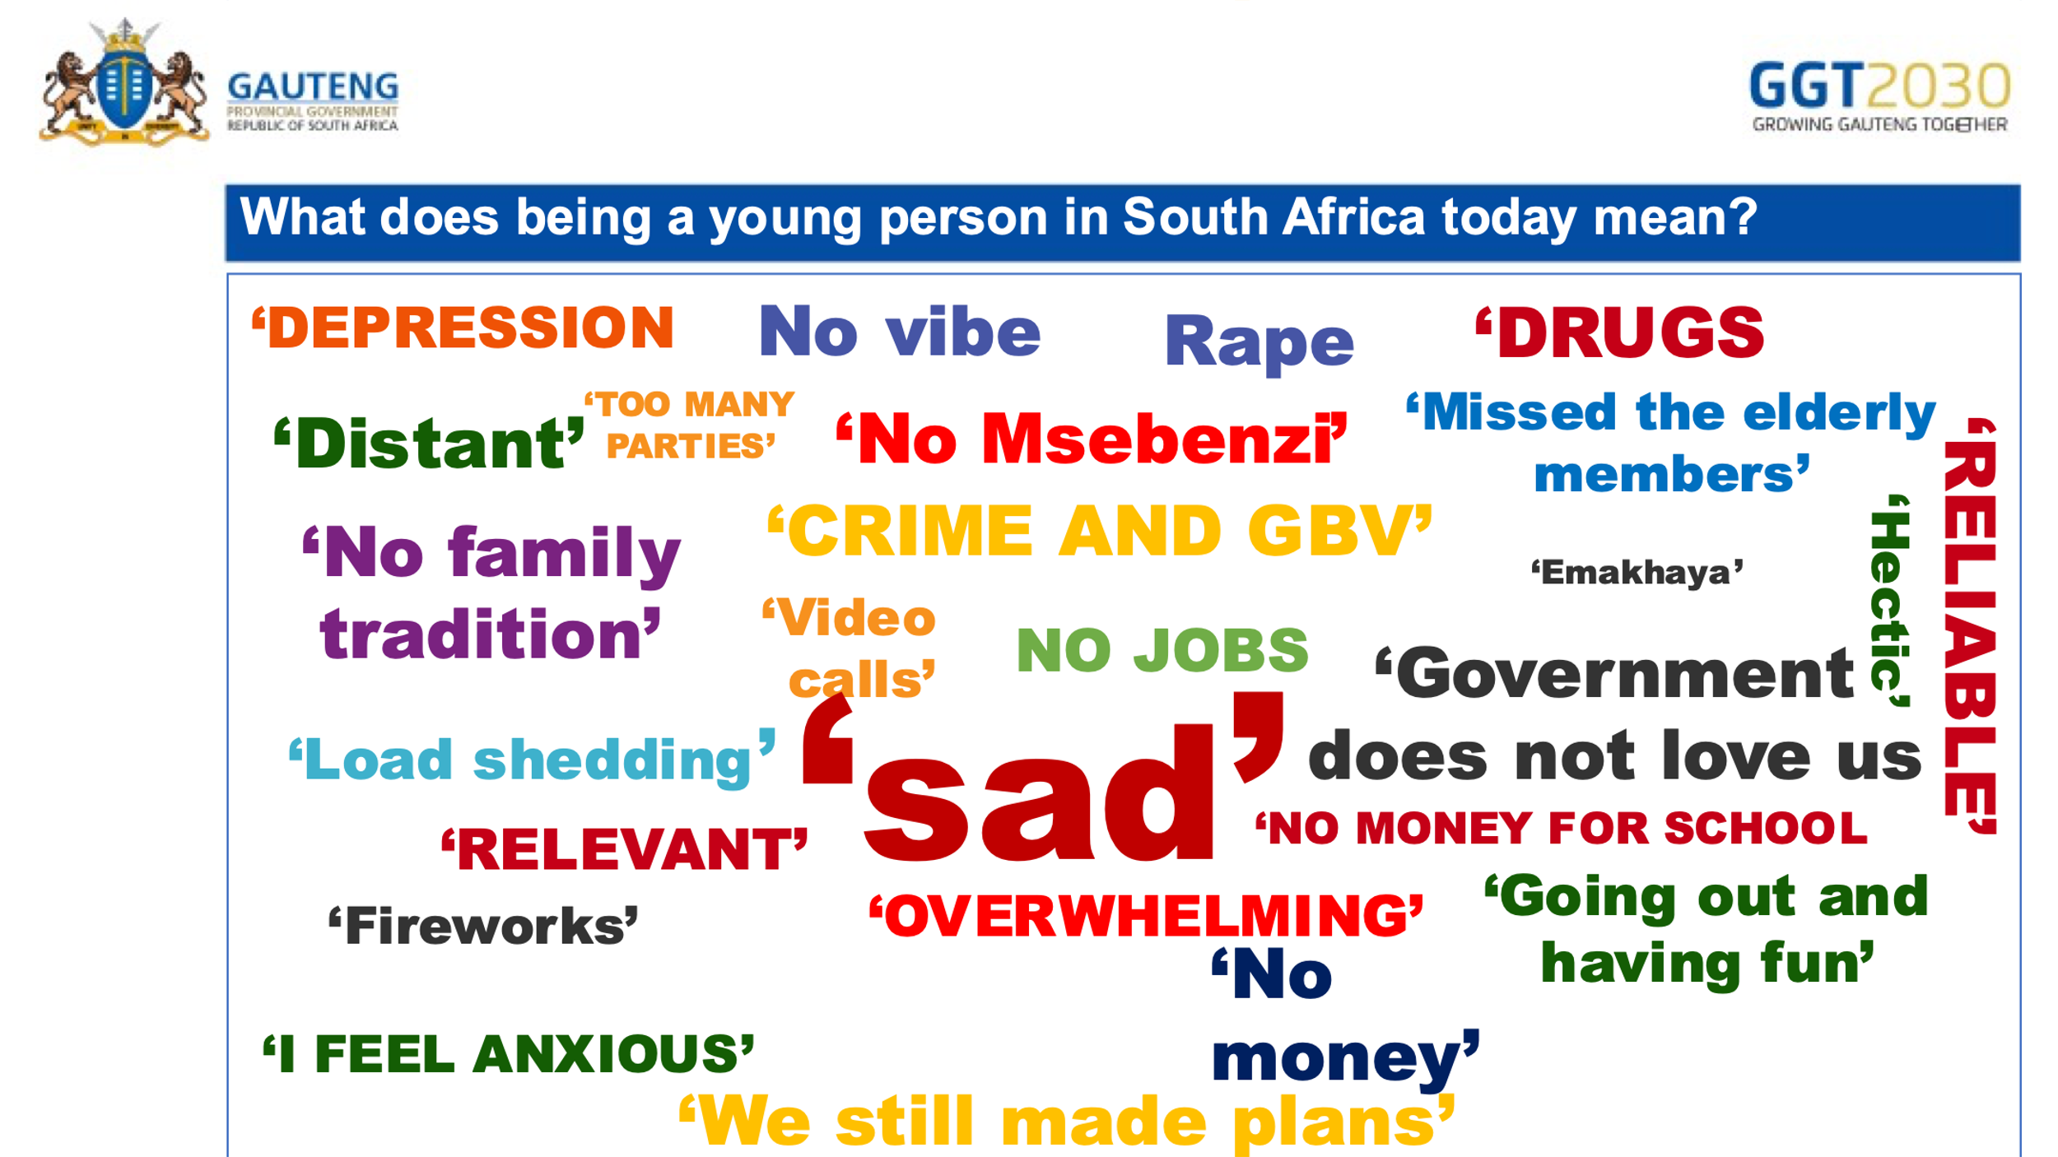
HOW DO GAUTENG YOUTH FEEL ABOUT THEMSELVES?
9.1 Status of Youth Report 2018
Words youth associated with being a young person in Gauteng were largely negative and pessimistic: i.e Drugs, Hopeless, Misguided generation, Disrespectful, Entitled, Corruption, Bad Role Models, Ill-informed, Unfocussed, Lazy, Crime, Escape reality and Talented
Same sentiments expressed by Gauteng youth participants during focus group discussions conducted for the purposes of rebranding Tshepo 1 million (see right diagram)
What does being a young person in South Africa today mean?
.
Source: Gauteng Office of the Premier, 2022
8

Slide 9
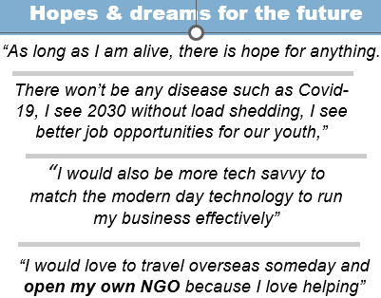
BUT THERE IS HOPE:
Source: Communication Unit, Gauteng OoP, 2022
9

Slide 10
SITUATIONAL ANALYSIS
9.2. Status of youth is desperate, but we have done well in terms of:
  Reducing poverty & inequality (until Covid-19 struck)
  Universal access to basic education
  Supporting in-school youth
  Creating youth development policies, programmes & institutions
  Funding youth development programmes to address situation of youth Not in Education, Employment, or Training (NEET)
  Reducing HIV/AIDS-related mortality rates and increasing access to treatment

Slide 11
SITUATIONAL ANALYSIS Cont.
9.3. Status of youth is desperate. We have to do better i.r.t.:
  Quality of basic education and outcomes
  Wider Access to quality Post School Education and Training (PSET)
  High learner drop-out/failure/repetition rates throughout our education system
  Unconducive learning environment in-and out of learning institutions
  Creating employment and jobs for youth
  Supporting young entrepreneurs and the self-employed
  Promoting mental health and well-being –
    Depression among the youth is sky-high and it triggers suicide, substance abuse and criminal behaviour

Slide 12
SITUATIONAL ANALYSIS Cont.
9.4. Status of youth is desperate. We have to do better i.r.t.:
  Teenage pregnancies
  GBVF, crime, violence corruption, apathy, social and moral fibre decline, declining civic
  Youth in conflict with the law – insufficient data on the scale of the problem
  Youth HIV ignorance/denialism (i.t.o. contracting the disease)
  Social cohesion, nation-building
  Coordinating efforts across government and with private sector
  Monitoring & evaluation of impact and collection of Baseline data & Knowledge management
  Communication – raising awareness on available programmes

Slide 13
GIYDS OBJECTIVES
Integrate youth development into the mainstream of policies, programmes, strategies and the provincial budget
Deliver positive youth development outcomes in addressing the needs of young people and building their assets
Support young people, particularly those outside the social, political and economic mainstream
Ensure responsiveness by linking young people with relevant service providers
Promote and advocate for young people’s access to quality services as a means to facilitate their smooth transition into independence
Support a culture of patriotic citizenship among young people to help them become responsible adults who care for their families and communities
Strengthen the capacity of key youth development institutions in delivery of coordinated package of services for the youth; and
Facilitate young people’s engagement in building a better Gauteng City Region, South Africa, Africa, and a better world
lease note the requested information form OCPOL
13

Slide 14
GAUTENG INTERGRATED YOUTH STRATEGY
FIVE STRATEGIC PILLARS
&
PROPOSED INTERVENTIONS
14

Slide 15
Strategic Pillars of the Approved GIYDS
Strategic pillar: One:
Quality education, skills and second chances
Strategic pillar Two:
Economic transformation, entrepreneurship, and job creation
Strategic Pillar Three:
Physical and mental health promotion including covid-19
Strategic Pillar Four:
Social cohesion and nation-building
Strategic Pillar Five:
Effective and responsive youth development machinery
15

Slide 16
PILLAR 1: QUALITY EDUCATION, SKILLS TRAINING & SECOND CHANCES
16

Slide 17
PILLAR 2 ECONOMIC TRANSFORMATION, ENTREPRENURSHIP & JOB CREATION
17

Slide 18
PILLAR 3: PHYSICAL AND MENTAL HEALTH & WELL BEING PROMOTION
18

Slide 19
PILLAR 3: PHYSICAL AND MENTAL HEALTH & WELL BEING PROMOTION CONT…
19

Slide 20
PILLAR 4: SOCIAL COHESION AND NATION BUILDING
20

Slide 21
PILLAR 4: SOCIAL COHESION AND NATION BUILDING CONT…
Strategic Goal: Youth are meaningfully included in the affairs of the province and efforts to create more cohesive communities
INTERVENTIONS CONT…
Enlist more youth in the National Youth Service and other government programmes
Promote and enable social entrepreneurship and economic opportunities in the creative and social sectors
Develop cadres of youth to serve in the security cluster (e.g., Community patrollers, youth brigades, scholar patrollers)
Implement adopt a cop in all public schools
Implement partnership safety programmes within institutions of learning
Implement diversion programmes for youth in conflict with the law in partnership with other stakeholders
21

Slide 22
PILLAR 5: EFFECTIVE & RESPONSIVE YOUTH MACHINERY
22

Slide 23
INSTITUTIONAL ARRANGEMENTS & RESOURCING
Institutional arrangements
The Youth Directorate in the OOP is the custodian of the GIYDS
It will work closely with the MEC responsible for Youth Development to coordinate the implementation of the GIYDS 2030 with the support of the Gauteng Youth Advisory Panel
  Resources for youth development (Gauteng budget speech 2022 highlights)
  GPG allocated R2,4 billion for youth development - R376 million to be spent on the Youth Brigade over the 2022 MTEF period
  R13.1 million allocated for Department of Community Safety to hire more patrollers to fight crime in the province
  R2 billion allocated by National Treasury for the Presidential Youth Employment Initiative
23

Slide 24
INSTITUTIONAL ARRANGEMENTS & RESOURCING Cont.
The fight towards eradicating high levels of youth unemployment/ economic inactivity has been prioritised by all 13 Departments within the Province
Collectively, all GPG departments have prioritised over R3.233 billion in the current financial year, expecting to create approximately 1.032 million wide-ranging opportunities towards the youth in Gauteng
24

Slide 25
GAUTENG INTERGRATED YOUTH STRATEGY
COMMUNICATIONS

Slide 26

GIYDS COMMUNICATION
  It is proposed that all departments communicate both the social and economic value of engagements and achievements on youth development in line with the Gauteng Youth 2030 Communication Strategy which is envisaged to augment the current communications plan
26

Slide 27
COMMUNICATIONS OBJECTIVES
To drive meaningfully engagement with young people and stakeholders
To inform young people of opportunities to improve their lives
To promote health services to young people with emphasis on mental health
Create awareness, advocacy and educate the youth about interventions, programmes and policies aimed at achieving an inclusive society
To celebrate young achievers in Gauteng to motivate and inspire others
To communicate the milestones and achievements of government, its stakeholders and partners
27

Slide 28
MONITORING & EVALUATION
The absence of Monitoring and Evaluation (M&E) plans has been identified as one of the biggest weaknesses of the previous Gauteng youth development strategies
An M&E plan is important for gauging the effectiveness of youth development programmes and improving on coordination, avoiding duplication and massifying interventions for sustainable impact
Without a credible M&E plan there is no assurance that verifiable performance data is collected on the achievement of targets in line with the programme’s objectives
To close this gap, this part of the strategy clarifies indicator targets per strategic pillar, key interventions, timeframes, and responsible entities. Time frame can either categorised as short term (1-3 years), medium term-4-8 years, or long term (8 years or more).
28

Slide 29
ROLE OF THE GAUTENG YOUTH ADVISORY PANEL IN ADVANCING YOUTH DEVELOPMENT

Slide 30
ABOUT THE GAUTENG YOUTH ADVISORY PANEL (GYAP)
    The Gauteng Youth Advisory Panel (“GYAP”) appointed by former Premier David Makhura on 16 June 2022
    Its current term is from June 2022 to March 2024
    GYAP comprises 14 youth representing a wide range of youth formations from across the GCR (15TH member to be appointed in new financial year)
    The primary role of the GYAP is to advice the Premier & EXCO provide oversight and advocacy on youth development and make recommendations on relevant youth matters, mainstreaming of youth development & delivery of services by GPG to young people
    Other key GYAP activities are:
      Finalising the GIYDS 2030 in consultation with the youth sector
      Monitoring the effectiveness of delivery structures tackling youth issues
      Liaising with stakeholders across all sectors of society
      Conducting relevant research on youth topics
30

Slide 31
GAUTENG YOUTH ADVISORY PANEL MEMBER DEPLOYMENT
NAME | DEPARTMENT
Oagile Louw | Office of the Premier and AIDS Council
Zulaikha Patel | Community Safety and Security
Vuyolethu Sibiya | Transport and Logistics
Irfaan Mangera | Education
Dimpho Lekgeu | Infrastructure Development
José Andre | Finance
Paballo Ponoane | Health and Wellness
Lorraine Dimakatso Mahlosane | Human Settlements
Vuyiswa Jentile | Traditional Affairs
Ndumiso Hadebe | Economic Development
Emma Lavinia George | Cooperative Governance
Duduzile Nyumbeka | eGovernance and Research
Luthando Mafunda | Social Development
Onkgopotse Peete | Sport, Arts, Culture and Recreation
31

Slide 32
PROGRESS TO DATE: YOUTH EMPLOYMENT AND ENTREPRENURSHIP PROGRAMMES AND OUTCOMES

Slide 33
PROGRESS ON YOUTH EMPLOYMENT AS AT THE END OF Q2-2022/23
Skills Development Progress
Youth Employment Progress
310 unemployed youths trained in the automotive skills in collaboration with Tshepo one million (GGDA)
98 youth trained in ICT skills (GGDA)
38 606 youth are participating in skills development programmes (DSD)
38 561 youth accessing economic opportunities/ Income generating programmes (DSD)
10 226 beneficiaries participated in the Welfare to work Programme.
573 work opportunities created through Tshepo 1 million
Planned Performance for 2022/23
1000 of bursary allocations to youth (GDE).
40 000 of youth benefiting from workplace experience programmes (including PYEI). (GDE)
3000 of youth in structured skills development programme (apprenticeship/learnership/skills programmes/work integrated learning)

Slide 34
GAUTENG YOUTH (15-34YRS) LABOUR MARKET NUGGETS
Gauteng | Q1:2022 | Q2:20222 | Q3:2022 | Q/Q Change | YTD Change
Thousands
Labour force | 2 878 | 2 888 | 2 916 | 28 | 121
Employed | 1 425 | 1 491 | 1 525 | 34 | 92
Unemployed | 1 454 | 1 397 | 1 390 | -6 | 29
Unemployment rate (%) | 50,50% | 48,36% | 47,68% | -0,68 pp | -1,0 pp
The number of employed youth in Gauteng grew by 34 000 from Q2:2022 to a level of 1 525 000 in Q3:2022
The number of employed youths in South Africa grew by 25 000 from Q2:2022 to a level of 5 505 000 in Q3:2022
The Unemployment rate for Youth in South Africa decreased by 1.1 percentage points from 46,55% to 45.47%
Percentage points = pp
The Unemployment rate for Youth in Gauteng decreased by 0.68 percentage points from 48.36% to 47.68%
The Youth labour force in Gauteng increased by 28 000 from 2 888 000 in Q2:2022 to 2 916 000 in Q3:2022
The Youth labour force increased by 121 000 for the year to date
South Africa | Q1:2022 | Q2:20222 | Q3:2022 | Q/Q | YTD
Thousands
Labour force | 9 791 | 10 253 | 10 096 | -157 | 544
Employed | 5 111 | 5 481 | 5 505 | 25 | 639
Unemployed | 4 680 | 4 772 | 4 590 | -182 | -95
Unemployment rate (%) | 47,80% | 46,55% | 45,47 | -1,1 pp | -3,6 pp

Slide 35
GAUTENG YOUTH BUSINESS OWNERSHIP
246909,1
246909,1
246909,1
Nearly 224 441 young people owned businesses in Gauteng, in the third quarter of 2022 (Q3:2022).
Compared to Q2:2022, Gauteng had 2431 less youth owning businesses in Q3:2022.
As would be expected, more than 80% of young people who owned businesses in Gauteng in the two quarters (Q2 and Q3:2022) were of cohort 25-35.
Johannesburg had the most of young business owners across the two quarters; followed by Ekurhuleni, Tshwane and non-Metro areas in that order.
Data source: Stats SA
Youth businesss ownership by corridor
Non Metro | Ekurhuleni | City of Johannesburg | City of Tshwane
24501,9 | 64531,1 | 85592,8 | 52246,7
26901,8 | 60817,5 | 88733,9 | 47988

Slide 36
Decent employment through inclusive Growth as at the end Quarter Two 2022/23
Dept. | Performance Indicator
DED | # (1582) jobs created through Township Economy Programmes
SACR | # (1657) job opportunities created through arts and culture programmes # (2 138) job opportunities created through heritage programme
GDARD | # (1 675) work opportunities created through Tshepo 1 million
DHS | # ( 35) jobs created through the Human Settlements Development Grant per financial year (Skilled Labour)
GGDA | # (29) Jobs created in the automotive value chain
 | # (69) indirect jobs facilitated through strategic partnerships
 | # (2 052) jobs created through investments facilitated
GTA | # (509) people employed through Working for Tourism Programme over the MTEF
 | # (400) temporary jobs created through working for tourism projects
COHWHS | # (62) job opportunities created through a roads and cycling maintenance programme
TASEZ | # (889) permanent jobs created by tenants in the zone.
 | # (500) temporary jobs created in the zone
The total of 11 597jobs as at Q2-2022/23

Slide 37
Performance Report on Jobs Created: Quarter Two 2022/23
A total of 74 624 EPWP as at Q2
Department | Performance Indicator
EPWP Opportunities
DID | # (17 283) of EPWP work opportunities reported by Municipalities in Gauteng
 | # (1 558) of EPWP work opportunities reported by the environment sector in Gauteng (Departments)
 | # (6 172) of EPWP work opportunities reported by the infrastructure sector in Gauteng (Departments)
 | # (31 590) of EPWP work opportunities reported by the social sector in Gauteng (Departments)
DHS | # (867) of work opportunities created through the Human Settlements Development Grant and the Expanded Public Works Programme Incentive Grant each financial year (Unskilled Labour)
DSD | # (6812) of EPWP work opportunities created
 | # (10 226) of beneficiaries participating in the Welfare- to -Work Programme
GGDA | # (126 ) of job opportunities created through EPWP (Infrastructure Sector)
DCS | # (6 000) crime wardens currently being recruited in 5 corridors.

Slide 38
SHORTLISTING OF 6 000 YOUTH PEACE WARDENS AS AT 21/12/22
Corridor | Wards | Number of TISH Wards | Townships & 26 Priority townships programme | Informal Settlements | Hostels | Capacity
Northern Corridor | 106 | 64 | 14 (9) | 128 | 05 | 1072
Central Corridor | 136 | 81 | 18 (3) | 66 | 22 | 1340
Eastern Corridor | 112 | 89 | 78 (5) | 145 | 21 | 1468
Southern Corridor | 73 | 53 | 08 (5) | 53 | 04 | 892
Western Corridor | 102 | 74 | 06 (4) | 74 | 18 | 1228
Total | 529 | 361 | 124 (26) | 466 | 70 | 6000
38

Slide 39
ELEVATED GGT PRIORITIES & DELIVERY STRUCTURE

Slide 40
ELEVATED PRIORITIES UNDERPINNED BY A FOCUS ON TISH AREAS
Accelerated economic recovery
Strengthen the battle against crime, corruption, vandalism, and lawlessness
Improve living conditions in townships, informal settlements, and hostels (TISH)
Improve health and wellness of communities
Strengthen the capacity of the state to deliver services
Focus on incomplete Infrastructure investment
Improve living conditions in townships, informal settlements, and hostels
TISH
Accelerated Economic recovery
Improve Health and wellness of communities
Strengthen the battle against crime, corruption, vandalism, and lawlessness
Strengthen the capacity of the state to deliver services
Focus on Incomplete Infrastructure
40

Slide 41
DELIVERY AGREEMENT STRUCTURE
  Delivery Priorities
These are key priorities that the MEC must closely monitor and ensure implementation thereof. These priorities have also been identified as being strategic in that they are meaningful, measurable and movable, and will show significant impact on service delivery in the current political term.
The PMO will work with departments to monitor progress, verify data and support implementation of the outcomes.
Progress against the targets will be reported at routine stocktakes with the Premier’s Stocktake meetings
Premier’s Elevated Priorities must be included in the APP and funded in the department’s budgets
Intervention | Indicator | 100-day target Q3 2022/3 (15 January 2023) | 6-month Target Q4 of 2022/3 (March 2023) | 12-month Target Q2 of 2023/4 (Oct 2023) | Cumulative end of term target (March 2024)
Delivery agreement indicators and target matrix

Slide 42
TRANSVERSAL TARGETS
  Cross Cutting Responsibilities
In addition to the above departmental specific targets, all MECs further commit to contribute to achieving the following cross cutting targets.
These targets will be monitored by the relevant transversal (CoG) departments and reported quarterly to the Office of the Premier’s Performance Monitoring and Evaluations unit; and the Provincial Legislature
Category | Indicator | Annual Target
Preferential Procurement | Percentage spend on women-owned businesses | 40%
 | Percentage spend on PWD-owned businesses | 7%
 | Percentage spend on Township businesses | 30%
 | Percentage spend on Youth businesses | 30%
Financial Management | Lifestyle Audits on SCM Officials | 100%
 | Payment of Suppliers | 15 or 30 days

Slide 43
YOUTH EMPLOYMENT-RELATED ELEVATED GGT PRIORITIES AND TARGETS IN DELIVERY AGREEMENTS BETWEEN PREMIER & MECs

Slide 44
DEPARTMENT OF COMMUNITY SAFETY
Indicator | 100-day target (End of Q3 2022/23) | 6-month Target (End of Q2 2022/23) | 12-month Target (End of Q2 2023/24) | Cumulative end of term target (March 2024
Number of school safety programmes implemented (including road safety) for learners in partnership with other government departments (Education, DSD, SACR, SAPS) | 115 school safety programmes implemented (including road safety) | 230 school safety programmes implemented (including road safety) | 460 school safety programmes implemented (including road safety) | school safety programmes implemented (including road safety)
Number of crime prevention wardens recruited | Advertisement published on the 15/11/2022. | Training of 6 000 crime prevention wardens conducted by the MPD’s training centres & SAPS Hammanskraal between 02/1/2023 – 31/03/2023 Declaration of peace officers will be conducted. 15/2/2023 – 28/2/2023. Appointment of 6 000 crime prevention wardens permanently. 3/4/2023 – 19/4/2023 Procurement of tools of trade for the crime prevention wardens |  | 6 000 crime prevention wardens recruited
Percentage preferential procurement spend on enterprises that are Youth-owned | 30% | 30% | 30% | 30%
44

Slide 45
DEPARTMENT OF E-GOVERNMENT
Indicator | 100-day target (End of Q3 2022/23) | 6-month Target (End of Q2 2022/23) | 12-month Target (End of Q2 2023/24) | Cumulative end of term target (March 2024
Number of previously disadvantaged ICT entrepreneurs supported | 100 | 120 | 185 | 250
Number of people benefiting from ICT skills development programme (Action Lab Programme) | 6000 | 8000 | 13000 | 15000
Percentage preferential procurement spend on enterprises that are Youth-owned | 30% | 30% | 30% | 30%
45

Slide 46
DEPARTMENT OF AGRICULTURE & RURAL DEVELOPMENT
Indicator | 100-day target (End of Q3 2022/23) | 6-month Target (End of Q2 2022/23) | 12-month Target (End of Q2 2023/24) | Cumulative end of term target (March 2024
No. of EPWP participants working on Bontle ke Botho | 2 980 | 6 000 | 8 000 | 16 980
No. of youth trained in food production programmes as part of the rehabilitation programme | 100 | 1 000 | 2000 | 3100
Percentage preferential procurement spend on enterprises that are Youth-owned | 30% | 30% | 30% | 30%
46

Slide 47
DEPARTMENT OF ECONOMIC DEVELOPMENT
Indicator | 100-day target (End of Q3 2022/23) | 6-month Target (End of Q2 2022/23) | 12-month Target (End of Q2 2023/24) | Cumulative end of term target (March 2024
Number of refurbished stores under the Kasi Umnotho (KU) programme | 2 555 stores under the Kasi Umnotho (KU) programme | 10 000 stores under the Kasi Umnotho (KU) programme | 20 000 stores under the Kasi Umnotho (KU) programme | 30 000 stores under the Kasi Umnotho (KU) programme
Percentage preferential procurement spend on enterprises that are Youth-owned | 30% | 30% | 30% | 30%
47

Slide 48
DEPARTMENT OF EDUCATION
Indicator | 100-day target (End of Q3 2022/23) | 6-month Target (End of Q2 2022/23) | 12-month Target (End of Q2 2023/24) | Cumulative end of term target (March 2024
Number of learners enrolled in welfare and wellness programme | Programme developed |  | Number of learners reported by DSD entering rehabilitation and integration/after care programmes. | Number of learners reported by DSD entering rehabilitation and integration/after care programmes.
Youth Development | The Repositioning of Gauteng City Region Academy (GCRA) | Targets to be ascertained when the function is handed over to Education from Office of the Premier
Percentage preferential procurement spend on enterprises that are Youth-owned | 30% | 30% | 30% | 30%
Percentage of grade 12 learners who passed the NCS examination | 85% | 86% | 86% | 86%
Percentage of grade 12 learners with a bachelor pass | 44% | 45% | 45% | 45%
Percentage of youth in conflict with the law supported | Programme developed | 100% of placed youth | 100% of placed youth | 100% of placed youth
48

Slide 49
DEPARTMENT OF HUMAN SETTLEMENTS
Indicator | 100-day target (End of Q3 2022/23) | 6-month Target (End of Q2 2022/23) | 12-month Target (End of Q2 2023/24) | Cumulative end of term target (March 2024
Number of serviced stands handed over to beneficiaries Release land to young people for access to building and occupying better housing (priority 39) 60% allocation to youth based on total sites ready for release | 600: 60% of 1000 RLRP sites to be allocated to the youth | 860 RLRP acquired from the private sector 1350: 60% of 2250 RLRP sites to be allocated to the youth 60% of the total RLRP serviced sites to be allocated to the youth | RLRP (subject to the BP approval and related budget by the NDHS) 2824 RLRP acquired from the private sector 60% of (100% planned: 2000) RLRP sites to be allocated to the youth with additional sites to be confirmed once market testing has been concluded (GPF procurement process to determine additional RLRP opportunities) 60% of total the serviced sites to be allocated to the youth Total planned RLRP sites acquired from prior years and under planning remaining as planning work in progress Obed Mthombeni: 764 by August 2023 GPF to release 2500 sites for RLRP | 75 000 RLRP serviced sites
Number of jobs & work opportunities created through EPWP work Opportunities & the HSDG & EPWP Incentive grant | 85 work opportunities | 11000 jobs & work Opportunities created 7500 work opportunities 3500 jobs | 11000 jobs & work Opportunities created 7500 (Work opportunities) 11 000 (Jobs) | 34202 jobs & work Opportunities created 28184 work opportunities (unskilled) 6018 jobs (skilled)
Percentage preferential procurement spend on enterprises that are Youth-owned | 30% | 30% | 30% | 30%
49

Slide 50
DEPARTMENT OF INFRASTRUCTURE DEVELOPMENT
Indicator | 100-day target (End of Q3 2022/23) | 6-month Target (End of Q2 2022/23) | 12-month Target (End of Q2 2023/24) | Cumulative end of term target (March 2024
Number of Direct jobs created in the construction sector by Public Provincial Projects | 700 |  |  | 1 050
Number of indirect jobs created in the construction sector by Public Provincial Projects | 3 747 |  |  | 9 352
Number of Expanded Public Works Programme work opportunities created through GPG Departments | 17 156 |  |  | 45 292
Number of Expanded Public Works Programme work opportunities created through GPG Municipalities | 38 584
Percentage preferential procurement spend on enterprises that are Youth-owned | 30% | 30% | 30% | 30%
50

Slide 51
DEPARTMENT OF HEALTH
Indicator | 100-day target (End of Q3 2022/23) | 6-month Target (End of Q2 2022/23) | 12-month Target (End of Q2 2023/24) | Cumulative end of term target (March 2024
Number of individuals with baseline medical assessment reports processed through the Primary Health Care facilities. | 300 | 600 | 1200 | Number of individuals with baseline medical assessment reports processed through the Primary Health Care facilities.
Number of individuals on dual diagnosis substance abuse programme | 30 | 60 | 120 | Number of individuals on dual diagnosis substance abuse programme
Number of patients referred to social development for rehabilitation | 11 | 20 | 60 | Number of patients referred to social development for rehabilitation
Percentage preferential procurement spend on enterprises that are Youth-owned | 30% | 30% | 30% | 30%
Number of additional mental health acute beds | 83 | N/A | 123 | 206
Number of appointed district mental health teams with all posts filled | 5 | 5 | 5 | 5
Number of non-specialists’ nurses and doctors working in 72 hours assessments units trained | 118 | 150 | 200 | 468
51

Slide 52
DEPARTMENT OF TRANSPORT AND LOGISTICS
Indicator | 100-day target (End of Q3 2022/23) | 6-month Target (End of Q2 2022/23) | 12-month Target (End of Q2 2023/24) | Cumulative end of term target (March 2024
Percentage preferential procurement spend on enterprises that are Youth-owned | 30% | 30% | 30% | 30%
Number of public transport users accessing public transport and infrastructure information through the TMC. |  | Ten (10) Youth data Captures trained for Transport Management Center (TMC) Call Centre | 250,000 public transport users accessing public transport and infrastructure information through the TMC. | 300,000 public transport users accessing public transport and infrastructure information through the TMC.
Supporting the Taxi Economy
 | No. of mini-bus Taxi type operators registered on GIPTAS - Digitalisation of the Public Transport Regulatory environment | Taxi Industry Consultations Co-development of the Programme of Action with TAG | 40 youth engaged as Data Capturers Data Capturing Training conducted. 18, 000 mini-bus type operators registered on the GIPTAS | 27, 561 mini-bus type operators registered on the GIPTAS
52

Slide 53
GAUTENG TREASURY
Indicator | 100-day target (End of Q3 2022/23) | 6-month Target (End of Q2 2022/23) | 12-month Target (End of Q2 2023/24) | Cumulative end of term target (March 2024
Percentage preferential procurement spend on enterprises that are Youth-owned | 10% | 10% | 10% | 10%
53

Slide 54
DEPARTMENT OF COOPERATIVE GOVERNANCE
Indicator | 100-day target (End of Q3 2022/23) | 6-month Target (End of Q2 2022/23) | 12-month Target (End of Q2 2023/24) | Cumulative end of term target (March 2024
Participatory Democracy Strengthened |  | Facilitate Voter Education Campaigns. Facilitate Community Engagement and Awareness Campaigns. | Facilitate Voter Education Campaigns. Facilitate Community Engagement and Awareness Campaigns. | Planned Voter Education Campaigns undertaken. Planned Community Engagement and Awareness Campaigns undertaken
Enhanced Public Participation. Social Mobilisation and Awareness Campaigns Undertaken. Asset Based Community Development Capacity Strengthened | Ongoing Support and Monitoring of the Functionality of Ward Committees. | Civic Awareness Campaigns across the Gauteng Regions. ABCD Awareness (Capacity Building) undertaken. Service delivery Challenges and Intervention Outreach Programs | Planned Civic Awareness Programmes Conducted in line with the Premier’s Priorities:- | Planned Civic Awareness and Social Mobilisation Initiatives Completed. Ward Committees Capacitated on ABCD Model. Community Service Delivery Outreach Programmes Implemented.
Percentage preferential procurement spend on enterprises that are Youth-owned | 30% | 30% | 30% | 30%
54

Slide 55
OFFICE OF THE PREMIER
Indicator | 100-day target (End of Q3 2022/23) | 6-month Target (End of Q2 2022/23) | 12-month Target (End of Q2 2023/24) | Cumulative end of term target (March 2024
Percentage preferential procurement spend on enterprises that are Youth-owned | 20% | 25% | 30% | 30%
55

Slide 56
CONCLUSION

Slide 57
CONCLUSION
GPG has realigned for accelerating delivery by setting specific, largely citizen-facing targets for achievement by the end of term
The establishment of the the Project Management Office in the OOP will strengthen coordination delivery across GPG departments and GPG agencies
The youth employment and entrepreneurship agenda stands to benefit greatly from this focused approached which is also aligned to other GPG plans and budgets
The GYAP will play a critical role in advancing youth development in Gauteng and monitoring GPG’s implementation of the GYIDS
OOP will accelerate delivery of opportunities through Youth sub-workstream within the economic recovery workstream recovery led by the Department of Economic Development and continue to enhance the Social compacting model
Through the Workstream, OOP will finalise the process of availing opportunities by departments in the 1st month of Quarter 4 of 2022-2023 financial year
OOP will report back to OCPOL at the end of Q4 2022-2023 FY on progress made made against the target set by departments and against budget set aside for youth
OOP through Tshepo 1Million and partners will take opportunities that came from GPG departments to young people of GCR through Activations; social media; media advertising and any other platform
OOP will drive #TISH focused intervention for Youth for the remainder of this administration term
57

Slide 58
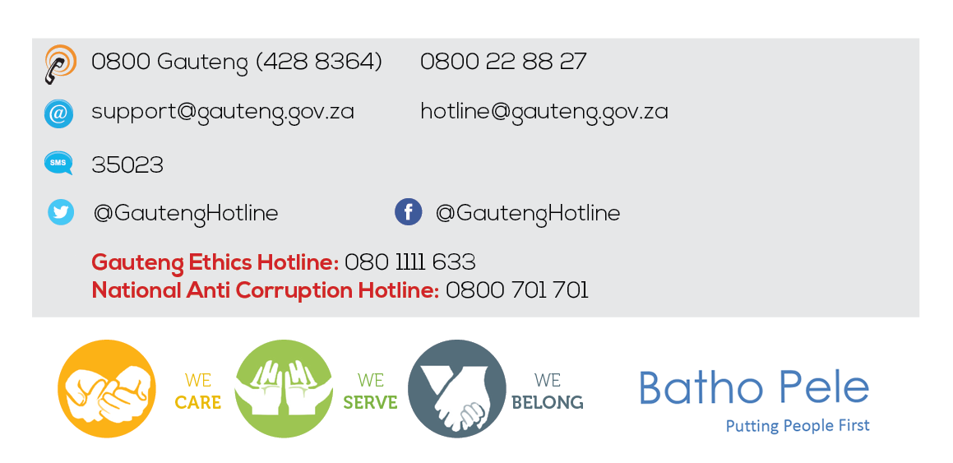
QUESTIONS …QUESTIONS …QUESTIONS
QUESTIONS…..QUESTIONS…..QUESTIONS
Thank You
58

