Slide 1
Roads and Transport Portfolio Committee
Responses emanating from the Annual Report of the GMA
^{04 November 2022}

Slide 2
CONTENTS
Question 19
The entity should provide progress report on the ridership post COVID 19
Question 20
The entity should also link the ridership report with the Patronage Guarantee Cost
Question 21
The GMA should explain why the entity remain with a surplus when Patronage Guarantee cost was still recovering from the shortfall caused by the COVID 19

Slide 3
01
RIDERSHIP POST COVID 19

Slide 4
QUESTION 19: THE ENTITY SHOULD PROVIDE PROGRESS REPORT ON THE RIDERSHIP POST COVID 19
RESPONSE:
During the 2020/21 Financial Year the annual ridership decreased by 81% from the 2019/20 Financial Year as a result of the direct and indirect effects of Covid 19
  Direct effects included the regulatory restrictions on travel
  Indirect effects included the increase in work from home and use of road-based modes by commuters
In March 2021 the ridership was around 25% of the daily pre-Covid demand
During the 2021/22 Financial Year the ridership increased by 63% from the previous year (2,653,160 to 4,336,451 train passengers).
In March 2022 the ridership was around 40% of the daily pre-Covid demand
In October 2022 the ridership has increased to around 47% of the daily pre-Covid demand
The ridership continues to be impacted by work from home and other external factors and may be further affected should the country go through further waves or pandemics

Slide 5
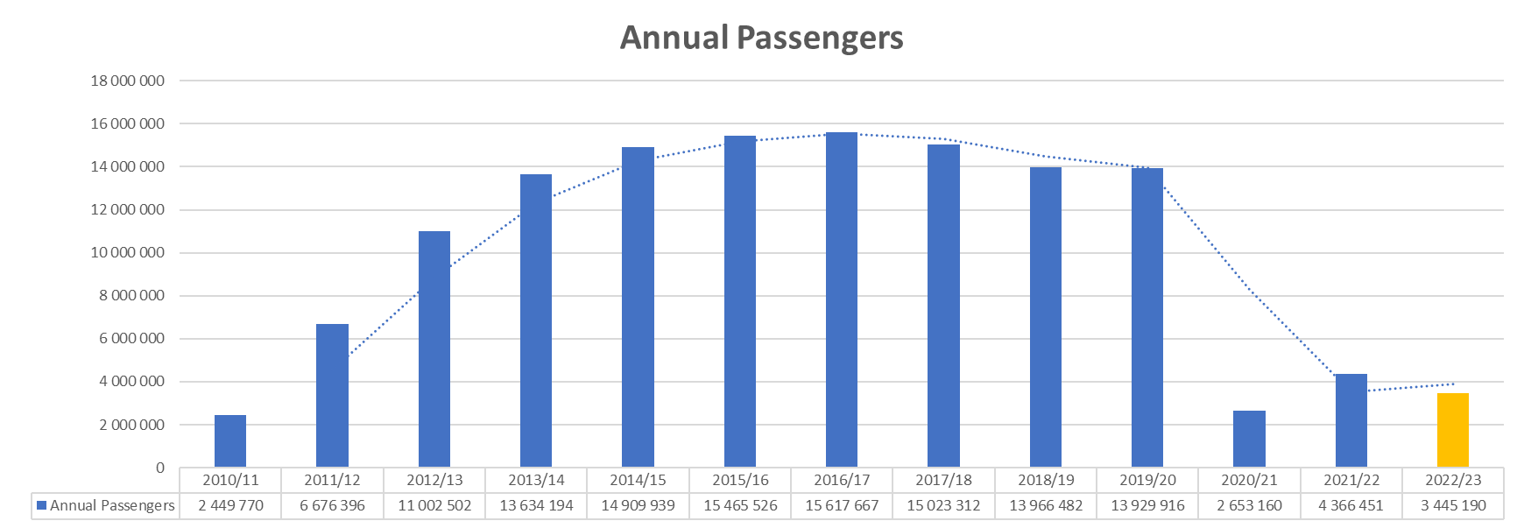
Post Covid 19 Ridership

Slide 6
02
Link between Ridership and Patronage Guarantee Costs

Slide 7
QUESTION 20: RIDERSHIP REPORT WITH THE PATRONAGE GUARANTEE COST
RESPONSE:
There is not a complete correlation between ridership and the Patronage Guarantee (PG) as the risk on patronage is balanced between the Concessionaire and Province
The Concessionaire bears all revenue losses below their contractual commitment known as the Concessionaires Demand Forecast (CDF)
During this post-Covid period the ridership and revenue from passengers is below that of the CDF. This means that the Province is at its maximum exposure of the PG while the Concessionaire takes the revenue loss between the CDF and actual total revenue
We estimate that in the last two financial years, the net Total Revenue decreased by R1.38 billion compared to the FY 2019/20 (when it was expected to grow by more than CPI)
In FY2020/21 the PG increased by R252 million and in FY2021/22 the PG increased by another R168 million
Until such time as the revenue increases above the CDF, the PG will not be directly related to ridership
GMA continues to monitor demand and implement measures to increase ridership

Slide 8
03
Accounting for Deficits and Surpluses

Slide 9
QUESTION 21: THE GMA SHOULD EXPLAIN WHY THE ENTITY REMAIN WITH A SURPLUS WHEN PATRONAGE GUARANTEE COST WAS STILL RECOVERING FROM THE SHORTFALL CAUSED BY THE COVID 19
RESPONSE:
In FY2021/22 the GMA had a R798 million deficit which was declared in the Statement of Financial Performance
As discussed above, the GMA is dealing with decrease in revenue to the Gautrain and an increase in the PG payable by the GMA that is above that budgeted for
An additional R366 million was allocated through the FY2021/22 adjustment budget process to cover the shortfall in the Patronage Guarantee and this plus funds utilized from prior periods allowed the GMA to end the year as a going concern
The GMA did end the year with a positive cash balance as reported in the Cash Flow Statement. This is made up of committed funds for system improvements and operating period variations as well as funds from the cancelled rolling stock tender that was approved as a retention by the Provincial Treasury
These funds are going to be fully utilized in the current and next financial year in line with the commitments made

Slide 10
THANK YOU

