Slide 1

DEPARTMENT OF TRANSPORT AND LOGISTICS
Presentation to Roads and Transport Portfolio Committee
Responses to issues raised by stakeholders in previous public meetings
04 November 2022

Slide 2

CITY OF TSHWANE METROPOLITAN MUNICIPALITY
2

Slide 3
QUESTION 1
DELAYS IN THE APPOINTMENT OF SUBSIDISED BUS CONTRACTS FOR MPUMALANGA CONTRACT IC 52
RESPONSE:
PUTCO is the current subsidised contractor operating the IC52 Mpumalanga – Moloto contract.
The contract extension terminates on 31st March 2023
The Department has initiated the negotiation process to regularise all subsidised contracts.
The negotiated bus contracts will be concluded to replace the current old order contracts
3

Slide 4
QUESTION 2
PAYMENT OF THE REMAINING SUB-CONTRACTORS IN RELATION TO THE CANCELLED CONTRACT OF THE PREVIOUS CONTRACTOR FOR K46 WILLIAM NICOL
RESPONSE:
Four subcontractors were remaining: Minatlou Trading, PEBS Holdings, Sekepe sa Bafana, and PJH Security. These subcontractors were paid except for PEBS Holdings as they failed to verify their works on the project. All the subcontractors were formally advised of rejected invoices and to remedy the situation.
To date the contract has not been cancelled and all sub-contractors have been paid in full for the month of September 2022. Payments for October 2022 were delayed for all subcontractors and were not paid as at 1st November 2022.
4

Slide 5
QUESTION 3
STATUS QUO ON THE REHABILITATION OF BEYERS NAUDE INTO A DUAL CARRIAGE WAY
RESPONSE:
The contractor (JMK Civils) has been appointed and site was handed over to the contractor on the 19th of September 2022. The contractor is currently busy with the site establishment.
There is however a challenge with the local SMMEs threatening to disrupt the project demanding 30% of the works.
5

Slide 6
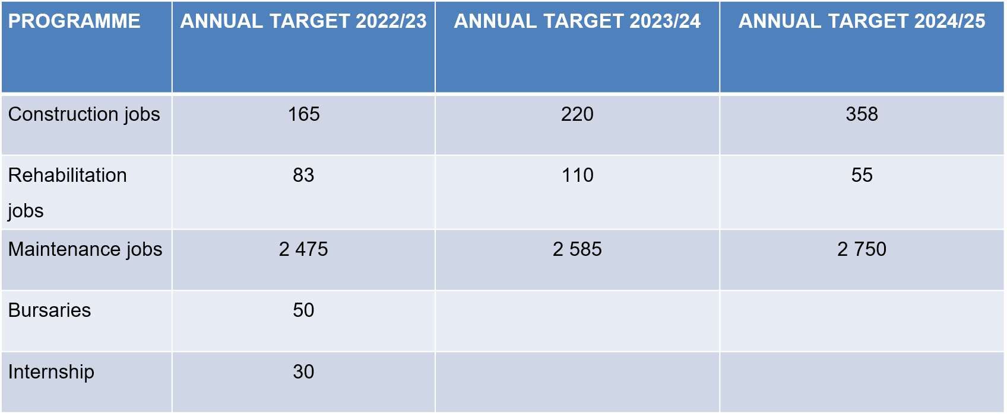
QUESTION 4
EMPOWERMENT OPPORTUNITIES AVAILABLE FOR YOUTH IN THE CONSTRUCTION PROGRAMME OF THE DEPARTMENT
RESPONSE:
The department is implementing the 30% local content on all the current road construction project.
6

Slide 7
QUESTION 5
NON-OPERATION OF METRORAIL LINE IN HAMMANSKRAAL
RESPONSE:
At the Heads of Department Forum technical meeting with municipalities, PRASA was invited, and they shared their rehabilitation programme with the DRT.
The rehabilitation programme will be enhanced, and an updated report will be tabled in more detail on the specific railway lines to be rehabilitated, at the next MEC/MMC Forum.
7

Slide 8
QUESTION 6
USAGE OF TSHWANE BRT AREYENG DUE TO NON-OPERATION OF SUBSIDISED BUSES
RESPONSE:
  PUTCO surrendered their operation of tendered contracts in Mamelodi in 2015
  Autopax was appointed as a replacement operator until 2017
  City of Tshwane ( Areyeng) replaced Autopax when they terminated their operation
  A tender was advertised to appoint new bus contracts in 2021
  Litigation against the tender was filed and the court ruled that the tender be cancelled.
  The Department has initiated the negotiation process to regularise all subsidised contracts.
8

Slide 9
VEREENIGING CIVIC CENTRE
(SEDIBENG DISTRICT MUNICIPALITY)

Slide 10
QUESTION 7
LACK OF ROAD MAINTENANCE IN THE ENTIRE REGION
RESPONSE:
Smart Mobility Weekend Program – Work done:
    22 January 2022 Merafong , D540 Kromdraai & P219/1 Lenasia
    2, 19 & 20 April 2022 Emfuleni, Sedibeng Houtkop Road(Waterdal)
    18-19 June –Emfuleni Postponed due inclement weather
    02-03 July- Emfuleni Pothole Patching and Grass Cutting
    Waterdal road potholes/defects done.
DRT Regional office in Vereeniging responsible for provincial road maintenance in the entire region.
RIFSA 1&2 service providers were just appointed and work will start in November 2022 for three years.
Grass Cutting service providers working in the area, on the provincial roads: R59, P156, P155/1, P202/1, etc.
40 municipal roads in the area to be rehabilitated by the DRT
10

Slide 11
QUESTION 8
NON - OPERATION OF SUBSIDISED BUSES IN SOME AREAS IN THE REGION
RESPONSE:
Public Transport Operational Grant (PTOG) allocated by the national Department of Transport (NDoT) annually is limited and is unable to be allocated to expand subsidised services to newly developed areas.
11

Slide 12
QUESTION 9
DELAYS IN THE COMPLETION OF SEBOKENG DLTC/TOLAB
RESPONSE:
  The Business case for the completion of the Sebokeng DLTC has been submitted to the Provincial Treasury.
  DRT is awaiting the approval of the Business Case
  Works on the contractor procurement specifications underway.
12

Slide 13
QUESTION 10
DELAYS IN THE COMPLETION OF VEREENIGING INTERMODAL FACILITY
RESPONSE:
  DRT submitted the Business Case to Treasury and was requested to separate the project in two phases; taxi rank and intermodal facility.
  The Business Case for the taxi rank has been approved and procurement of the contractor is at the final stages.
  The Business case for the Intermodal Facility will be submitted to the Treasury, the team is working on the comments by Treasury for final resubmission.
13

Slide 14
QUESTION 11
LACK OF NECESSARY INFRASTRUCTURE IN THE TEMPORARY TAXI RANK IN VEREENIGING
RESPONSE:
  The procurement process for a contractor to address all infrastructure inadequacies in the temporary taxi rank is at its final stages.
  The appointment of the contractor is expected before the end of November 2022.
14

Slide 15
QUESTION 12
DELAYS IN THE DEVELOPMENT AND IMPLEMENTATION OF INTEGRATED TRANSPORT PLAN IN THE REGION
RESPONSE:
The implementation of an integrated transport plan in the region will be included as part of the transport planning programme.
At the Heads of Department Forum technical meeting with municipalities, PRASA was invited, and they shared their rehabilitation programme with the DRT.
The rehabilitation programme will be enhanced, and an updated report will be tabled in more detail on the specific railway lines to be rehabilitated, at the next MEC/MMC Forum.
15

Slide 16
QUESTION 13
DELAYS IN THE RE-OPENING OF VEREENIGING METRORAIL LINE
RESPONSE:
At the Heads of Department Forum technical meeting with municipalities, PRASA was invited, and they shared their rehabilitation programme with the DRT.
The rehabilitation programme will be enhanced, and an updated report will be tabled in more detail on the specific railway lines to be rehabilitated, at the next MEC/MMC Forum.
16

Slide 17
QUESTION 14
LACK OF JOB OPPORTUNITIES IN THE TRANSPORT SECTOR IN THE REGION
RESPONSE:
    Job opportunities are created by independent bus companies such as Ipelegeng Bus Company to render subsidised services on behalf of government.
    A minimum of 30% of individual subsidised bus contracts monetary value allocated to previously disadvantaged public (taxi industry, small bus operators, and women) transport operators. Example is Gauteng Coaches/ Triponza Joint Venture.
    Job opportunities are also created through the Supervisory Monitoring Firms (SMFs) who monitor subsidised bus contracts.
    The limited job opportunities are also as a result of the limited grant funding received from national government.
17

Slide 18
MAGALIESBERG
(MOGALE CITY LOCAL MUNICIPALITY)

Slide 19
QUESTION 15
NON - OPERATION OF SUBSIDISED BUSES IN THE AREA
RESPONSE:
Public Transport Operational Grant (PTOG) allocated by the national Department of Transport (NDoT) annually does not cover the area since the region does not have a subsidised bus service currently.
Studies need to be conducted to investigate ridership and other market related issues.
19

Slide 20
QUESTION 16
LACK OF RAIL SYSTEM IN THE AREA
RESPONSE:
At the Heads of Department Forum technical meeting with municipalities, PRASA was invited, and they shared their rehabilitation programme with the DRT.
The rehabilitation programme will be enhanced, and an updated report will be tabled in more detail on the specific railway lines to be rehabilitated, at the next MEC/MMC Forum.
20

Slide 21
QUESTION 17
LACK OF INTEGRATED TRANSPORT SYSTEM IN THE AREA
RESPONSE:
The implementation of an integrated transport plan in the region will be included as part of the transport planning programme.
At the Heads of Department Forum technical meeting with municipalities, PRASA was invited, and they shared their rehabilitation programme with the DRT.
The rehabilitation programme will be enhanced, and an updated report will be tabled in more detail on the specific railway lines to be rehabilitated, at the next MEC/MMC Forum.
21

Slide 22
QUESTION 18
LACK OF ROAD INFRASTRUCTURE IN THE AREA
RESPONSE:
  Smart Mobility Weekend Program – Work done in the area:
    08 & 09 January 2022 Tarlton, P126/1 Magalies to Hendrick Potgieter
    20-21 Aug-Mogale City – Brandvlei area N14 (P28/1) , D2081 Wheatland area.
  DRT regional office (Kruger's Dorp) working on the provincial roads to do routine maintenance work: D400, R24, D443, P123, P16/1, etc
  RISFSA 1&2 contractors to commence work in the area.
  Grass contractors maintaining provincial roads: P123
22

Slide 23
QUESTION 19
LACK OF JOB OPPORTUNITIES FOR YOUTH AND WOMEN IN THE TRANSPORT SECTOR IN THE AREA
RESPONSE:
    Job opportunities can only be identified when the service is up and running.
    Currently public transport is by means of minibus taxis which are privately owned by operators and job opportunities are created through the employment of taxi drivers, queue and rank marshalls.
    The implementation of an integrated transport plan in the region will be included as part of the transport planning programme.
23

Slide 24
TSAKANE COMMUNITY HALL
(EKURHULENI METROPOLITAN MUNICIPALITY

Slide 25
QUESTION 20
LACK OF ROAD MAINTENANCE IN THE AREA
RESPONSE:
Smart Mobility Weekend Program – Work done:
    12 & 13 March 2022 Ekurhuleni at Lesedi,R23 Heidelberg and Jan Buis Street
    27 & 28 March 2022, Ratanda Litopo, Dinuzulu ,Blesbok street,R559 towards Denneysville
    14-15 May 2022 Launch of Smart Mobility Grass Cutting Project at Ekurhuleni-grass cutting executed at R24 and pothole patching- Barbara road, Sundale road and Pretoria road P38/1
    23-24 July – Ekurhuleni
  DRT regional office (Binoni) working on the provincial roads to do routine maintenance work.
  RIFSA 1&2 contractors to commence work in the area.
  Grass contractors maintaining provincial roads.
25

Slide 26
QUESTION 21
DELAYS IN THE RE-OPENING OF RAIL LINE IN THE AREA
RESPONSE:
At the Heads of Department Forum technical meeting with municipalities, PRASA was invited, and they shared their rehabilitation programme with the DRT.
The rehabilitation programme will be enhanced, and an updated report will be tabled in more detail on the specific railway lines to be rehabilitated, at the next MEC/MMC Forum.
26

Slide 27
QUESTION 22
NON-COOPERATION OF TAXI INDUSTRY WITH THE E - HAILING SYSTEM
RESPONSE:
    The Department is constantly trying to narrow the gap that exists between these modes of public transport.
    Through the frequent interaction with the federal structures of the Minibus Taxi Type service (SANTACO and NTA). The Department emphasizes the importance of harmonious operations in the interest of the commuters.
    Sometimes the Minibus Taxi Patrol Squads harass the e-hailing operators and the riders/commuters. Whenever this happens we involve the Public Transport Intervention Unit and the law takes its cause.
    We acknowledge the commuter’s freedom of choice in as far as modes of transport are concerned.
    The Department discourages the spirit of entitlement by the Minibus Taxi type mode of transport. They have operated along side with Metered Taxi for a long time, this made them think that they own the routes, this is not the case.
    Through the prompt reaction of the Law Enforcement and the constant reminder to the Minibus Taxi Type industry that route do not belong to them, they are allocated to the operators in the interest of the commuters. This challenge will be problem will be eradicated.
27

Slide 28
QUESTION 23
NON-OPERATION OF SUBSIDISED BUSES IN THE AREA
RESPONSE:
    The City of Ekurhuleni that owned Brakpan Bus Company ceded their contract to the department. A process to find a replacement company was undertaken taking into account the procurement processes underpinning this exercise.
    It is anticipated that the current section 41 negotiation exercise of the National Land Transport Act (NLTA) will finally lead to the provision of subsidised bus service in the area.
28

Slide 29
QUESTION 24
LACK OF JOB OPPORTUNITIES FOR YOUTH AND WOMEN IN THE TRANSPORT SECTOR IN THE AREA
RESPONSE:
Job opportunities can only be realised when the service is up and running.
Currently public transport is by means of minibus taxis which are privately owned by operators and job opportunities are created through the employment of taxi drivers, queue and rank marshals
The implementation of an integrated transport plan in the region will be included as part of the transport planning programme.
29

Slide 30
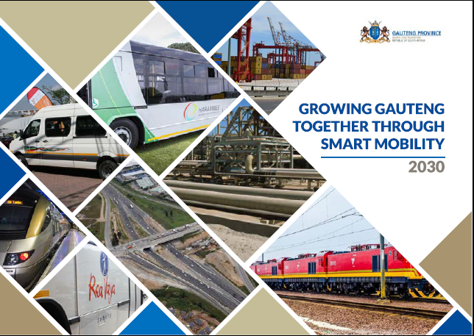
THANK YOU

