Slide 1
2021/22 ANNUAL REPORT:
FINANICAL AND NON-FINANCIAL PERFORMANCE INFORMATION
PRESENTATION: OCPOL
Date: 3 November 2022 | Venue: Virtual Meeting

Slide 2
PRESENTATION OUTLINE
2020-2025 STRATEGIC INTENT
2021/22 PERFORMANCE OVERVIEW & DEVIATIONS
CONCLUSION
INTRODUCTION & PURPOSE
APR STRUCTURE, PROCESS & TIMELINES
SUMMARY OF AUDIT OUTCOMES

Slide 3
INTRODUCTION AND PURPOSE
2021/22 Annual Performance Report
Prepared and submitted in line with Chapter 8, Section 55 and 59 of the Financial Management of Parliament and Provincial Legislatures Act (FMPPLA), No. 10 of 2009.
Presents an assessment of GPL’s annual performance against the Annual Performance Plan 2021/22-FY.
Performance achievement together with areas of performance deviation are highlighted.
Report submitted to Internal Audit in adherence to the combined quality assurance principle for validation by external assurance provider, prior to scrutiny the AGSA
GPL maintained clean audit outcomes

Slide 4
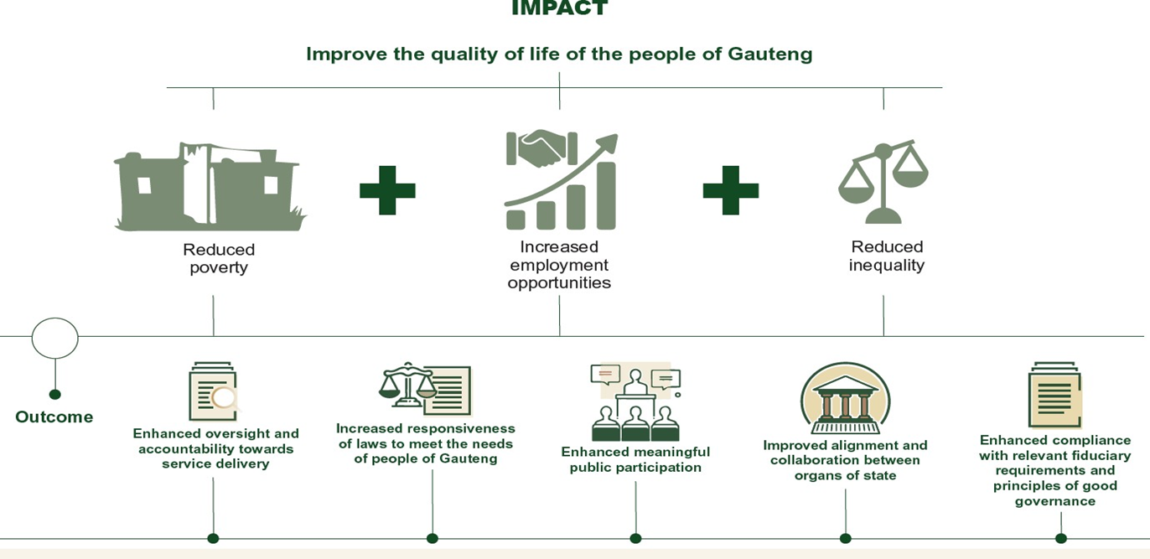
STRATEGIC INTENT: 6TH LEGISLATURE

Slide 5
STRUCTURE OF THE 2021/22 APR
PART A – GENERAL INFORMATION
PART B – PERFORMANCE INFORMATION
PART C - GOVERNANCE
General information about the entity, including a foreword by the Speaker, report by the Secretary, strategic overview, legislative mandate, organisation structure
Achievements against targets set in strategic plans and annual performance plans. Includes AGSA report on findings
PART E – FINANCIAL INFORMATION
PART D – HUMAN RESOURCE INFORMATION
Discussion on governance arrangements and reports by internal oversight bodies (e.g. LSB & its committees, OCPOL & SCOPA)
Status of HR in the GPL including performance management, wellness programmes and resource plans
Annual financial statements and the report by AGSA on findings

Slide 6
PROCESS TOWARDS 2021/22 APR DEVELOPMENT & PUBLICATION
End Apr
Appointment of APR Task Team
4-11 May
Finalisation of Q4 AoPo
20-27 May
Consolidated APR submitted for editing;
Revision of APR based on IA recommendations
Updated Draft submitted for editing by Hansard
23–28 May
Presentations:
Secretariat, ARC/PRC, LSB – 27/5
31 May
Submission to AGSA/Treasury
Updated APR input for Part A, B, C & D
Submission of consolidated draft APR to IA for AoPo – submission of PoE
1 June – 31 July
Audit Process
Address audit findings
Receive management & audit report
1-30 August
Print APR and submit to oversight structures

Slide 7
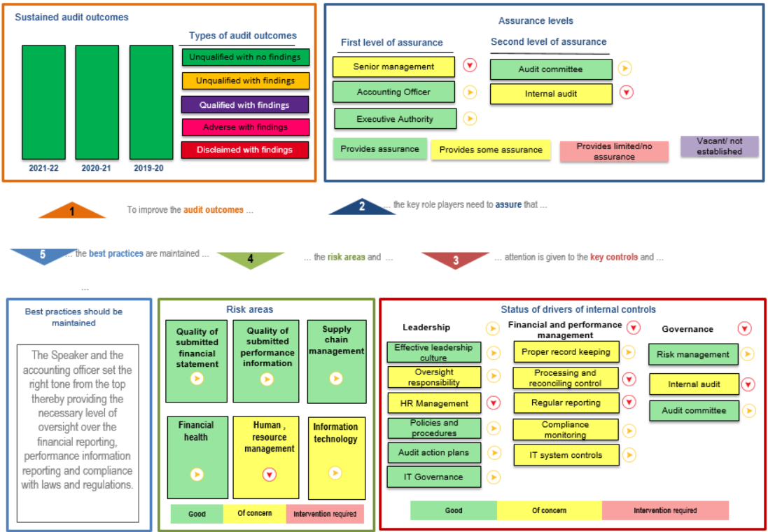
2021/22 AUDIT OUTCOMES SUMMARY

Slide 8
2021/22 PERFORMANCE OVERVIEW

Slide 9
PERFORMANCE OVERVIEW BY PROGRAMME & STRATEGIC OUTCOME

Slide 10


SUMMARY: 2021/2022 INSTITUTIONAL PERFORMANCE
2020/21 Audited Performance: 68%
2021/22 Total Annual Performance Targets: 24
Achievement: 83% (20) and 17% (4) Not Achieved
Rating scale 100% - Achieved Less than 100% - Not Achieved

Slide 11
PERFORMANCE BY STRATEGIC OUTCOME
SO1: Oversight & scrutiny
Law-making
All 4 planned targets achieved
Public
participation
1 of 2 planned targets achieved
5 of the planned 6 targets achieved
94 of 120 planned petitions, considered
19 s76, 2 s77, and 7 Provincial Bills processed
4 Bills sighed into law
34% (257 of 765) resolutions’ responses were considered vs. 95% mid-year target
170 SOM reports adopted vs 130 planned target
59 oversight question papers vs 42 developed
6 of 10 substantive motions adopted
4 reports on performance of committees processed
6 regulations approved.
1 204 684 people reached through social media

Slide 12
PERFORMANCE BY STRATEGIC OUTCOME
Governance & Administration
10 of 11 planned targets achieved
GPL participated in national, regional, and international engagements
FMPPLA compliance reports & MTEF Budgets tabled in line with prescribed timeframes
SoCATT,
Implementation of various functional strategies in support to corporate strategy – ICT, HR, ILR, Leadership initiative
Cooperative Governance
Leading the Gauteng Speakers’ Forum, implementing National Speaker’s Forum resolutions in the province
Fostered relations with academia, civil society for mutual beneficial outcomes
Partnered with ITCILO on Gender Responsive Budgeting
Unqualified audit with no matters of emphasis for 2021/22FY audit achieved
Memorandum of Understanding with NSG - leadership and management capacity training will be executed via this agreement

Slide 13
2021/22 ANNUAL REPORT – PERFORMANCE BY SO
SO# | PERFORMANCE INDICATOR | ANNUAL TARGET | ANNUAL ACHIEVEMENT | DEVIATION
Strategic Outcome 1: Enhanced oversight and accountability towards service delivery
1.1. | Number of quarterly oversight reports on the performance of committees produced | 4 | 4 | None
1.2 | Number of adopted SOM oversight reports | 130 | 170 | 40
1.3 | Percentage of House resolutions’ responses considered by the Committees | 95% | 34% (257 of 765) | 61% (469 of 765)
1.4 | Number of oversight question papers produced | 42 | 59 | 17
1.5 | Number of Motions adopted by the House | 5 | 6 | 1
1.6 | Number of adopted Committee Inquiries reports | 1 | 0 | 1
Strategic Outcome 2: Increased responsiveness of laws to meet the needs of the people of Gauteng
2.1 | Number of annual oversight report on discharge of law-making mandate | 1 | 1 | None
2.2 | Percentage of Bills processed | 100% | 100% (23/23) | None
2.3 | Percentage of laws passed | 100% | 100% (4/4) | None
2.4 | Number of of approved regulations | 4 | 6 | 2

Slide 14
2021/22 ANNUAL REPORT – PERFORMANCE BY SO
SO# | PERFORMANCE INDICATOR | ANNUAL TARGET | ANNUAL ACHIEVEMENT | DEVIATION
Strategic Outcome 3: Enhanced meaningful public participation
3.1 | Number of petitions considered by the Legislature | 120 | 94 | 26
3.2 | Number of people participating in GPL business reached through digital platforms | 1 000 000 | 1 218 844 | 218 844
Strategic Outcome 4: Improved alignment and collaboration between organs of state
4.1 | Percentage achievement of targets in ILR Strategy implementation plan | 80% | 83% | None
Strategic Outcome 5: Enhanced compliance with relevant fiduciary requirements and principles of good governance
5.1 | Number of initiatives undertaken to promote the ethical conduct – seminar | 1 | 1 | None
5.2 | Number of compliance performance information progress reports on the APP | 1 | 1 | None
5.3 | Percentage implementation of Leadership Implementation Plan | 100% | 100% | None
5.4 | Number transversal mainstreaming trainings | 4 | 5 | None
5.5 | Number of initiatives conducted to promote ethical conduct (e-Disclosure & Member Declaration of Interest Register | 2 | 2 | None

Slide 15
2021/22 ANNUAL REPORT – PERFORMANCE BY SO
SO# | PERFORMANCE TARGET | ANNUAL TARGET | ANNUAL ACHIEVEMENT | DEVIATION
Strategic Outcome 5: Enhanced compliance with relevant fiduciary requirements and principles of good governance
5.6 | Percentage implementation of scheduled Members’ training | 50% | 75% | None
5.7 | Percentage achievement of milestones in the ICT Strategy’s annual implementation plan | 80% | 93% | None
5.8 | HR Strategy and Implementation Plan approved | Strat & IP approved | N/A | None
5.9 | Percentage achievement of milestones in the annual implementation plan of the Integrated Communication Strategy | 80% | 70% | 10%
5.10 | Unqualified audit opinion with no matters of emphasis for 2019/20 FY | Unqualified outcomes | Unqualified outcomes | None
5.11 | Percentage Fraud Risk Management initiatives implemented | 100% | 100% | None
Positive deviations: 9/24 = 38 Negative deviations: 4/24 = 17%

Slide 16
PERFORMANCE DEVIATIONS

Slide 17
AREAS OF UNDER-PERFORMANCE AND REASONS FOR DEVIATION
# | PERFORMANCE TARGETS | ANNUAL PLANNED | ANNUAL ACHIEVED | REASON FOR DEVIATION | MITIGATION
SO1.3 | 95% of House resolutions’ responses considered by the Committees | 95% | 34% (257 of 765) | 61% (469 of 765) Time allocation to review resolution was limited, resulting in lower volumes of resolutions reviewed | Increased time allocation for consideration of resolutions’ responses will be prioritised on all House Committees agendas to ensure that the implementation of a full cycle of this oversight mechanism is completed.
SO1.6 | 1 adopted Committee Inquiries reports | 1 | 0 | -1 - Further consultation with relevant stakeholders resulted in delays. In addition, legal opinion was sought to mitigate potential litigation risk, lack of internal technical capacity contributed. | Technical expertise is being sought to support the committeeS to implement the inquiry in the next reporting period.
SO3.1 | 120 Petitions considered by the Legislature | 120 | 94 | 26 - changes in the term programme was rescheduled to prioritise the sitting of Appropriation Bill, this impacted the PSC session to consider Petitions. | Ensure that the approved Programme is adhered to; consideration for additional meetings for high-volume committees to do its business will be made.
SO5.9 | 80% achievement of milestones in the annual implementation plan of the Integrated Communication Strategy | 80% | 70% | 10% - emerging political priorities and tight legislative schedule affected planned milestones. | Prioritise implementation of outstanding activities in the next financial year

Slide 18
CONCLUSION
2021/22 – overall improvements in institutional performance
Maintained clean audit outcomes
Measures put in place to address areas of under-performed

Slide 19


Slide 20


