Slide 1

DEPARTMENT OF TRANSPORT AND LOGISTICS
Presentation to Roads and Transport Portfolio Committee
Responses emanating from the Annual Report 2021/22
04 November 2022

Slide 2
QUESTION 1
THE DEPARTMENT SHOULD DEVELOP A REASONABLE PLAN TO ADDRESS THE REOCCURRING POOR PERFORMANCE IN THE PROCUREMENT EXPENDITURE FOR HDIs.
RESPONSE:
  The department obtained the database of designated categories and is ensuring that procurement from HDI’s is prioritised.
  The department has issued directive to contractors which makes it mandatory for contractors to submit proof of payment to sub-contractors when submitting their claims for payments.
  The department has put in place measures to ensure that contractors make use of sub-contractors that were awarded business during the bidding process.
02

Slide 3
QUESTION 2
THE DEPARTMENT SHOULD PROVIDE A REPORT ON THE COURT INTERDICTS AND PROGRESS REPORT IN K148. K60, K56
RESPONSE:
  Road K56 between K46 (William Nicol Road) and P71-1 (Main Road) and Erling Road between Dorothy Road and K56
  The application for leave to appeal the interim interdict and for the operation of the interim interdict to be suspended pending the appeal in terms of Section 18(3) of the Superior Court Act has been held in abeyance while the Compliance Office conducts an investigation into the authenticity of each of the completion certificates submitted by the successful bidder. The investigation is based on allegations raised by the Applicants of possible fraud regarding the completion certificates submitted by successful bidder.
  The Applicant’s filed their supplementary founding affidavit in the review application on 3 June 2022. The Department filed its notice of intention to oppose Part B of the review application on 22 September 2022.
  The Department’s answering affidavit in the review is due on 03 November 2022.
03

Slide 4
QUESTION 2 (CONT.)
THE DEPARTMENT SHOULD PROVIDE A REPORT ON THE COURT INTERDICTS AND PROGRESS REPORT IN K148. K60, K56
RESPONSE:
  Road K60 between Maxwell Drive and Allandale Road
  Advocate Jabu Motepe SC and Karabo Mvubu have been appointed to bring an application to rescind the interim interdict granted on 18 January 2022.
  The rescission application has been set down for 7 November 2022. The parties must now file a joint practice note for the rescission application.
  The Applicants filed their replying affidavit in the review application on 29 September 2022. The parties must now file heads of argument and then a date on the opposed roll will be allocated for the hearing of the review application.
04

Slide 5
QUESTION 2 (CONT.)
THE DEPARTMENT SHOULD PROVIDE A REPORT ON THE COURT INTERDICTS AND PROGRESS REPORT IN K148. K60, K56
RESPONSE:
  Road K148 between Roads K146 and K133 (including the N3/K148 Interchange)
  The application for leave to appeal the interim interdict and for the operation of the interim interdict to be suspended pending the appeal in terms of Section 18(3) of the Superior Court Act was launched by the Department (under case number 4478/2020) on 23 June 2022.
  The Respondents filed their answering affidavit and the Department has also filed its replying affidavit.
  The Department is to approach the Judge for the allocation of a hearing date for the section 18(3) application and the leave to appeal.
  The Department has also filed answering affidavits in their review applications under case numbers 8517/2022; 4346/2018 and 13473/2020. The Applicants have objected to the late filing of the answering affidavits. The Department, with the counsel team, is in the process of preparing its response/condonation.
05

Slide 6
QUESTION 3
THE DEPARTMENT SHOULD ALSO PROVIDE A DETAILED PROGRESS REPORT ON THE CONSTRUCTION OF K46
RESPONSE: (BACKGROUND)
  K46 (Phase2) project is located in Diepsloot in the Fourways area, north of Johannesburg. The K46 phase 2 starts at Erling interchange adjoining phase 1 at Km 7.5 and continuing in the north direction ending a km 13.8 after the N14. The project when complete will improve traffic capacity in the North –South direction between the N1 and N14.
  The project is implemented in partnership with Steyn City Properties (Pty) Ltd where GDRT contributes 70% and Steyn City contributes 30% towards the total costs of the project.
  K46(phase2) was first implemented through an appointed contractor Lubbe construction (PTY) Ltd in January 2016. Lubbe was terminated in November 2018 due to non - performance.
  A new process to complete the incomplete K46 phase2 project started on the 21st February 2020 with tender advert which closed on 24th July 2020 due to Covid 19 restrictions.
  Slim B and D was the successful bidder to continue with completion of remaining works,
  The award date was on 2nd June 2021.
06

Slide 7
QUESTION 3 (CONT.)
THE DEPARTMENT SHOULD ALSO PROVIDE A DETAILED PROGRESS REPORT ON THE CONSTRUCTION OF K46
RESPONSE:
Project Information
  Contractor : Slim B & D Construction (Pty) Ltd
  Contract Amount : R 469 414 877.50 (Including VAT)
  Contract expenditure : R 71 156 484.07 (Including VAT)
  Consultants : WSP Group Africa (Pty) Ltd
  Consulting Fee : Nil
  Consultant’s expenditure : Nil
  Project duration : 16 Months
  Project commencement date : 03 August 2021
  Project Completion Date : 02 December 2022
  Completion percentage : 25%
  Time lapsed : 11 months (56.0 %)
  Extension of time Requested : 4.5months
  Revised Estimated Project Duration : 20.5months
  Revised Estimated Completion Date : 31 May 2023
07

Slide 8
QUESTION 3 (CONT.)
THE DEPARTMENT SHOULD ALSO PROVIDE A DETAILED PROGRESS REPORT ON THE CONSTRUCTION OF K46
RESPONSE: (PROGRESS TO DATE)
  The contractor has achieved 38% completion on overall progress from the following activities:
  96% on the site establishment
  80% on clearing and grubbing
  100% remedial works
  100% establishment of survey benchmarks
  90% bulk earthworks including Rose Road Interchange and fill at km9+100 to km9+180 NBC
  10% of road layer works
  10% on construction of Bridges and concrete structures
  60% on construction of storm water and drainage structures
08

Slide 9
QUESTION 3 (CONT.)
THE DEPARTMENT SHOULD ALSO PROVIDE A DETAILED PROGRESS REPORT ON THE CONSTRUCTION OF K46
RESPONSE: (PROGRESS TO DATE)
  Remedial works have been completed, including removing concrete kerbs & layer works, removing stormwater pipes, demolishing / removing partly completed culvert @km12+860, demolishing partly completed floor slabs for culvert @km9+180, Clearing , Removing rubbles & Rubbish dumped on site to an approved dumping site, sandblasting of rusted re-bars at Bridges A&B at Rose Interchange and Culvert @km9+180.
  Bulk earthworks at Rose Road Interchange have been completed.
  Blasting from km7+300 to km7+600 South Bound Carriageway
  Stormwater pipes laying and subsoil drainage in progress.
  Processing of layer works including lower selected layer from km7+900 to km8+200 NBC; km8+600 to km8+900 NBC&SBC.
  Casting floor slabs for Panels A&B , and South-East wing wall at km9+180 & steel fixing, shuttering formwork and staging for walls and roof slab (Culvert 5601).
  Casting floor slabs for Panels A&B at km12+860 (Culvert 5600) & shuttering formworks and staging for walls & roof slab.
  All benchmarks for survey have been identified and reinstated.
  Traffic accommodation & potholes repairs on haul roads & deviations.
09

Slide 10
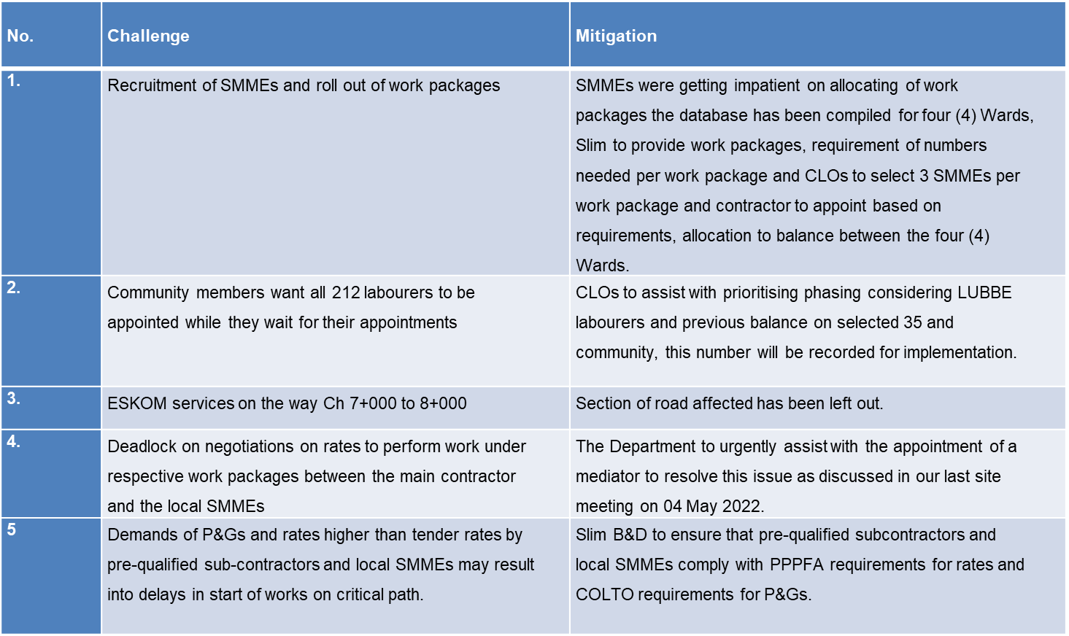
QUESTION 3 (CONT.)
THE DEPARTMENT SHOULD ALSO PROVIDE A DETAILED PROGRESS REPORT ON THE CONSTRUCTION OF K46
RESPONSE: (CHALLENGES AND MITIGATIONS)
10

Slide 11
QUESTION 4
THE DEPARTMENT SHOULD PROVIDE A PROGRESS REPORT ON THE REHABILITATION OF P241 AND P156
RESPONSE: (BACKGROUND)
  GDRT advertised an open tender which closed on 01 April 2019.
  The project was awarded to Boitshoko Road Surfacing and Civil Works (Pty) Ltd and the supervising consultant was Nyeleti Consulting Engineers.
  Appointment date : 25 October 2019
  Site handover : 4 December 2020
  Commencement date : 20 February 2020
  Original Practical Completion date : 27 September 2021
11

Slide 12
QUESTION 4 (CONT.)
THE DEPARTMENT SHOULD PROVIDE A PROGRESS REPORT ON THE REHABILITATION OF P241 AND P156
RESPONSE: (BACKGROUND)
  Contractor : Boitshoko Road Surfacing and Civil Works (Pty) Ltd
  Contract Amount : R 93 673 037.69 (incl. VAT, excl. CPA ).
  Revised Contract Amount : R 108,499,600.77 (incl. VAT and CPA))
  Consultants : Nyeleti Consulting Engineers
  Consulting Amount : R10,513,549.75 (incl. VAT)
  Revised Consultant Amount : R11,376,049.75 (incl. VAT)
  Construction Duration : 18 Months
  Project commencement date : 20 February 2020
  Project Completion Date (Terminated) : 27 June 2022
  Completion percentage : 96%
  Time lapsed : 27 months (56.0 %)
  Extension of time Granted : 5.5months
  Revised Construction Completion Date : 7 February 2022
12

Slide 13
QUESTION 4 (CONT.)
THE DEPARTMENT SHOULD PROVIDE A PROGRESS REPORT ON THE REHABILITATION OF P241 AND P156
RESPONSE: (BACKGROUND)
  The Contractor had been slow in the execution of the project mainly due to his lack of financial resources.
  The Contractor had brought the project to approximately 96% completion, however, had struggled to complete the final outstanding works since December 2021, due to what appears to be cashflow issues.
  The contract concluded by GDRT and Boitshoko was then terminated by the Department on 27 June 2022 with immediate effect in terms of clause 9.2.1.3.4 of the GCC.
13

Slide 14
QUESTION 4 (CONT.)
THE DEPARTMENT SHOULD PROVIDE A PROGRESS REPORT ON THE REHABILITATION OF P241 AND P156
RESPONSE: (PROGRESS TO DATE)
  In response to the termination, on the 15th of July Boitshoko wrote to the HOD (GDRT) appealing the termination of their contract.
  On the 1st of August 2022, the Department then advertised an RFQ for the appointment of a replacement Contractor to complete the remaining works through a limited bidding process as contemplated in PFMA SCM Instruction Note 3 of 2021/2022. The advert closed on 15 August 2022.
  A reinstatement and cession agreement has been prepared by the Department and was shared with Boitshoko for their review before it is signed by all three parties.
  GDRT awaits the feedback from Boitshoko legal team.
  The supervising Consultant have completed an assessment of the outstanding works to be completed on the project.
  The cost of completion is approximately R27 million, and the duration is estimated at sixteen (16) weeks.
14

Slide 15
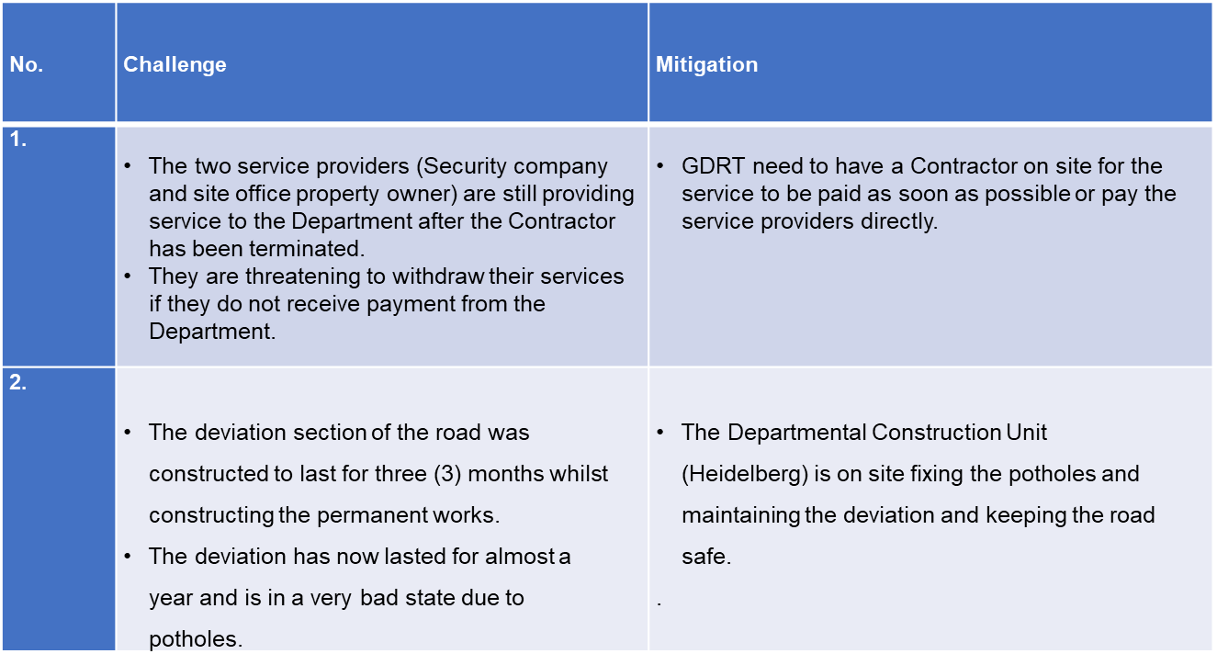
QUESTION 4 (CONT.)
THE DEPARTMENT SHOULD PROVIDE A PROGRESS REPORT ON THE REHABILITATION OF P241 AND P156
RESPONSE: (CHALLENGES AND MITIGATIONS)
15

Slide 16
QUESTION 5
THE DEPARTMENT SHOULD EXPLAIN WHY PROCUREMENT PROCESS TOOK LONGER THAN EXPECTED IN THE SURFACED AND GRAVELLED ROADS VISUALLY ASSESSMENT PROJECT
RESPONSE:
  The project is awaiting the provision of the original Performance guarantee so that the HOD can sign the contract.
16

Slide 17
QUESTION 6
THE DEPARTMENT SHOULD ALSO PROVIDE A PROGRESS REPORT ON THE VISUALLY ASSESSMENT OF SURFACED AND GRAVELLED ROADS
RESPONSE:
  The Department had completed the evaluation process. The Preferred Supplier has signed their contract, their appointment letter and have provided a performance guarantee.
  SCM to forward the contract to HOD for the HOD to approve the Contract.
  Work is anticipated to commence before the 15 November 2022.
17

Slide 18
QUESTION 7
THE DEPARTMENT SHOULD EXPLAIN WHY SOME OF SET TARGETS WERE REVISED, AND ALSO EXPLAIN AS TO WHAT HAPPENED TO THE BUDGET THAT WAS ALLOCATED FOR THE REVISED SET TARGETS IN THE TRANSPORT OPERATIONS PROGRAMME
RESPONSE:
Firstly, for the new subsidised bus contracts, the MEC made a decision to advertise the remaining 8 new subsidised bus contracts in one tender as a replacement for the staggered approach over a 2-year period. The bus subsidies are allocated as per the Public Transport Operations Grant (PTOG), which is utilised on existing and new contracts. Projected under expenditure was surrendered
18

Slide 19
QUESTION 7 (Cont.)
THE DEPARTMENT SHOULD EXPLAIN WHY SOME OF SET TARGETS WERE REVISED, AND ALSO EXPLAIN AS TO WHAT HAPPENED TO THE BUDGET THAT WAS ALLOCATED FOR THE REVISED SET TARGETS IN THE TRANSPORT OPERATIONS PROGRAMME
RESPONSE:
Secondly, the Output for the Taxi Ranks developed as Economic nodes was revised as the project was rescoped and revised in response to the ongoing engagements with stakeholders needs and expectations. The project, evolved into a 2 phased approached of delivering the Vereeniging Taxi Rank as per the stakeholder requests. (Phase 1) Intermodal facility (Phase 1 towards Phase 2 of the conversion into the economic hub). The Department was in discussion with Provincial Treasury on the rescoping of the project and budget allocations.
Thirdly, the Integrated Fare Management (IFM) project planned out of public transport modes with operationalised The Account Based Ticketing (ABT) system had to be rescoped to take into consideration the anticipated new National Department of Transport’s electronic fare collection regulations. R30 000 million allocated at the beginning of the year however, adjusted to R26 million during adjustments. Budget utilised to fund the Transport Management Center (TMC) which is part of the IFM project. The interim TMC is established.
19

Slide 20
QUESTION 7 (Cont.)
THE DEPARTMENT SHOULD EXPLAIN WHY SOME OF SET TARGETS WERE REVISED, AND ALSO EXPLAIN AS TO WHAT HAPPENED TO THE BUDGET THAT WAS ALLOCATED FOR THE REVISED SET TARGETS IN THE TRANSPORT OPERATIONS PROGRAMME
RESPONSE:
The bus subsidies are allocated as one amount, only the unit knows how to split that between existing and new contracts
The subsidy is distributed to 34 bus contracts according to the annual percentage of PTOG increase or decrease determined by National Department of Transport applied on the previous year’s allocation.
There is no specific funding for taxi nodes - Funding of the Vereeniging Taxi Rank had not been confirmed as assessments had not been concluded. As all related projects have been motivated on merit. Any form of a long term programme will be drawn, informed by the Taxi Rank Survey that is underway. Nodes of interest for integration will be lifted and consolidated. Business Case will be prepared for motivation at Treasury. In line with the prescripts of the Township Economic Development Act in favour of the Taxi economy, a PPP will be considered for greenfields projects going forward.
20

Slide 21
QUESTION 8
THE DEPARTMENT SHOULD INDICATE THE 1 NEW SUBSIDISED BUS THAT WAS OPERATIONALISED IN THE FINANCIAL YEAR UNDER REVIEW
RESPONSE:
  The department operationalized the Meyerton bus contract DRT 091 operated by Gauteng Couches and Triponza JV.
21

Slide 22
QUESTION 9
THE DEPARTMENT SHOULD ALSO PROVIDE THE LIST OF PREVIOUSLY DISADVANTAGED PUBLIC TRANSPORT OPERATORS THAT WERE ALLOCATED SUBSIDISED BUS CONTRACTS
RESPONSE:
30% of the contract in monetary value has been allocated to Previously disadvantaged Public Transport operators, (Small Bus operator (Triponza) and the Meyerton Taxi Association).
The joint venture contract between Gauteng Coaches/ Triponza / Taxi industry is continuing. Breakdown of operation % :Gauteng Coaches 49%, Triponza 21%, Meyerton Taxi Association 30%.
22

Slide 23
QUESTION 10
THE DEPARTMENT SHOULD EXPLAIN WHY SOME OUTPUTS WERE REVISED, AND WHAT HAPPENED TO THE BUDGET THAT WAS ALLOCATED FOR THE REVISED OUTPUTS IN THE TRANSPORT REGULATION PROGRAMME
RESPONSE:
The outputs were revised due to the recommendations emanating from the previous audit outcomes and findings related to performance information. The relevant Outputs, Output Indicator and Target revised as per the audit recommendation of the Auditor General.in alignment with the SMART criteria and to improve the usefulness of targets as per the performance information service delivery and audit process.
The indicator was amended to make reference to the Number of Operating Licenses issued
23

Slide 24
QUESTION 11
THE DEPARTMENT SHOULD BE SPECIFIC IN TERMS OF EXACT AMOUNT THAT WAS COLLECTED IN THE FINANCIAL YEAR UNDER REVIEW
RESPONSE:
The total revenue that was collected in the financial year under review was R4 471 351 000 made up as follows:
Motor vehicle licences R4 407 797 000
Sale of goods and services R62 958 000
- Other revenue R596 000
24

Slide 25
QUESTION 12
THE DEPARTMENT SHOULD ALSO GIVE DETAIL REPORT ON THE BACKLOG ON THE RENEWAL OF DRIVER’S LICENSE AS AT THE END OF FINANCIAL YEAR
RESPONSE:
Initial backlog was 989 058. The backlog number has changed from 989 058 to 973 635 as RTMC has removed the deceased persons (deceased holders of Driving Licence cards.
Renewed Driver Licenses as at 29 March 2022 was 505 430 (51.1%)
25

Slide 26
QUESTION 13
THE DEPARTMENT SHOULD PROVIDE A DETAIL REPORT ON THE FINANCIAL PERFORMANCE OF THE DEPARTMENT WITH A PARTICULAR FOCUS ON THE UNDER EXPENDITURE, IRREGULAR EXPENDITURE AND FRUITLESS AND WASTEFUL UNDER EXPENDITURE
RESPONSE:
The department spent R7, 741 billion(2021: R7,122 billion) against the adjusted budget of R8,515 billion (2021: R8,377 billion), incurring under spending R774 million which is 9%. Infrastructure spent R1,681 billion against adjusted budget of R1,824 billion, recording underspending of R143 million (8%). Delayed procurement, interdicts, project stoppages by community, encroachments and poor project management contributed to the underspending. Transport Operations spent R2,621 billion against adjusted budget of R3,194 billion, recording underspending of R573 million which is 18%. The greatest contributors of underspending in Transport Operations continues to be the “Did Not Operate (DNO”s) which results mainly from routes that are no longer operated by bus operators due to poor viability of the routes. The department attempted to advertise the bus tender in 2022, but was interdicted and is now in the process of negotiating new contracts with
The department incurred irregular expenditure of R29 million in the current year. The irregular expenditure on bus subsidised amounting to R2,447 billion was condoned by Provincial Treasury. R18 million was incurred from the awarding of the tender for K46. The balance of the irregular expenditure was as a result of non-compliance with procurement laws and regulations. The expenditure is in the process of being investigated.
26

Slide 27
QUESTION 13 (CONT.)
THE DEPARTMENT SHOULD PROVIDE A DETAIL REPORT ON THE FINANCIAL PERFORMANCE OF THE DEPARTMENT WITH A PARTICULAR FOCUS ON THE UNDER EXPENDITURE, IRREGULAR EXPENDITURE AND FRUITLESS AND WASTEFUL UNDER EXPENDITURE
RESPONSE:
The department recorded fruitless and wasteful expenditure of R215 million relating to K46 and was incurred in prior years. Investigations were conducted in 2018 regarding this expenditure. Additional fruitless and wasteful expenditure of R68,929 million was incurred as a result of settlement of litigations.
The department, due to the nature of its operations, is exposed to litigations and measures that are put in place can only reduce the amount of litigations, but not to eliminate them. The fruitless and wasteful expenditure of R13 million incurred and reported in prior years is still under investigations.
27

Slide 28
QUESTION 14
THE DEPARTMENT SHOULD ALSO PROVIDE A DETAILED REPORT WITH REGARDS TO CONDONATION OF R215 MILLION IN IRREGULAR EXPENDITURE IN RELATION TO K46 WILLIAM NICOL CONSTRUCTION CONTRACT, INCLUDING THE PROCESS OF APPOINTMENT OF CONTRACTOR, INVESTIGATION CONDUCTED, OUTCOMES THEREOF AND CONSEQUENT MANAGEMENT STEPS TAKEN
RESPONSE:
The R215 million irregular expenditure relating to K46 was not condoned, but was disclosed as fruitless and wasteful expenditure. The investigations into K46 was concluded in 2018 by Provincial Treasury. Management did not disclose the irregular expenditure of R215 million for financial years 2019, 2020 and 2021 as they indicated that they needed to verify certain aspects of the investigation report. In 2021 AGSA raised a finding that management should have made disclosures in the financial statements of the irregular expenditure and/or fruitless and wasteful expenditure. Some officials were implicated were subjected to disciplinary hearings which are still ongoing, Some officials who were implicated left the employ of the department. In the case of some offiicials, it was indicated that there was not sufficient evidence to warrant undertaking disciplinary actions.
In 2022, a new contractor, Slim B & D was appointed to continue the project. Management made an assessment of structures that were constructed by the previous contractor to determine the extent of costs that would be disclosed as fruitless and wasteful expenditure. Based on the assessment done, management disclosed the whole R215 million as fruitless and wasteful expenditure.
28

Slide 29
QUESTION 15
THE DEPARTMENT SHOULD PROVIDE A REPORT ON THE CONSEQUENCE MANAGEMENT THAT WAS DONE ON THE IRREGULAR EXPENDITURE AND FRUITLESS AND WASTEFUL EXPENDITURE
RESPONSE:
Irregular expenditure that was incurred due to bus subsidies and was condoned by Provincial Treasury. The R29 million irregular expenditure that was incurred in the current year (made up of different transactions) is under investigation and consequence management will commence based on the outcome of the investigations.
The R181 million irregular expenditure of prior years was incurred mainly on DLTC’s and Vereeniging Intermodal when the projects were under the management of Department of Infrastructure Development (DID).
These projects were done several years ago and the current management could not find evidence of investigations and consequence management. The absence of adequate documentation, the fact that the projects were managed and executed by DID and that most officials have left the employ of the department, management is not able to conduct investigations or institute consequence management.
29

Slide 30
QUESTION 16
THE DEPARTMENT SHOULD ALSO PROVIDE A PLAN TO ADDRESS THE QUALIFIED AUDIT OPINION AS WELL AS FINDINGS THAT WERE RAISED BY THE AG
RESPONSE: (PERFORMANCE INFORMATION AUDIT)
Annual Performance Information Audit: The Department obtained an unqualified audit opinion for performance information with no findings during the 2021/22 audit. The Department continues to adhere to its monitoring and evaluation frameworks and guidelines with the aim of repeating an unqualified audit opinion for performance information in the 2022/23 audit.
The department held a two day workshop on the 5-6 of September 2022 where the audit findings were discussed as part of the audit improvement plan. Management has started to implement the corrective actions to the recommendations by AGSA. In case of areas where the department does not have adequate capacity, the department is seeking external assistance to provide assistance. The department aims to address the audit findings by AGSA by the end of the 3rd quarter.
30

Slide 31
QUESTION 17
THE DEPARTMENT SHOULD PROVIDE A DETAIL REPORT ON THE UNDER EXPENDITURE IN THE ADMINISTRATION PROGRAMME IN TERMS OF CORPORATE SUPPORT SUB PROGRAMMES, AND THE FOLLOWING ITEMS OF ECONOMIC CLASSIFICATION: COMPENSATION OF EMPLOYEES, BUILDINGS, MACHINERY AND EQUIPMENT AND SOFTWARE AND OTHER INTANGIBLE ASSETS
RESPONSE:
Less usage of consumables (paper and cartridges) as some officials were working remotely,
Department of e-Government did not bill the Department (DRT) for voice (landline telephony)
Shortage of computer equipment's due to international shortage of micro chips, and Directorates did not request any new software's except one.
31

Slide 32
QUESTION 18
THE DEPARTMENT SHOULD PROVIDE DETAIL REPORT ON THE UNDER EXPENDITURE RECORDED IN TRANSPORT INFRASTRUCTURE PROGRAMME FOCUSING ON THE MAINTENANCE SUB PROGRAMME AND AFFECTED PROJECTS, AND THE FOLLOWING ITEMS OF ECONOMIC CLASSIFICATION: CONSULTANTS: BUSINESS AND ADVISORY SERVICES AND CONTRACTORS
RESPONSE:
The under expenditure incurred was as result of slow moving of infrastructure projects that were interdicted and projects were stopped as a result of community protests or road encroachments.
The greatest contributors of underspending in Transport Operations continues to be the “Did Not Operate (DNO”s) which results mainly from routes that are no longer operated by bus operators due to poor viability of the routes. The department attempted to advertise the bus tender in 2022, but was interdicted and is now in the process of negotiating new contracts.
32

Slide 33
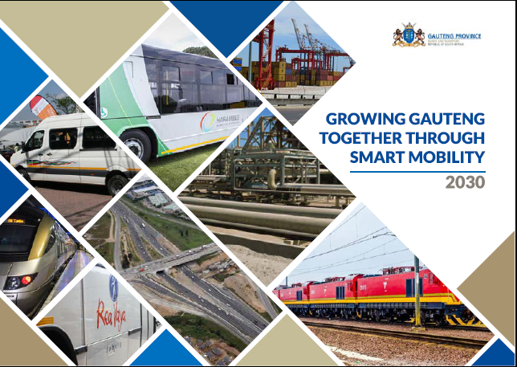
THANK YOU

