Slide 1

DEPARTMENT OF ROADS AND TRANSPORT
Presentation to Roads and Transport Portfolio Committee
Annual Report 2021/22 presentation
04 November 2022

Slide 2
Achievements for the 2021/22 Financial year
Restructured Urban Form – Smart Roads System
  Completed the rehabilitation of Road P24 in the Magalies Central Business District.
  133, 805.46 m² Blacktop patching completed
  122, 000.00m² of surfaced roads resealed
  R657, 985 million spent on Road maintenance activities
  5, 638km of provincial road network maintained
Supporting District Municipality Road Infrastructure Rehabilitation
  The Sedibeng District Municipality Emfuleni Road Upgrade Programme was successfully completed he following townships, namely: (1) Three Rivers; (2) Vereeniging; (3) Vanderbiljpark and Bophelong; (4) Sharpeville, Boipatong and Tshepiso; and (5) Sebokeng. A total of 23 streets were rehabilitated at a cost of R168,969 million.
Developing Future Road Construction Entrepreneurs
  36 level 1 learner contractors who were part of the 3-year Contractor Development Programme successfully completed the programme and upgraded their CIDB levels to level 4. There were five Consultant Engineers as mentors and supervisors. 20 contractors were youth-led/owned whilst 11 were women managed/owned.
Job creation
  Total - 3, 358 - 1, 929 youth and 1, 587 women. 552 Military Veterans (MV) employed IN COVID-19 Transport Programme.
  176 youth were employed in various programmes
  72 interns were employed on 2-year Internship Programme thereby contributing to youth employment initiatives.
2

Slide 3
Achievements for the 2021/22 Financial year
Empowerment of Previously Disadvantaged Public Transport Operators
  The new Meyerton Bus Contract, a joint venture contract, commenced operations in May 2021. The joint venture operations are between Gauteng Coaches (49%), Meyerton Taxi Association (30%) and the Triponza Bus Company (21%). The contract includes the Meyerton Taxi Association having a 30% contract value allocation.
Subsidised bus services
  1, 788 subsidised busses electronically monitored.
  2, 390 subsidised busses providing subsidised commuter trips.
Issuance of Public Transport operating licences
  2, 081 public transport operating licences issued.
Revenue Maximisation
  Successfully achieved its revenue target of R4.4 billion.
Payment of Suppliers
  100% of service providers within the 30 days and 92% of those invoices were paid within 15 days
Modernisation of Public Transport Systems and Infrastructure
  Gauteng Integrated Public Transport Administration System (GIPTAS). – Database of public transport modes and operators.
  Online Renewal of the Motor Vehicle Licences System - online in renewing motor vehicle licences.
  Pothole Management System Application - management of turnaround times in attending and patching identified potholes.
  Contractor’s Site Construction Daily Reporting Tool - Maintenance and Construction Digital Platform for contactor reporting.
3

Slide 4
Achievements for the 2021/22 Financial year
Driver and Motor Vehicle regulatory services
  1, 951,307 motor vehicle licences registered
  4, 809, 223 motor vehicle licences renewed.
  356, 637 Learner licence applications received.
  242, 023 Learner licences issued.
  263, 210 driver licence tests applications processed.
  200, 319 Driver licence issued.
Challenges Navigated
Severe external pressures which negatively impacted on its transport infrastructure projects implementation - community unrest, work stoppages, encroachment on road reserves, contractors experienced cash flow challenges due to the negative impact of the COVID-19 pandemic on the economy.
Several projects were halted due to court interdicts on open tender projects.
COVID-19 infection waves resulted in lower ridership, particularly on subsidised public transport and Gautrain.
COVID-19 negative impact on the issuance of driver licences continued.
As a result of COVID-19, new public transport operating licence applications were temporarily suspended in order to process and finalise those already submitted.
A number of mini-bus taxi disputes, some of which were cross-border disputes.
During July 2021 riots the Kliptown Driver Licence Testing Center (DLTC) was vandalised.
13

Slide 5
Financial Performance
The Department is continuing with implementation of the GGT2030 Programme and all the allocations are geared towards contributing to it from a roads and transport perspective.
Programme 1: Administration: The programme experienced an underspending of 19,717, 000 due to the unfilled positions.
Programme 2: Transport infrastructure: The underspending of R143, 201, 000 within this programme was, mainly caused by delays and challenges within the procurement processes, adversely affected infrastructure delivery, e.g., maintenance contractors were not appointed. Maintenance projects' contracts which were not issued in time are the main cause of the underspending.
Programme 3: Transport Operations: The underspending of R573, 406, 000 within this programme was mainly as a result of bus subsidies – decrease of services by operators due to lower than usual travel usage by commuters and delays in finalising new bus tenders.
Programme 4: Transport Regulation: The underspending of 38,137, 000 is as a result of delays in implementing the Organisational Structure Review. Furthermore, the lower-than expected spending on the gazetting budget due to delays at Government Printing Works.
Programme 5: Gautrain: All transfers to Gautrain were made in line with the financial year 2021/22 payment schedule.
2

Slide 6
Financial Performance
Overall budget expenditure
The Department expenditure for the financial year is 91%
Unauthorised expenditure
There is no unauthorised expenditure for financial year 2021/22.
Irregular expenditure
R2, 476, 449 000 was incurred. The majority of the irregular expenditure was caused by extension of bus subsidy contracts devolved from National Department of Transport.
Fruitless and wasteful expenditure
Amount of R284, 538 000, as disclosed. The majority of the fruitless and wasteful expenditure was caused by caused by payments of settlements on contract terminations.
2

Slide 7
Governance
Minimising Conflict Of Interest
  100% Senior Management financial disclosure.
Fraud And Corruption
  Regular fraud risk assessments conducted to determine the effectiveness of its risk management strategy and to identify new/emerging risks.
  Ethics and anti-fraud and corruption awareness sessions and induction workshops were conducted.
Internal Control
  The Internal Audit performed its audits according to the approved Internal Audit coverage plan. The Plan was based on high-risk areas as per the Strategic risk profile.
  All planned internal audits were completed during the year under review. Performance Audit; Computer Audit, and Information Technology Risk Assessment.
  Administrative policies were reviewed, approved and communicated.
  Quarter audit reports were presented to audit committee for independent oversight.
  Risk management action plans were closely monitored for implementation.
2

Slide 8
Audit and Performance Outcome
Financial Information - Qualified Audit Opinion
Performance Information – Unqualified with no findings
3

Slide 9
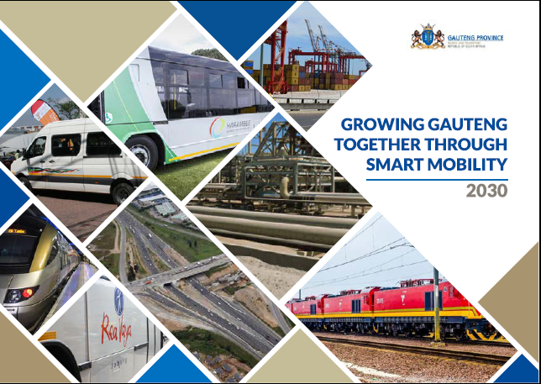
THANK YOU

