Slide 1
Gauteng Department of Social Development
Institutional Realignment Project (IRP) 2022-2027
“Changing the way we do things”
GPL Portfolio Committee on Social Dev.
28 OCTOBER 2022

Slide 2
Presentation Outline
Purpose
Introduction
Key legislative and policy frameworks
IRP in a nutshell
Budget distribution Govt vs NPOs
Proposals towards strengthening state capacity
Institutional arrangements
Workstreams
Project implementation plan
Value of the IRP to DSD
Implications of IRP to the NPO Sector

Slide 3
Purpose
To provide an overview of the Institutional Realignment Project (IRP)
To inform the Portfolio Committee on the IRP and its implications to the Department and the NPO sector

Slide 4
Introduction
GDSD is mandated by various legislative and policy prescripts to render core services through a variety of programmes that enables target groups to deal effectively with all social ills and other adverse social conditions
GDSD currently employs the bulk of social service professionals to effectively deal with the social problems and issues such as psychological stress, chronic poverty, food insecurity and other adverse social conditions.
GDSD faced lack of capacity to implement these policies and programmes due to amongst others, the overwhelming demand for services and the inability of the sector to deal effectively with the surge in demand, mainly because of the shortage of Social Workers.
To mitigate this, the GDSD implemented the Recruitment and Retention strategy for Social Workers whilst simultaneously increasing the number of funded NPOs
This led to increased internal capacity to provide services by appointing additional social service professionals such as Social Workers, Social Auxiliary Workers and Child and Youth Care Workers to implement services to the vulnerable groups

Slide 5
Key Legislative and Policy Frameworks
Constitution of the Republic of South Africa, Act 108 of 1996
Children’s Act, 38 of 2005:
The Children’s Second Amendment Act 18 (c) of 2016
Older Persons Act,13 of 2006
Prevention of and Treatment for Substance Abuse Act 70 of 2008:
Child Justice Act, 75 of 2008:
The Prevention and Combating of Trafficking in Persons Act, 7 of 2013
The Probation Service Act, 116 of 1991
The Criminal Procedures Act, 51 of 1971
White Paper on the Rights of Persons with Disabilities, 2015
The White Paper on Families, 2013.
The National Strategic Plan for HIV, TB and STIs, 2017-2022
National Strategic Plan for Gender Based Violence and Femicide
National Development Plan (2030)
The White Paper for Social Welfare (1997)

Slide 6
IRP in a nutshell
What is IRP
  Project undertaken by the department to build the state capacity and reduce over reliance on NPOs on the constitutionally legislated mandates
  The project is informed by the approved Service Delivery Model and the Organizational Re-alignment (new Organogram for GDSD) which must be funded mainly from within the Department
  DSD must be the leader of the social development sector, which is an area that straddles other Government spheres and those of civil society and should be able to develop technical and specialist professional skills as envisaged by the National Development Plan(NDP,2030).
  The Department has a commensurate responsibility to have sufficient human resources to enable delivery on this mandate.
  This includes capability in workforce planning and development to ensure that there is a pool of talent to enable the Department to realise its legislated mandate

Slide 7
IRP in a nutshell Cont…..
Why IRP
  The Department is & should be in the forefront of dealing with these challenges through the implementation of variety programmes designed to care, support, protect and empower the most vulnerable in our communities.
  Due to the shrinking budget, government departments are expected to do more with less due to declining revenue. This is happening at the same time as the shrinking donor funding for NPOs.
  The current partnership model with NPOs is unsustainable as more resources are allocated to NPOs at the expense of a developed state capacity.
  Service delivery by NPOs still remains largely at urbanized areas
  Delivery of services often does not reach those who need them the most
  Factors that contribute to failures in service delivery include lack of governance and leadership, institutional inadequacies
  GDSD has appointed hundreds of new social workers into the system over the past years.
  The increase in internal capacity must translate directly into increased state capacity

Slide 8
IRP in a nutshell Cont…..
GDSD implemented retrieval of services previously in areas where internal capacity has been built and to protection of vulnerable groups including children:
In 2012/2013 FY, GDSD retrieved probation services from NPOs. These include assessment of children in conflict with the law, presentence reports, pre-trial reports, victim impact statements etc.
In December 2021, the department successfully retrieved secure care services for children in conflict with the law from Mogale CYCC (Former Bosasa). Qualifying staff from Mogale Secure Care were absorbed into GDSD workforce.
The GDSD has been retrieving services from non-performing/non compliant Child Protection Organizations (CPOs) and other services, Kagiso Child Welfare, NG Welsyn, WAWA Toekomsus, RIET, CMR North etc.
As of June 2021, GDSD trained & registered 159 social workers to do adoption services free of charge
All these services are now provided by the department

Slide 9
Budget distribution Govt vs NPOs
The size and scope of NPO sector has grown significantly since the 1990s.
According to the recent data from NDSD, there are 258 827 registered NPOs and 148 306 of these are non-compliant.
Gauteng has 81 996 registered NPOs and 47 677 are non-compliant.
Of the registered NPOs, 27 117 are registered to provide social welfare services in Gauteng.
The Department of Social Development in Gauteng funded approximately 3 402 during the 2021/2022 FY.
FINANCIAL YEAR | DSD BUDGET | TRANSFERS TO NPOS | % TO NPOS
2016/2017 | R4,271,602 | R2,249,623 | 53%
2017/2018 | R4,586,319 | R2,452,366 | 53%
2018/2019 | R4,661,496 | R1,935,907 | 42%
2019/2020 | R5,442,951 | R2,277,987 | 43%
2020/2021 | R5,887,349 | R2,571,152 | 41%
2021/2022 | R6,148,557 | R2,783,547 | 44%
2022/2023 | R5,537,037 | R2,240,870 | 40%

Slide 10
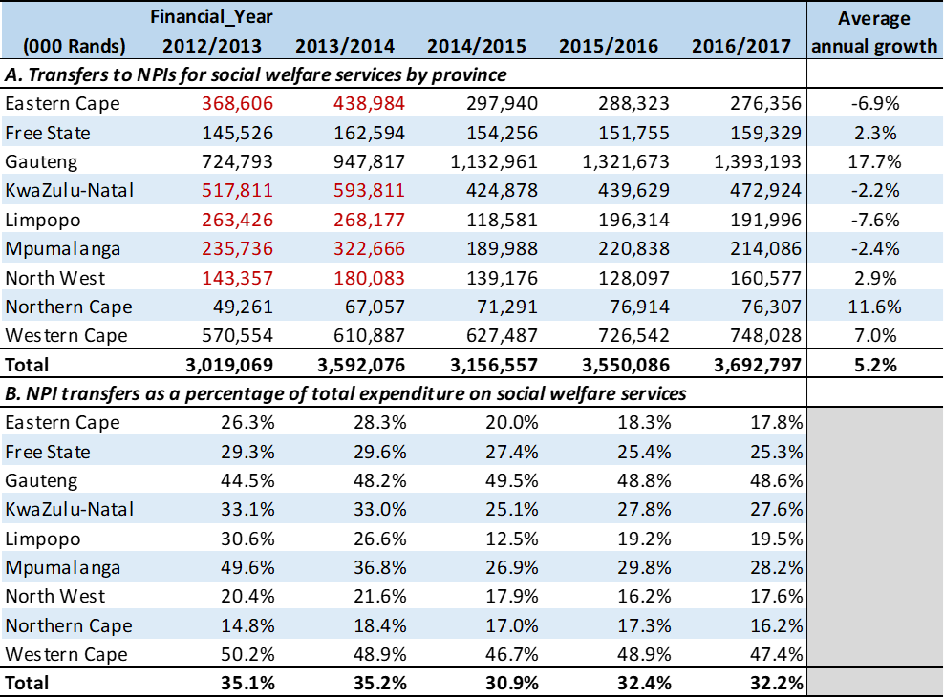
National Budget Distribution: State viz NPOs
Source: Team analysis - 06

Slide 11
Budget distribution cont. …
Already in 2016/17, GP allocated 48.6 % of its expenditure on social welfare services to NPOs, while WC transferred 47.4 %
At the other end, KZN transferred 27.6 % of its spending on social welfare services, NC allocated only 16.2 %, with NW at 17.6 per cent and EC at 17.8 % of its expenditure on social welfare to NPOs
Despite the NAWONGO Judgements, the FS reduced its funding for NPOs from R162 m in 2013/14 to R154 m in 2014/15, and to R151 m in 2015/16.

Slide 12
Proposals towards strengthening state capacity
Re-organise the state-civil society model for delivering welfare services to ensure greater accountability and improve service delivery
  In SWS, the state has adopted a partnership model of service provision and relies mainly on NGO’s to provide professional social services.
  Funding of these organisations has declined steadily since 1994, reducing the range & compromising the quality of services at the same time as demand for such services has increased.
  Such organisations are unable to respond to the scale & complexities of SA's poverty, social fragmentation & lack of social support systems. Increasingly, the burden of care has fallen on the poorest communities & on women & the elderly, often leading to a sense of powerlessness & social isolation.
  There is also a need to ensure that accountability is built into partnerships with the non-governmental sector.
  The state has to ensure that nongovernmental providers do not take advantage of vulnerable groups and that they provide the correct benefits.

Slide 13
Proposals towards strengthening state capacity
Address the skills deficit in the social welfare sector
  In the immediate and medium term, the country needs to increase the supply of 4 categories of social service professionals to respond to the demand for appropriate basic social welfare services (Social Workers, SAWs, CDPs & CYCWs).
  Responding to the social breakdown of families, communities and society requires a range of generic and specialist education and training that is not available to poor communities.
  Problems in the supply of qualified social service professionals are also linked to poor working conditions and a lack of funding for social services. The skills deficits are not limited to the social welfare sector. Delivery of effective and efficient social protection services is reliant on an effective and capable public sector.

Slide 14
Proposals towards strengthening state capacity
The state should play a much larger role in the provision of social welfare services, including establishing effective partnerships with the private and community sectors
  SA needs to confront the reality that social services are critical for improving social integration and human development.
  The current model of shifting the burden of care, treatment & rehabilitation to the NGO sector & the poorest communities need to be reviewed.
  Complex social problems require professional interventions to deal with the symptoms and underlying causes of social pressures, most evident in schools, workplaces and neighbourhoods that are plagued by gang warfare and households afflicted by violence, including the abuse of women and children.

Slide 15
Institutional Arrangements
Approved Framework
Project Implementation Plan
Project Steering Committee

Slide 16
Workstreams
Partnerships and Finance
Regions and Institutions
Programmes
Infrastructure
HR
Communications
Stakeholder Relations
Risk Management

Slide 17
Key elements of project implementation plan
Implementation plan covers the following aspects:
  Analysis of internal capacity
  Supervision
  Mapping of services
  Skills Audit
  Assessment of workloads
  Training and capacity building
  Analysis of available resources
  Review of funding processes and priorities
  Review of APP targets
  Monitoring and evaluation
  Addressing Infrastructure and related challenges
  Stakeholder Management and Communications
  Management of project risks

Slide 18
Value of the project to GDSD
Reduced overreliance on NPOs to implement constitutionally legislated mandates
Improved and better integrated planning within the department:
Reproduction of skills and foster sense of professional common purpose for SSPs
Capacitated, empowered an accessible public service responding to the needs of vulnerable groups
Enhanced systems, structures and mechanisms of coordination at all levels to promote professional, ethical, and efficient service delivery
Strengthen and sustain the capacity of the department to enhance accountable and transparent public service through effective monitoring, evaluation, and verification processes.
Strengthening of monitoring, QA, QI, quality controls across all levels
Capability matching and production of specialist technical skills that are necessary to fulfill core functions and mandates of the department
Maximised utilisation of existing resources
Communities will be aware of service provision by the department

Slide 19
Implications of IRP to the NPO Sector
Retrieval of functions from identified non-performing/dysfunctional NPOs (non-centre based services, non-compliant NPOs or NPOs suspended from service)
Take over of identified services including certain statutory services (e.g. new foster care cases, adoption services, etc.)
Retrieval of services will not be considered for residential facilities (at least for now) due to limited capacity. These incl CYCC, Shelters for Homeless, Shelters for victims of GBV, Residential Facilities for Older Persons, Residential Facilities for Persons with Disabilities, Inpatient Treatment Centres & Halfway Houses
Moratorium on new applications for funding of residential facilities or additional funding of beds at existing facilities and new NPOs except in identified priority areas
Advertisements for 2023/2024 financial year will be informed by departmental needs and priorities
APP and operational plans targets for govt and NPOs to be reviewed.
Improved programme and finance monitoring
Reduction in the number of funded NPOs

Slide 20
Recommendations
It is recommended that the Portfolio Committee:
  Note the presentation on the Institutional Re-alignment Project (IRP) 2022-2027

Slide 21
Thank you

