Slide 1

GAUTENG DEPARTMENT OF SOCIAL DEVELOPMENT
2021/2022 FY PERFORMANCE MONITORING REPORT:
ANALYSIS OF PERFORMANCE
SOCIAL DEVELOPMENT PORTFOLIO COMMITTEE
2022

Slide 2
Table Of Contents
  Part A: Overview Of Department Performance.
  Part B: 1. Non-financial Performance:
  2. Governance and Administration
  3. Areas of Significant Deviation from Planned Performance
  4. Monitoring of NPOs
  Part C: Financial Report
2

Slide 3
Purpose
To present departmental performance for the 2021/22 FY.
3

Slide 4
Non-financial performance report
Technical analysis per programme/sub-programme
PART A
Overview of Department Performance
4

Slide 5
Rating Categories
The performance for the Department is disaggregated according to the threshold represented by the following ratings categories and definitions:
Rating Symbol | Rating Category | Value
 | Achieved | 100% and greater
 | Not Achieved: Good progress | 76% - 99%
 | Not Achieved: Fair progress | 51% - 75%
 | Not Achieved: Poor Progress | 26% - 50%
 | Not Achieved: Very Poor Progress | Less than 26%
 | Not targeted for the Q | No quarterly targets set for the quarter under review.

Slide 6
Overview Of Non-Financial Performance
Notes:
Overview comparison.

Slide 7
Achievement vs Weighted Performance

Slide 8
Year On Year Comparison

Slide 9
Non- Financial Vs Financial Comparison: AYTD
Weighted YTD Non-Financial performance against YTD financial expenditure

Slide 10
Departmental Achievement of National and Provincial Strategic Priorities
DEPARTMENT ACHIEVEMENT OF STRATEGIC PRIORITIES
STRATEGIC LINKAGES |  | STRATEGIC PLANNING | STRATEGIC REPORTING
NDP/MTSF Priority | GGT Priority | Outcome as per approved Dept Strat Plan | Summarised Dept Performance during Q4
Priority 2: Economic transformation and job creation | Priority 1: Economy, Jobs & Infrastructure | Reduce hunger and poverty | National Priority 2 Of the 15 planned targets, 9 were fully achieved at 60%; 5 targets illustrated good progress representing 33%; and 1 target indicated poor progress representing 7%. Provincial Priority 1 Of the 10 planned targets, the Department achieved 4 targets representing 40%; 5 targets showed good progress representing 50%; and 1 target illustrated poor progress representing 10%.

Slide 11
Departmental Achievement of National and Provincial Strategic Priorities
DEPARTMENT ACHIEVEMENT OF STRATEGIC PRIORITIES
STRATEGIC LINKAGES |  | STRATEGIC PLANNING | STRATEGIC REPORTING
NDP/MTSF Priority | GGT Priority | Outcome as per approved Dept Strat Plan | Summarised Dept Performance during Q4
Priority 4: Consolidating the social wage through reliable and quality basic services | Priority 4: Safety, Social Cohesion and Food Security | Enhanced care and protection of poor and vulnerable groups Reduce hunger and poverty Reduce the demand for substances and harm caused by substances | National Priority 4 Out of 24 planned targets, the Department achieved 17 targets representing 71%; 3 targets were in good progress representing 13%; 3 targets were in fair progress representing 13% and 1 target was poor progress representing 4%. Provincial Priority 4 Of the 25 planned targets, the Department achieved 19 targets representing 76%; 2 targets exhibited good progress representing 8%; 3 targets showed fair progress representing 12%; and 1 target indicated poor progress representing 4%.

Slide 12
National Priorities

Slide 13
Provincial Priorities

Slide 14
1. Programme Performance
Part B:
Non-financial Performance
14

Slide 15
Overview Of Non-Financial Performance: Prog 2
Notes:
Bar chart with sub programmes
See if we can include weighted avg within this slide along with bar chart.

Slide 16
Care and Service to Older Persons
During the quarter under review :
20 616 (T:24 369) older persons were reached through services provided by funded community based care and support facilities (home based; service centres and luncheon clubs) and 5 768 (T:6 525) older persons benefitted from residential facilities.
Active ageing programmes reached 17 456 (T:23 626) older persons including gym facilities programmes.
2 129 729 (T:451 280) beneficiaries were reached through elder abuse prevention programmes.
16

Slide 17
Care and Service to Older Persons
COVID -19 Interventions – Protection of older persons
Assistance with the vaccination registration in facilities under the jurisdiction of the department from May 2021 to date.
Weekly monitoring reports were compiled to monitor infection and progress regarding vaccination of beneficiaries in facilities under the jurisdiction of the department rendering services to Older Persons
Education and Awareness programmes
Centenary events for older persons were held in all 5 regions to honour older persons for their contribution to families and communities and to provide an opportunity to them to provide inputs and proposals on how the department can improve services. In total 460 were reached.
17

Slide 18
Services to Persons with Disabilities
During the period under review the following were achieved:
  Education and awareness programmes on disability prevention reached 4 267 136 (T:1 162 294) beneficiaries.
  Residential and assisted living care were accessed by 1 748 (T:1 980) Persons with Disabilities in government and NPO managed facilities; 544 (T:491) benefitted from home based care services .
  Protective workshop programme aimed at socio economic empowerment of persons with disabilities reached 3 957 (T:4 362) beneficiaries.
  17 473 (T:14 882) persons with disabilities received psycho-social support services.
18

Slide 19
Services to Persons with Disabilities
COVID -19 Interventions
Weekly monitoring reports were compiled to monitor infection and progress regarding vaccination of beneficiaries
Procurement and provision of 767 boxes of gloves, 426 boxes of masks and 129 25L bottles of sanitiser to Residential facilities and 102 electronic thermometers to Protective workshops for persons with Disabilities.
Prevention and awareness programmes
The National Epilepsy Week was celebrated from 19 – 25 May 2021 through media education programmes offered by community radio stations
The Deaf Awareness Month was celebrated in September 2021 through media education programmes offered by 14 community radio station from 07 – 14 September 2021.
Mental Health Awareness Month as well as Social Development month was celebrated in October 2021 through media education programmes by 13 community radio stations from 18 – 21 October 2021. 1 168 012 persons were reached.
Disability Rights Awareness Month (DRAM) was celebrated from 3 November – 3 December 2021 through media education programmes by 16 community radio stations from 08 – 23 November 2021. 1 409 970 persons were reached.
White Cane Week was celebrated from 1-8 February 2022 through media education programmes by 13 community radio stations. 1 409 970 persons were reached.
19

Slide 20
HIV And AIDS & EPWP
During the period under review the following were achieved:
Nutritional support was provided to 192 069 (T:119 200) through food parcels to date and 29 770 (T:37 900) through cooked meals
99 872 (T:99 945) beneficiaries received psychosocial support services including Orphans and Vulnerable Children
123 693 (T:138 320) beneficiaries were reached through the Social behaviour Change Programmes
7 268 (T:7 210) work opportunities were created through EPWP
20

Slide 21
HIV And AIDS & EPWP
During the period under review:
Prevention Programme
Implementation of the Social and Behaviour Change programme (YOLO, Chommy; Men / Boys Championing Change; Families Matter) was intensified.
Provision of support to the Government Capacity Building Support (GCBS) and Government to Government (G2G) programmes.
Care and Support Program
Comprehensive package of essential services that include nutritional support, counseling, skills development, home and school visits, psychosocial support, educational support, medical support, food supplements and referrals was provided to:
  Orphans and Vulnerable Children and Youth (OVCY)
  Youth Headed Household
  Older Persons who are caregivers and Support Groups
21

Slide 22
Overview of Non-Financial Performance: Prog 3

Slide 23
Care and Support to Families
During the quarter under review the following was achieved to ensure families perform the critical role of nurturing and caring for individual family members:
  173 222 (T:99 629) family members participated in preservation programmes
  7 479 (T:7 582) families participated in re-unification programmes
  1 895 (T:1 668) family members were reunited with their families
  61 640 (T:42 456) families participated in parenting programmes
  14 093 (T:33 900) families received crisis intervention services
23

Slide 24
Child Care and Protection
During the period under review:
1 338 (T:1 790) ECD centres were fully registered and 640 (T: 709) were conditionally registered .
70 858 (T:111 253) children accessed funded and non-centre based ECDs; 20 406 (T:17 688) children accessed conditionally funded ECDs.
3 335 (T:5 163) children in need of care and protection were placed in foster care.
58 176 (T:62 706) children already in foster care received social work services.
4 141 (T:4 572) children were placed in CYCCs for developmental social welfare services.
24

Slide 25
Overview of Non-Financial Performance: Prog 4

Slide 26
Crime Prevention and Support
During the period under review the following were achieved:
Social crime prevention and awareness campaigns reached 1 875 228
(T:354 238) children and adults.
All children and adults in conflict with the law referred to the Department for further interventions were attended to:
  5 909 (T:6 024) children and adults were assessed; 883 (T:1 173) were referred and 1 156 (T:1 801) participated in diversion programmes.
  2 secure care centers managed by government accommodated 761 (T:680) children in conflict with the law that are awaiting trial.
26

Slide 27
Victim Empowerment
During the period under review the following were achieved:
The Department continues to create awareness against gender-based violence (GBV). On the 25th of each month awareness is created around Orange Day.
The Department funded 106 (T:102) facilities and shelters that provided psycho-social support to 56 046 (T:45 085) victims of violence and crime.
The programme of no violence against women and children including 16 days of activism reached 1 822 453 (T:294 072) beneficiaries; to date.
27

Slide 28
Substance Abuse Prevention and Rehabilitation
During the period under review
The Department continued to render substance abuse prevention and rehabilitation services in terms of the Prevention of and Treatment of Drug Dependency Act 70 of 2008 and the National Drug Master Plan to ensure that the demand and the harm caused by drugs is reduced.
3 702 345 (T:1 022 626) beneficiaries were reached through substance abuse prevention programmes.
The Ke-Moja coaches deployed in schools and communities to roll out the Ke-Moja Drug Prevention programme reached 1 138 493 (T:896 396) children and youth; to date.
Substance abuse disorder treatment services were provided to 35 277 (T:27 055) users.
  9 913 (T:10 467) beneficiaries that completed treatment programmes are participating in after care programmes.
28

Slide 29
Substance Abuse Prevention and Rehabilitation
During the period under review:
Airing of the 13-part Kick It TV Documentary on SABC 1 started on 6 September 2021.
The department continued with prevention and awareness campaign through distribution of posters and pamphlets which covers a variety of subjects such as Foetal Alcohol Syndrome, Ke-Moja and nyaope.
The media campaign on illegal treatment centres is continuing to educate people about registration processes and warning that action will be taken against unregistered centres. Interviews were done at E-nuus - Kyknet and ENCA including social media platforms
The Gig Rig truck outreach programmes were implemented and reached over 9 856 beneficiaries.
29

Slide 30
Overview of Non-Financial Performance: Prog 5

Slide 31
Poverty Alleviation and Sustainable Livelihoods
The Department through its funded organisations has:
  Poverty reduction programmes were accessed by 2 195 965 (T:2 815 414) beneficiaries.
  Distributed 636 119 (T:2 100 000) dignity packs for the year to date.
  Enabled the participation of 72 858 (T:44 846) people in income generation programmes.
  Distributed 1 020 202 (T:261 640) food parcels through foodbanks and
  77 129 (T:12 190) persons received food through feeding programmes; to date.
  16 021 (T:15 400) beneficiaries participated in the Welfare to work programmes; to date.
  561 (T:444) cooperatives provide goods and services to the Department.
31

Slide 32
Youth Development
During the period under review the following were achieved:
63 416 (T:38 616) work opportunities for youth have been created through the Youth Structures Programme EPWP and Job Centre Programme.
The programme has further enabled 73 591 (T:46 417) youth to participate in various skills development programmes through youth structures.
25 470 (T:18 499) youth participated in the Entrepreneurship Development Programme.
32

Slide 33
Women Development
During the period under review the following were achieved:
The Department has established partnerships with various training institutions, development agencies, the private sector and other government agencies to train women in skills such as financial management, marketing, business development and procurement procedures.
21 380 (T:20 674) women participated in empowerment programmes; to date.
5 343 (T:5 200) women on child support grant were linked to economic opportunities.
The Department successfully launched The Beauty Hub Academy in Partnership with the SANDF in Lenasia Military Base on 14 October 2021. The academy will train 120 young women in its first year of operation.
33

Slide 34
Departmental Infrastructure/ Capital Projects
DEPARTMENT INFRASTRUCTURE / CAPITAL PROJECTS
Name of Project | Brief description of project | Start Date | End Date | Current Status | Challenges | Requests for Intervention
Devon Early Childhood Centre | Construction of Early Childhood Centre | 30 April 2018 | 24 March 2021 | Completed | None | None
Garankuwa CYCC Office Facility | Construction of Garankuwa CYCC office accommodation | 01 April 2014 | 26 March 2021 | Completed | None | None
Bantubonke Early Childhood Centre | Construction of Early Childhood Centre | 31 August 2017 | 31 August 2022 | Construction (90%) stage | Delays in approval by the municipality and cashflow challenges | As the implementing agent, the Department of Infrastructure is currently assisting the contractor with outstanding compensation events (Variation Order) so that the project can be completed.
Bekkersdal Social Integrated Facility | Construction of Early Childhood Centre; community facility for older persons; and regional offices | 31 July 2017 | 30 September 2022 | Construction (93%) stage | Cashflow challenges | As the implementing agent, the Department of Infrastructure is currently assisting the contractor with outstanding compensation events (Variation Order) so that the project can be completed.

Slide 35
Departmental Infrastructure/ Capital Projects
DEPARTMENT INFRASTRUCTURE / CAPITAL PROJECTS
Name of Project | Brief description of project | Start Date | End Date | Current Status | Challenges | Requests for Intervention
Ratanda Shelter | Construction of shelter for vulnerable women and children | 31 July 2017 | Not yet available | Planning Stage | None | None
Sebokeng Inpatient Rehab centre | Construction of Inpatient Rehabilitation Centre | 31 July 2017
Soshanguve Inpatient Rehab centre | Construction of Inpatient Rehabilitation Centre | 01 October 2018
Tembisa Inpatient Rehab centre | Construction of Inpatient Rehabilitation Centre | 01 April 2018
Walter Sisulu CYCC (demolition and reconstruction) | Demolition of office accommodation and construction of new office accommodation | 31 July 2016

Slide 36
Human Resource Capacity
Human Resource Capacity
During the period under review 01 January to 31 March 2022
Total number of posts on the Dept. Structure as at the last day of the period under review | Total number of posts currently filled as at the last day of the period under review |  | Total number of vacant posts as at the last day of period under review
5 961 | 5 340 |  | 621
Total number of acting positions as at the last day of the period under review | Total number of terminations during the period under review |  | Total number of new appointments during the period under review
7 | 1 633 of which 1 442 were contracts that expired (4-month short term and stimulus) |  | 2 235 of which 1 910 appointments are on contract (4-month short term and stimulus)
Total number of suspensions during the period under review | Summarized information on the GEYODI / HDI compliance for the period under review
1 employee was placed on precautionary suspension for the period under review. | Females= 75% (4 006 out of 5 340) | Youth=36% (1 948 out of 5 340) | Persons with disabilities= 4% (216 out of 5 340)
 | Race
 | African | Coloured | Indian | White
 | 96% (5 105 out of 5 340) | 2% (121 out of 5 340) | 0.3% (18 out of 5 340) | 1.7% (96 out of 5 340)

Slide 37
2. Governance/ Administration
Part B:
Non-financial Performance
37

Slide 38
Resolution Management
RESOLUTION MANAGEMENT
Ref Nr | Date Received | Due Date | Detail / Title of Resolution | Progress to Date / Current Status | Date submitted to GPL
SDSCOPAOR006 | 25th March 2021 | 31st July 2021 | Resolutions for responses on SCOPA oversight report on the report of Auditor-General of South Africa (AGSA) on the financial statements and performance information to the Gauteng provincial legislature on vote 6: Gauteng Department of Social Development for the year ended 31 March 2020. | The Department submitted the response on the 26th July 2021. A detailed progress report on lawsuits was submitted to the Committee. In response to mitigate against underspending, the Department established and strengthened its monitoring and oversight function to track and monitor expenditure and ensure that potential areas of slow or underspending is identified timeously. These interventions included In-year-monitoring reports submitted to Provincial Treasury on the 15th of each month; Monthly budget bilateral meetings with programme managers; Quarterly review sessions with MEC, HOD and Management and Expenditure reports are sent to managers on a monthly basis to provide status of expenditure on their allocated budget. | 27th July 2021

Slide 39
Resolution Management
RESOLUTION MANAGEMENT
Ref Nr | Date Received | Due Date | Detail / Title of Resolution | Progress to Date / Current Status | Date submitted to GPL
SDQ3OR001 | 23rd March 2021 | 30th April 2021 | Social Development Portfolio Committee Oversight Report on the 3rd Quarter Report of the Department of Social Development for the 2020/21 Financial Year | The Department submitted the response on the 23rd April 2021. The resolution noted that the Department should put a plan in place that will ensure underspending does not recur especially under those programmes that are service delivery orientated. | 23rd April 2021
No Reference Number | 20th June 2021 | 31st July 2021 | Reports – SCOPA In-Year Oversight in compliance with Rule 178(1)(A) of the Gauteng Provincial Legislature. | The Department submitted the response on the 19th July 2021. The Department responded to the Committee noting it had incurred no unauthorised expenditure and provided details and mitigation plans on the fruitless and wasteful expenditure as well as irregular expenditure. There has been no further follow ups from the Committee on the responses provided. | 19th July 2021

Slide 40
Resolution Management
RESOLUTION MANAGEMENT
Ref Nr | Date Received | Due Date | Detail / Title of Resolution | Progress to Date / Current Status | Date submitted to GPL
SDAOR002 | 23rd March 2021 | 30th April 2021 | Request for the response On Social Development Portfolio Committee Oversight Report on the Annual Report of the Department of Social Development for the 2019/20 financial year. | The Department submitted the response on the 24th April 2021. The Department was requested to provide a progress report on the filling of key vacant posts especially those that are located within the monitoring and evaluation of NPOs as well as a report on the distribution of dignity packs and school uniform. The Department noted it had implemented the Post-Filling Plan to address the vacancy rate. However, there are critical posts that were prioritised by the Department, of which most of them were posts in the NPO unit. These Posts had since been filled. | 24th April 2021
SDQ3GPGOR001 | 26th March 2021 | 15th April 2021 | Resolutions for responses on Finance Portfolio Committee adopted oversight report on the 3rd quarter financial performance report of the Gauteng Provincial Government for the 2020/21 financial year. | The Department submitted the response on the 14th April 2021. The resolutions requested a response on under expenditure related to infrastructure and its impact on service delivery. | 14th April 2021

Slide 41
Resolution Management
RESOLUTION MANAGEMENT
Ref Nr | Date Received | Due Date | Detail / Title of Resolution | Progress to Date / Current Status | Date submitted to GPL
SOCDEV / Q4PR / 001 | 15th June 2021 | 30th July 2021 | Resolutions for responses on request for the response on Portfolio Committee on Social Development Oversight Report on the fourth quarterly report of the Department of Social Development for the 2020/21 financial year. | The Department submitted the response on the 27th July 2021. The Department was requested to provide a detailed report on the underspending of R304 million on programme 3. | 27th July 2021
SDQ4BV003 | 15th June 2021 | 30th July 2021 | Social development committee oversight report on the budget vote report of the department of social development for 2021/22 financial year | The Department submitted the response on the 27th July 2021. The Department was requested to provide details on the ECD Employment Stimulus Relief Fund allocated during the adjustment budget period of the 2020/21 financial year that was not spent as at 31 March 2021. The Department had responded noting that approval to roll-over ECD Employment Stimulus Relief Fund from 2020/21 to the 2021/22 financial year was granted and it is anticipated that full allocation will be spent by the end of the financial year. | 27th July 2021

Slide 42
Resolution Management
RESOLUTION MANAGEMENT
Ref Nr | Date Received | Due Date | Detail / Title of Resolution | Progress to Date / Current Status | Date submitted to GPL
No Reference Number | 2nd Aug 2021 | 31st Aug 2021 | SCOPA Preliminary questions emanating from Report of the Auditor-General of South Africa to Gauteng Provincial Legislature on the First Special Report on Financial Management of the Government’s COVID-19 Initiatives. | The Department submitted the response on the 31st Aug 2021. The Department noted that it did not act against the facilities in terms of the audit findings instead it reviewed the controls at the Food banks and all areas related to the findings were strengthened. Furthermore, the Department continues to monitor the controls during its site visits to the food banks. | 31st Aug 2021
SDQ1OR001 | 17th Nov 2021 | 31st Jan 2022 | Resolutions for responses on request for the response on Portfolio Committee on Social Development Oversight Report on the first quarter report of the Department of Social Development for the 2021/22 financial year. | The Department submitted the response on the 29th January 2022. The Department was requested to explore and implement other necessary interventions to ensure the achievement of its targets and ensure its beneficiaries receive services. The Department noted its innovative interventions as part of its continuity of services midst the COVID-19 Pandemic. | 29th Jan 2022

Slide 43
Resolution Management
RESOLUTION MANAGEMENT
Ref Nr | Date Received | Due Date | Detail / Title of Resolution | Progress to Date / Current Status | Date submitted to GPL
No Reference Number | 10th Dec 2021 | 31st Jan 2022 | Resolutions on Standing Committee on Public Accounts Oversight Report of the Auditor-General of South Africa to Gauteng Provincial Legislature on Financial Statements of Vote 6: Gauteng Department of Social Development year ended 31 March 2021. | The Department submitted the response on the 31st January 2022. A detailed progress report on lawsuits was submitted to the Committee. In response to mitigate against underspending, the Department established and strengthened its monitoring and oversight function to track and monitor expenditure and ensure that potential areas of slow or underspending is identified timeously. These interventions included In-year-monitoring reports submitted to Provincial Treasury on the 15th of each month; Monthly budget bilateral meetings with programme managers; Quarterly review sessions with MEC, HOD and Management and Expenditure reports are sent to managers on a monthly basis to provide status of expenditure on their allocated budget. There has been no further follow ups from the Committee on the responses provided. | 31th Jan 2022

Slide 44
Resolution Management
RESOLUTION MANAGEMENT
Ref Nr | Date Received | Due Date | Detail / Title of Resolution | Progress to Date / Current Status | Date submitted to GPL
SDQOR001 | 10th Dec 2021 | 28th Feb 2022 | Resolutions for responses on request for the response on Portfolio Committee on the 2nd quarter report of the Department of Social Development for the 2021/22 financial year. | The Department submitted the response on the 29th January 2022. The Department was requested to provide an action plan/ progress report with realistic time frames indicating how 300 learners would be placed back into the Isibindi Programme and how this has impacted learners. The Department had adequately responded noting that there were delays in the awarding of tenders hence the Programme commenced in February 2022. | 29th Jan 2022
Total number of Resolutions received from GPL during the Financial Year under review |  |  |  |  | 11
Total number of Resolutions responses due to GPL during the Financial Year under review |  |  |  |  | 11
Total number of Resolutions responded to and submitted back to GPL during the Financial Year under review |  |  |  |  | 11

Slide 45
Petitions Management
PETITIONS MANAGEMENT
Ref Nr | Date Received | Due Date | Detail / Title of Petition | Progress to Date / Current Status | Date submitted to GPL
PP08D/02/20/LO/SD | 18th Feb 2021 | 16th March 2021 | Bongani Old Age Home | The report was not submitted timeously due to the Department seeking a comprehensive report from various Departments on the status of ownership of the building. | 26th August 2021
PP14D02/21/SD | 26th Feb 2021 | 26th March 2021 | SASSA Grant | A feedback report as retrieved from SASSA (26th May 2021) was submitted to the Committee on the 4th June 2021. | 4th June 2021
PP60B/09/20/LO-SD | 15th Nov 2021 | 19th Nov 2021 | COT Home (District Orphan Care Home) | The Petitions Standing Committee facilitated an engagement on the District Orphan Care Home in its efforts to resolve the issues on the allocation of land and funding for the Home. | 18th Nov 2021

Slide 46
Petitions Management
PETITIONS MANAGEMENT
Ref Nr | Date Received | Due Date | Detail / Title of Petition | Progress to Date / Current Status |  | Date submitted to GPL
No Ref Number | 1st Dec 2021 | No due date | Phuthaijhaba Old Age Home | The Committee requested the Department to assist the Old Age Home with fencing. |  | 14th Dec 2021
PP03A/05/17/LO/SD | 9th Feb 2022 | No Due Date however the petition was Received Late – 9th Feb 2022 | ECD Evaton | The Department provided information on measures put in place for ECDs in terms of compliance. The Department further noted the legislative prescripts that inform compliance for Early Childhood Development. |  | 15th Feb 2022
Total number of Petitions received from GPL during the Financial Year under review |  |  |  |  | 5
Total number of Petitions responses due to GPL during the Financial Year under review |  |  |  |  | 5
Total number of Petitions responded to and submitted back to GPL during the Financial Year under review |  |  |  |  | 5

Slide 47
Auditor–General & PSC Requests
[AUDITOR – GENERAL REQUESTS FOR INFORMATION RECEIVED DURING THE PERIOD UNDER REVIEW]
Total number of AGSA Requests for Information received from AGSA during this Quarter | 9
Total number of AGSA Requests for Information due during this Quarter | 9
Total number of AGSA Requests for Information responded to and submitted back to AGSA during this Quarter | 9
  PSC REQUESTS FOR INFORMATION
[PUBLIC SERVICE COMMISSION REQUESTS FOR INFORMATION RECEIVED DURING THE PERIOD UNDER REVIEW]
Total number of PSC Requests for Information received from the PSC during this Quarter | 1
Total number of PSC Requests for Information due during this Quarter | 1
Total number of PSC Requests for Information responded to and submitted back to the PSC during this Quarter | 1

Slide 48
Departmental Achievement on Actual GEYODI Empowerment
GEYODI EMPOWERMENT
Gender | Indicator | Male | Female | Undisclosed | Youth | Persons with Disabilities | Total
 | HIV/AIDS programmes | 319673(31%) | 714685(69%) | 76(0%) | 201589(19%) | 8972(1%) | 1034434
 | Victim Empowerment Programme | 39462(10%) | 43304(12%) | 296288(78%) | 35736(9%) | 2987(1%) | 379054
 | Poverty Alleviation and Sustainable Livelihoods | 849536(43%) | 1109247(57%) | 3713(0%) | 655970(33%) | 14564(1%) | 1962496
 | Women Development Programme | 0(0%) | 26723(100%) | 0(0%) | 25268(95%) | 49(0%) | 26723
 | 16 Days of Activism | 181301(10%) | 232571(13%) | 1408554(77%) | 147637(8%) | 2857(0%) | 1822426
 | Grand Total | 1389972(27%) | 2126530(41%) | 1708631(32%) | 1066200(20%) | 29429(1%) | 5225133
Youth | Indicator | Male | Female | Undisclosed | Youth | Persons with Disabilities | Total
 | All beneficiaries in Child & Youth Care Centres | 8152(50%) | 8301(50%) | 3(0%) | 564(3%) | 1811(11%) | 16456
 | Youth Development Programme | 102380(25%) | 164215(40%) | 142243(35%) | 261076(64%) | 1168(0%) | 408838
 | Crime Prevention Programme | 174304(10%) | 192296(11%) | 1439216(79%) | 88030(5%) | 3394(0%) | 1805816
 | Substance Abuse Prevention, Treatment & Rehabilitation | 1105355(21%) | 1376484(26%) | 2880743(53%) | 999040(17%) | 7157(0%) | 5362582
 | Grand Total | 1390191(18%) | 1741296(23%) | 4462205(59%) | 1348710(18%) | 13530(0%) | 7593692

Slide 49
Departmental Achievement on Actual GEYODI Empowerment
GEYODI EMPOWERMENT
Disabled | Indicator | Male | Female | Undisclosed | Youth | Persons with Disabilities | Total
 | Services to Persons with Disabilities | 35588(1%) | 39563(1%) | 4233697(98%) | 31181(1%) | 47650(1%) | 4308848
Senior Citizens | Indicator | Male | Female | Undisclosed | Youth | Persons with Disabilities | Total
 | Services to Older Persons | 52558(2%) | 149067(7%) | 2028039(91%) | 6859(0%) | 20697(1%) | 2229664

Slide 50
Governance/ Administration
Performance on foster care placements is due to compliance with Lockdown regulations. Inability to acquire relevant reports from Psychologist & Psychiatric services from DoH, NDSD, as well as relevant legal documents from prospective foster parents for submission to Courts. The achievement of the target is also dependent on the courts. The Department will continuously monitor the foster care implementation plan which includes the engagements with the NDSD and other stakeholders.
The provision of dignity packs and school uniform was affected due to unavailability of stock, as the 2021/2022 Supply Chain Management tender was suspended due to concourt ruling. The tender will be re-advertised/ the closing date will be extended after receiving guidelines from the National Treasury on the Constitutional Court judgement. The Department requested for exemption from the National Treasury to deviate from the provision of the Preferential Procurement Regulations, 2017 and the Department is still awaiting a response.

Slide 51
Governance/ Administration
New ECD programmes could not be funded as a result of COVID-19 restrictions. Tshwane ECD centers were affected by the change in by-laws by City of Tshwane and could not sign SLA with most of the ECD . The Department continued to capacitate ECDs to meet compliance status for registration and will also liaise with key stakeholders such as Local government.
The Department ensured successful shift of the ECD Function to the Gauteng Department of Education with concomitant resources. The extensive work done by both Departments ensured seamless migration.
.

Slide 52
Challenges
CHALLENGES
Challenge | Consequence | Recommendation
The dignity packs and school uniform programmes have been temporarily put on hold due to a Constitutional Court ruling. | Impact on orphaned and vulnerable learners in identified schools targeted to benefit from the programme, which may lead to absenteeism. | The Department should fast track tender processes or request a deviation from the Gauteng Provincial Treasury.
Community-based services for Older Persons and Persons with Disabilities were not fully operational due to COVID-19 Lockdown Regulations/third wave and the Department ensuring the protection of the aforementioned vulnerable sectors. | This could have a negative impact on expenditure. | Implementation of alternative service delivery mechanisms e.g., media education and awareness programme, visits to SASSA pay points, telephonic monitoring of residential facilities, and in some instances arrangements of virtual meetings.
Delayed registration of Drop-In Centres. | Non-compliance with the Children’s Act 38 of 2005. | Conversion of unqualifying drop-in centres to HCBC sites and provide food parcels.

Slide 53
Requests for Intervention
REQUESTS FOR INTERVENTION
What area / subject does this relate to | What intervention is sought from the Legislature? | Why is this intervention sought?
None - There were no interventions requests for GPL from the Office of the HOD. These are usually addressed during Department’s appearance at the Portfolio Committee. | None | None

Slide 54
3. Areas of Significant Deviation from Planned Performance
Part B:
Non-financial Performance
54

Slide 55
Indicators Showing Performance Below 80%
Performance Indicator | 2021/22 Target | 2021/22 Actual | Reason for Deviation | Mitigating measure | % Achieved Annual
Number of older persons participating in active aging programmes | 21 154 | 16 490 | Target: Not Achieved Performance is due to fewer beneficiaries participating in active aging programmes than anticipated due to compliance to COVID-19 protocols. | The Department will continue to facilitate access to the programme in compliance with the current COVID-19 protocols. | 78%
Number of children with disabilities accessing registered ECD programmes | 282 | 220 | Target: Not Achieved Performance was impacted by COVID-19 Lockdown restrictions as per Disaster Management Act (DMA) and regulations. ECDs are required to comply with specified health and safety directives before they can be allowed to operate. | The Department will continue to implement the ECD massification strategy; and monitor compliance to SOPs as per the objectives of Vangasali campaign. | 78%

Slide 56
Indicators Showing Performance Below 80%
Performance Indicator | 2021/22 Target | 2021/22 Actual | Reason for Deviation | Mitigating measure | % Achieved Annual
Number of beneficiaries receiving daily meals at HCBC organisations | 37 900 | 29 770 | Target: Not Achieved Performance is due to limited access to communities as a result of COVID-19 regulations. Comment: It should be noted that most of the beneficiaries were redirected to food parcels as a mitigation mechanism. | The Department will continue to facilitate access to the programme in compliance with the current COVID-19 protocols. | 79%
Number of people benefitting from poverty reduction initiatives | 2 815 414 | 2 195 965 | Target: Not Achieved Performance is impacted by poverty reduction initiative where SCM process are underway. | SCM processes to be finalised after receiving guidelines from the National Treasury on the Constitutional Court judgement. In addition, the Department requested for exemption from the National Treasury to deviate from the provision of Preferential Procurement Regulations 2017 and still awaiting the response. | 78%

Slide 57
Indicators Showing Performance Below 75%
Performance Indicator | 2021/22 Target | 2021/22 Actual | Reason for Deviation | Mitigating measure | % Achieved Annual
Vacancy rate of staff on salary level 13-16(%) | 10% | 14% | Target: Not Achieved One post is filled through secondment and is currently not in the process of being advertised. One post was re-advertised and is in the process of being filled. Four posts became vacant during the current financial, two of which during the last six months of the year. These four posts were advertised and are at various stages of the recruitment process. | All funded posts are at the recruitment phase and to be filled within the legislated timeframes | 71%
Number of written supervision contracts between social work supervisors and supervisees signed. | 1 920 | 1 012 | Target: Not Achieved Performance is due to delays in signing the contracts between supervisors and supervisees caused by Staff Rotational system in order to comply with Lockdown Regulations. | The Department will continue to motivate and capacitate social work supervisors and to sign contracts with supervisees. | 53%
Number of ECD centres maintained/ upgraded | 84 | 51 | Target: Not Achieved 51 ECDs Centres Completed (36 were reported in the 3rd quarter + 15 4th quarter). The 33 ECDs remains outstanding due to permanent closure of facility and others closed temporally due to Covid-19 pandemic effect. | The 33 ECDs will be renovated in the 2nd quarter of the 2022/23 FY. | 61%

Slide 58
Indicators Showing Performance Below 75%
Performance Indicator | 2021/22 Target | 2021/22 Actual | Reason for Deviation | Mitigating measure | % Achieved Annual
Number of social relief applications recommended for approval by SASSA | 4 070 | 2 884 | Target: Not Achieved Performance is based on the beneficiaries eligible for social relief. Fewer social relief applications were recommended for approval due to compliance to COVID19 protocols. Furthermore, it is to be noted, SASSA focused more on COVID related grants than SRDs. | The Department will continue to facilitate access to the programme in compliance with the current COVID-19 protocols. | 71%
Number of children with valid foster care orders. | 35 617 | 24 870 | Target: Not Achieved The performance is due issuance of the North Gauteng High Court Order (NGHCO) in November 2020, declaring all foster care orders valid. | The Department to continue complying with the NGHCO. Furthermore, the Department will continue taking matters to the children's court for review. | 70%
Number of children in foster care re-unified with their families. | 206 | 145 | Target: Not Achieved Less children were reunified during the period under review. | The Department will continue to facilitate access to the programme in compliance with the current COVID-19 protocols. | 70%

Slide 59
Indicators Showing Performance Below 75%
Performance Indicator | 2021/22 Target | 2021/22 Actual | Reason for Deviation | Mitigating measure | % Achieved Annual
Number of children accessing non-centre based services | 1 902 | 1 342 | Target: Not Achieved Performance was impacted by COVID-19 Lockdown restrictions as per Disaster Management Act (DMA) and regulations. ECDs are required to comply with specified health and safety directives before they can be allowed to operate. | The Department will continue to implement the ECD massification strategy; and monitor compliance to SOPs as per the objectives of Vangasali campaign. Regional Summits were held in collaboration with Municipalities, one of the objective was to highlight the requirements for ECD Registration. | 71%
Number of fully registered ECD centres | 1 790 | 1 338 | Target: Not Achieved Performance was impacted by lockdown restrictions as per DMA regulation to curb the spread of COVID-19. ECDs not able to meet the minimum norms and standards as per Children’s Act 38 of 2005. Awareness raised on 15 newspapers across the Province. | The Department will continue to implement the ECD massification strategy; and monitor compliance to SOPs as per the objectives of Vangasali campaign. Regional Summits were held in collaboration with Municipalities, one of the objective was to highlight the requirements for ECD Registration. | 75%

Slide 60
Indicators Showing Performance Below 75%
Performance Indicator | 2021/22 Target | 2021/22 Actual | Reason for Deviation | Mitigating measure | % Achieved Annual
Number of ECD programmes registered | 2 335 | 1 654 | Target: Not Achieved Performance was impacted by lockdown restrictions as per DMA regulation to curb the spread of COVID-19. ECDS not able to meet the minimum norms and standards as per Children’s Act 38 of 2005. Awareness raised on 15 newspapers across the Province. | The Department will continue to implement the ECD massification strategy; and monitor compliance to SOPs as per the objectives of Vangasali campaign. Regional Summits were held in collaboration with Municipalities, one of the objective was to highlight the requirements for ECD Registration. | 71%
Number of children subsidised through equitable share | 109 351 | 69 516 | Target: Not Achieved Performance was impacted by COVID-19 Lockdown restrictions as per Disaster Management Act (DMA) and regulations. ECDs are required to comply with specified health and safety directives before they can be allowed to operate. | The Department will continue to implement the ECD massification strategy; and monitor compliance to SOPs as per the objectives of Vangasali campaign. | 64%

Slide 61
Indicators Showing Performance Below 75%
Performance Indicator | 2021/22 Target | 2021/22 Actual | Reason for Deviation | Mitigating measure | % Achieved Annual
Number of children accessing registered partial care facilities | 157 150 | 108 440 | Target: Not Achieved Performance was impacted by COVID-19 Lockdown restrictions as per Disaster Management Act (DMA) and regulations. ECDs are required to comply with specified health and safety directives before they can be allowed to operate. | The Department will continue to implement the ECD massification strategy; and monitor compliance to SOPs as per the objectives of Vangasali campaign. | 69%
Number of school uniform packs distributed | 232 098 | 151 797 | Target: Not Achieved Delay in 2021/22 SCM processes impacted the implementation of the programme. | Finalisation of specifications and advertisement of tenders after receiving guidelines from National Treasury on the Constitutional Court judgement. In addition, the Department requested for exemption from the National Treasury to deviate from the provision of Preferential Procurement Regulations 2017 and still awaiting the response. | 65%

Slide 62
Indicators Showing Performance Below 50%
Performance Indicator | 2021/22 Target | 2021/22 Actual | Reason for Deviation | Mitigating measure | % Achieved Annual
Number of contracts awarded by the Department to HDI/SMME companies. | 45 | 19 | Target: Not Achieved Six (06) tenders evaluated and at the final stage of evaluation, six (06) tenders to be cancelled and re-advertised. Two (02) tenders cancelled due to non-responsiveness of bidders and project being handled by National Department of Social Development. Six (06) specifications finalised and to be presented to BAC pending the outcome of the Constitutional Court judgement on implementation of Preferential Procurement Regulations 2017. Two (02) tenders advertised and put on hold. The dignity packs tender was classified as four (04) projects and the four projects were combined into one (01) tender. Four (04) projects at probity audit stage and put on hold due to the Constitutional Court judgement. | Bid Specification Committees to finalise specification as per the proposed project plan. Bid Evaluation Committees and probity auditors to finalise evaluation of tenders as per proposed project plan. Probity auditors engaged to improve on the turnaround times for finalisation of projects. Finalisation of specifications and advertisement of tenders after receiving guidelines from National Treasury on the Constitutional Court judgement. | 42%

Slide 63
Indicators Showing Performance Below 50%
Performance Indicator | 2021/22 Target | 2021/22 Actual | Reason for Deviation | Mitigating measure | % Achieved Annual
Number of tenders awarded through the open tender system | 40 | 11 | Target: Not Achieved Six (06) tenders evaluated and at the final stage of evaluation, six (06) tenders to be cancelled and re-advertised. Two (02) tenders cancelled due to non-responsiveness of bidders and project being handled by National Department of Social Development. Six (06) specifications finalised and to be presented to BAC pending the outcome of the Constitutional Court judgement on implementation of Preferential Procurement Regulations 2017. Two (02) tenders advertised and put on hold (catering and supply of dignity packs). Furthermore, dignity packs tender was categorised as four (04) tenders and the four tenders were combined into one (01) tender. Four (04) tenders are at specification review stage by the Probity auditors and were put on hold due to the Constitutional Court judgement. | Bid Specification Committees to finalise specification as per the proposed project plan. Bid Evaluation Committees and probity auditors to finalise evaluation of tenders as per proposed project plan. Probity auditors engaged to improve on the turnaround times for finalisation of projects. Finalisation of specifications and advertisement of tenders after receiving guidelines from National Treasury on the Constitutional Court judgement. In addition, the Department requested for exemption from the National Treasury to deviate from the provision of Preferential Procurement Regulations 2017 and still awaiting the response. | 28%

Slide 64
Indicators Showing Performance Below 50%
Performance Indicator | 2021/22 Target | 2021/22 Actual | Reason for Deviation | Mitigating measure | % Achieved Annual
Number of older persons in 50 poorest wards and other prioritised areas utilising gym facilities | 2 472 | 966 | Target: Not Achieved Performance is due to fewer beneficiaries utilising gym facilities than anticipated due to compliance to COVID-19 protocols. | The Department will continue to facilitate access to the programme in compliance with the current COVID-19 protocols. | 39%
Number of dignity packs distributed | 2 100 000 | 636 119 | Target: Not Achieved Performance is due to unavailability of stock , 2021/2022 SCM tender was suspended due to concourt ruling. | Finalisation of specifications and advertisement of tenders after receiving guidelines from National Treasury on the Constitutional Court judgement. In addition, the Department requested for exemption from the National Treasury to deviate from the provision of Preferential Procurement Regulations 2017 and still awaiting the response. | 30%

Slide 65
Indicators Showing Performance Below 25%
Performance Indicator | 2021/22 Target | 2021/22 Actual | Reason for Deviation | Mitigating measure | % Achieved Annual
Number of reports on the implementation of the SDIP | 4 | 0 | Target: Not Achieved Reporting on SDIP has been discontinued as per the DPSA Circular 1 of 2021 dated 24 March 2021, and the Circular was received by the Department after the approval of the 2021/22 APP. | The Department will await further guidance from DPSA. | 0%
Number of non-center-based ECD programmes registered. | 493 | 32 | Target: Not Achieved Performance was impacted by COVID-19 Lockdown restrictions as per Disaster Management Act (DMA) and regulations. ECDs are required to comply with specified health and safety directives before they can be allowed to operate. | The Department will continue to implement the ECD massification strategy and monitor compliance to SOPs as per the objectives of Vangasali campaign. | 6%
Percentage of funded secure care centres | 1 | 0 | Target: Achieved The contract has since been terminated at the end of the third quarter due to changes in the departmental mandate. | Services are currently rendered internally. | 0%

Slide 66
4. Monitoring Of NPOs
Part B:
Non-financial Performance
66

Slide 67
Monitoring Of NPOs
The Department funded 2 856 NPOs to render a variety of social welfare and developmental services.
The Department capacitated 1 424 (T:600) NPOs

Slide 68
Key Success Stories
Social development implemented Youth Month Commemoration events | The Gauteng Department of Social Development through its youth development programme launched the Ikusasalethu Centre of Excellence on the 03rd June 2021. The programme targeted youth , mainly rehabilitated substance users, youth at risk and welfare recipients with the aim to train them in various accredited skills, provide psychosocial support and link youth to livelihood opportunities.
Lenasia Beauty Hub Academy | The Gauteng Department of Social Development, in partnership with the South African Defence Force, has established a beauty academy at the Lenasia Army Base. The academy is now operational and training of 40 young people has commenced on hair and beauty.

Slide 69
Financial Report
PART C
Financial Performance
69

Slide 70
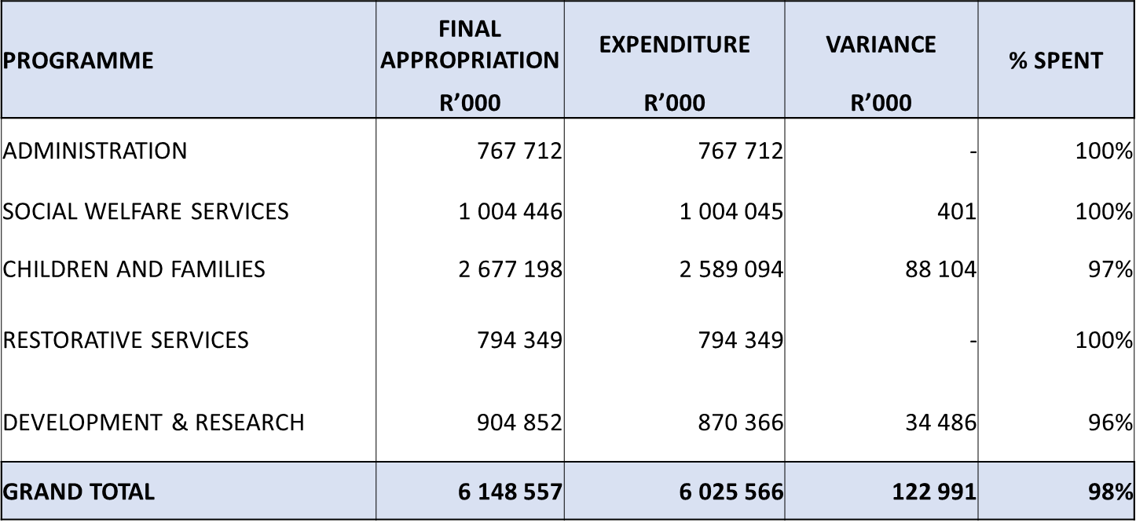
DEPARTMENTAL EXPENDITURE AS AT 31 MARCH 2022: PER PROGRAMME

Slide 71
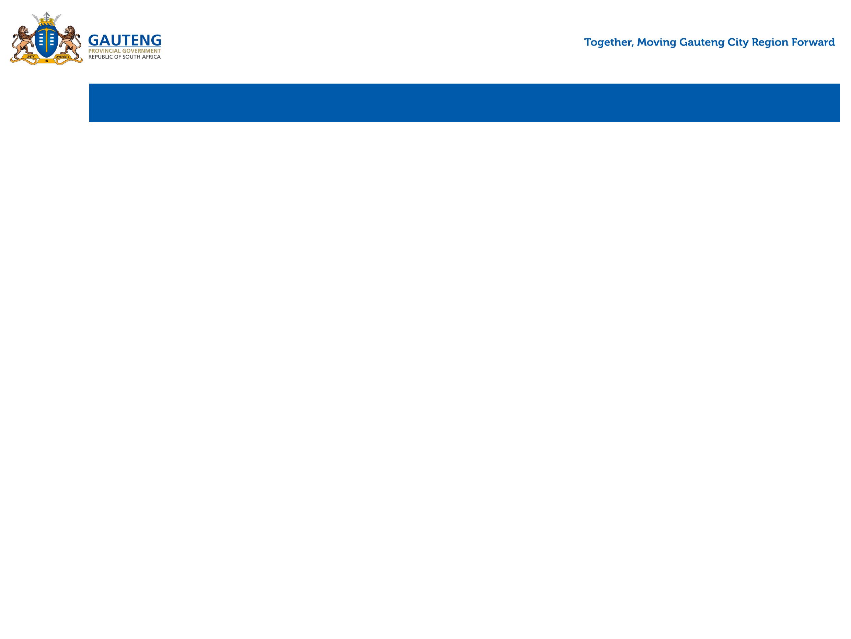
REASONS FOR DEVIATION - SUMMARY PER PROGRAMME
Programme 1: Administration - 100%
The programme spent full allocation by end of the financial year.
Programme 2: Social Welfare Services - 100%
The programme spent full allocation by end of the financial year.
Programme 3: Children and Families - 97%
The underspending in this programme is mainly on the following areas:
  Compensation of Employees – Additional funds received in the adjustment budget to appoint Social Workers on a four-month contract was not spent in full by end of the financial year.
  Non-Profit Institutions - ECD Employment Stimulus Relief Fund reported an underspending of R64 million due to rejections caused by unverified bank accounts, ECD Centres registered as Companies, Partnerships and other forms of businesses other than Non-Profit Organisations.

Slide 72
REASONS FOR DEVIATION - SUMMARY PER PROGRAMME
Programme 4: Restorative Services - 100%
The programme spent full allocation by end of the financial year.
Programme 5: Development and Research - 96%
The allocated budget for dignity packs was not spent in full by end of the financial year due to late finalisation of specifications.
The programme also reported and underspending of R2.3 million on non-profit-institutions.

Slide 73
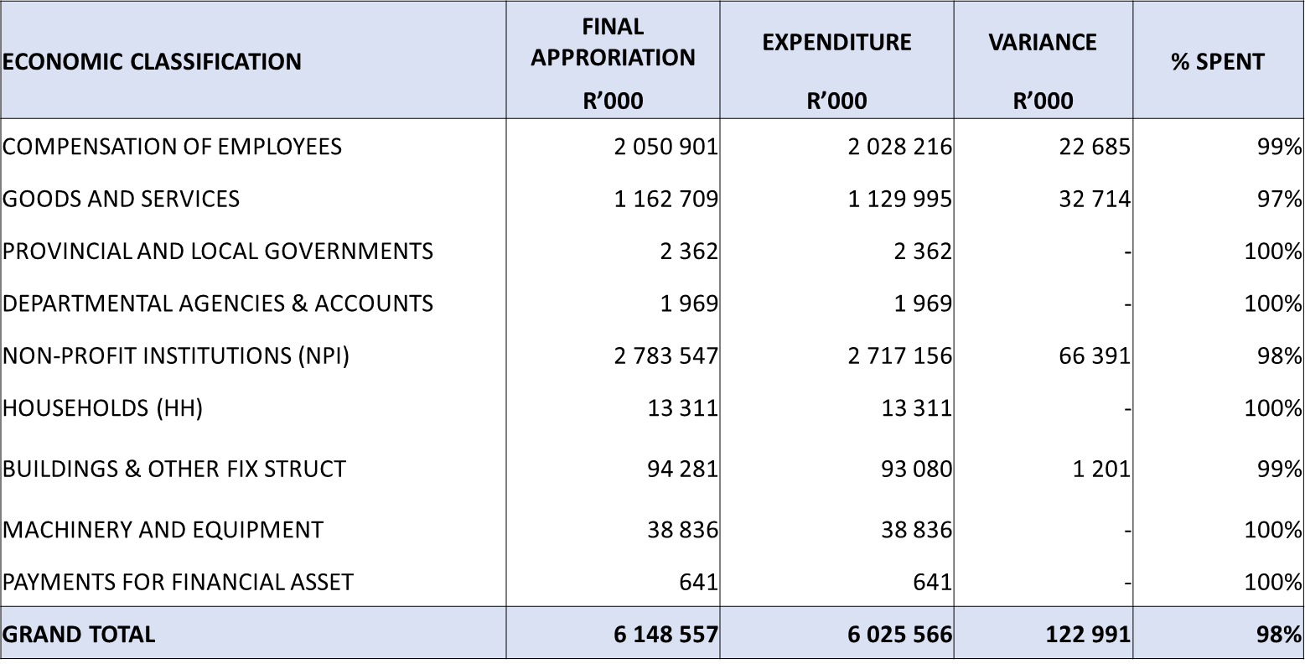
DEPARTMENTAL EXPENDITURE AS AT 31 MARCH 2022 : ECONOMIC CLASSIFICATION

Slide 74
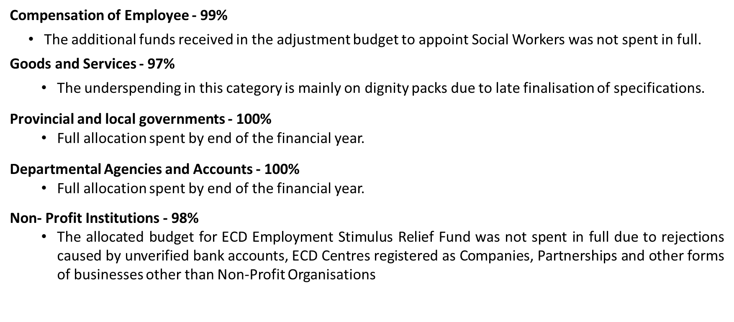
REASONS FOR DEVIATION - SUMMARY PER ECONOMIC CLASSIFICATION

Slide 75
REASONS FOR DEVIATION - SUMMARY PER ECONOMIC CLASSIFICATION
Households - 100%
  Full allocation spent by end of the financial year.
Building & Other Fixed Structure - 99%
  The infrastructure budget was underspent by 1% due to delays in completion of some projects.
Machinery & Equipment - 100%
  Full allocation spent by end of the financial year.

Slide 76
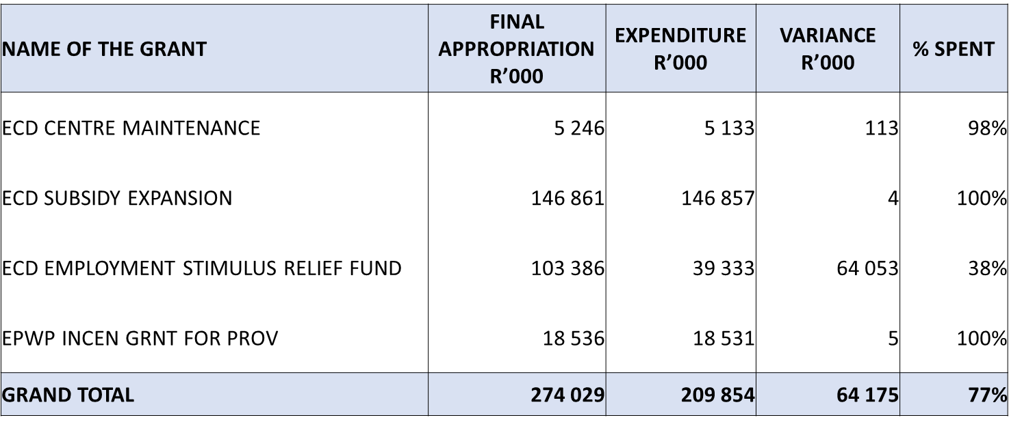
CONDITIONAL GRANT AS AT 31 MARCH 2022

Slide 77
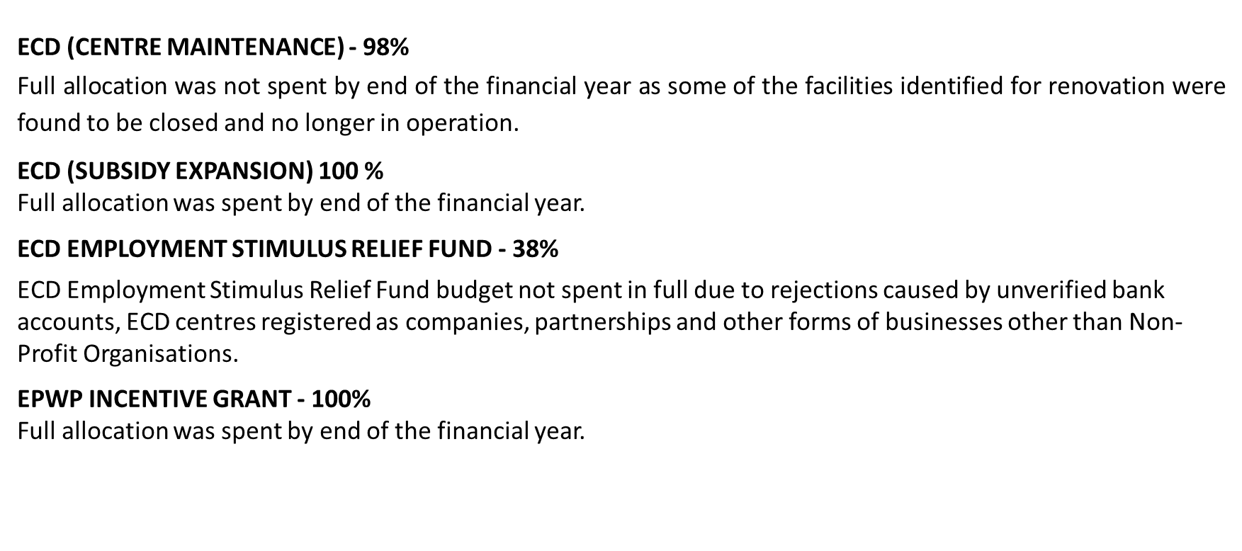
REASONS FOR DEVIATION - CONDITIONAL GRANTS

Slide 78
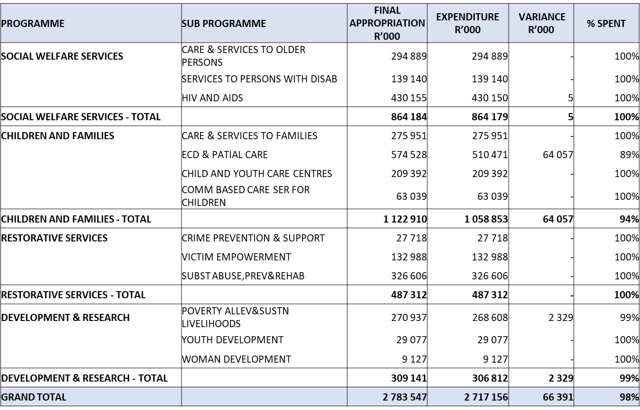
NON - PROFIT INSTITUTIONS EXPENDITURE PER SUB PROGRAMME AS AT 31 MARCH 2022

Slide 79
PAYMENT OF INVOICES WITHIN 15 DAYS

Slide 80
PAYMENT OF INVOICES WITHIN 30 DAYS

Slide 81
PREFERENTIAL PROCUREMENT SPEND AS AT 31 MARCH 2022
HDI(BBBEE) CATEGORG | FY 2021/22 | ACTUALS AS AT 31 MARCH 2022 | TOTAL SPENT
HDI | BBBEE : 80% | HDI: 89.26% | R821 545 441.10
WOMEN | WOMEN: 40% | Women:42.80% | R392 951 681.48
YOUTH | YOUTH: 10% | Youth: 26.86% | R188 528 373.68
PEOPLE WITH DISABILITIES | People with Disabilities :5% | People with Disabilities: 2.14% | R18 387 931.92

Slide 82
TOWNSHIP ECONOMY REVITILISATION SPENDAS AT 31 MARCH 2022
DEPARTMENT NAME | TOWNSHIP | NON-TOWNSHIP | UNCLASSIFIED | TOTAL SPEND | % TOWNSHIP
VOTE 6: SOCIAL DEVELOMENT | R340 944 899.57 | R494 373 136.69 | R56 624 265.84 | R903 831 263.74 | 38%
PROGRESS ON THE IMPLEMENTATION OF TOWNSHIP ECONOMIS REVITILISATION STRATEGY
  Provincial Annual Target: 40%
  Achievement as at 31 March 2022: 38%

Slide 83
Recommendation
It is recommended that the Portfolio Committee note the report as presented.
83

Slide 84

84

