Slide 1

GAUTENG DEPARTMENT OF ROADS AND TRANSPORT
Presentation to the Portfolio Committee on Roads and Transport
02 June 2022

Slide 2
Request to table a Presentation
The Portfolio Committee requested the tabling of a presentation by the Department of Roads and Transport and its entities on the following matters:
  Approved Gautrain Expansion Plan Phase 1
  Launch of the Province wide FIXGP APP to report potholes
  Questions emanating from the Fourth Quarter Report for 2021/22 financial year for DRT, GMA and g-FleeT
  Transport Infrastructure House – Presentation on progress made during the 4th Quarter for 2021/22 financial year
  Detailed report on the progress made in dealing with backlog on the renewal of expired driving licenses
  Presentation on the Role and responsibility of the Krugersdorp Regional Office
2

Slide 3

FIXGP APP to Report Potholes

Slide 4
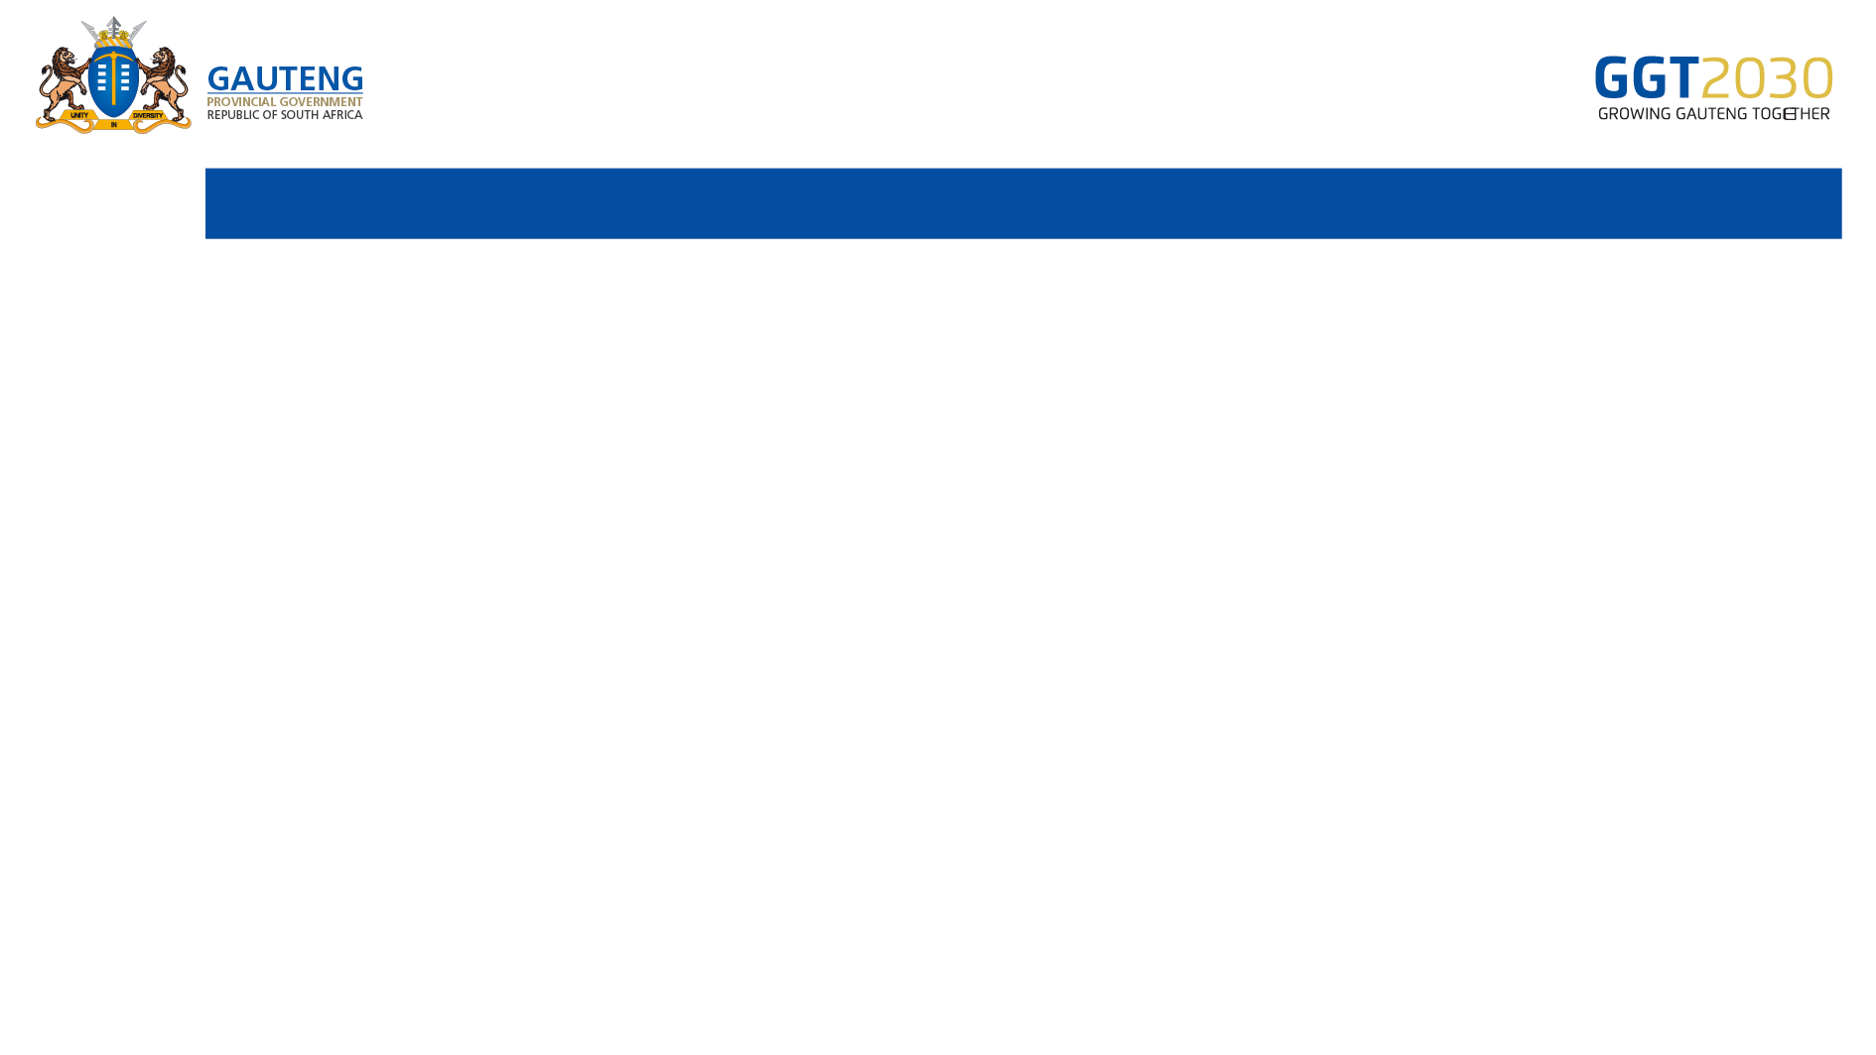
Purpose of the project
The Gauteng MEC of Public Transport and Road Infrastructure, honourable Jacob Mamabolo, the RIMS Directorate developed a pothole reporting app, called PotholeFixGP.
The public has been given an opportunity to interact with the department to report potholes and to receive feedback on the progress of the repairs of the pothole via their email address.
The app also includes a public dashboard where anyone with the app can view reported potholes and the status of the potholes.

Slide 5



APP Download
This app is downloadable from the Google Play Store
Coming Soon on The Huawei App Store & The Apple App Store

Slide 6
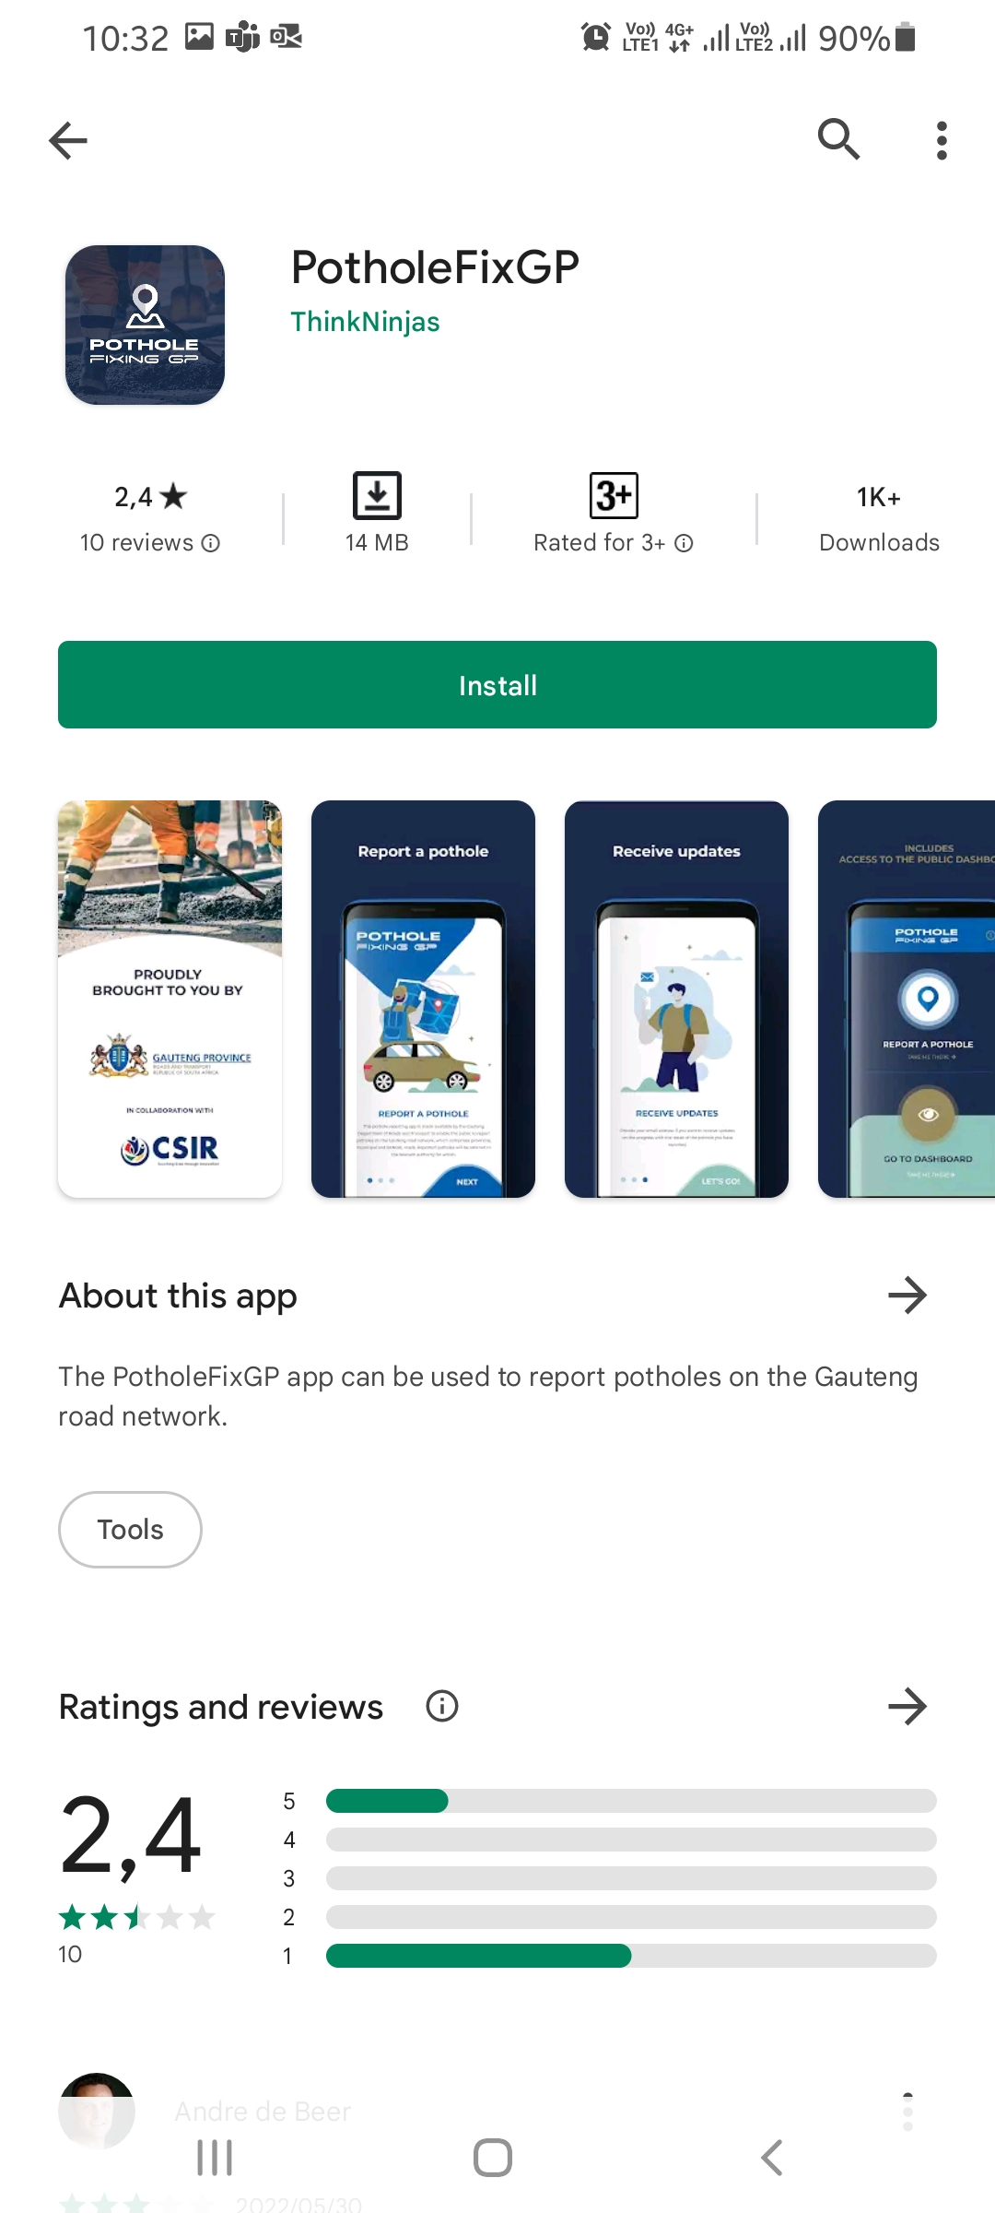
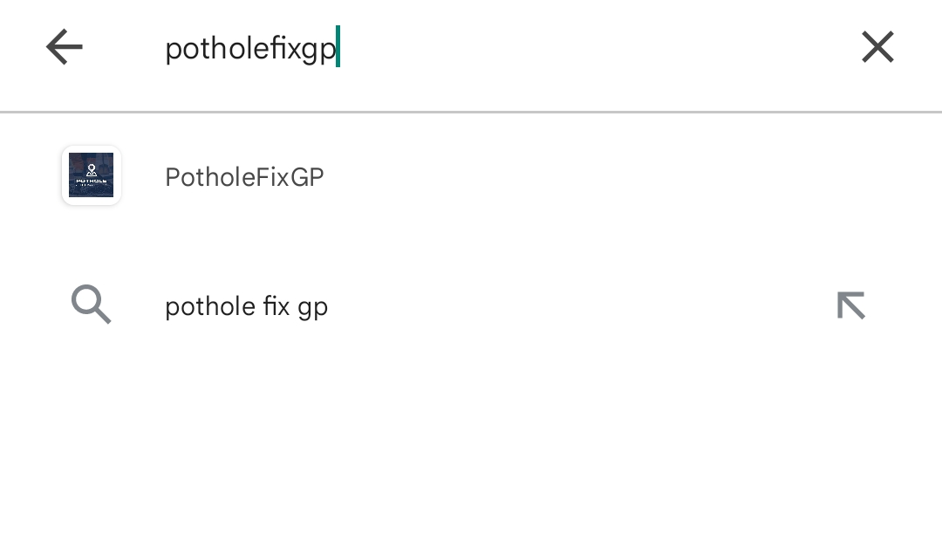
How to download the APP
Search for “PotholeFixGP”
The app must indicate that it is
“Proudly brought to you by Gauteng Province”

Slide 7
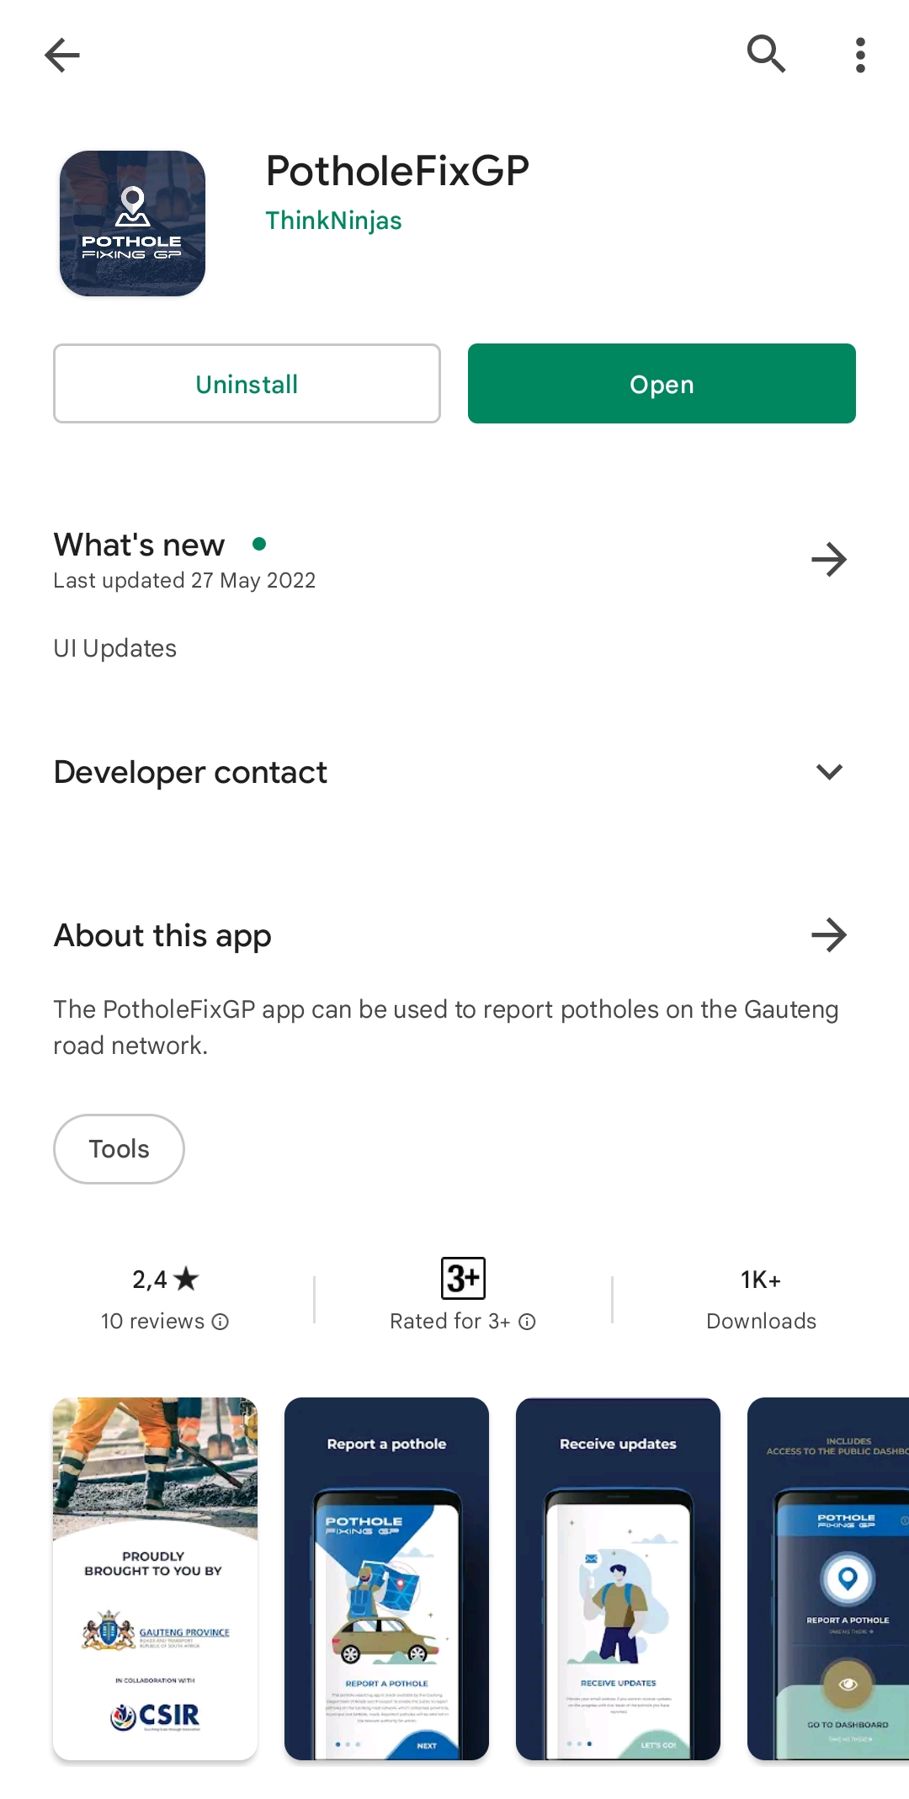
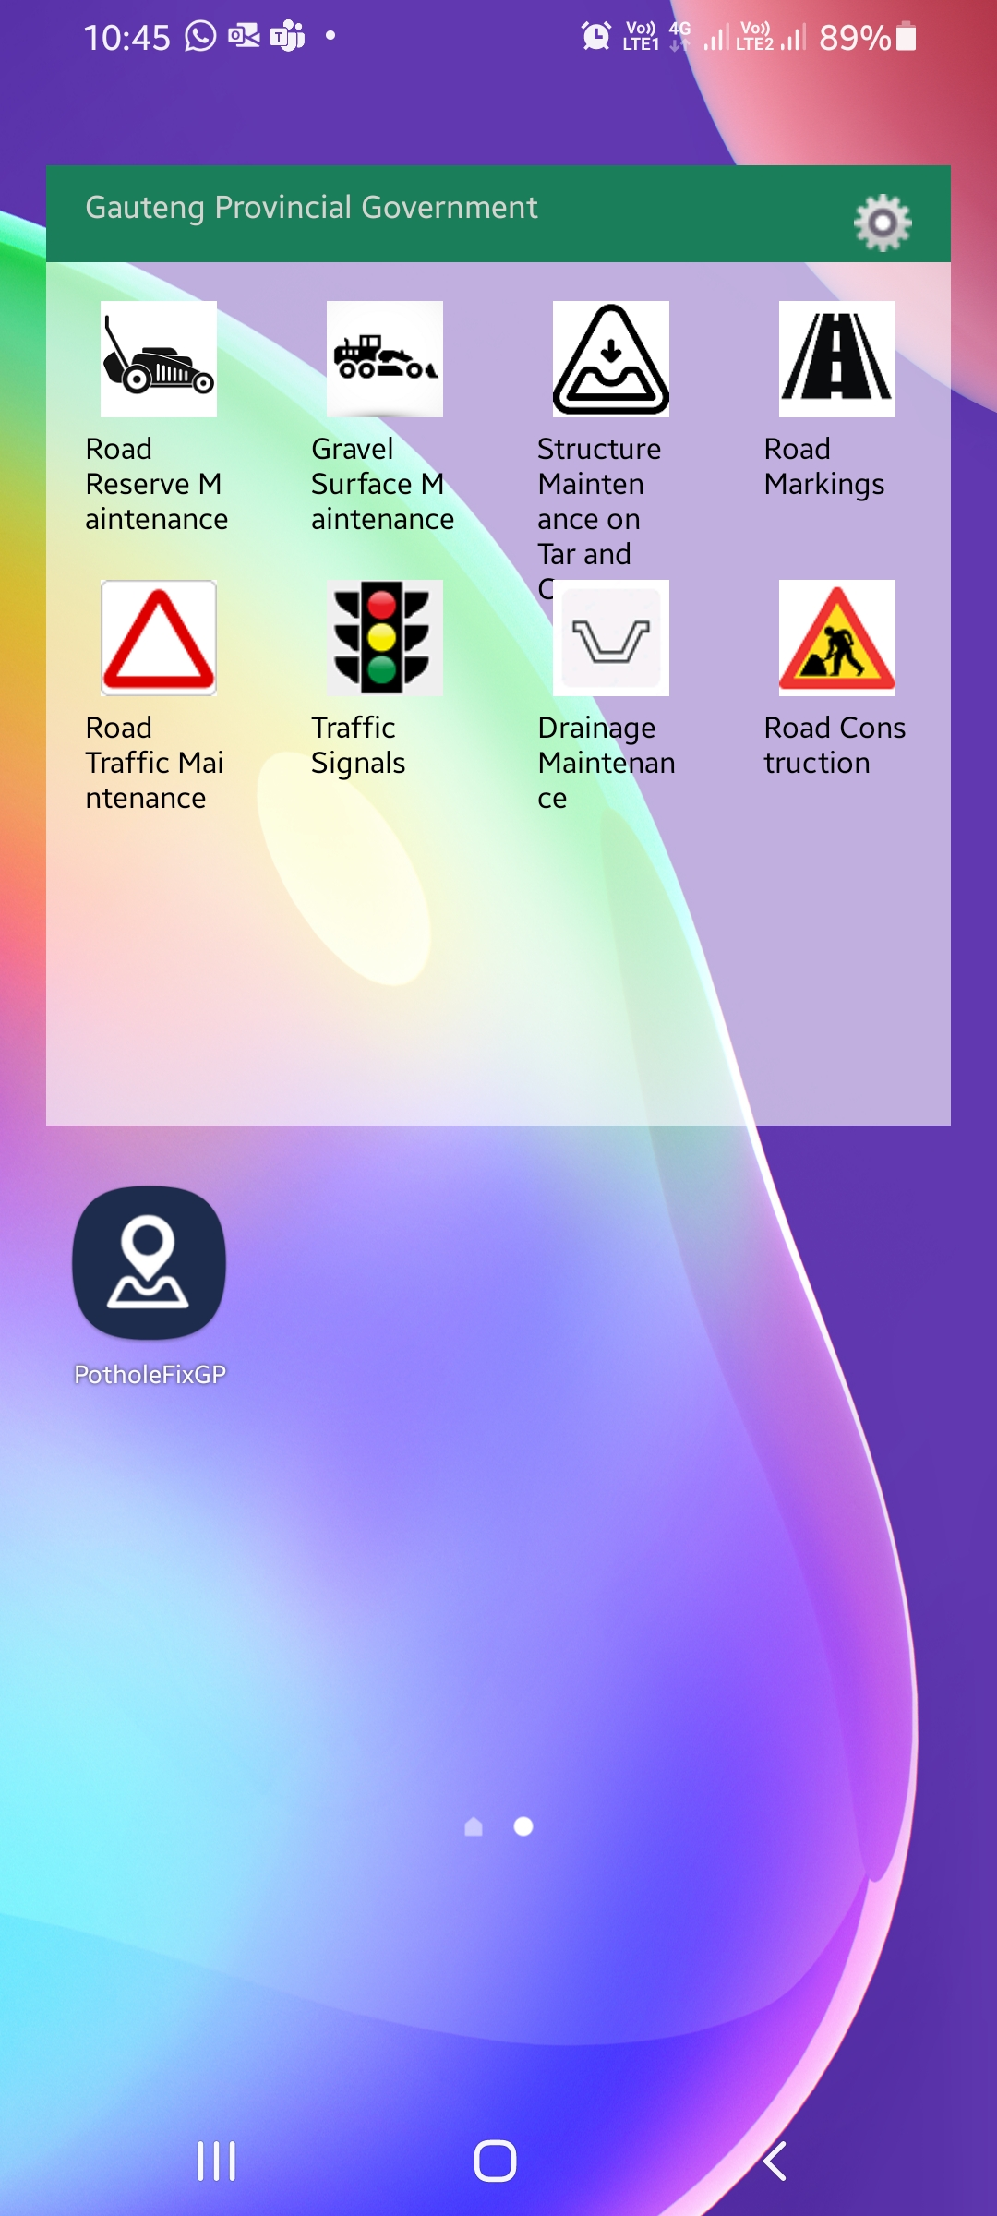
How to download the APP
App Icon once downloaded

Slide 8

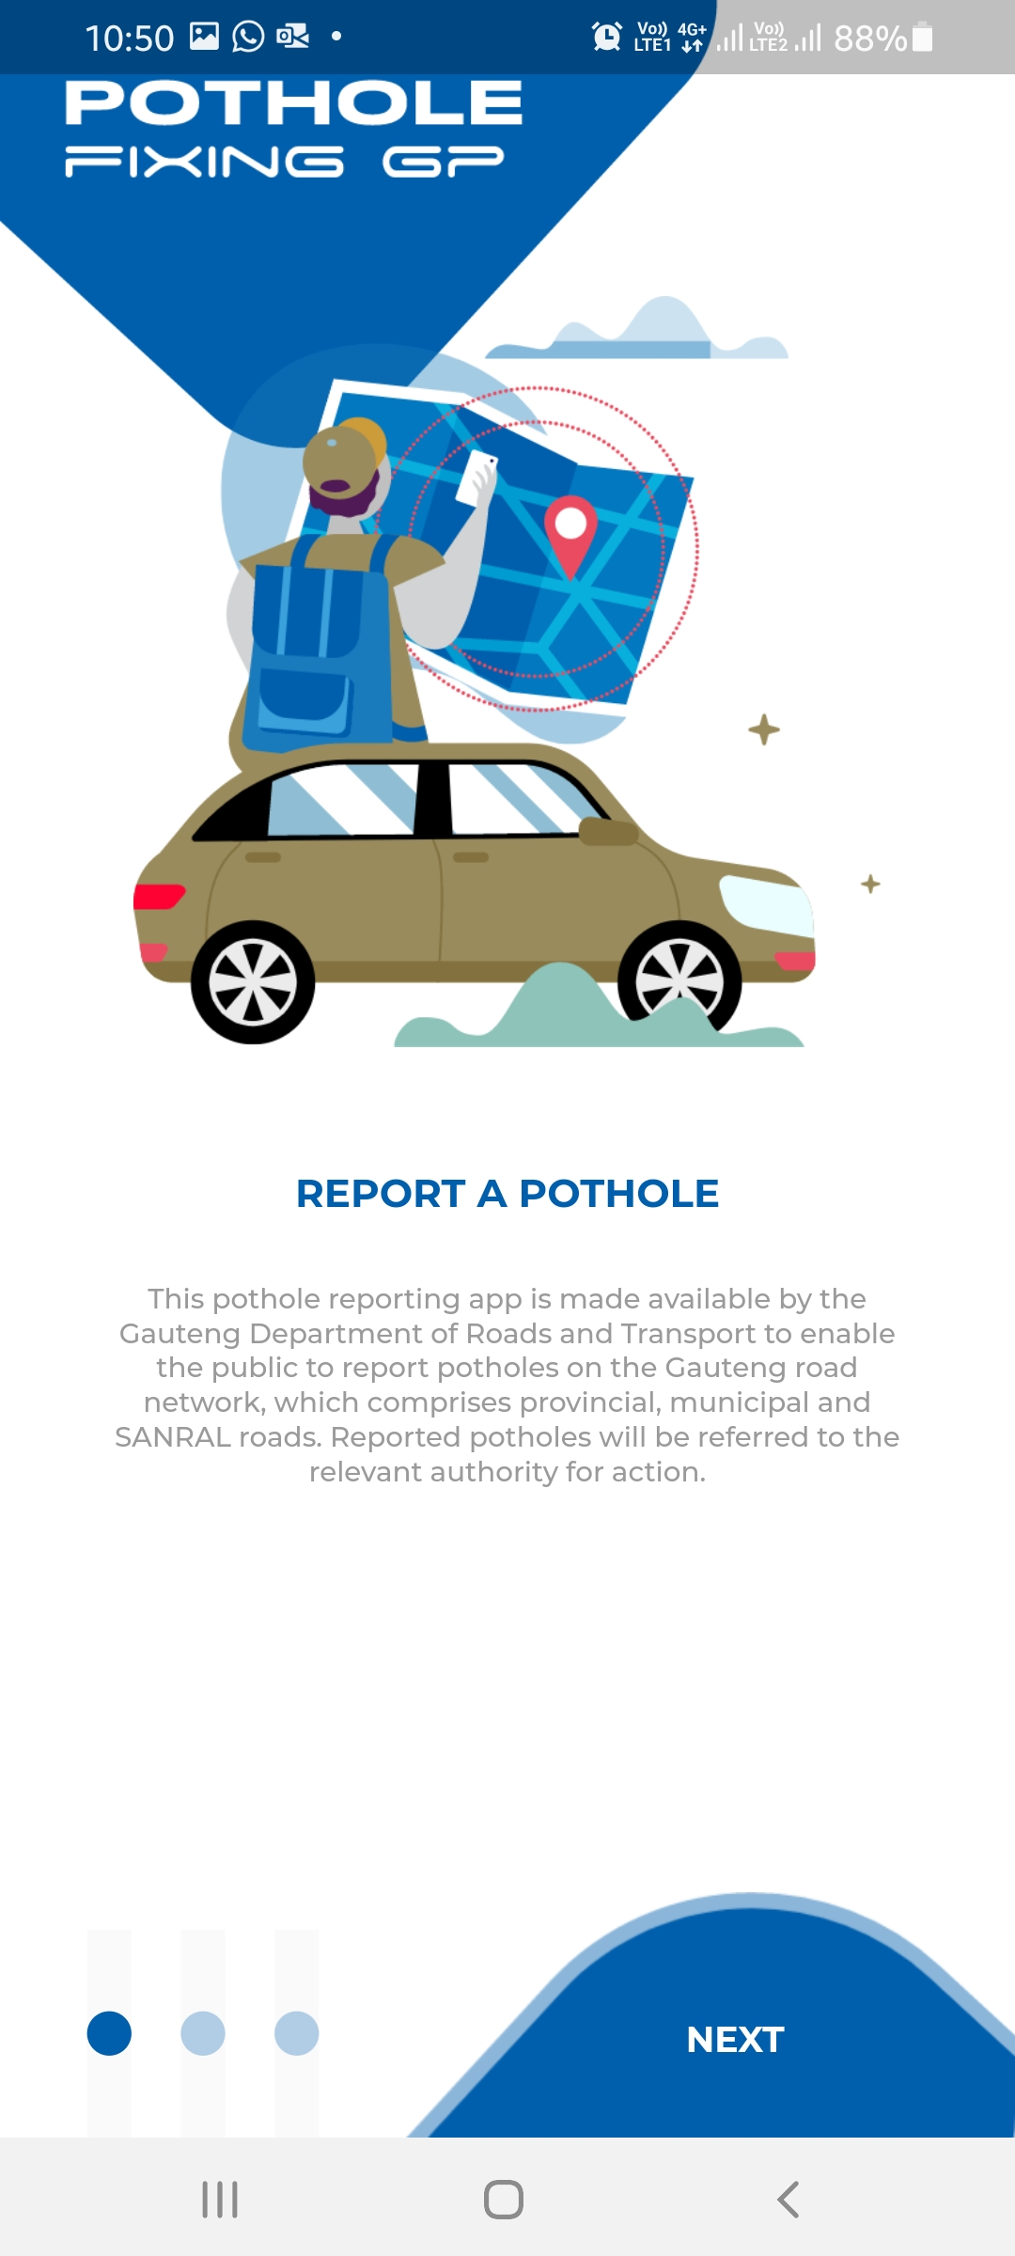
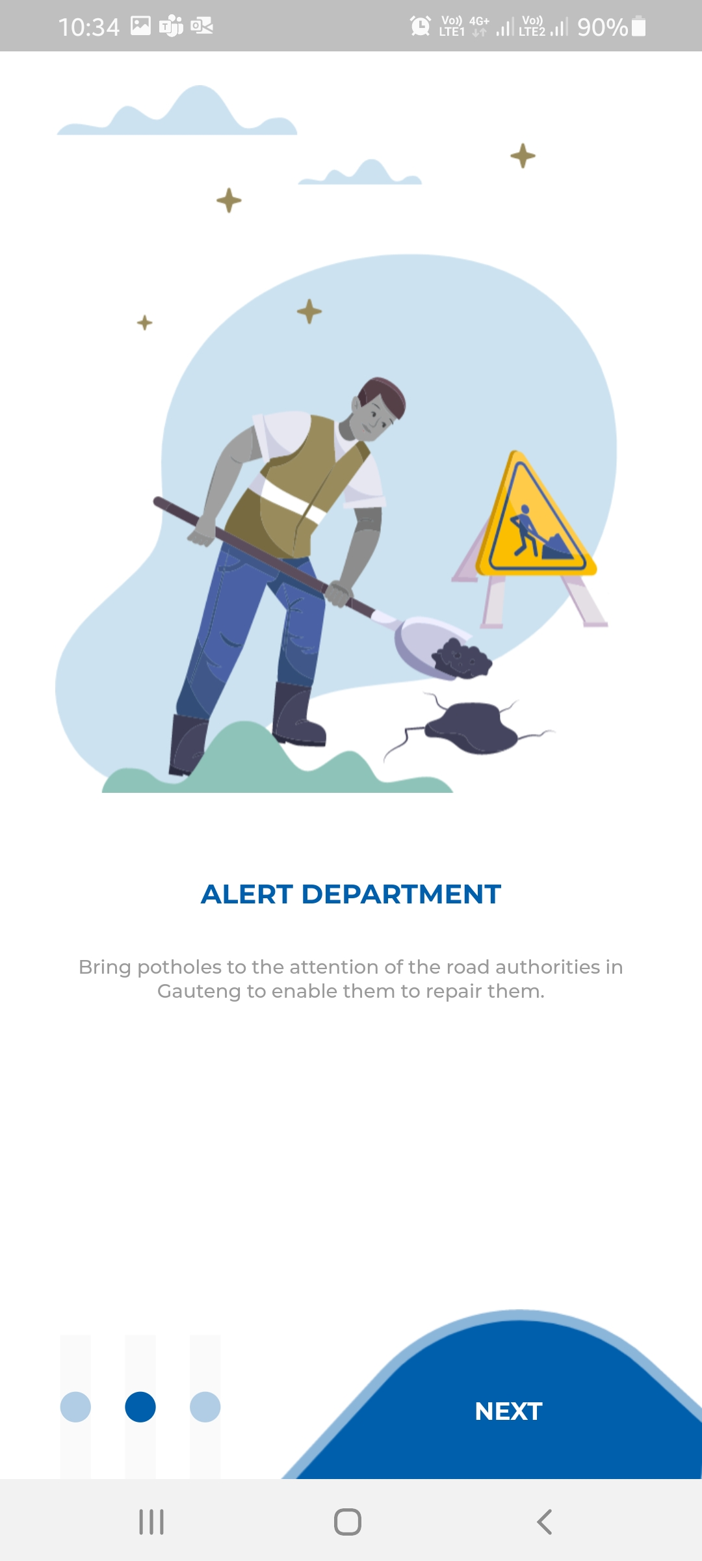

How the APP works
8

Slide 9

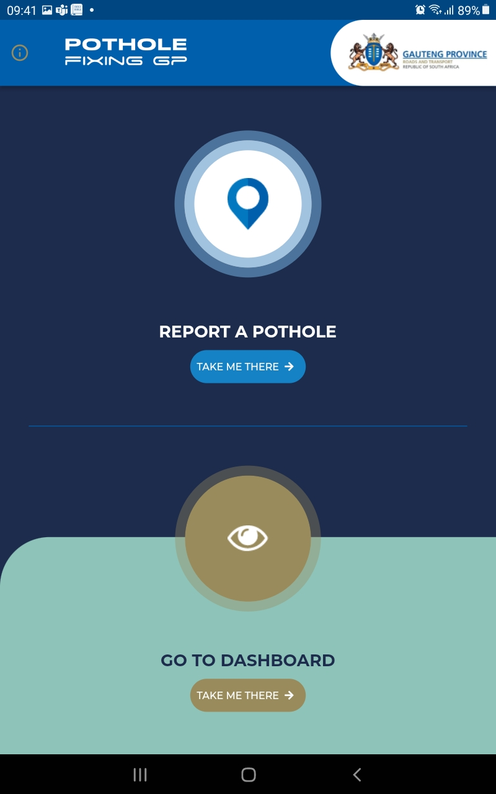
How to report a pothole
Click any of the two to report a pothole
The user will choose between reporting a pothole and viewing the dashboard.

Slide 10
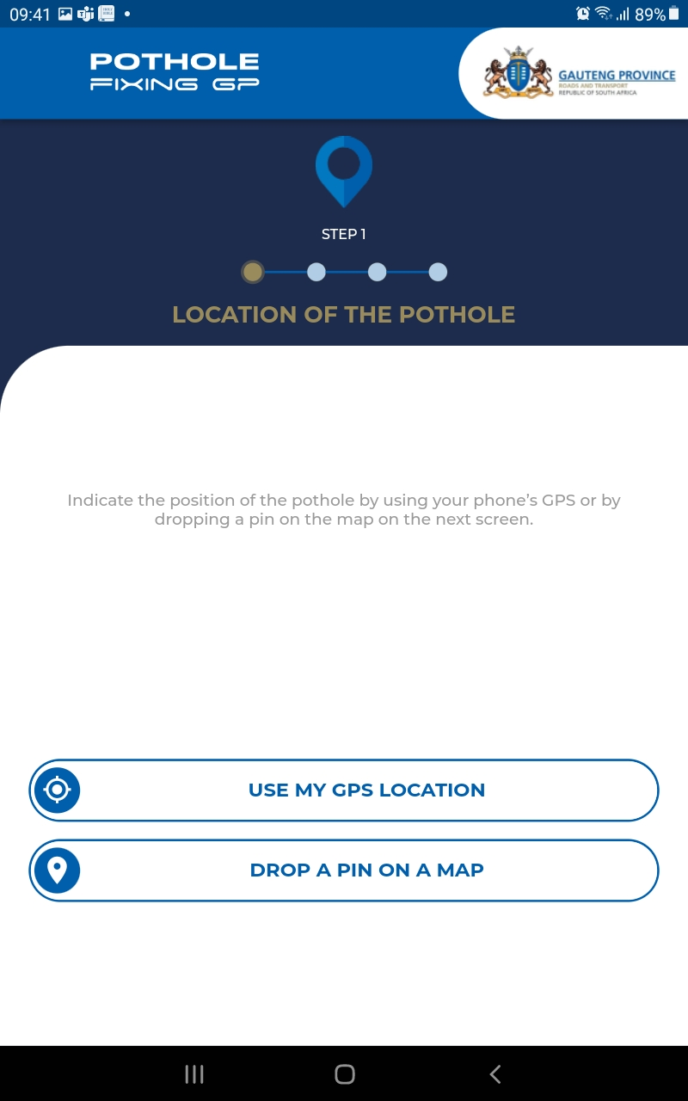
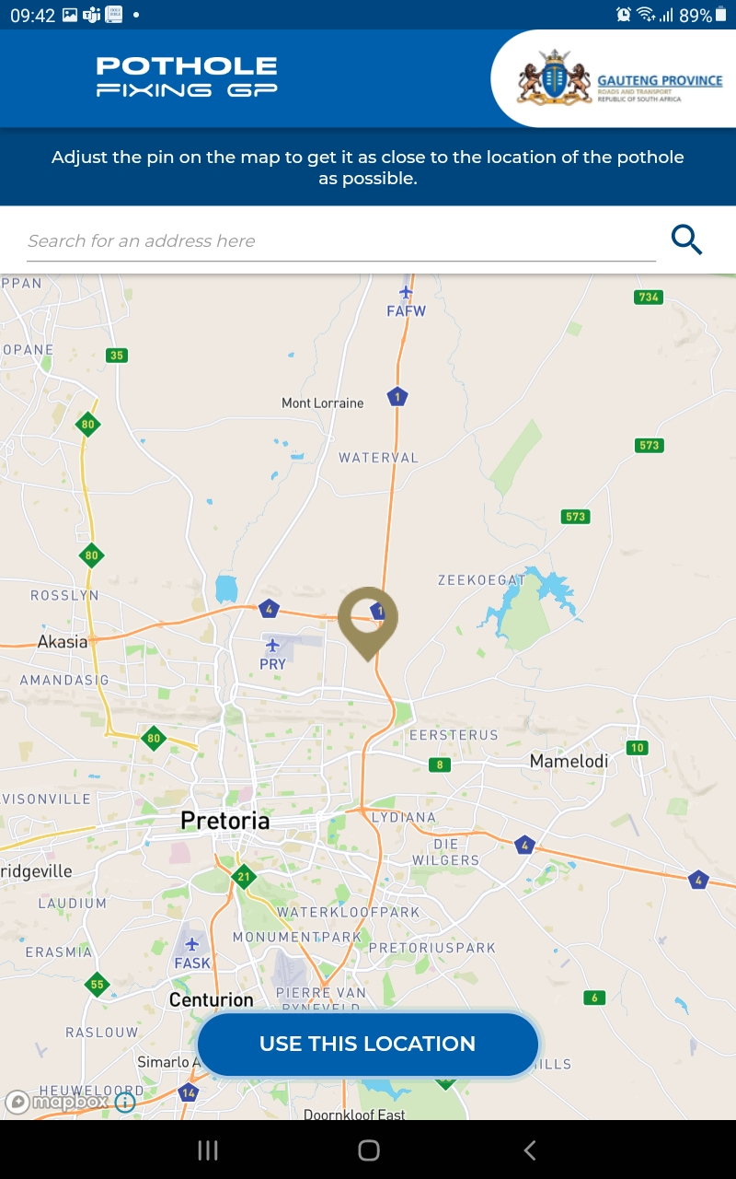
How to report a pothole
Use when you are directly at the location of the pothole
Use when you are in a different location to show where the pothole is
Select once satisfied with the location.

Slide 11
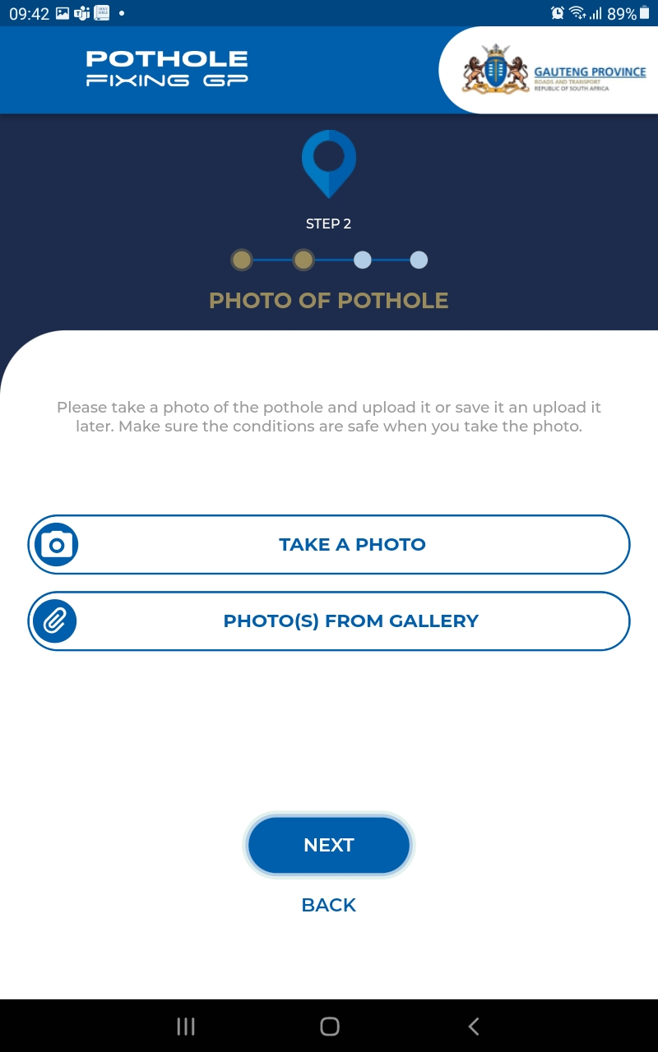
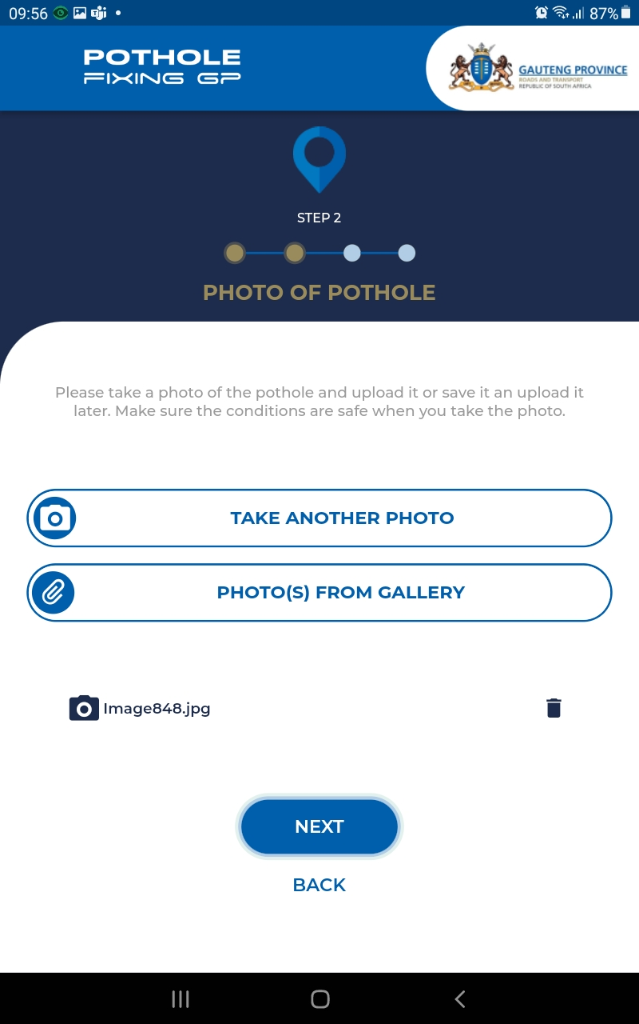
How to report a pothole
If you are in an area that is safe and you are able to take a picture and upload it immediately
If photos were taken in a different location before the report was started
The selected picture attached to the app

Slide 12
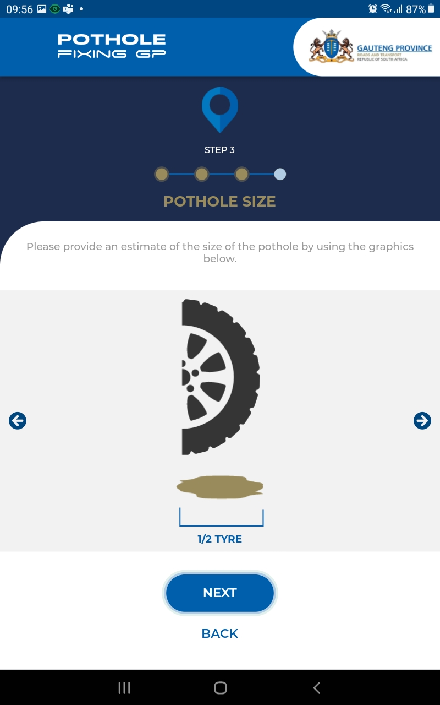
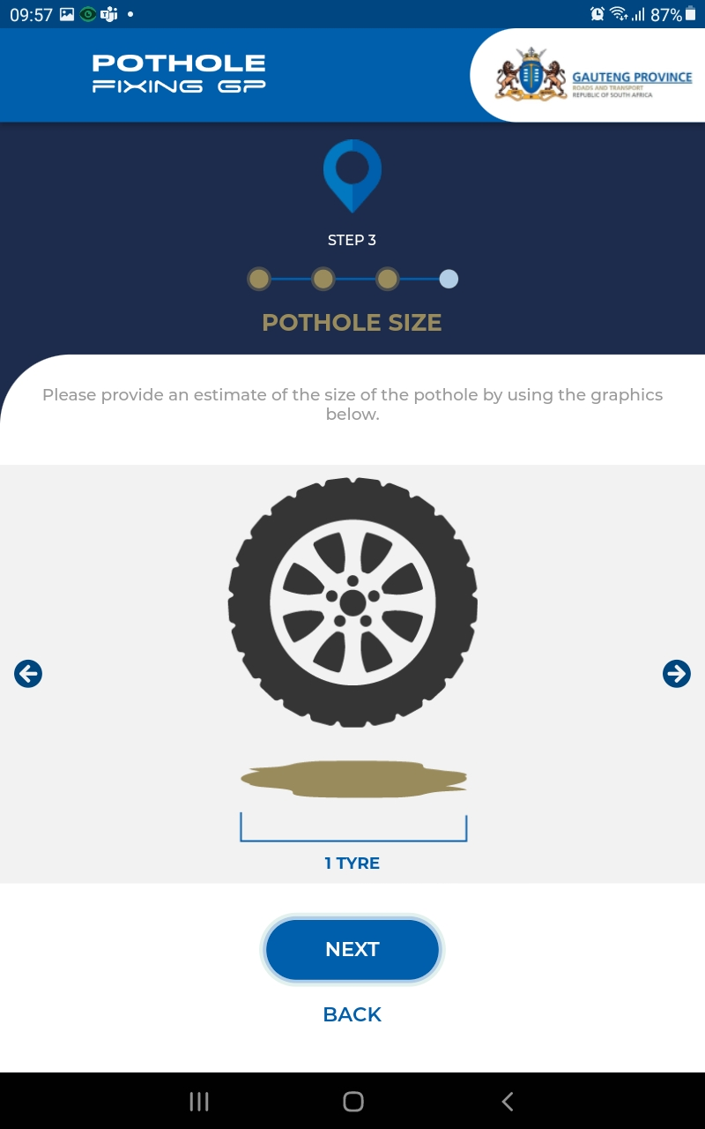
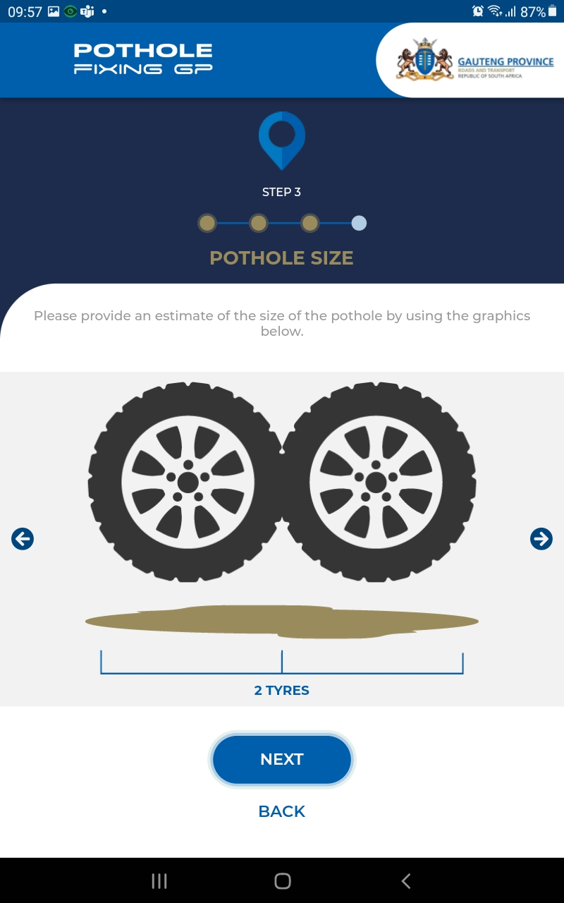
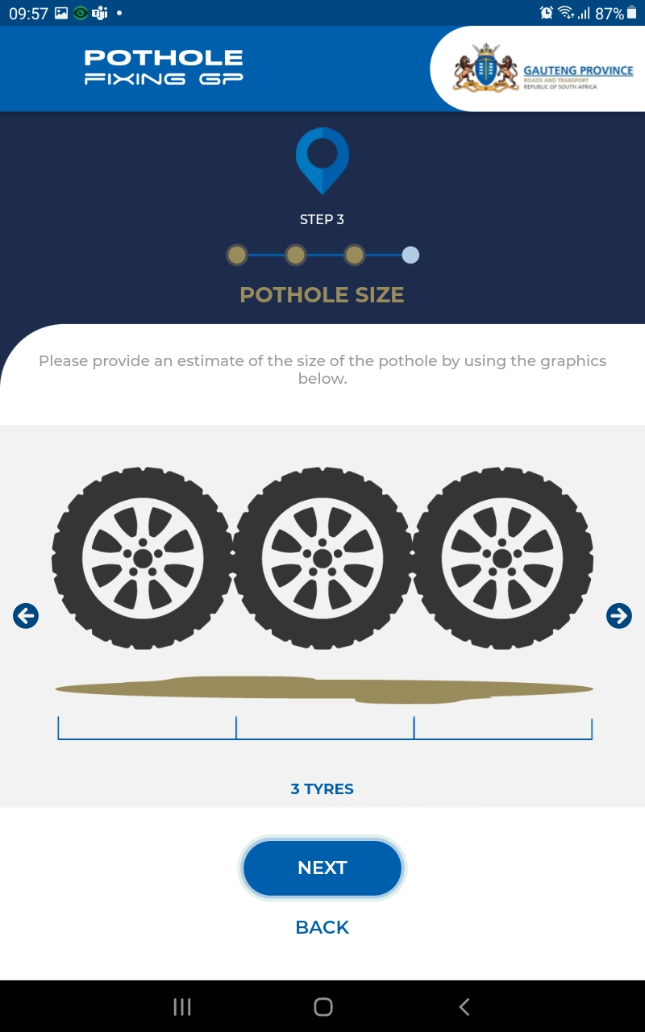
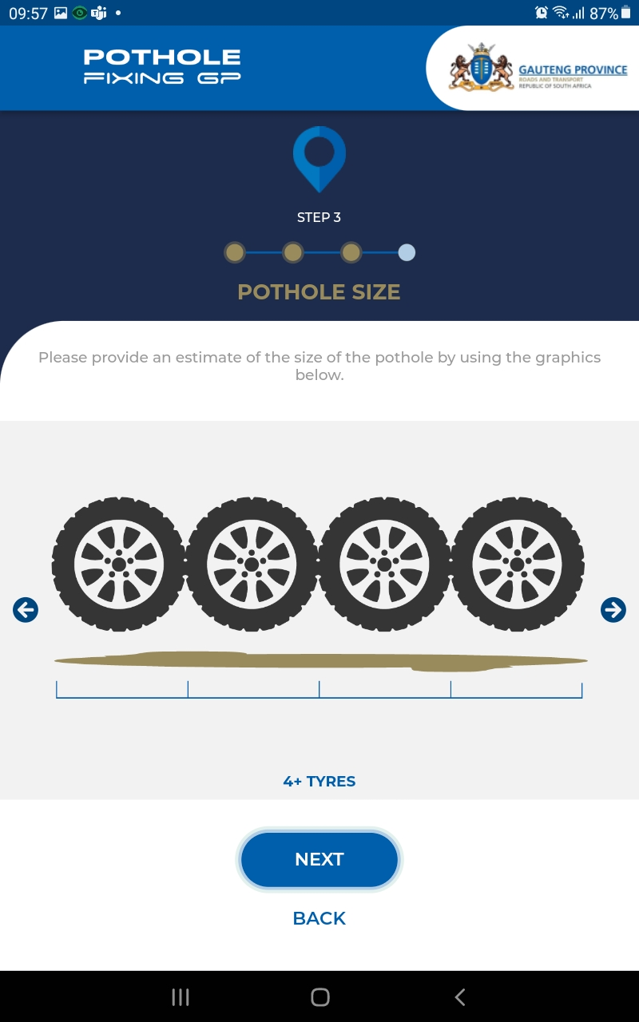
How to report a pothole
Indicate the size of the pothole by selecting the best fitting tire size.

Slide 13
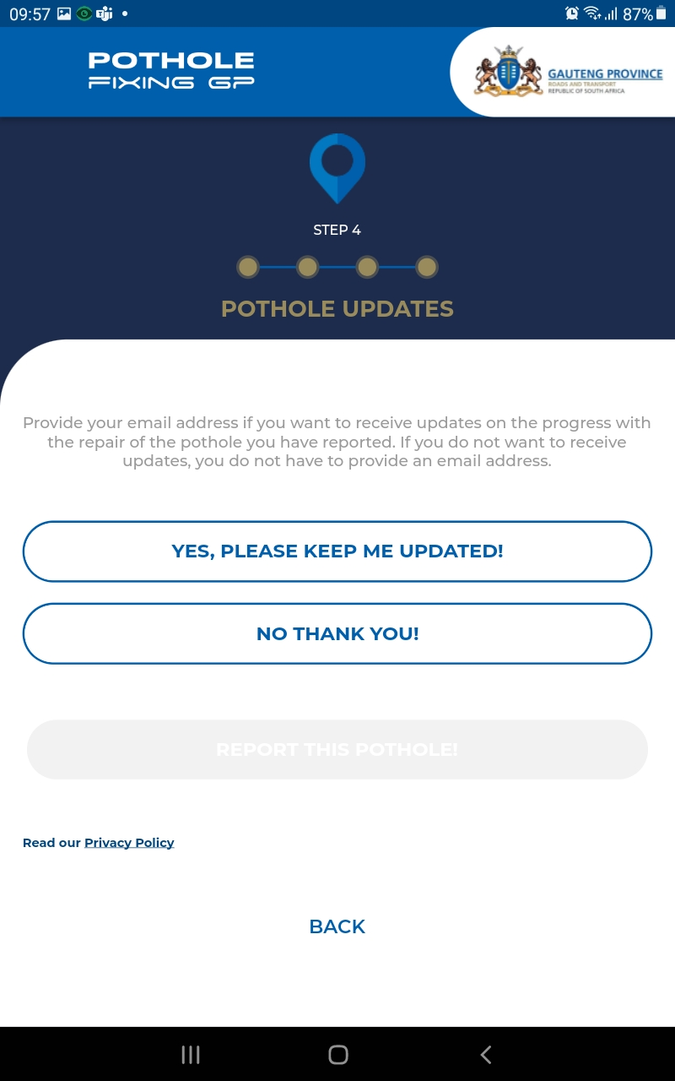
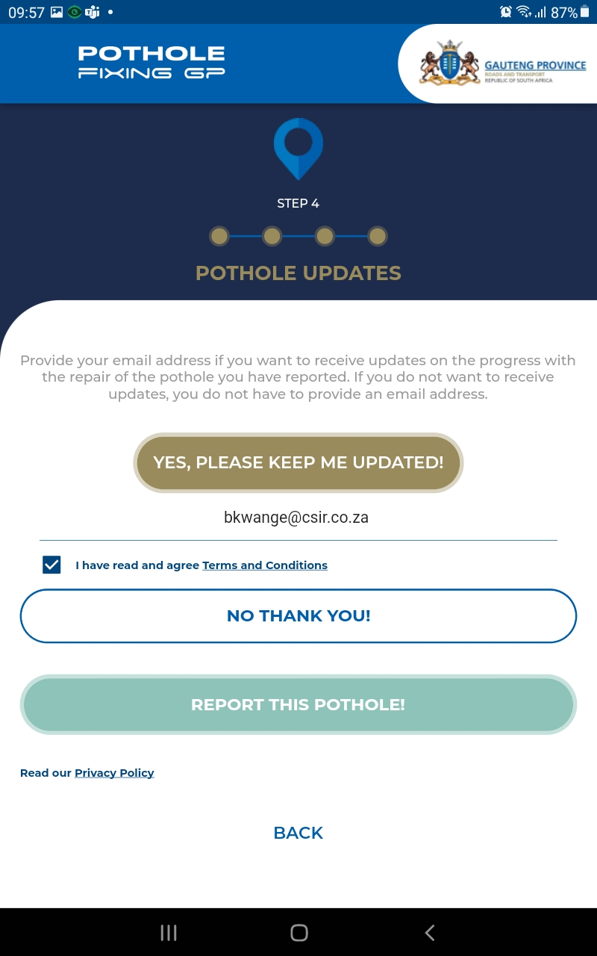
Pothole Reported
To receive updates on the status of the reported pothole please provide your email address
Please read all terms and conditions.

Slide 14
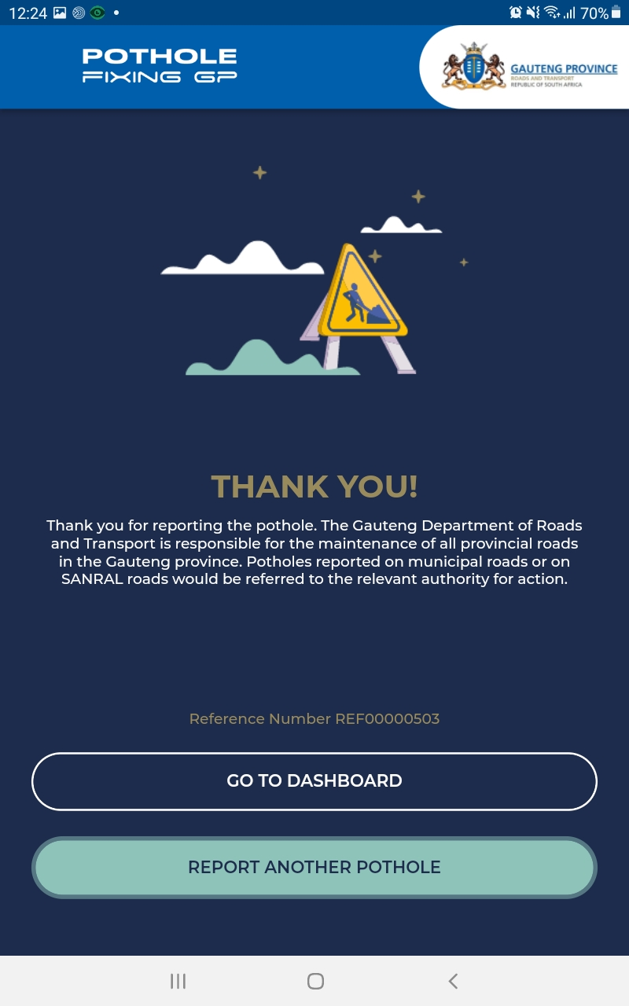
Pothole Reported
Please take a screenshot of this page so that you do not lose your reference number.

Slide 15
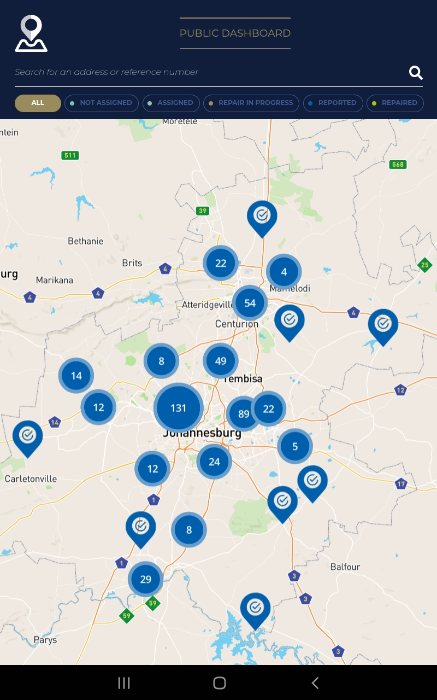
Public Dashboard
Use the last three digits of your reference number to search for your pothole status.

Slide 16
Questions emanating from the Fourth Quarter Report for 2021/22 financial year

Slide 17
Response to Quarter 4 Questions
The Department should explain why the actual achievements were not reported on the percentage expenditure awarded to Historically Disadvantaged Individuals, youth, Women and People with Disability.
The Department receives the actual achievements from Provincial Treasury upon which they review and effect the necessary amendments. Due to Quarter 4 being financial year end, Treasury informed the Department that there were delays in finalising the data and releasing it on time for reporting. The Department received the Quarter 4 expenditure reports for Historically Disadvantaged Individuals, youth, Women and People with Disability from Provincial Treasury in April 2022, which was after the submission of the Quarter 4 report to Provincial Legislature due date of 31st March 2022.
17

Slide 18
Response to Quarter 4 Questions
The Department should indicate the purpose and objectives of the two research surveys that were deferred to the current financial year.
The Department deferred one survey (The Customer Satisfaction Survey); the details are outlined below.
Background and Purpose of the Customer Satisfaction Survey
The Department had identified the need to conduct a Customer Satisfaction Survey in the Gauteng province, specifically in terms of how customers in the province perceive the Department and what service delivery expectations they have.
The purpose of this survey is to find out how satisfied customers are with the services provided by the GDRT. The findings of this investigation will help determine whether the Department is meeting the minimum satisfaction level.
Objectives of the Study
The survey should determine the expectations and concerns of Department of Roads and Transport (GDRT) customers and address the following questions:
  How satisfied are GDRT customers with various services and aspects of GDRT's relationship with them?
  What are the GDRT customers' expectations?
  How can GDRT improve the way its customers perceive it?
  Serve as a diagnostic tool for DRT to facilitate effective assessment of and solutions to service delivery problems
  Document both the best practices and to find arrears of improvement in identified gaps.
18

Slide 19
Response to Quarter 4 Questions
WORKING FROM HOME SURVEY REPORT
The second survey was a short quick survey conducted internally, titled The Work from Home Survey.
Purpose of the survey
The purpose of the survey was to establish if working from home was feasible during the nation-wide lockdown and could be normalised or adopted going forward. In addition, the survey also focused on identifying the relevant tools or resources required by employees to ensure business continuity while working from home or remotely.
Objectives of the Survey:
State of readiness by the department when WFH.
Is it achievable to work from home?
Any recommendations that can be brought forward to the management in order to improve working conditions.
19

Slide 20
Response to Quarter 4 Questions
The Department should also provide a summary of transport section in the Quality-of-Life Research Survey that was conducted by the Gauteng City Region Observatory.
20

Slide 21
Summary on transport from Quality-of-Life Survey 6 (2020/21) Overview Report
Background
Data Collection
Quality Assurance
Most frequent trips
Public transportation accessibility and perceived safety
e-Hailing
Findings from the GCRO QOL 6 2020/21 Report
21

Slide 22
Background
Gauteng has the highest population share in South Africa, with the following cities (Johannesburg, Ekurhuleni, and Tshwane, as well as the district municipalities of the West Rand and Sedibeng)
Gauteng has a current population of approximately 15,81 million people, according to South Africa's mid-year population estimate for July 2021.
COVID-19 had a negative impact on transportation because most people were forced to work from home (as well as attend meetings virtually) and attend classes virtually.

Slide 23
Data Collection
This was delayed by six months due to the state of emergency , however this allowed sets of questions to be included on the impact of Covid-19 on households.
The data collection began on October 26, 2020, to 27 May 2021.
The rate of data collection slowed slightly in early 2021 as the COVID-19 second wave increased refusals and more stringent COVID-19 protocols made access to some areas more difficult. A period of heavy rain across Gauteng complicated logistics and slowed fieldwork progress.
Sanitized data collection devices were given to participants to complete the self-completion section. During the second wave, which lasted from early January 2021 to early March 2021, COVID-19 protocols were strengthened to ensure safety.

Slide 24
Quality Assurance
The quality control processes for QoL 2020/21 were designed to ensure confidence in the survey results while also ensuring the timely and smooth implementation of data collection and finalization.
To ensure the accuracy of sampling and interview administration, as well as the data itself, quality control used a variety of methods.
All incoming data was subjected to automated checks to ensure that any issues with sampling, questionnaire administration, or data quality were identified quickly.
Telephonic call backs and in-field revisits were used to resolve data queries. Furthermore, approximately 25% of respondents received random telephonic call backs during the data collection period.

Slide 25
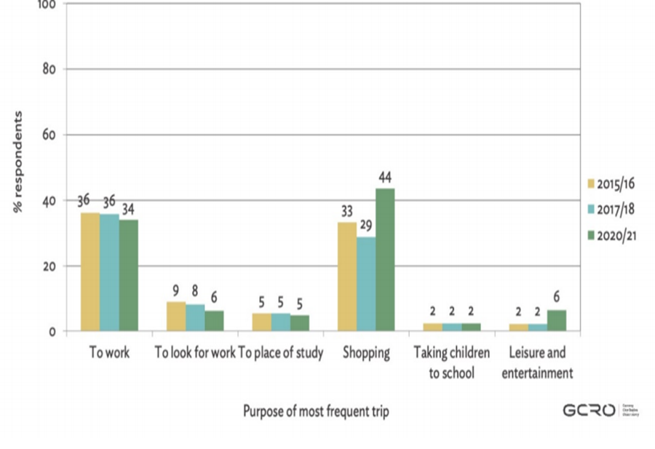
QoL Report Findings
Most Frequent Trips:
Trips to the shops were the most common reason for respondents' trip-making in the QoL 2020/21 Survey, accounting for nearly half (44 percent) of the most frequent trips – a 15 percentage point increase from 2017/18 (29 percent), as indicated below.
Figure 3.1: Percentage of respondents reporting purpose of most frequent trip over survey iterations. Data sources: GCRO QoL 6 (2020/21), GCRO QoL V (2017/18) and GCRO QoL IV (2015/16).

Slide 26
Most Frequent Trips: Purpose of trips
Summary:
Trips to the shops were the most common reason for respondents' trip-making in the QoL 2020/21 Survey
Thus, representing a significant shift from 2017/18, when commuting to work was the most common reason for people to travel.
Compared to the previous two surveys, the percentage of respondents who travel to work, look for work, or study has decreased. These findings are most likely the result of the pandemic's altered mobility patterns.

Slide 27
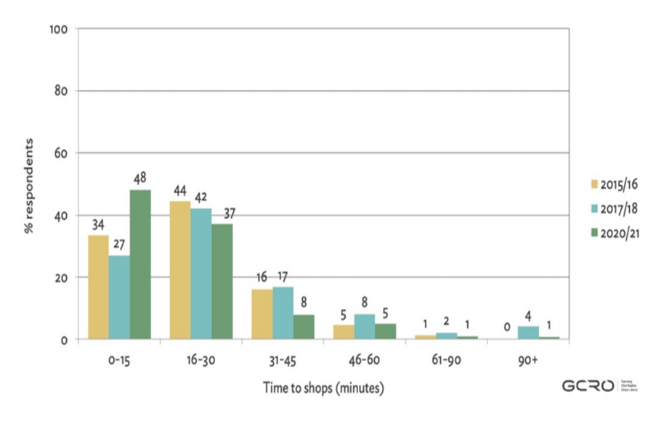
QoL Report Findings
Most Frequent Trips:
Shopping trips, respondents' most frequent trip, have become more local, with nearly half (48%) taking less than 15 minutes to reach the shops (Figure 3.2).
Figure 3.2: For respondents whose most frequent trip is for shopping, reported travel time over survey iterations. Data sources: GCRO QoL 6 (2020/21), GCRO QoL V (2017/18) and GCRO QoL IV (2015/16).

Slide 28
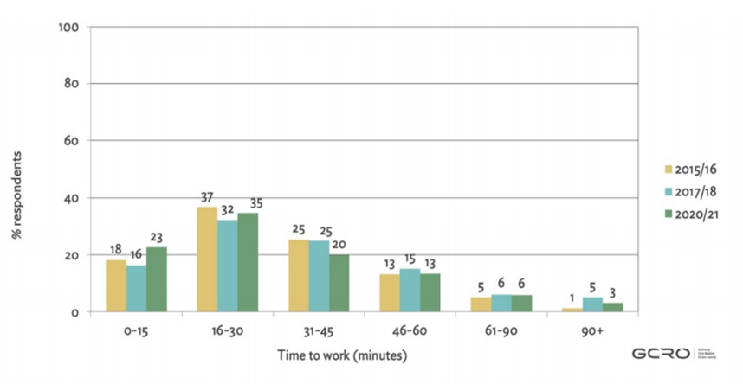
QoL Report Findings
Most Frequent Trips:
Commuting time has decreased in recent years, with 57 percent arriving at work in less than 30 minutes (Figure 3.3). This could be due to a variety of factors, including respondents traveling shorter distances and less traffic.
Figure 3.3: For respondents whose most frequent trip is to work, reported travel time over survey iterations. Data sources: GCRO QoL 6 (2020/21), GCRO QoL V (2017/18) and GCRO QoL IV (2015/16).

Slide 29
Most Frequent Trips - Commuting times
Summary
Private vehicles and minibus taxis continue to be the most popular modes of transportation in Gauteng (33 percent and 43 percent, respectively), followed by walking (19 percent).
Figure 3.4 shows that the percentage of people who use trains as their primary mode of transportation has decreased significantly, from 3% in 2015/16 to nearly zero (0.4%) in 2020/21.
This could be explained by a modal shift caused by train closures during lockdown level 5, as well as the extent of train infrastructure vandalism in 2020 and 2021.
Cycling has increased in other parts of the world as a result of the pandemic. This trend has not been seen in South Africa, most likely due to the barriers to cycling as a mode of transportation, such as long distances and hazardous conditions.

Slide 30
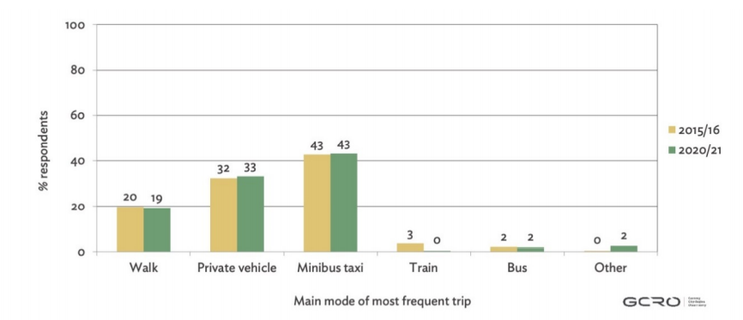
QoL Report Findings
Most Frequent trips:
Figure 3.4: Main mode of transport used in the most frequent trip, over survey iterations. Data sources: GCRO QoL 6 (2020/21) and GCRO QoL IV (2015/16).

Slide 31
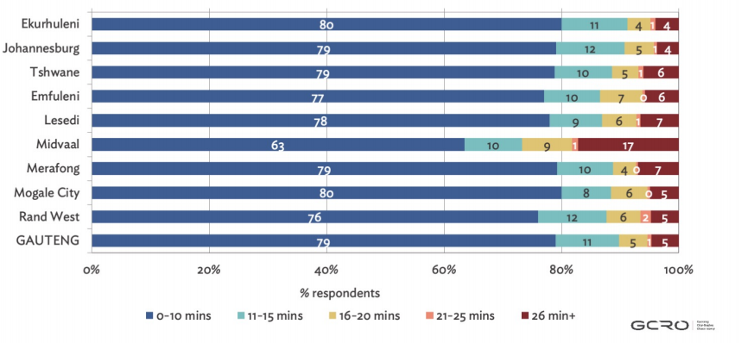
Public Transportation Accessibility and Perceived Safety
The vast majority of Gauteng respondents (79%) said they live within ten minutes of a public transportation access point (e.g. bus station, taxi route).
Figure 3.5 shows that these results are fairly consistent across the province’s municipalities.

Slide 32
Public Transportation Accessibility and Perceived Safety
The Survey also found that a vast majority of Gauteng respondents (79%) reported that they live within a ten-minute walk of a public transport access point (e.g. bus station, taxi route). These results are fairly consistent across Municipalities in the Province.
There has been an encouraging drop in the proportion of respondents who walk more than twenty-five (25) minutes to reach public transport (from 9% in 2017/18 to 5% in 2020/21).
The majority of those who use public transportation reported feeling safe while waiting for and using public transportation (75 percent and 74 percent respectively).
Nearly one in every five people feels unsafe while waiting for or using public transportation (18 percent for both). This demonstrates that more work needs to be done to improve public transportation safety.

Slide 33
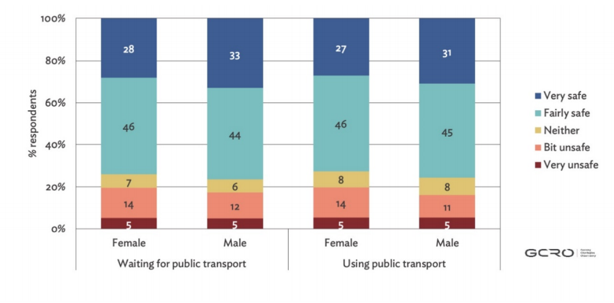
Public Transportation Accessibility and Perceived Safety - Gender
There is a slight difference in perceived safety between men and women, with women feeling slightly more unsafe than men while waiting for and using public transportation (Figure 3.6).
Women are also less likely than men to feel safe.
Figure 3.6: Male and female public transport users’ perceived level of safety while waiting for and using public transport. Data source: GCRO QoL 6 (2020/21).

Slide 34
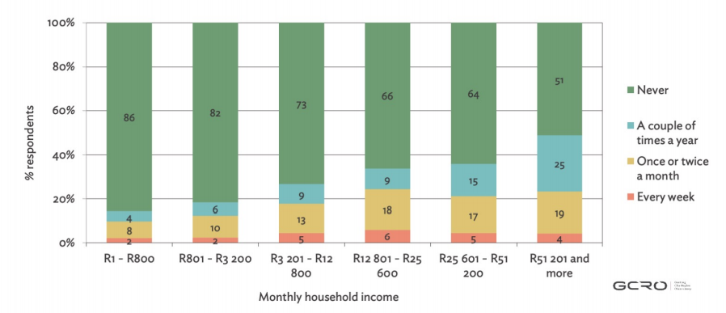
e-Hailing
24 percent of QoL 2020/21 respondents said they use e-hailing services (Figure 3.7).
Figure 3.7: For each income group, percentage of respondents reporting frequency of use of e-hailing taxis. Data source: GCRO QoL 6 (2020/21).
According to the survey, the use of e-hailing taxis is correlated with income, with usage increasing with income.
Some twenty-four percent (24%) of QoL 2020/21 respondents indicated that they make use of e-hailing services
While these services can be more expensive than other forms of public transportation, the fact that 14% of people in the lowest income group (R1–R800 per month) use e-hailing, and in some cases on a regular basis, shows that it is not solely a high-end transport option.

Slide 35
Findings from the GCRO QoL 6 2020/21 Report
There was a decrease in the percentage of people traveling to work, to look for work, and to places of study when compared to previous surveys. The Survey concludes that the following findings are most likely a result of the changed mobility patterns due to the pandemic.
The percentage of respondents citing shopping as the most frequent trip purpose has increased significantly, from 29 percent (2017/18) to 44 percent (2020/21).
In comparison to previous surveys, there has been a significant shift in mobility patterns, with people's most frequent trips now more likely to be short (less than 15 minutes) and less likely to be longer than 30 minutes.
For the first time, the survey asked about the perceived safety of public transportation. Although most people feel safe waiting for and using public transportation, nearly one-quarter of those who use it feel a little or very unsafe.
There has been a notable decrease in the percentage of people using trains as their main mode, dropping from three percent (3%) in financial year 2015/16 to virtually zero, zero, four percent (0.4%) in financial year 2020/21.

Slide 36
Findings from the GCRO QoL 6 2020/21 Report
While the use of e-hailing increases with income, 14 percent of respondents in the lowest income group use these services at least twice a year, and for some much more frequently.
Private vehicles and minibus taxis remain the primary modes of transport for most frequent trips in Gauteng thirty-three percent (33%) and forty-three percent (43%) respectively), followed by walking nineteen percent (19%).
Despite one in four people reporting, they had changed their mode of transport to mitigate COVID-19 risk, there’s only been marginal shifts across the main transport modes since financial year 2015/16. However, the Survey concludes that this could be due to changes being temporary rather than permanent.
There has been a notable decrease in the percentage of people using trains as their main mode, dropping from three percent (3%) in financial year 2015/16 to virtually zero, zero, four percent (0.4%) in financial year 2020/21.

Slide 37
Response to Quarter 4 Questions
COVID 19 Pandemic impact on Public Transport
They were significant changes in transportation patterns as a result of the COVID-19 pandemic.
In response to the pandemic, ninety-two percent (92%) of households avoided public spaces and gatherings and eighty-nine percent (89%) of households bought alcohol-based sanitiser. A smaller proportion of households changed their mode of transport twenty-five percent (25%) or how they buy groceries thirty-five percent (35%).
Thirty-nine percent of households with children kept children away from school when they were allowed to return and of those households, sixty-three percent (63%) did not have access to a working computer and eighty percent (80%) did not have internet access, constraining the potential for learning at home. In addition, these households keeping children away from school were more likely to be poor. As a result, the impact on children’s education may be greater for households already at a disadvantage and extends beyond school closures.
Women have disproportionately borne the additional responsibility for looking after children and family members since March 2020.
The economic impact of the pandemic has been widespread. Almost a third of respondents who were working prior to March 2020 subsequently had their salaries or working hours reduced, and one (1) in five (5) lost a job. Eleven percent (11%) of all adults in Gauteng had lost a job since March 2020, while four percent (4%) were forced to permanently close a business. Those who lost a job or closed a business, it was found that only forty-four percent (44%) subsequently found new employment.
37

Slide 38
Response to Quarter 4 Questions
The Department should provide a progress report on the outputs that were deferred to the next financial year.
No. | Quarter 4 Target Deferred | Progress report
1. | New PLTF completed | Service provider appointed to compile the Provincial Land Transport Framework and work has commenced with the following: Stakeholder Management matrix finalised. Process for the literature review for context setting and current reality analysis commenced.
2. | Number of kilometres of surfaced roads visually assessed as per the applicable TMH manual. | Project at Bid Evaluation Committee stage.
3. | Number of kilometres of Gravel roads visually assessed as per the applicable TMH manual. | Project at Bid Evaluation Committee stage.
4. | 2 Designs completed – R59 and K43 | R59: Final stages of Detail designs and to be completed in Q2 2022/23 K43: Final stages of Detail designs and to be completed in Q3 2022/23
38

Slide 39
Response to Quarter 4 Questions
No. | Quarter 4 Target Deferred | Progress report
5. | 200, 200.00m2 K69 Mamelodi | Project Progress 58%. Contractor ceded a portion of the contract to KPMM Contractor to the value of R74mil which has been exhausted. To grant approval for EOT and extension of cession agreement.
6. | 310, 114.00m2 Surfaced Roads rehabilitated P39 - 172, 400.00m2 P241 - 94, 720.00m2 P156 - 42, 994.00m2 | P39 – Progress to date is 90%. P241 – Progress is at 96.6% complete P156 – Progress is at 99% complete Expected practical completion in Quarter 1, financial year, 2022/23.
7. | 500 EPWP Preventative Maintenance Job opportunities created. | 1, 200 Jobs achieved in Quarter 1 of the financial year 2022/23.
39

Slide 40
Response to Quarter 4 Questions
No. | Quarter 4 Target Deferred | Progress report
8. | 95% of 2, 390 subsidised contracted bus fleet electronically monitored. | The Department is proceeding with the new tender advertisement for the Supervisory Monitoring Firm (SMF) appointment for electronic monitoring of the Sedibeng and Ekurhuleni Subsidised bus Contracts.
9. | 3 mobility card centric systems integrated into 1 Account Based Ticketing (ABT) system. | The Department is developing the Provincial Fare Policy which will guide the business rules for the development of the Integrated fare ticketing system. The Department is engaging with South African National Road Agency on facilitating the interoperability guided by the New Integrated Fare Systems Regulation which were recently amended by the National Department of Transport (NDOT).
10. | Interim TMC established. | Data platforms are currently being interfaced. Furniture has been delivered and the MEC plans to launch TMC in transport month.
40

Slide 41
Response to Quarter 4 Questions
The Department should go back to the drawing board and develop a legally sound plan to ensure that new bus contracts are appointed in due course as the current bus service and conditions that the commuters are subjected to is appalling
The Department is exploring alternative legal ways of ensuring the continued provision of subsidized bus services beyond 31st March 2023 which entails the following:
Confirmation of scope for engagement with the provincial subsidized bus service stakeholders.
Consideration of applicable sections of legislation to be applied in the engagements.
    Deciding on whether to amend current contracts and draw completely new ones.
    Rationalisation of network size to fit the allocated Public Transport Operations Grant (PTOG) and equitable share.
    Determination of the net operating costs to arrive at the acceptable rate.
41

Slide 42
Response to Quarter 4 Questions
The Department should update the Committee on the outstanding electronic monitoring of subsidised buses
The department is currently monitoring subsidised busses in Joburg and Tshwane regions through the Supervisory Monitoring Firms (SMFs).
In respect of Ekurhuleni and Sedibeng, tender specifications for the appointment of SMFs for those regions have been completed and approved by the Bid Adjudication Committee.
The tender was initially put on hold as a result of the Afriforum court judgement.
The tender will now be advertised in June 2022 since the department has been exempted by National Treasury.
42

Slide 43
Response to Quarter 4 Questions
The Committee should brief the Committee on the departmental revenue maximisation strategies utilised in DLTCs
43

Slide 44
Revenue Maximisation Matrix
eNatis Control Environment
Audits of certain transactions that removes fees in the eNatis (e.g. Illegal dumping, C94)
Strategy
Expected Outputs
Stakeholder Inclusion
eNatis Data Cleanup
Inclusion of the various stakeholders.
Cost Minimisation with fee comparisons and reviews
Efficient Revenue Collection
Open borders to improve competition
Including stakeholders such as Metro Police, SAPS, Community Safety etc.
Revenue growth
Revenue accountability
Improved governance (financial)
Elimination of the audit queries.
Cost Minimisation & Rev Maximisation
Online licensing
SAPO (less agency fees)
Annual tariff reviews (comparisons ).
Reconciliations
Efficient Revenue Collection
The use of technologies which allows for:
Automation of revenue management processes (i.e. invoicing, allocations, statement & reporting)

Slide 45
Revenue Maximisation
Matrix | Description
eNatis Data Cleanup /eNatis Control Environment | The focus is on monitoring certain transactions that removes fees in the NaTIS system (e.g. illegal dumping of fees, backdating, cancellations etc.)
Inclusion of the various stakeholders. | Including stakeholders such as Metro Police, SAPS, Community Safety etc. to stop vehicles and verify whether license discs are in order
Cost minimisation with fee comparisons and reviews | This entails the rolling out of the Online licensing (at 8% agency fees), SAPO (at 11,5% urgency fees) that paying 20% urgent fees to municipalities. Annual tariff reviews comparisons entail comparing fees charged by other provinces to ensure the Gauteng fees are not too high. This will allow GP to compete with other provinces on fees thereby keeping motorists in the province especially big companies with offices throughout the country. Reconciliations – comparing fees received against fees transacted in the system
Efficient Revenue Collection | The use of technologies to automate certain revenue management functions (i.e. Revenue Information Management System)
Open borders to improve competition | Previously a motorist could only renew his/her motor vehicle license in an area where he/she resides. However, in Gauteng, we have opened borders – meaning that a motorist can renew his/her motor vehicle license anywhere in the province. Therefore, a motorist can decide to renew vehicle license disc where its convenient for him/her. This allowed more transaction to be concluded by agents like Post Office whether the deposit monies on daily basis to the department and with cheaper agency fees
45

Slide 46
G-FleeT

Slide 47
g-FleeT
The entity should update the committee on debt recovery from the Gauteng Department of Community Safety and the Gauteng Department of Health.
Whilst there have been some improvements in this area, the consistent challenges pertaining to the timeous (within 30 days) receipt of outstanding debts from both the Gauteng Department of Community Safety and the Gauteng Department of Health continue to plague the Entity. The Entity continues to implement the debt collection processes including daily and weekly engagements with the relevant officials within both the departments.
The Gauteng Provincial Treasury has also been consulted for assistance in this regard. The Entity has also written formally to the respective Head of Departments of the two departments requesting for their interventions in settling the long-outstanding debts to the Entity.
47

Slide 48
g-FleeT
The table below depicts the positive feedback from both the departments in response to the intervention measures undertaken by the Entity:
NAME OF DEPARTMENT | BALANCE OUTSTANDING AS OF 31ST MARCH 2022 | BALANCE OUTSTANDING AS OF 27TH MAY 2022 | TOTAL DEPT RECOVERED FROM THE USER DEPARTMENT SINCE 31 MARCH 2022 | COMMENTS
Gauteng Department of Community Safety | R38,131,358.41 | R17,089,115.28 | R29,835,517.56 | The outstanding amount is reflective of the March 2022 and April 2022 invoices.
Gauteng Department of Health | R39,944,757.49 | R20,107,654.46 | R38,402,411.22 | The outstanding amount is reflective of the April 2022 invoices.
48

Slide 49
g-FleeT
The entity should also explain the significant recorded balance of the allocated budget in the Office of the CFO and financial services programme.
The significant recorded balance of the allocated budget in the Office of the CFO is as a result of the underspending within the following areas:
Compensation of employees - the critical post of CFO was budgeted for during the 2021/22 financial year however was subsequently could not be re-advertised with the other thirty-one posts because the 2012 organisational structure does not make provision for the CFO post and could not be filled.
During the budget adjustment, the line item of the Auditor-General of South Africa was increased by R1.2 million due to the anticipated increased expenditure within this line item.
In addition, the planned expenditure in relation to the tariff review process did not materialise due to the delays in the tender process.
49

Slide 50
g-FleeT
Financial Services
The significant recorded balance of the allocated budget in Financial Services is as result of the underspending within the area of compensation of employees.
Critical posts of Director: Financial Services, Deputy Director: Assets Management, Assistant Director: Accounts Receivables and Assistant Director: Supply Chain Management which were budgeted for during 2021/22 financial year, were advertised however have not yet been filled.
50

Slide 51
Transport Infrastructure House Progress Report

Slide 52
Transport Infrastructure House
Objectives:
  To develop the Programme Management culture within the GPDRT with the aim of strengthening efficiencies and accountability.
  To develop reporting systems with a view of standardising the management of information and the ease of reporting to all levels ranging from project to programme to portfolio and management levels with the intent to assist decision makers within the GDRT to make strategic decisions with up-to-date information.
  To establish a framework for delivery in terms of the National Programmes and the GDRT strategic directions.
52

Slide 53
Performance Reporting
TIH Report covers the following work streams:
  Design
  Transport Planning
  Bus Contracts
  Construction
  Maintenance
  G-fleet
  SCM
  Developer Projects
  Resolution of distressed areas
53

Slide 54
Achievements
  Workstream Establishment and Coordination.
    Main Workstreams: Planning, Design, Construction and Maintenance
    Support: Supply Chain Management, IT, Finance, Probity Audit and Risk Assessment
  Development of a Single Book of Projects, containing:
    Project Owner by Directorate and Chief Directorate
    Responsible Project Manager
    Project Status and Progress Reporting
    Project Problem Identification and Key Intervention Definition
    Budget
  Project Reporting by Workstream
  Using common reporting template and dashboard
  Active Tracking of Project Progress
54

Slide 55
Work Streams Highlights
Awarded three major roads construction tenders: K31 in January 2022
K101 and K73 roads construction projects commenced.
RTMC launching an online payment system for vehicle related services in February 2022
GDRT and University of Pretoria signs an MOU for collaboration on:
  Emission studies (pollution)
  Early porthole detection
  Road reserves monitoring
  Research and Development – Koedoespoort Lab revival
Gauteng Infrastructure Dashboard launched
Weekly BAC sitting
55

Slide 56
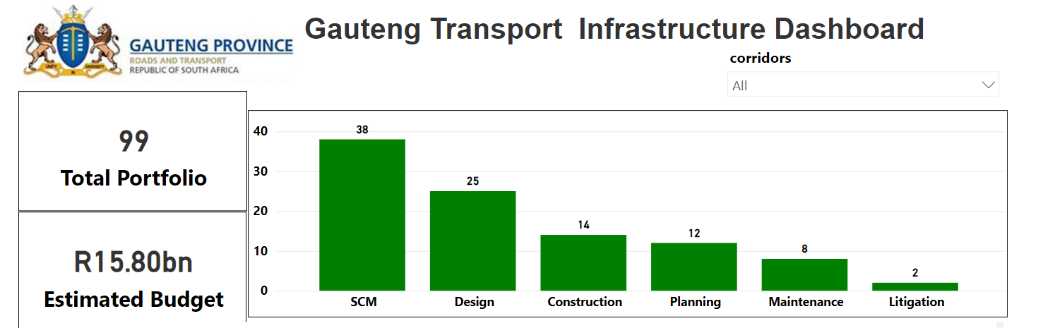
Dashboard Portfolio
56

Slide 57
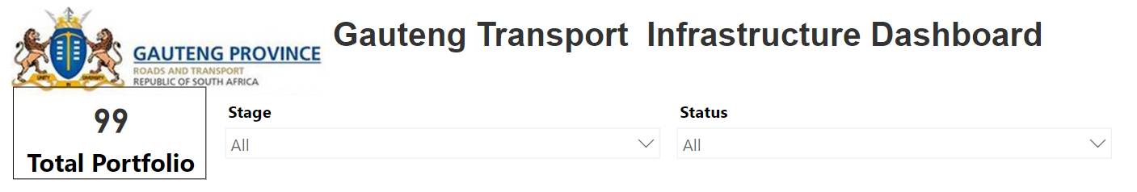
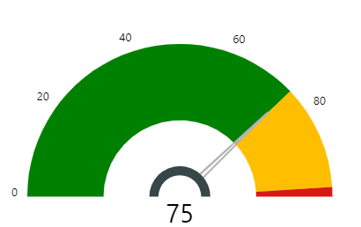
Status per stage – All Stages
From a total portfolio of 99 projects:
  75 are Green
  22 are Amber
  2 are Red
57

Slide 58
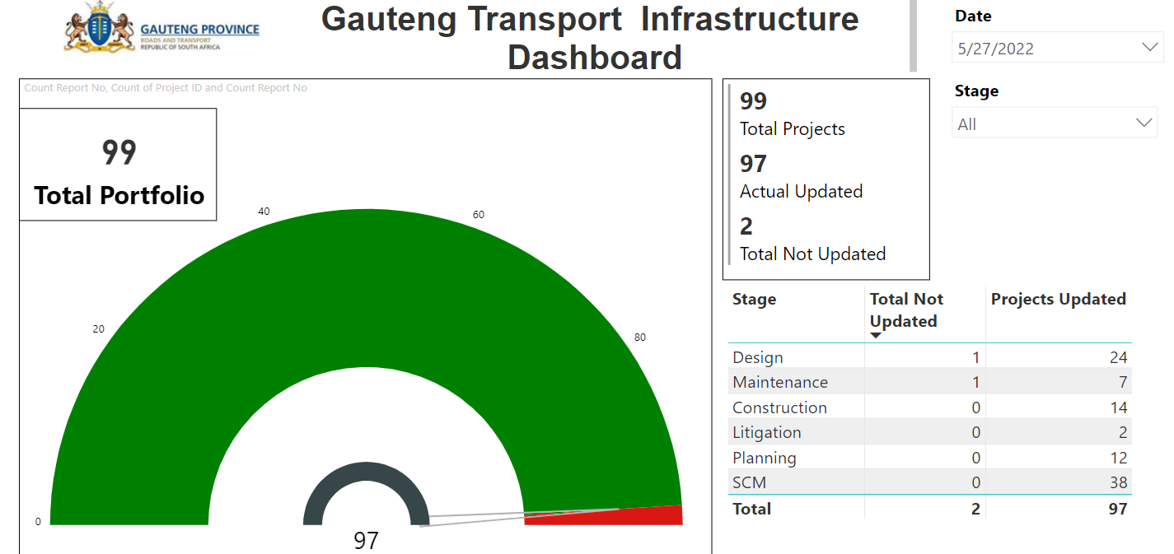
Reporting – Previous Friday (27/05/2022)
58

Slide 59
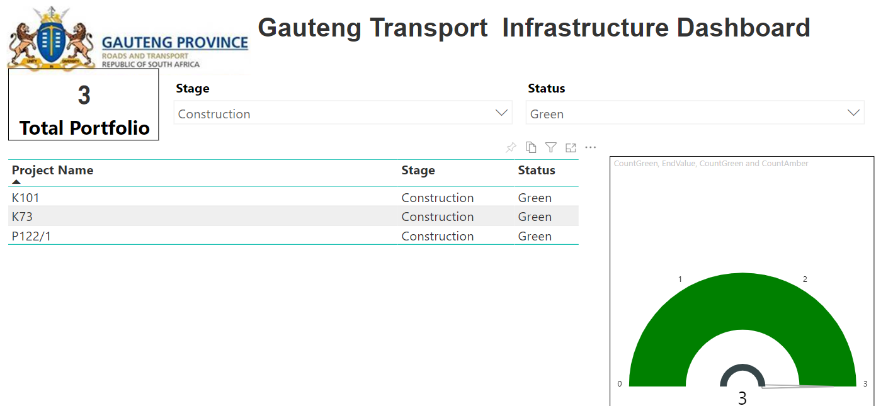
Status Per Stage – Construction
59

Slide 60
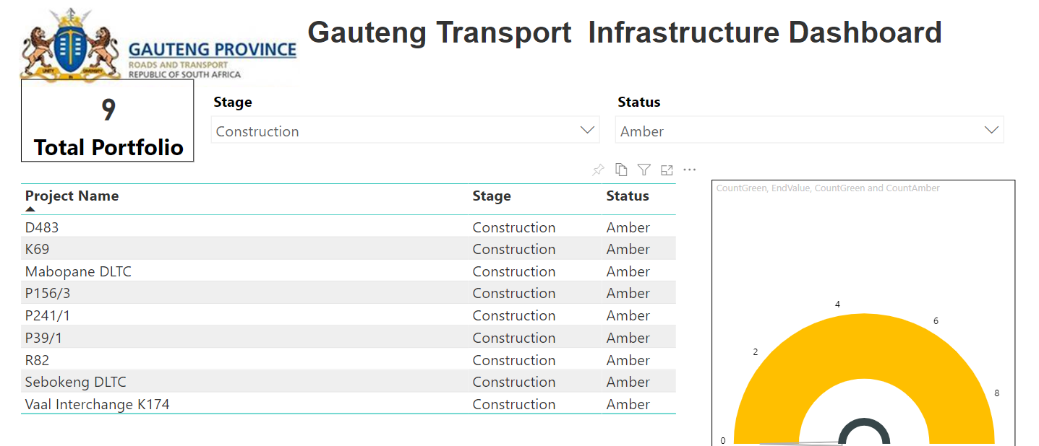
Status per Stage – Construction
60

Slide 61
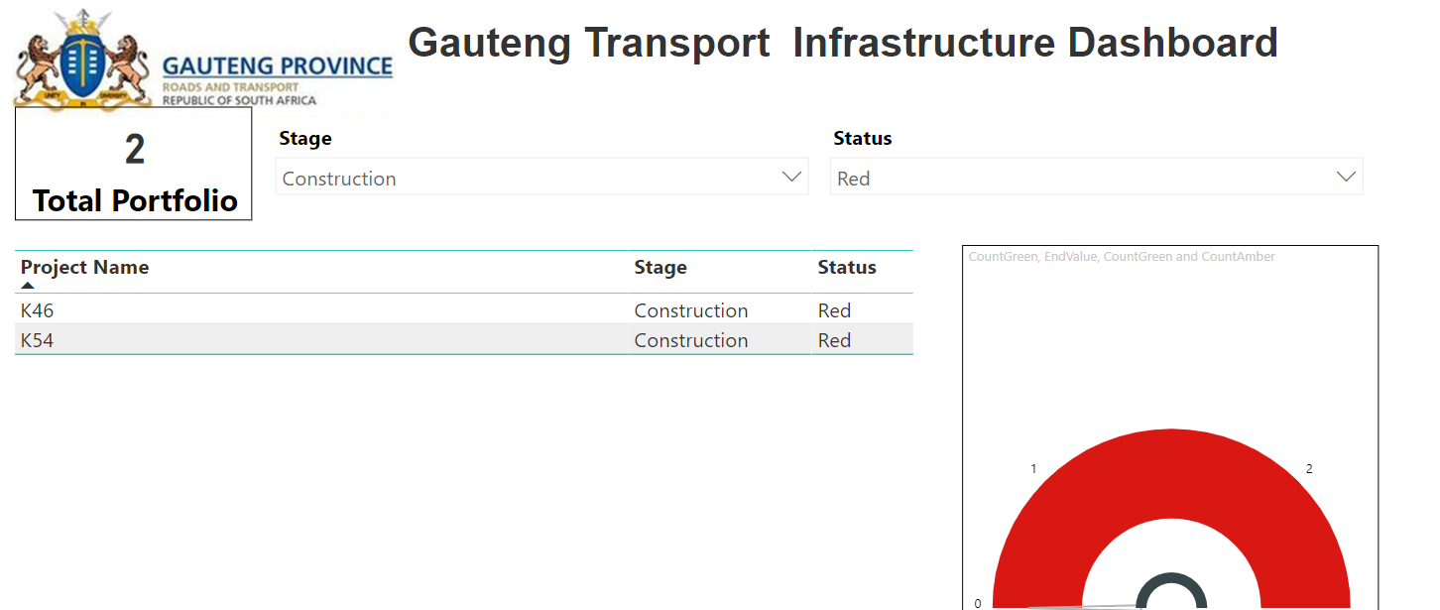
Status per stage – Construction
61

Slide 62
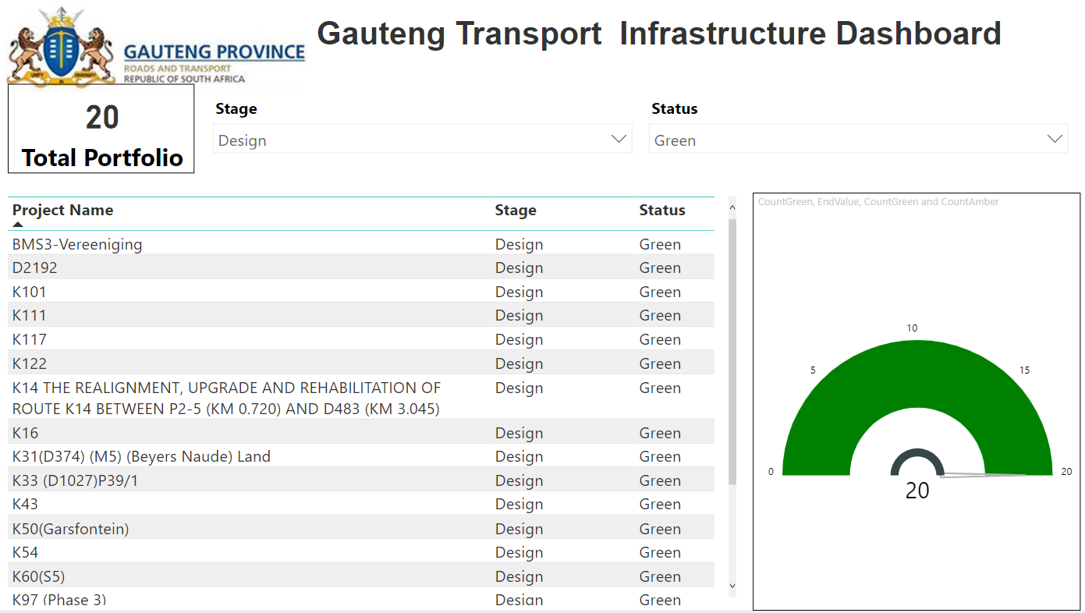
Status per stage – Design
62

Slide 63
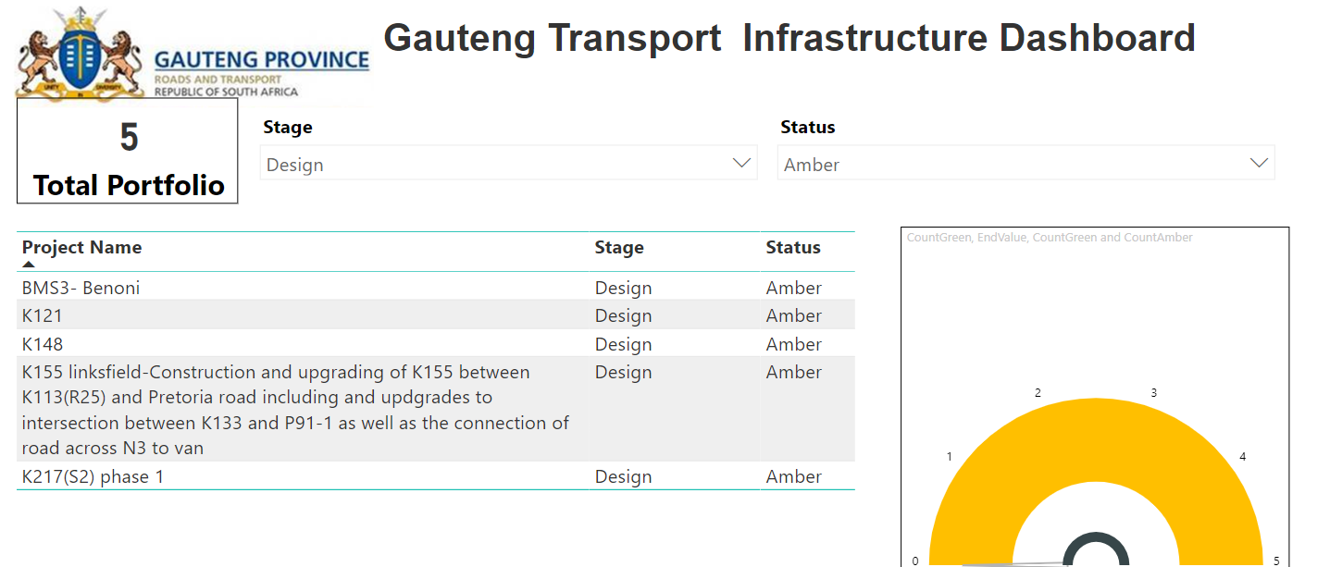
Status per stage – Design
63

Slide 64
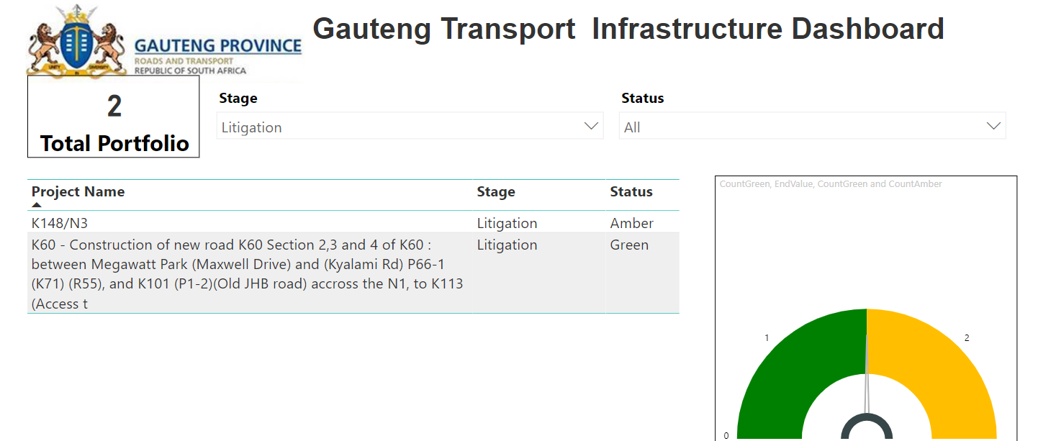
Status per stage – Litigation
64

Slide 65
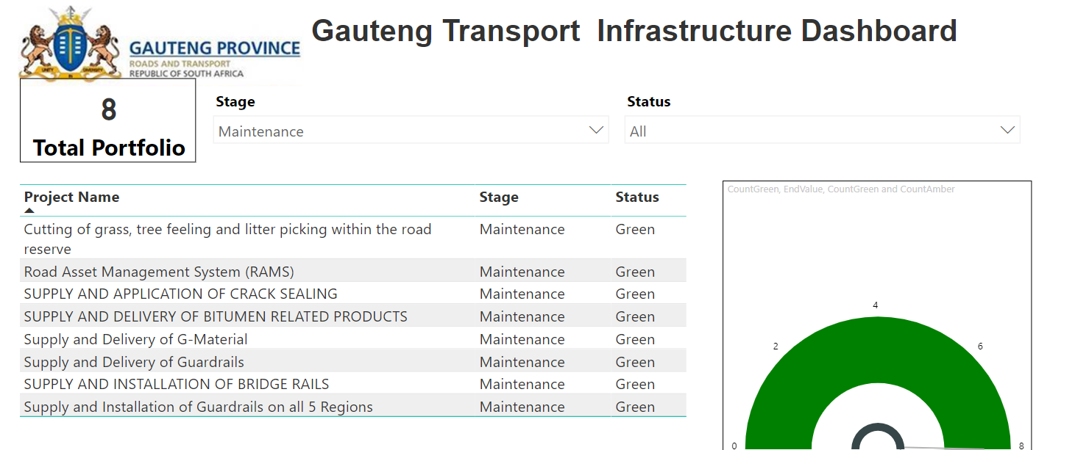
Status per stage – Maintenance
65

Slide 66
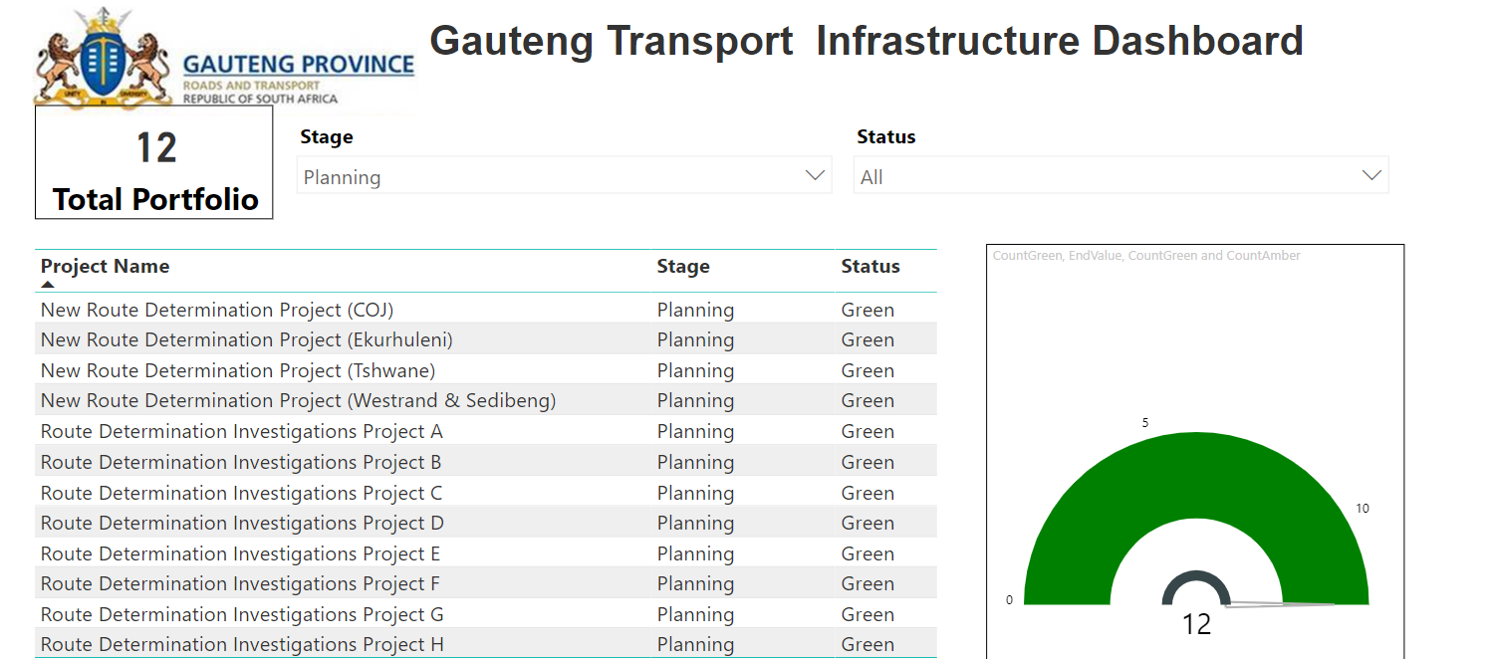
Status per stage – Planning
66

Slide 67
Progress Report on the backlog of the renewal of expired driving licenses

Slide 68
Driving License backlog as at 23 May 2022
The initial backlog in the Province was a grand total of 989 058
Revised by RTMC after removing the deceased person (holders of DL licences) to a grant total of 973 635
As at 23 May 2022, 535 347 driving licences has been renewed
And 438 288 are yet to renewed;
The percentage driving licence renewal is at 55%.
68

Slide 69
Performance comparison with other provinces
Backlog - As at 30 May 2022- All Provinces
Province | Grand Total | Not Renewed | Renewed | %
GP | 973,635 | 435,129 | 538,506 | 55.3%
ZN | 440,500 | 210,987 | 229,513 | 52.1%
WP | 397,631 | 165,792 | 231,839 | 58.3%
L | 230,722 | 119,898 | 110,824 | 48.0%
MP | 217,280 | 108,279 | 109,001 | 50.2%
EC | 189,973 | 93,337 | 96,636 | 50.9%
NW | 131,915 | 59,153 | 72,762 | 55.2%
FS | 131,829 | 61,441 | 70,388 | 53.4%
NC | 51,309 | 23,337 | 27,972 | 54.5%
Grand Total | 2,764,794 | 1,277,353 | 1,487,441
69

Slide 70
National backlog age analysis
BACKLOG – NOT RENEWED
Age group | Total - Not Renewed | % per Age Group
0-25 | 6,177 | 1.4%
25-50 | 296,181 | 68.1%
50-60 | 67,546 | 15.5%
Above 60 | 65,225 | 15.0%
Grand Total | 435,129
70

Slide 71
Agents extended working hours
Agents | Comments
City of Ekurhuleni | All DLTC’s and MVRA’s operational on all Saturdays of the month excluding holidays; from 08h00 to 12h00. Dedicating majority of their staff members on Wednesdays and Saturdays in assisting the senior citizens with renewals of both DL and PrDP cards; Normal working hours from Monday to Friday, 08:00 – 15:00.
City of COJ | Normal working hours from Monday to Friday 07:30 – 15:00 Saturdays from 08:00 – 13:00 excluding holidays.
City of Tshwane | From 05 – 14 April 2022 operating weekdays from 08:00 – 18:00. Saturday from 08:00 – 16:00
71

Slide 72
Agents extended working hours
Agents | Comments
Sedibeng | Normal hours and days from Monday to Friday 08:00 – 15:00
RandWest City | Normal working hours from Monday to Friday 08:00 – 16:00
Merafong | Normal working hours from Monday to Friday 08:00 – 18:00 (Overtime 15h00 – 18h00) Saturdays from 08:00 – 13:00 excluding holidays.
Mogale City | Operating normal working hours from Monday to Friday Weekends only 3 Saturdays a month.
Provincial Registering Authority | Operated extended hours from 06:00 to 18:00 hours Monday to Friday Weedends (Saturday and Sunday) including public holiday from 08:00 to 12:00 100% of staff and resources over the weekend were dedicated for DL and PRDP renewals to mitigate the backlog. suspended from end of March 2022 awaiting approval of memo.
72

Slide 73
Agents extended working hours
Agents | Comments
RTMC DLTCs | Operate 7 days a week from 07:00 – 21:00.
GMA DLTCs | Operate weekdays from 08:00 to 17:00 Saturdays from 09:00 – 15:00.
73

Slide 74
Intervention to increase capacity
Establishment of a full Licencing Service Centre (LSC) at Tembisa by the City of Ekurhuleni. The Tembisa DLTC started operation with effect from July 2021.
RTMC working together with the Department established two (2) grade F DLTCs (renewal of driving licence cards) at Waterfall park at Midrand and at Eco Park at Centurion, operation resumed from October 2021.
City of Tshwane reopend Rayton LSC which was closed in 2017 for renovations. The centre was lauched on 18 October 2021 and operational.
Gautrain Management Agency working together with the Department established a Grade F DLTC at Grant Central Boulevard, Midrand, registered and operational with effect from January 2022.
74

Slide 75
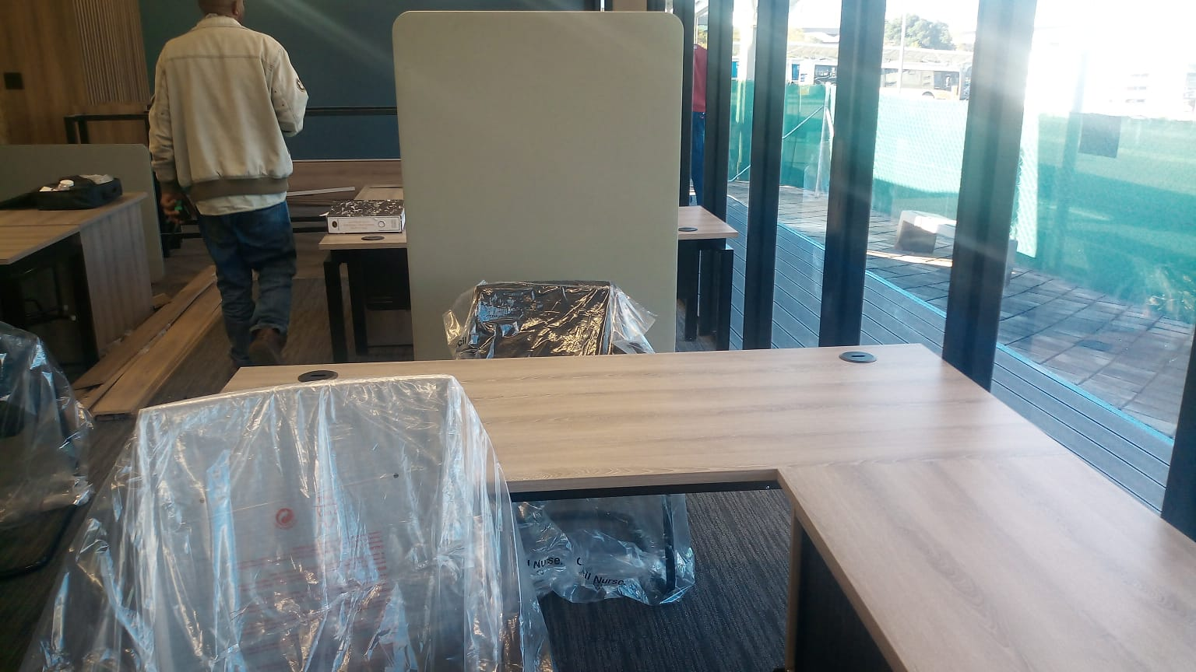
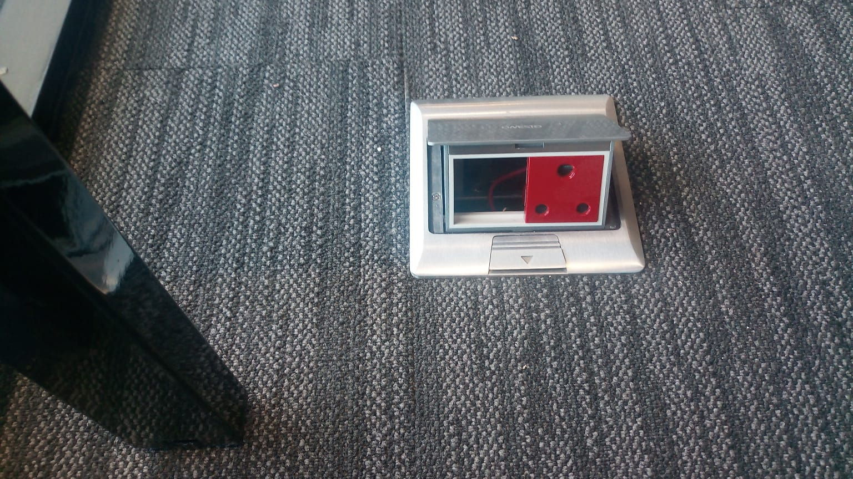
Expansion of Service Centres
Site Name | Requirements | Comments | Cabling | Computer rollout
Gautrain Centurion DLTC – pictures below | 4 LCU (eye test machines) 6 NaTIS computers and printers | The site is ready for cabling. | Anticipated to resume early June 2022. | RTMC does not have monitors currently and are expecting them to arrive mid-May. Still outstanding, no equipment from RTMC.
Midrand Gautrain DLTC | 4 LCU (eye test machines) 6 NaTIS computers and printers | Screens have been provided by the GMA. NaTIS and eye test machines installed, awaiting request from GMA for DRT to facilitate the inspection and grading of the DLTC | Done, contractor to fix cabling by elevating the cables off the ground

Slide 76
Expansion of additional Service Centres
Site Name | Requirements | Comments | Cabling | Computer rollout
CoT – Mabopane DLTC | 10 NaTIS computers and printers 3 LCU machines | Awaiting monitors to install NaTIS equipment | Completed | RTMC does not have monitors currently and are expecting them to arrive mid-May. Still outstanding, no equipment from RTMC.
CoT - Garankuwa | 12 NaTIS computers and printers 4 LCU machines 12 CLLTs (Computerised Learner Licence Testing machines) | Awaiting monitors to install NaTIS equipment | Completed
COJ – Diepsloot DLTC and Mobile Unit | Registration process finalized (inspection and gazetting) Outstanding is the issuing of the Registration Certificate.
76

Slide 77
Systems issues
Programme | Comments
Downtime of LEU (Live Enrolment Units) | The DLCA, RTMC and DoT working on the smart enrolment implementation The assessment of the vision screening is complete. The pilot on the smart enrolment pilot has been delayed and will commence soon. Once finalised the implementation plan will be developed for full roll-out.
Downtime of Natis | RTMC migrated to a new infrastructure including the upgrading/migration of firewalls The infrastructure refresh complete and a survey is been conducted to validate the turn around time performance.
Printing of Driving Licence cards backlog | production machines broke down creating a production backlog. As at 10 May 2022, there was a production backlog of 183 004 for Gauteng It is estimated that this backlog will be addressed by end of June. DLCA working 24 hours a day, using a shift system
77

Slide 78
Role and Responsibility of the Krugersdorp Regional Office

Slide 79
Location and Human Resources Capacity
The Krugersdorp regional office is located in Mogale City in Krugersdorp
It is at 1770 Sterfontein road Paardeplaath
The office caters the following areas:
  Mogale City
  City of Johannesburg
There are:
  82 road maintenance personnel
  8 mechanical personnel
The regional office is using inhouse teams to do routine maintenance work.
79

Slide 80
Plant and Equipment
The office has the following construction plant:
  4 Flat bed trucks
  3 Tractors
  4 graders
  4 Tipper trucks
  3 Water tankers
  8 bakkies
  3 busses – 10 seater and 32 seater
  1 fork lift
  1 crane truck
80

Slide 81
Budget
The annual budget allocation on both PRMG and Equitable:
  Budget for grass cutting - R149 500 000 and this will be done by the appointed service providers
  RISFSA 3 – R100 000 000 (equitable Share) and R 56 000 000 (PRMG).
  RISFSA 1&2 - R137 787 000 (equitable share) and R362 213 000 (PRMG).
The RIFSA 1, 2, and 3 are at SCM.
81

Slide 82
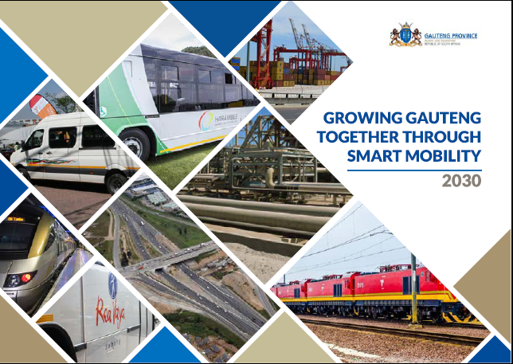
THANK YOU

