Slide 1
Department of Roads and Transport
Portfolio Committee
June 2022

Slide 2
Purpose
To apprise the Portfolio Committee of the progress of the Route Determination for the proposed Gauteng Rapid Rail Integrated Network Extensions Project

Slide 3
Gauteng Rapid Rail Integrated Network (GRRIN) Extensions Project
Feasibility Study for Possible Rail Extensions to the Gauteng Network
The premise of the GRRIN Extensions Project is the ITMP25 (August 2013)
Extensive feasibility study for possible extensions the existing rapid rail network undertaken by the GMA (November 2016)
TA1 application for Phase 1 submitted to National Treasury (April 2017)

Slide 4
Gauteng Rapid Rail Integrated Network (GRRIN) Extensions Project
Proposed GRRIN Extensions

Slide 5
Route Determination Process
Legislative requirement as per Section 6 of the GTIA and enables the following
The first step in the process of defining the future railway reserve
Determines a 400m-wide land corridor in which the future railway reserve may be located
Enables the MEC to have rights over any land-use changes within this corridor
Prevents land speculation over the location of the future rail reserve
Provides a basis for Preliminary Design which aims to define the cadastral boundaries of the railway line, enables proclamation, expropriation, and procurement scope

Slide 6
Route Determination Process
Route Determination Process as per Section 6 of the GTIA

Slide 7
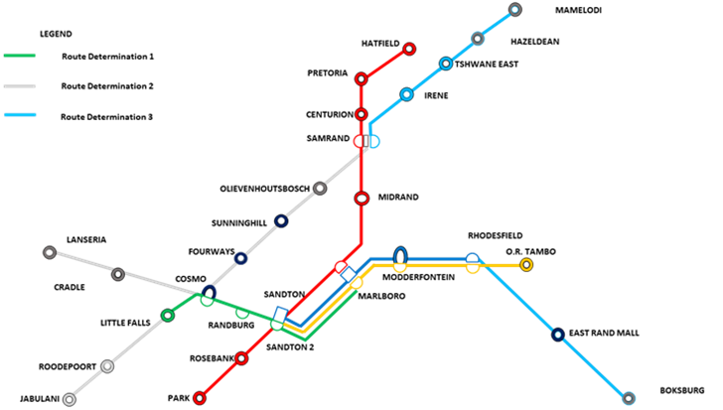
Route Determination for the GRRIN Extensions
Route Determination Programme

Slide 8
Route Determination for the GRRIN Extensions
Route Determination for Phase 1 of the GRRIN Extensions
Preliminary Route Alignment Study Initiated by MEC (October 2018)
Route Alignment Options (July 2019)
Environmental Investigation of Route Alignment Options (November 2019)
Stakeholder Consultation (August 2019-June 2021)
Public Participation (July 2021-August 2021)
Recommended Route (December 2021)
GPG EXCO of Determination of the Route (March 2022)
Publication of the Determined Route (May 2022)

Slide 9
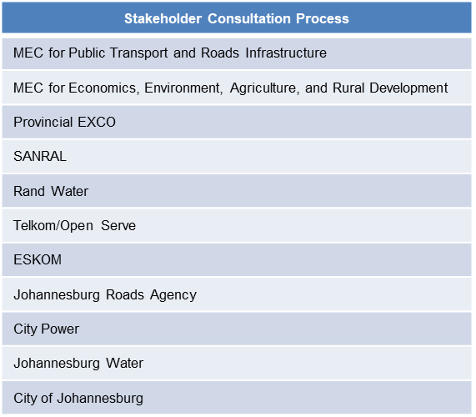
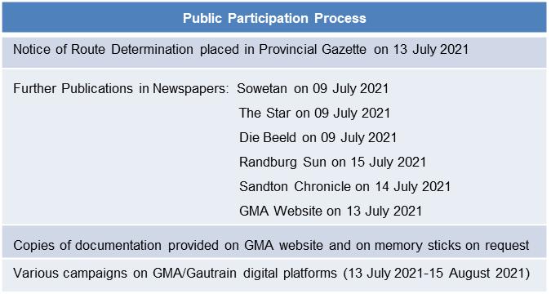
Route Determination for the GRRIN Extensions
Route Determination for Phase 1 of the GRRIN Extensions

Slide 10
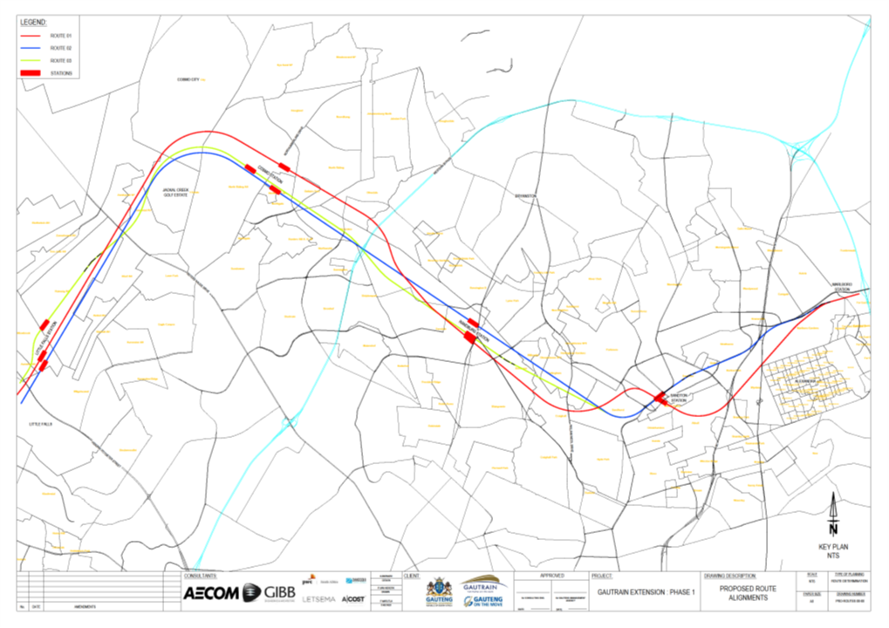
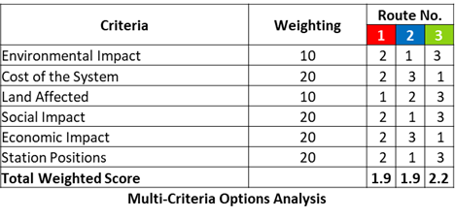
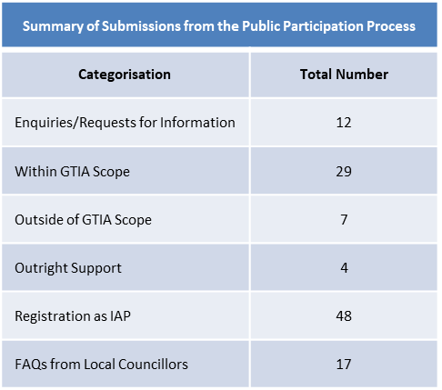
Route Determination for the GRRIN Extensions
Route Alignment Options for Phase 1 of the GRRIN Extensions

Slide 11
Route Determination for the GRRIN Extensions
Recommended Route for Phase 1 of the GRRIN Extensions

Slide 12
Route Determination for the GRRIN Extensions
High-Level Risks for Route Determination

Slide 13
Route Determination for the GRRIN Extensions
Conclusions & Recommendations for Route Determination for Phase 1
Legislative requirements of GTIA fully complied to
Recommended route is the best possible alignment in regard to:
Environmental Impact
Total Cost of System
Land Affected
Social Impact
Economic Impact
Station Locations
Further Connection to Soweto through Roodeport

Slide 14
Route Determination for the GRRIN Extensions
Conclusions & Recommendations for Route Determination for Phase 1
Independent Technical Paper on the Economic and Financial Impact of the GRRIN Concludes:
Rail networks are still essential for cities providing critical urban mobility and serve as key catalysts for equitable and sustainable economic recovery
It is critical that rail networks remain at the core of their cities’ transport systems supported by flexible modes like buses or BRT, congestion mitigating measures, and land use and development policies – Alignment to ITMP25
Determination of the future route continues in lieu of growing passenger demand to safeguard space as early as possible (as is the practice with roads master planning)

Slide 15
Route Determination for the GRRIN Extensions
Route Determination 2: Soweto Extension & Cosmo City Junction
The process to determine the route for the Soweto Extension and Cosmo City Junction has been initiated by the GMA
Includes Prefeasibility Study on further Extensions to the GRRIN
The project through which this process will be undertaken is in procurement
Route Determination 3: Mamelodi & Boksburg Extensions
Initiation of the process to determine the route for the Mamelodi and Boksburg extension is planned for the 2024/25 FY

Slide 16
Route Determination
The End

