Slide 1

Department of Roads and Transport g-FleeT Management Presentation to the Roads and Transport Portfolio Committee on
Responses to Committee Questions of the 3rd Quarter 2021/22 FY
10 March 2022

Slide 2
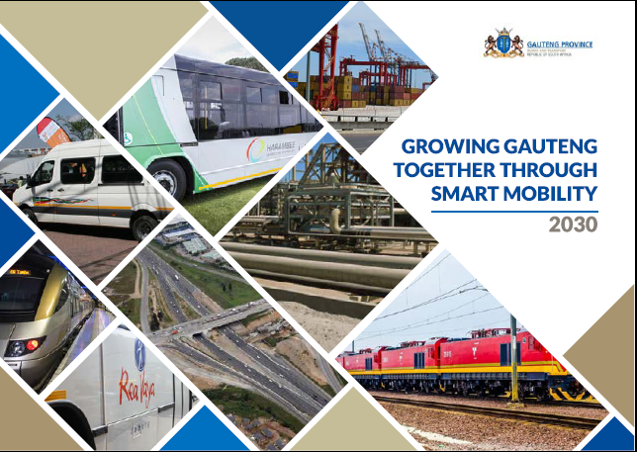

Slide 3
Responses to Questions on the 3rd Quarter Report for 2021/22 FY
Q7. The entity should provide a report on the appointment of external party to review the service offered by the FirstRand, and also provide a report on the resolutions that were tabled in the special meeting held on the 9 December 2021 on the RT46 contract.
The National Department of Transport (NDoT) and National Treasury did not appoint the external service provider for the review of the services offered by FirstRand/FNB. In the special meeting held on 10 December 2021, the Coordinating Committee of Government Motor Transport (CCGMT) resolved that issues pertaining to FirstRand/FNB under performance or non-delivery will be managed by NDoT, through the CCGMT.

Slide 4
Responses to Questions on the 3rd Quarter Report for 2021/22 FY
A Task Team comprising of government officials from various government departments including provinces has since been established by the CCGMT.
The Task Team, amongst other issues, was mandated to review the information and confirm data accuracy of the reports received from FirstRand/FNB.
The CCGMT further resolved that the RT46 contract between NDoT and FirstRand/FNB should be expedited and concluded as a matter of urgency.
FirstRand/FNB was requested to present proposed interventions to address their underperformance or non-delivery in the next CCGMT Meeting.

Slide 5
Responses to Questions on the 3rd Quarter Report for 2021/22 FY
Q8. The entity should provide detail report on the adjustment on the final appropriation in the quarter under review.
The 2021/20 budget was adjusted downwards by an overall amount of R5.6 million due to the following:
The delays in the filling of vacant positions.
The delay in the commencement of Phase 2 of the building rehabilitation project at g-FleeT main offices.
Savings derived due to the strict implementation of cost containment measures.
The table below depicts the budget adjustment:

Slide 6
Responses to Questions on the 3rd Quarter Report for 2021/22 FY

Slide 7
CLOSURE
END OF PRESENTATION
THANK YOU!

