Slide 1

Department of Roads and Transport
Presentation to the Roads and Transport Portfolio Committee on
Transport Infrastructure House – Delayed Infrastructure Projects
10 March 2022

Slide 2
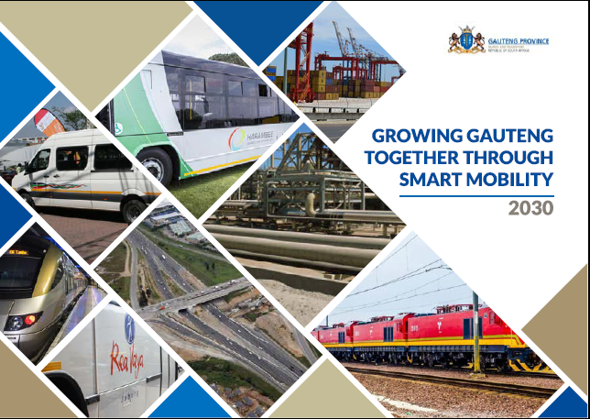

Slide 3
Transport Infrastructure House – Delayed Infrastructure Projects
Detailed reports on Delayed infrastructure projects focusing on the work done, as well as financial and non-financial impact of the delays, in resuming the following projects:
K46 William Nicol progress report
Contract awarded to Slim B and D Construction Pty (Ltd)
Contract amount is R 469 414 877.50 incl. VAT
Award date was 2 June 2021 and project commencement in February 2022.
Completion date is 3 December 2022 with contract duration is 16 months.

Slide 4
Transport Infrastructure House – Delayed Infrastructure Projects
K46 William Nicol
Contractor completed 70% of site establishment and re-establishment of missing survey benchmarks with physical progress at 37% of time lapsed.
All Community Liaison Officers have been appointed.
70 local labourers have been appointed and started work on 01/03/2022.
Stakeholder consultation completed.
Contracting of SMMEs is ongoing.
Construction of the materials lab commenced.

Slide 5
Transport Infrastructure House – Delayed Infrastructure Projects
P39/1 Muldersdrift progress report
Jodan Construction was appointed for an amount of R 141 513 202.45 (Incl. VAT) on the 28th of February 2019 for the rehabilitation of provincial road P39/1 between KM39.90 and KM45.35 near Muldersdrift and the improvement of P39/1 and Cedar road intersection.
The Consultant on the project is Element Consulting Engineers (ECE) appointed for an amount of R16 134 280.35 (incl. VAT).

Slide 6
Transport Infrastructure House – Delayed Infrastructure Projects
P39/1 Muldersdrift progress report
Progress to date is 90% and time lapsed 194%.
Approval of two months extension of time for completion of works and payment for work done for the contractor and consultant was granted.
The construction duration was 18 months with a completion due date of 29th September 2020.
An extension of time of 2.3 months was approved with the revised completion date of 11 December 2020, for an amount of R 2,225, 573.09.
Contractor suspended works on the 30 of October 2021 due to non-payments of work done between July 2021 and end of October 2021.

Slide 7
Transport Infrastructure House – Delayed Infrastructure Projects
P39/1 Muldersdrift progress report
An extension of time of 2.3 months was approved with the revised completion date of 11 December 2020, for an amount of R 2,225, 573.09.
Contractor suspended works on the 30 of October 2021 due to non-payments of work done between July 2021 and end of October 2021.
Payment of outstanding invoices to the contractor and consultant which led to the abandoning of site is currently in progress
Contractor will resume works in April 2022 when payment have been effected.

Slide 8
Transport Infrastructure House – Delayed Infrastructure Projects
Vereeniging Intermodal Facility progress report
GPT advised GDRT by letter dated 14th Feb 22 that the Business Case for Vereeniging is not approved and requires further information.
Approximately 23 Issues/concerns identified by GPT need to be addressed in “Version 2” of the BC’s and re-submitted for approval
GDRT response with a request for clarification of a number of issues sent to HoD Provincial Treasury.
To track the matter, HOD DRT required a meeting with Provincial Treasury to address any other concerns.

Slide 9
Transport Infrastructure House – Delayed Infrastructure Projects
Vereeniging Intermodal Facility progress report
GDRT in the same letter proposed that the Temporary taxi facilities be approved as Phase 1 while the issues for the main facility are addressed.
The draft budget allocations for FY22/23 currently do not allow any funds for the repairs to the temporary facility.
The current budget allocation for FY22/23 provides for pre-design investigations for the permanent facility.

Slide 10
Transport Infrastructure House – Delayed Infrastructure Projects
Vereeniging Intermodal Facility progress report
GMA and GDRT have commenced addressing the issues raised by GPT
The two key consents now required to proceed are the Treasury approval of our proposal to split the BC into the temporary and permanent ranks, and certainty by the NT on the Procurement Regulations.
Stakeholder meetings to share the latest concept designs delayed until confirmation of budget allocation by GPT.

Slide 11
Transport Infrastructure House – Delayed Infrastructure Projects
Vereeniging Intermodal Facility progress report
Separate stakeholder meetings were held with Vereeniging Business Chamber and the MMC with top officials in Sedibeng on 23 Feb 2022
Meeting with all stakeholders to be held last week of March to keep all stakeholders informed of developments
It is envisaged that it will take another 12 months before construction work can commence on the permanent facility

Slide 12
Transport Infrastructure House – Delayed Infrastructure Projects
Sebokeng TOLAB and DLTC progress report
In 2012 the Department (GDRT) engaged with the Department of Infrastructure Development (DID) to assist with the implementation of the Refurbishment of existing and Establishment of new DLTC’s.
Pro Plan Engineers were appointed as the Professional Service Provider (PSP) for the design and supervision of the Sebokeng DLTC. Planning for the DLTC commenced in 2013/14 financial year
The contractor(Makholi Projects) was appointed in September 2015 and construction of the DLTC and MVRA buildings commenced in October 2015

Slide 13
Transport Infrastructure House – Delayed Infrastructure Projects
Sebokeng TOLAB and DLTC progress report
During construction (excavations) of the project, it was found that the contaminated soil conditions were deeper than the recommended excavation depth, this necessitated additional excavations, funding and material.
A meeting was held with the MEC on the 7th April 2016 (MEC Dr. Vadi), resulting in the MEC requesting the DRT, GDID and Gauteng Treasury officials to find alternative ways to reduce the amount required to build the three buildings (MVRA, DLTC & TOLAB).

Slide 14
Transport Infrastructure House – Delayed Infrastructure Projects
Sebokeng TOLAB and DLTC progress report
The department engaged with Provincial Treasury to assist with a cost review exercise where a report was developed and approved. The report had the following recommendations.
- The functions of the new Sebokeng MVRA be incorporated into the new
Sebokeng DLTC building. (Implemented)
- The new Sebokeng TOLAB to use the building originally designed for the new
MVRA. (Not Implemented)

Slide 15
Transport Infrastructure House – Delayed Infrastructure Projects
Sebokeng TOLAB and DLTC progress report
Subsequent to the approval of the report, a follow up meeting was held between Provincial Treasury, GDRT& GDID on the 5th April 2017 to follow up on the implementation of the report.
Two letters dated 23/06/2017 and 04/12/2017 were written and sent to GDID: HOD by GDRT: HOD requesting the Department of Infrastructure Development to implement the project as per the recommendations report. (which is to construct two buildings instead of one, the other building will the be occupied by the TOLAB unit).

Slide 16
Transport Infrastructure House – Delayed Infrastructure Projects
Sebokeng TOLAB and DLTC progress report
Subsequent to the second letter an instruction from GDID: HOD dated 22/01/2018 was issued to the consultants (Pro Plan) to commence with the implementation of TOLAB building.
The contractor was issued with a negative certificate amounting to R26 535 000 by the PSP for over payment on G material submitted by Contractor.

Slide 17
Transport Infrastructure House – Delayed Infrastructure Projects
Sebokeng TOLAB and DLTC progress report
The contractor lodged a formal dispute against the department (GDID) for the negative certificate issued
During the dispute resolution process, the contractor abandoned site and thus led to the site being vandalised.
GDID has subsequently organised 24hr security to be on site to mitigate further vandalism on site.

Slide 18
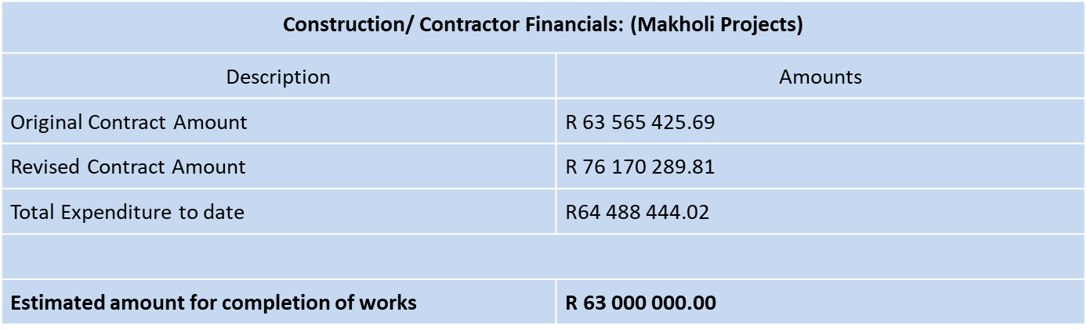
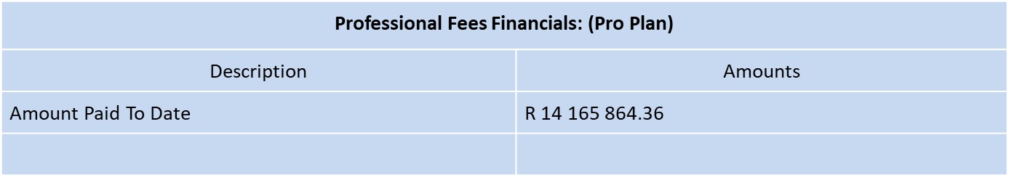
Transport Infrastructure House – Delayed Infrastructure Projects
FINANCIAL IMPLICATIONS

Slide 19
Transport Infrastructure House – Delayed Infrastructure Projects
WAY FORWARD
A letter dated 23 March 2021 was send to GDID: HOD to recall the Sebokeng and Mabopane DLTC projects due to poor performance,
Project were formally transferred to GDRT on the 25/08/2021,
A decision was taken to make use of the services of HATCH for the development of the condition assessment report, and
Appointment of the PSP’s from the GDRT panel of consultants for the review of drawings, finalisation of the tender document and construction supervision.

Slide 20
Transport Infrastructure House – Delayed Infrastructure Projects
WAY FORWARD
The condition assessment report was completed which will be followed by the appointment of Professional Service Providers (PSP).
However, the appointment of PSP’s can only be concluded as soon as SCM has finalised the framework for procurement of PSP through a panel.

Slide 21
Transport Infrastructure House – Delayed Infrastructure Projects
Financial Impact of the delays:
Delays result in cost escalations for the affected projects.
Delays also result in under-expenditure of infrastructure budget of the Department.
The Department has mitigated the financial impact of the delays by adjusting the budget downward to avoid gross underspending on the projects.

Slide 22
Transport Infrastructure House – Delayed Infrastructure Projects
Non-Financial Impact of the delays:
The projects might not be completed on time thus affecting the attainment of planned targets.
Consideration of EoT and review of the programme of works are some of the measures to prevent late completion of projects.
The introduction of the recently unveiled Project Management Dashboard and the establishment of the Compliance Office will mitigate against poor performance of infrastructure projects.

Slide 23
CLOSURE
END OF PRESENTATION
THANK YOU!

