Slide 1
Department of Roads and Transport Presentation to the Roads and Transport Portfolio Committee on the Provincial Appropriation Bill for 2021/22FY
10 March 2022

Slide 3
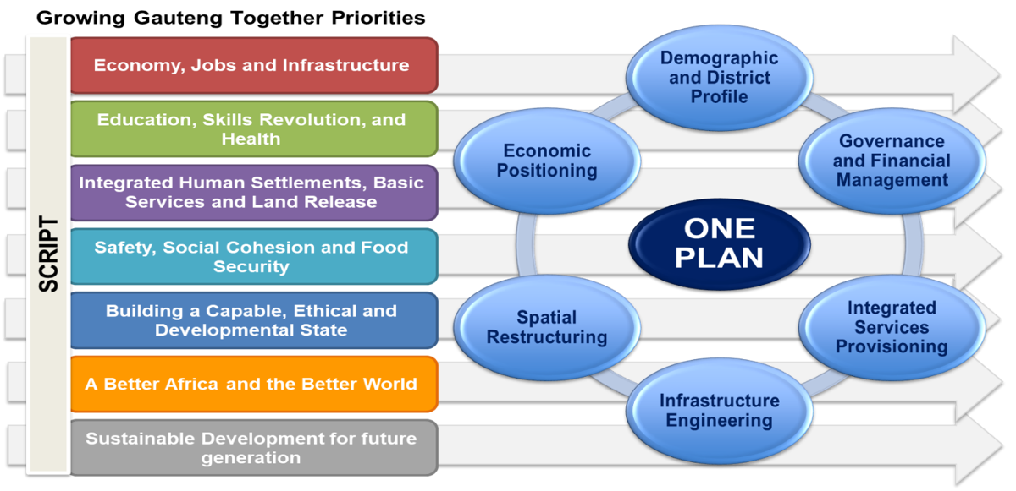
INTRODUCTION OF THE 2021-22 APPROPRIATION BILL
The Appropriation Bill 2021-22 is premised on the seven priorities in the GGT2030:

Slide 4
THE PROVINCIAL ADJUSTMENT FOR 2021-22 FY
Q1. The Department should reconcile the adjustment that was reported in the third quarter report (R207 396 000) and adjustment budget tabled by the provincial government (R112 920 000).
RESPONSE:
The DRT’s adjustments were as follows:
ITEM | AMOUNTS (R’000)
Surrender | (R207 396)
Rollover – PTOG | 94 476
TOTAL - RECON | (112 920)

Slide 5
THE PROVINCIAL ADJUSTMENT FOR 2021-22 FY
Q1. The Department should reconcile the adjustment that was reported in the third quarter report (R207 396 000) and adjustment budget tabled by the provincial government (R112 920 000).
RESPONSE:
The Department was informed through the allocation letter that the Rollover that was applied for in April had been approved by the National Department of Transport (NDoT), which meant that the adjustments totaled a reduction of R112 920 million from the original allocation.

Slide 6
THE PROVINCIAL ADJUSTMENT FOR 2021-22 FY
Q2. The Department should explain the downward adjustment of budget in the Administration programme in relation to Compensation of employees, Goods and Services and Payments for Capital assets.
RESPONSE:
The CADET and Military Veterans (MV) programme was the cornerstone of the Department’s response to the COVID-19 pandemic. This programme was not initially allocated with budget, however the Department engaged in a rigorous reprioritization process to ensure that savings could be realized to shift to Programme 3: Transport Operations where the programme was managed from. The amounts below were all the savings that were identified and shifted to fund the CADET and MV programme.

Slide 7
THE PROVINCIAL ADJUSTMENT FOR 2021-22 FY
ITEM | AMOUNTS (R’000)
Compensation of employees | (5 000)
Goods and services | (15 500)
Capital assets | (2 500)

Slide 8
THE PROVINCIAL ADJUSTMENT FOR 2021-22 FY
Q3. The Department should explain the downward adjustment in the Transport Infrastructure programme in relation to Compensation of employees, Goods and Services, Transfers and Subsidies, and Payments for Capital assets.
RESPONSE:
The explanations are provided below:
ITEM | AMOUNTS (R’000) | COMMENTS
Compensation of employees | (25 000) | As explained in Question 2 above, the amount was shifted after the reprioritization process to shift funds from Programme 1 to Programme 3: Transport Operations for the CADET and MV programme.

Slide 9
THE PROVINCIAL ADJUSTMENT FOR 2021-22 FY
.
ITEM | AMOUNTS (R’000) | COMMENTS
Goods and services | (399 949) | As explained in 2 above, the amount was shifted after the reprioritization process to shift funds to Programme 3: Transport Operations for the CADET and MV programme.
Capital assets | (174 547) | The reduction was due to the surrender of funds back to the Provincial Revenue Fund (PRF) (R207 396 000) and the shift to Gautrain (R366 000 000) to assist with the Patronage Guarantee (PG) that became due and had to be settled to ensure that the GMA was not contravening the contractual obligations of the Concession Agreement (CA).

Slide 10
THE PROVINCIAL ADJUSTMENT FOR 2021-22 FY
Q4. The Department should explain the roll-over amounting to R94 million in the subsidised bus in relation to the under expenditure which was recorded in the previous financial year.
RESPONSE:
The State of Emergency in terms of the Disaster Management Act placed heavy restrictions on public transport services, with low to no operations during April 2020. This resulted in minimal claims on the subsidy allocations by the operators, and in continuous underspending for the rest of the 2020/21 financial year.

Slide 11
THE PROVINCIAL ADJUSTMENT FOR 2021-22 FY
Some of the services operated for the period 16th to 31st March 2021, which could
only be submitted in April 2021 in line with the provisions of the subsidized bus contracts
(within 7 days of the end of the month being claimed for). This arrangement was effected
in line with the relevant provisions of the PFMA, which prescribes that payment can only
be made for services rendered.
Since the second claim could therefore only be settled using the resources from the 2021/22 financial year, a rollover was requested within the PTOG to settle this second set of claims. Attached please find Annexure A with the table indicating the said claims per operator:

Slide 12
THE PROVINCIAL ADJUSTMENT FOR 2021-22 FY
Q5. The Department should also explain an increase of Transport Operations’ budget in the Compensation of employees.
RESPONSE:
The increase in the budget for compensation of employees within this programme was solely to avail resources for the CADET and Military Veterans (MV) programme that was the cornerstone of the Department’s response to the COVID-19 pandemic.

Slide 13
THE PROVINCIAL ADJUSTMENT FOR 2021-22 FY
Q6. The Department should explain the budget cut in the Compensation of Employees and Goods and Services in the Transport Regulation programme.
RESPONSE:
The explanations are provided below:
ITEM | AMOUNTS (R’000) | COMMENTS
Compensation of employees | (5 000) | As explained in Question 2 above, the amount was shifted after the reprioritization process to shift funds to Programme 3: Transport Operations for the CADET and MV programme.
Goods and services | (20 500) | There was a shift of R19 800 000 from this item to transfers and subsidies that was mainly a correction of the classification of the taxi support budget that will be transferred to the Taxi Trust. Furthermore, there were other minor (R700 000) budget shifts within the programme to clear possible overspending.

Slide 14
THE PROVINCIAL ADJUSTMENT FOR 2021-22 FY
Q7. The Department should explain the additional budget in the Transfers and Subsidies and Payments for Capital assets in the Transport Regulation programme.
RESPONSE:
The explanations are provided below:
ITEM | AMOUNTS (R’000) | COMMENTS
Transfers and subsidies | (19 800) | This shift was to ensure that the transfer of the taxi support budget to the Taxi Trust can be duly processed from the correct item.
Capital assets | (1 800) | The two shifts that contributed to this are: R700 000 for the procurement of note counting machines at the DLTCs as well as small furniture items that were requested for the TOLAB; The budget for the Sebokeng DLTC was increased by R1 100 000 to settle an invoice that was anticipated by the project managers.

Slide 15
THE PROVINCIAL ADJUSTMENT FOR 2021-22 FY
Q8. The entity should explain the significant upward adjustment amounting to R366 000 000 per cost drivers.
RESPONSE:
A sudden drop in passengers using the Gautrain through the Covid 19 impact caused the PG to increase up to the maximum limit payable by the Province to the Concessionaire in terms of the Concession Agreement (CA). The GMA did not carry any passenger through the hard lock down and had to carry reduced passengers at various stages of the lockdown which resulted in reduced revenue being collected and thereby increasing the Patronage Guarantee over the MTEF period.

Slide 16
THE PROVINCIAL ADJUSTMENT FOR 2021-22 FY
In the current financial year an additional R366 million budget was allocated through the adjustment budget process to ensure the immediate sustainability of the Gautrain.
The adjustment budget was only used to cover the cost of the Patronage Guarantee.

Slide 17
CLOSURE
END OF PRESENTATION
THANK YOU!

