Slide 1
ECD FUNCTION SHIFT
Preparing for the function shift
GAUTENG PROVINCE
27 OCTOBER 2021

Slide 2
Introduction
Provincial Steering Committee continues to meet weekly on Mondays
The first phase has been completed with the signing and gazetting of Provincial Proclamation and MOA for managing the Transition
2nd Phase = Readiness to assume the function
Each work stream has developed Action Plan to achieve all milestones by end of December 2021
These Action Plans include activities & milestones from National and those that are unique to Gauteng
Presentation on the Children’s Act Second Amendment Bill –for input
Presentation from the Office of the Premier in preparation for Change Management
Presentation from the South African Social Services Professions Council on legislation governing the professionals moving over to Education

Slide 3

Preparing for the function:
Policy & Legislation
Activity | Timeframe | Responsibility | Progress
Develop detailed register of all contracts, SLAs, MOUs and litigation | September | DSD | SLAs Register is available & updated every week To be finalized by 31 October 2021
Transfer all contracts, SLAs, MOUs and litigation | October 2021 - February 2022 | DSD & DBE | Transfer of SLAs has been done Analysis is underway
Developing business process for entering into new SLAs | October 2021 - February 2022 | DBE | Implementation underway in that; NPO Funding Business Process were completed jointly Call for Proposal is Advertised for new ECDs Approval to sign Declaration for 2022/23 SLAs with currently funded ECDs that complied with provisions of 2021/22 SLA i.e. ECDs with no adverse findings from M&E is underway

Slide 4
SLA Update – 22 Oct 2021
ECD SLA Status as at 22 Oct 2021
Provision Type | Provide Type (Sub-Programme) | Total Business Partners | Quarterly Budgets | Number of SLAs Signed | % of SLA Signed | No of Unsigned SLAs | % of Unsigned SLAs.
104 - Place of Care | 104 - ECD | 1122 | R86,607,727 | 1075 | 96% | 46 | 4%
 | 104 - ECD (Con Grant) | 469 | R37,203,903 | 442 | 95% | 27 | 5%
 | 104 - ECD Mobile Services | 5 | R2,302,225 | 5 | 100% | 0 | 0%
104 – Place of Care Total |  | 1595 | R 127,286,345 | 1522 | 96% | 73 | 5%
Region | Total Business Partners | Number of SLAs Signed | % of SLA Signed | 01 Oct | 22 Oct | Newly Signed SLAs
 |  |  |  | No. of Unsigned SLAs | No. of Unsigned SLAs
Ekurhuleni | 305 | 300 | 99% | 11 | 5 | 0
Jhb | 534 | 517 | 97% | 19 | 17 | 0
Provincial | 3 | 3 | 100% | 0 | 0 | 0
Sedibeng | 228 | 217 | 96% | 15 | 11 | 0
Tshwane | 363 | 345 | 95% | 18 | 18 | 0
West Rand | 162 | 140 | 87% | 22 | 22 | 0
Grand Total | 1595 | 1522 | 96% | 85 | 73* | 0
* Difference is caused by a decreased in Total Business Partners resulting from closed NPOs.

Slide 5
Action Plan
Action |  |  | Responsibility | Timeframe
 |  | 2021/22 FINANCIAL YEAR
Finalize all matters on unsigned ECDs through either funding or reprioritization of budget to other service delivery pressures (NPI Budget) |  |  | Provincial NPI Budget Committee | 1st week of Oct 2021
2022/23 FINANCIAL YEAR
CURRENTLY FUNDED ECDs | Submission of 2022/23 Approved ECDs which would be preceded by; Approval to sign Declaration to sign 2022/23 SLAs with ECDs that complied with provisions of 2021/22 SLA. | Submission of 2022/23 Approved ECDs which would be preceded by; Approval to sign Declaration to sign 2022/23 SLAs with ECDs that complied with provisions of 2021/22 SLA. | GDSD supported by GDE | 29 October 2021.
CURRENTLY FUNDED & THOSE THAT QUALIFIED TO BE FUNDED FOR 2022/23 | Final Report on approved ECDs to sign SLAs for 2022/23 which should be a combination of newly approved through Call for Proposal & currently funded ECDs | Final Report on approved ECDs to sign SLAs for 2022/23 which should be a combination of newly approved through Call for Proposal & currently funded ECDs | GDSD supported by GDE | 15 December 2021
 | Signing of SLAs for 2022/23 | Signing of SLAs for 2022/23 | GDE supported by GDSD | Jan 2022

Slide 6
Finance & Budgets

Slide 7
Preparing for the function:
Finance & Budgets
Activity | Timeframe | Responsibility | Progress
1. Finalisation of Fund Transfers, Budget Structures and Allocations (i.e., Governance Processes)]
Explanatory memo to relevant treasury motivating function shift prepared and submitted. (i.e., formal submission co-signed by Acctng. Officers) confirming budgets (historical, current, and future) to be shifted. | August | DSD | Explanatory memo co signed by Accounting Officers submitted by end of June but will be updated with historical data by end of September.
NDSD and NBE to provide input to 2022 DORA with regards to ECD Conditional Grant conditions | October | DBE & DSD | National Function
Changes to DBE budget structures agreed to and request sent to relevant treasury | September | DBE | Gauteng provided inputs to National
Prepare budget templates (database) as per 2022 MTEF guideline | October | DBE & DSD | 1st draft submission was done without ECD shift as per guidance by Provincial Treasury
Relevant treasury to issue amended first draft of 2022 MTEF database | October | NT/ PT | Function of Treasury
Finalise the 2022 MTEF budget template (database) | November | DBE & DSD | To be submitted as per Treasury timelines
Relevant treasury to issue second draft of 2022 MTEF allocation letters | December | NT/ PT | Function of Treasury
Relevant Treasury to issue Final MTEF allocation letters | February 2022 | NT/ PT | Function of Treasury
PDSD and PDoE to finalise the 2022 MTEF Budgets and Function Shift (i.e., assets, funds and staff transferred) | February 2022 | DBE & DSD | Budget to be submitted in line with Treasury timeline. Assets transfer to be finalised by end of February (having concluded HR processes).
Confirmation of function shift through appropriation | March 2022 | NT/ PT | Function of Treasury
PDSD to submit to Auditor General the file with all information pertaining to the function shift | March 2022 | PDSD | PDSD to establish what needs to be submitted to meet the March deadline.

Slide 8
Preparing for the function:
Finance & Budgets
Activity | Timeframe |  | Responsibility |  | Progress
2. Accountable executives (i.e., CFO's and their direct reports) align on business activities, processes and information assets been transferred
Confirmation of DBE (interim) process owner for the NPI funding and payment process | September | DBE & DSD |  | School Funding and ECD directorate are DBE (interim) process owners. They will take part in the funding process for 2022/23 as part of the handover.
DBE and DSD CFO's and relevant direct reports meet to discuss current NPI funding and payment process and confirm who the key process owners on both sides are | September | DBE & DSD |  | See above
DBE CFO / process owner confirms align of NPI payment process to other NPI registration and monitoring processes | September | DBE & DSD |  | GDE has aligned the processes on NPI registration and monitoring to GDSD.
Confirmation and existence and level of detailed contained in SOPs or process maps for NPI funding and payment process | September | DBE & DSD |  | SOPs exists and shared by GDSD with GDE. Implementation of SOP on NPI Business Planning Process for 2021/22 in preparation for ECDs to be funded in 2022/23 underway.
Confirmation of existences of and quality assurance of draft list of assets and liabilities to be transferred | September | DBE & DSD |  | Assets have been identified. Quality assessment of assets still needs to be undertaken upon finalisation of warm bodies.
Confirmation of existences and quality assurances of list of NPI's that DBE should continue paying from April 2022 | September | DBE & DSD |  | 2021 qualifying NPI are preliminarily added to the list of 2022 approved NPI pending the results of monitoring and evaluation. Monthly updates done and final list will be available in January 2022.
Confirmation of existence and quality assurance of payment details of NPIs that DBE should continue paying from April 2022 | September | DBE & DSD |  | Database submitted to GDE by GDSD and monthly updates will be done by GDSD.

Slide 9
Preparing for the function:
Finance & Budgets
Activity | Timeframe | Department | Progress report
3. Transfer and onboarding of Finance Staff from DSD to DBE as well as transfer of relevant information assets and tools of trade
Target staff identified and ring-fenced | September | DBE & DSD | Posts identified and ringfenced.
Finance staff to be transferred confirmed (post the HR consultation process) | October | DBE & DSD | Post confirmed, consultation still underway.
Finance staff to be transferred briefed on their placement both in terms of organisational structure and physical place of work | October | DBE & DSD | Post confirmed, consultation still underway.
Existing DBE finance and DSD staff to be transferred meet and share knowledge on how NPI payment process works (meetings to be organised by DBE process owners identified by the CFOs) | November | DBE | Engagement between management took place on processes. One on one engagement of operational staff will take place by end of November.
To be DBE (ECD) Finance team engage with other To-Be DBE ECD management teams to confirm interface and ways of working between DBE (ECD) Finance team and the other DBE staff involved in the ECD functions (registration and deregistration of service providers, receipt and verification of invoices etc.) | November | DBE | Engagements to take place by end of November.
DBE and DSD staff prepare to work in shared office space | Nov – Dec | DBE | This will be done pending finalisation of HR process.
DBE and DSD staff begin to work in shared office space but co-report to their respective DSD and DBE Heads | January | DBE | This will be done pending finalisation of HR process.
Adequacy of tools of trade and office space for transferred staff confirmed | January | DBE | This will be done pending finalisation of HR process.
DSD staff share key information assets that DBE will need to take over the payment process (i.e., process maps, SOPs, list of NPI and associated payment details and payment commitments to be transferred etc.) | January – February | DBE | Information sharing will be finalised by January – February
DBE confirm receipt and completeness of information assets receieved | Feb – Mar | DBE | This will be done pending finalisation of HR process.
Function shift effected and DSD staff fully report to DBE Head | 1 April | DBE | This will be done pending finalisation of HR process.

Slide 10
Preparing for the function:
Finance & Budgets
Activity | Timeframe | Responsibility | Progress
4. Interactions with NPIs and Testing of agreed to processes
DSD and DBE Finance participate in public meeting with NPIs | November | DBE & DSD | Meetings with the funded ECD centres are planned for the month of October.
Formal letters sent to NPIs to inform them about change in ownership of TPAs, implications for point of contact going forward, and to request NPIs to confirm payment details prior to uploading onto DBE's system and issuing of necessary purchase orders etc. | December | DBE & DSD | Letters will sent by December.
Confirmation of details from NPIs received and NPI details uploaded onto DBE system and Purchase Orders issued if necessary | Jan - Feb 2022 | DBE | Confirmation to be done by Jan - Feb
Follow up made with NPIs yet to confirm details | Jan - Feb 2022 | DBE | Follow-up to be done by Jan - Feb
NPI's asked to submit first invoices for payment | May 2022 | DBE | To be finalised in April in terms of GDE plans
DBE process first payments and performance in terms of payment cycle times, errors and other glitchs noted for improvement | May 2022 | DBE | To be finalised in April in terms of GDE plans
Glitches for 1st payment run addressed | June 2022 | DBE | Glitches for 1st payment run will be addressed by June

Slide 11
NOTES FROM MEETING GDE & DSD
Based on the finalization of the application process between DSD and GDE, the dates have been changed to accommodate the application process
The GDE will form part of the team that will be responsible for the application process
The GDE will be involved in the post registration financial monitoring process, this will be done by officials at the District Offices
Because of the financial monitoring that will be required in all the ECD centres, there’s a need for some of the officials to be transferred to the district offices (Provisioning for Institution) to ensure compliance
The Centres will be paid via SAP upload as the same process with other schools that the Department is subsidizing
The GDE will still continue with quarterly payments of subsidies
Below are the dates as moved to accommodate the finalization of the application process

Slide 12
NPO FUNDING CYCLE- Progress as at 13 September
SUMMARY OF THE Payment system and processes
Objective | Activity | Proposed Timeframe | Responsible Office
1. Unique identification of institutions | Transfer of existing database to GDE Creation of EMIS numbers for all registered and qualifying ECD centres | 01 Dec 2021 to 31 Jan 2022 | DSD EMIS Directorate
2. Compilation of consolidated data | Process Applications Signing of SLA’s School Funding- Responsible for Finance compliance | 01 Sep 2021 to 31 Jan 2022 | DSD ECD Directorate Finance
3. Smooth processing of payments | Registering / conversion of vendors numbers Align vendor numbers with GDE plant | 31 Jan 2022 | Treasury School Financial Management & Gov
 | After the finalization of the approved ECD centres when the application process is finalized by DSD & GDE
4. Sound and Proper financial management | Awareness campaign of the migration Build capacity on model of funding and financial management monitoring of ECDs | 28 Feb – 31 March 2022 | School Financial Management & Gov District offices DSD

Slide 13
NPO FUNDING CYCLE
SUMMARY OF THE Payment system and processes
Objective | Activity | Proposed Timeframe | Responsible Office
5. Database of all qualifying ECD centres | All qualifying ECD centres to have signed the SLA for funding for financial year 2022/23 | 1 Jan 2021 to 15 Mar 2022 | ECD Directorate
6. Confirmation of banking details | All qualifying ECD centres to receive confirmation of banking details forms to complete and send back by the 28th February 2022 | 01 Feb- 31 Mar 2022 | School Financial Management & Gov
7. Final allocation database | Receive final allocation of all to be subsidized for 2022/23 | 1 April 2022 | School Financial Management & Gov ECD Directorate
8. Allocation transfer for first quarter | Upload transfers payments to qualifying ECD centres for the first quarter payment via SAP | 11 – 15 April 2022 | School Financial Management & Gov

Slide 14
HR & LR

Slide 15
National reporting template
HR & LR
Activity | Timeframe | Department | Progress
Consultation with organised labour | October 2021 | DSD | In progress - Commenced on 21 Sep 2021 05 October 2021 – Change Mngt Strategy
N/PMOG approvals received from relevant parties | October 2021 | DSD & DBE | PMOG approvals received
Affected staff informed / consulted | October 2021 | DSD | In progress 1st round completed 11 – 15 /10/2021) 2nd round 26 October 2021 Expected to complete by 31/10/2021
Confirmation of warm bodies to be transferred | 30 September 2021 | DSD | All 5 Regions submitted list Analysis and verification of Person to Post Matching
Contractual issues around affected staff resolved | November 2021 | DSD & DBE
Residual risks associated with staff movement identified (disciplinary issues etc.) | November 2021 | DSD & DBE
Risk treatment plans associated with residual risks agreed to and actioned | January - February 2021 | DSD & DBE

Slide 16
CCPGP ECD PROVINCIAL TASK
The CCPGP ECD Provincial Task Team meeting took place on 05 October 2021.The following topics were discussed.
The terms of reference
The role of the Provincial Task in line with resolution 1 of 2019.
Employer presented the project plan on consultation process as well as factors considered during the conceptualisation and allocation of post in GDE
PTT will meet once a month and expectation is that the employer should provide progress report
The OOP will present the change management strategy

Slide 17
Change Management
Led by the Office Of the Premier – who also are part of SteerCom
Presented the overall Change Management Strategy
Developed Change Management Readiness Survey comprising of 2 survey forms – 1 for relinquishing department and another for the receiving department
Preparatory meeting with HR & LR Workstream took place wherein a power point presentation was prepared for all affected employees – to be presented on 26 October 2021

Slide 18
South African Social Services Professions Council
Purpose
To introduce GDE to the Council as a regulatory body for SSPs
With a view to create enabling environment for a new relationship as new employers of this cohort of SSPs
Ensuring that the Profession is not compromised
Presentation covered
  legislation governing the professionals moving over to Education
  Collective Agreements
  Conditions of Service
The Council has been invited to present to the Executive Structures in GDE

Slide 19
GDE POST ALLOCATION PER DISTRICT
 | Johannesburg | Johannesburg |  |  |  |  | Ekurhuleni |  |  | Tshwane |  |  |  | Sedi-West Rand |  |  | Total
 | H/O | JN | JS | JC | JW | JE | EN | ES | GE | GN | TW | TS | TN | SW | SE | GW
Social Worker Supevisor | 0 | 0 | 0 | 1 | 1 | 1 | 0 | 1 | 0 | 0 | 1 | 1 | 0 | 1 | 0 | 1 | 8
Social Workers | 0 | 5 | 7 | 9 | 11 | 6 | 6 | 9 | 1 | 2 | 19 | 6 | 1 | 12 | 3 | 14 | 111
Social Auxilliary Services | 0 | 1 | 1 | 1 | 2 | 1 | 1 | 1 | 1 | 1 | 3 | 1 | 0 | 2 | 1 | 2 | 19
Social Worker Manager | 2 | 0 | 0 | 0 | 0 | 0 | 0 | 0 | 0 | 0 | 0 |  | 0 | 0 | 0 | 0 | 2
Assistant Director NPO Funding | 1 | 0 | 0 | 0 | 0 | 0 | 0 | 0 | 0 | 0 | 0 | 0 | 0 | 0 | 0 | 0 | 1
SAO NPO Funding | 0 | 0 | 0 | 1 | 0 | 0 | 0 | 1 | 0 | 0 | 1 | 0 | 0 | 1 | 0 | 1 | 5
Admin Clerk | 1 | 0 | 0 | 1 | 0 | 0 | 0 | 1 | 0 | 0 | 1 | 0 | 0 | 1 | 0 | 1 | 6
Assistant Director NPO Monitoring | 1 | 0 | 0 | 0 | 0 | 0 | 0 | 0 | 0 | 0 | 0 | 0 | 0 | 0 | 0 | 0 | 1
SAOs: NPO M & E | 0 | 1 | 1 | 1 | 1 | 1 | 1 | 1 | 1 | 1 | 1 | 1 | 0 | 2 | 1 | 2 | 16
Information Officer NPO M&E | 0 | 0 | 0 | 0 | 1 | 0 | 0 | 1 | 0 | 0 | 1 | 0 | 0 | 0 | 0 | 1 | 4
Admin Clerk | 2 | 0 | 0 | 0 | 0 |  | 0 | 0 | 0 | 0 | 0 | 0 | 0 | 0 | 0 | 0 | 2
Total | 7 | 7 | 9 | 14 | 16 | 9 | 8 | 15 | 3 | 4 | 27 | 9 | 1 | 19 | 5 | 3 | 175

Slide 20
HR Readiness to receive DSD posts
Organisational Development will hand over the responsibility to Transversal HRM and Recruitment and Selection as soon as the list of officials and transfer letters are made available by GDSD.
In line with OTP’s Change Management Activities GDE will ensure that the following are achieved as soon as warm bodies are confirmed:-
1. Update staff establishment
2. Upload personnel info on PERSAL with current Conditions of Employment
3. Physical placement of personnel (office allocation)
-(Infrastructure, line function)
4. Signing of performance agreements (PMDS)
5.** Ongoing communication and orientation programmes (Change Management)

Slide 21
Plans from HR & LR include
List of names of personnel have been received
Letters of transfer of personnel to GDE will be prepared before the end of the week
A submission to the MEC with the list of names of personnel will be prepared
Change Management team will continue to meet with all affected employees to respond to the concerns and questions raised during consultation
OOP will also present of Change Management and
GDE to present on the allocation of transferred staff across all the Districts

Slide 22


Infrastructure

Slide 23
Preparing for the function:
Infrastructure
Activity | Timeframe | Responsibility | Progress
Collect lists of ECD centres that are scheduled for maintenance etc. | September | DSD & DBE | The following projects are on the GDSD ECE for the 2021/22 MTEF: - 29 centres for maintenance 3 new construction projects COMPLETED
Develop a plan for rolling out maintenance & renovations | October | DSD & DBE | GDSD will continue with the maintenance and renovation programme for the 2021/22 FY until capacity is created in GDE. COMPLETED
Develop a plan for constructing new ECD centres | October | DSD & DBE | GDSD will continue with the completion of 3 new ECD Centres. One project for a new ECD Centres consisting of grade RR and R classes is in the planning phase with GDE. COMPLETED
Agree on contracting mechanism and system for managing implementing agents and/or contractors | November | DSD & DBE | GDSD will continue with its current arrangement with GDID (Implementing Agent). When GDE takes over the ECD infrastructure function (2022/23) it will include the ECD programme in the current arrangement with GDID. COMPLETED

Slide 24
Preparing for the function:
Infrastructure
Activity | Timeframe | Responsibility | Progress
Agree on database for ECD centres at provincial levels | November | DSD & DBE | This is reported on by the Data Information Monitoring & Evaluation Work stream.
Develop system and capacity for managing the Conditional grant | November | DSD & DBE | GDSD will continue managing the conditional grant until GDE has established the required capacity (2022/23). Both departments are currently attending a national capacity building workshop. Infrastructure Workstream meeting held with CFO’s on 2021-10-14 and 2021-10-21. Annexure A of MoU being updated for distribution to relevant role players. Legal to advise regarding process to be followed
Agree on reporting system, template and frequency | December | DSD & DBE | In progress
Finalisation of the provision of office accommodation for all transferring DSD staff | January | DSD & DBE | GDE is in the process of determining spaces available in the 15 District Offices and Head Office.
An assessment to determine readiness to manage the ECD function conducted | January | DBE | At the 2021-10-14 CFO meeting OD provided feedback on GDE infrastructure organogram update. Further engagement required, schedule for 2021-10-25.

Slide 25
ECD SHIFT: LIST OF ECDS
SOCIAL INTEGRATED FACILITIES/ EARLY CHILDHOOD DEVELOPMENT
 | Tshwane | Mamelodi / Matimba Intergrated Facility (incl ECD) | 29355, Marishane street Ext 5 | Mamelodi | Municipality
 | Rand West | Mohlakeng ECD 1 | Luipaardsvlei farm 243 IQ | Mohlakeng | Municipality
 | Rand West | Mohlakeng ECD 2 | Segaetsho Street, Ext 4 | Mohlakeng | Municipality
 | Tshwane | Kwasokhulumi Early Childhood Centre | Vlakfontein 453 JR | Kwasokhulumi | Municipality
 | Ekurhuleni | Duduza/ Tshwaranang ECD & Community facility for the elderly | Nala Street | Duduza | Municipality
 | Emfuleni | Boipatong Social Integrated Facility (Incl ECD) | Portion 149 of Farm 550 Vanderbijlpark IQ | Boipatong | Municipality
 | Rand West | Bekkersdal Social Integrated Facility (Incl ECD) | Farm Gemsbokfontein 290 IQ | Bekkersdal | Municipality
 | Lesedi | Devon ECD | Impumelemo | Devon | Municipality
 | Midvaal | Bantuboke ECD | Portion 0 and Portion 8 of Farm Panfontein 437 IR | Bantubonke | Municipality
 | Tshwane | Hammanskraal Social Integrated facility (incl ECD) | Hammaskraal- stinkwater section | Hammanskraal | Municipality
 | Tshwane | Winterveldt Social Integrated facility ( Incl ECD) | Not available | Winterveldt | Municipality
 | Tshwane | Mabopane Social Integrated facility (Incl ECD) | 6225 Lekekeruane Street | Mabopane | Municipality
 | Tshwane | Bophelong Social Integrated Facility (incl ECD) | Bophelong section | Bophelong | Municipality
 | Emfuleni | Evaton ECD & office | Evaton West | Evaton | Municipality

Slide 26
ECD SHIFT: LIST OF ECDS
SOCIAL INTEGRATED FACILITIES/ EARLY CHILDHOOD DEVELOPMENT
 | Ekurhuleni | Tsakane (David Bopape) ECD and Old Age Day Care | 8648 Letswalo street,Lobedu Street | Tsakane
 | Ekurhuleni | Sharpville ECD and Old Age Day Care | Boundary Street | Sharpville
 | Lesedi | Ratanda (Tswelopele) Integrated Facility | 4134 Blessbok street | Ratanda
 | Ekurhuleni | Tembisa (Zodwa Mofokeng) ECD | 457 Sun street, Kopanong, Tembisa | Tembisa
 | Ekurhuleni | Etwatwa/Dephney Masuku ECD | Sibanyoni Street, Mandela Park | Etwatwa
 | Ekurhuleni | Daveyton/Rose May Dabula ECD and Community Facility For Older Persons | ERF 11776, Tswana & Taung street | Daveyton
 | Ekurhuleni | Katlehong Early Learning Resource Unit/ ECD | ERF 1080, Cnr Sibongile & Sibusiso street Siluma View | Katlehong
 | Ekurhuleni | Kwathema / Eyethu Sonke ECD | Thokalo Street and Shabangu Street | Kwatema
 | Johannesburg | Protea Glen (Joe Gqabi) Integrated Facility (Including ECD) | ERF 8968, Portion 3, Protea Boulverd | Protea Glen
 | Tshwane | Ga-Rankuwa/ Korwe Multi purpose centre (Including ECD) | Sedumi street, Zone 2 | Ga-Rankuwa
 | Tshwane | Fr Smangaliso /Rethakgetse ECD Community facility for the elderly | Soutpan Road, Soshanguve | Soshanguve
 | Tshwane | Refilwe ECD | 901 Ithuta Street | Refilwe
 | Tshwane | Eyethu Thusong service centre / Rethabiseng Integrated facility ( Including ECD) | 312 Nkosi Street, Rethabiseng Ext 1 | Rethabiseng Ext 1
 | Rand West | Munsieville ECD | Corane Street | Munsieville
 | Rand West | Kagiso ECD | Mqanduli & Okatsha street | Kagiso

Slide 27
Infrastructure Planning: Office Accommodation
Social Development Integration

Slide 28
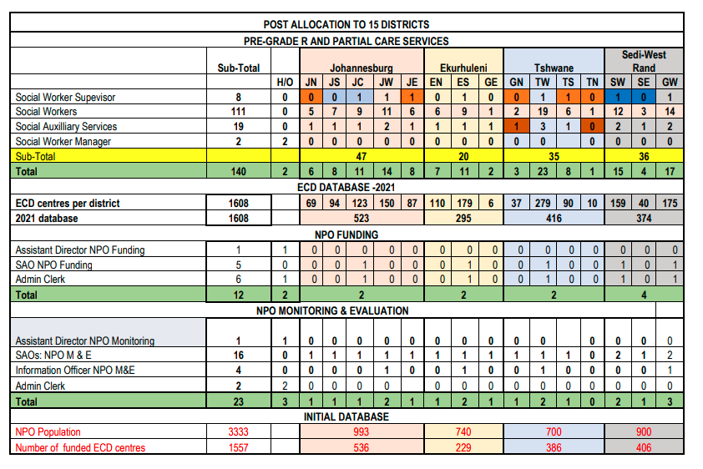
Infrastructure Workstream

Slide 29
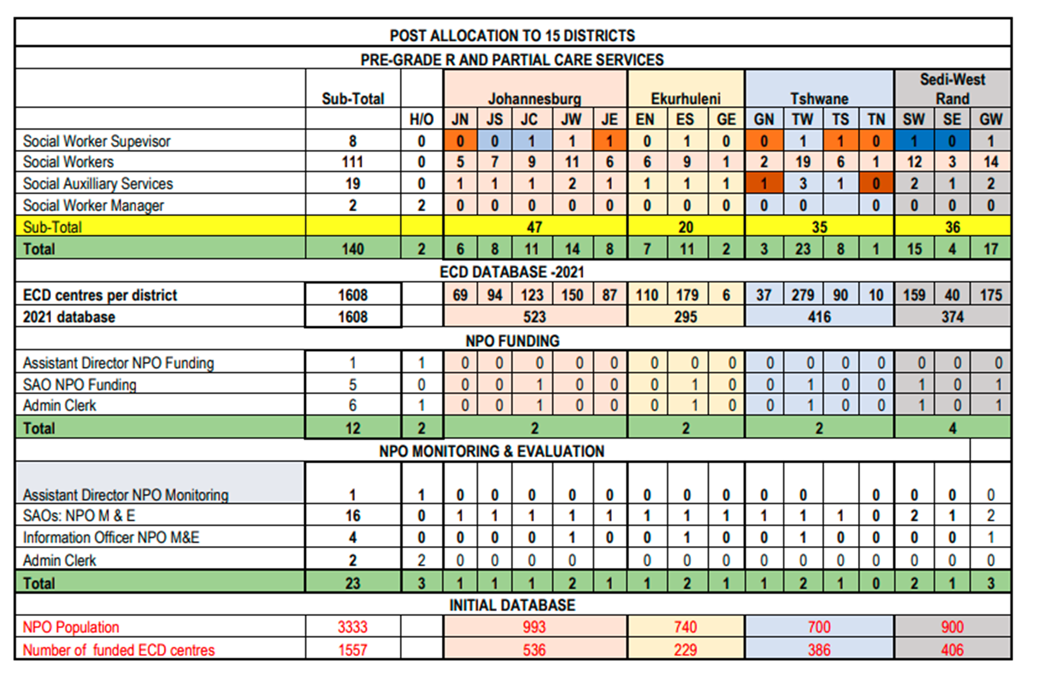

Slide 30
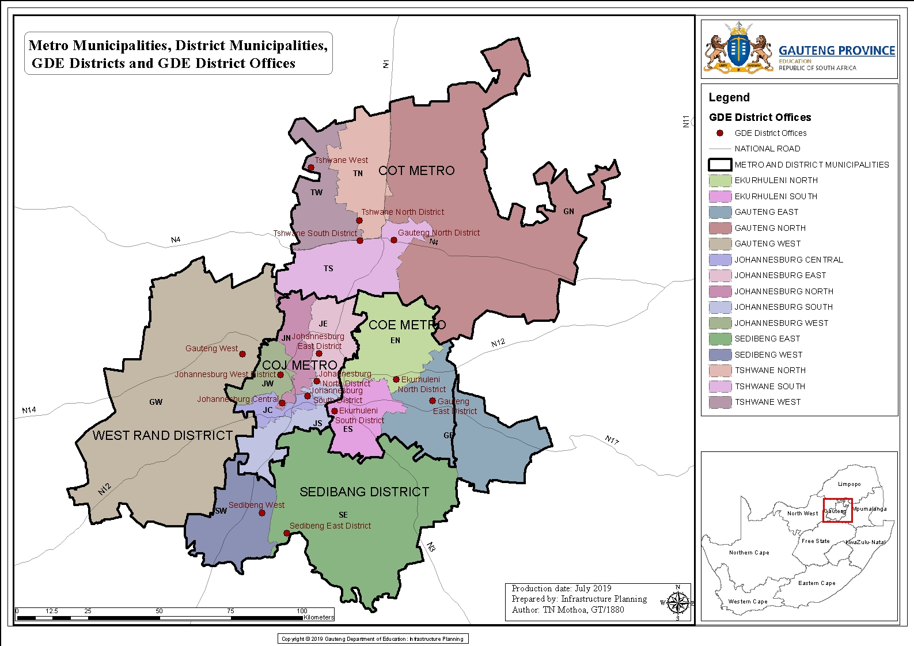
GDE Districts
GDE Districts

Slide 31
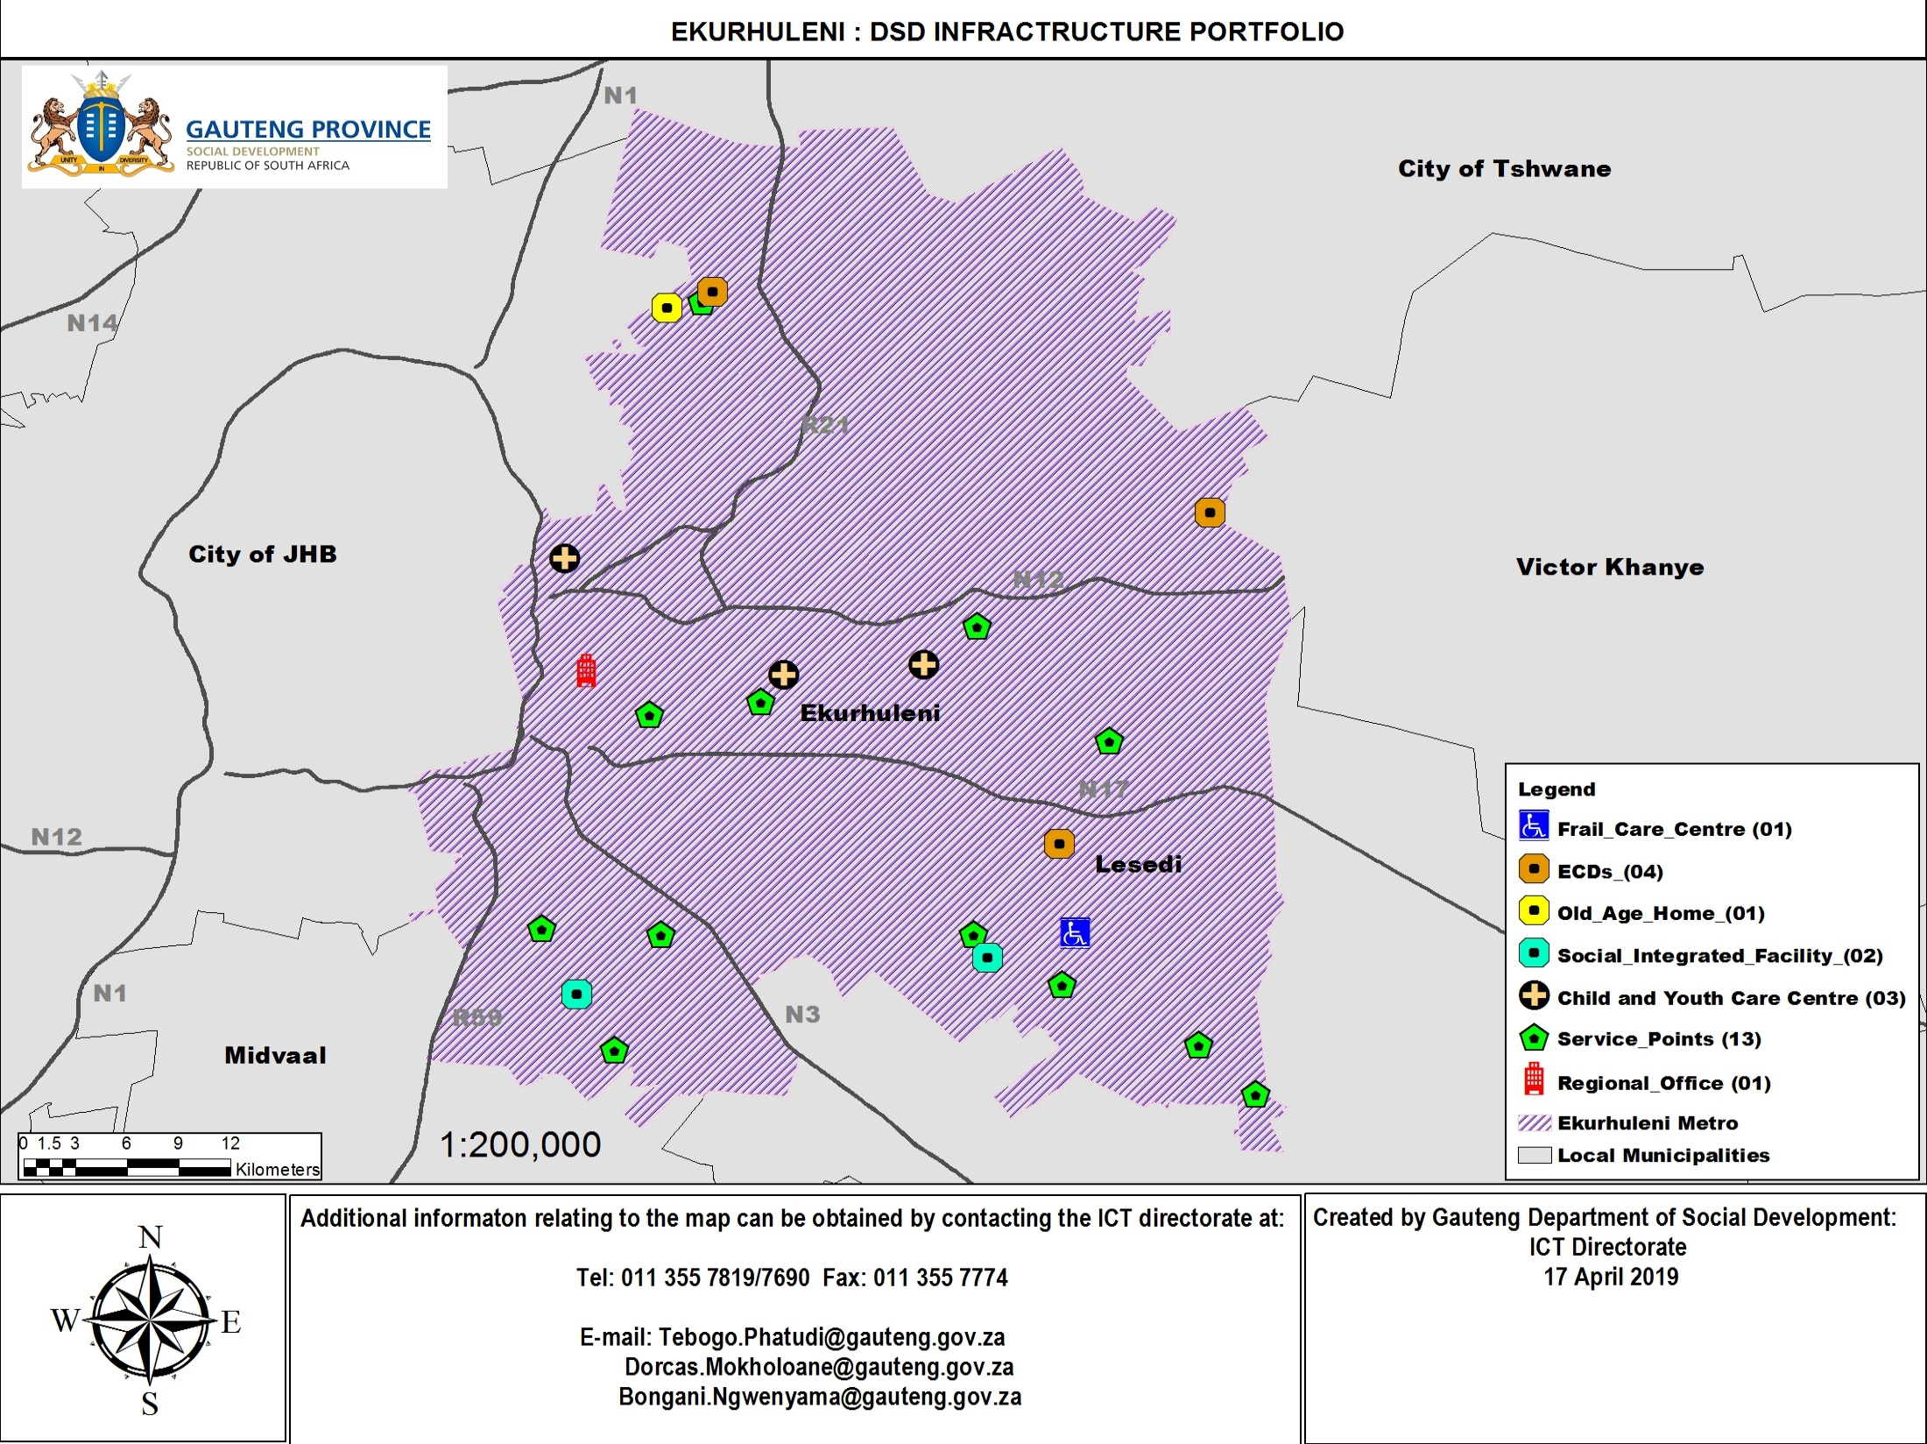

Slide 32
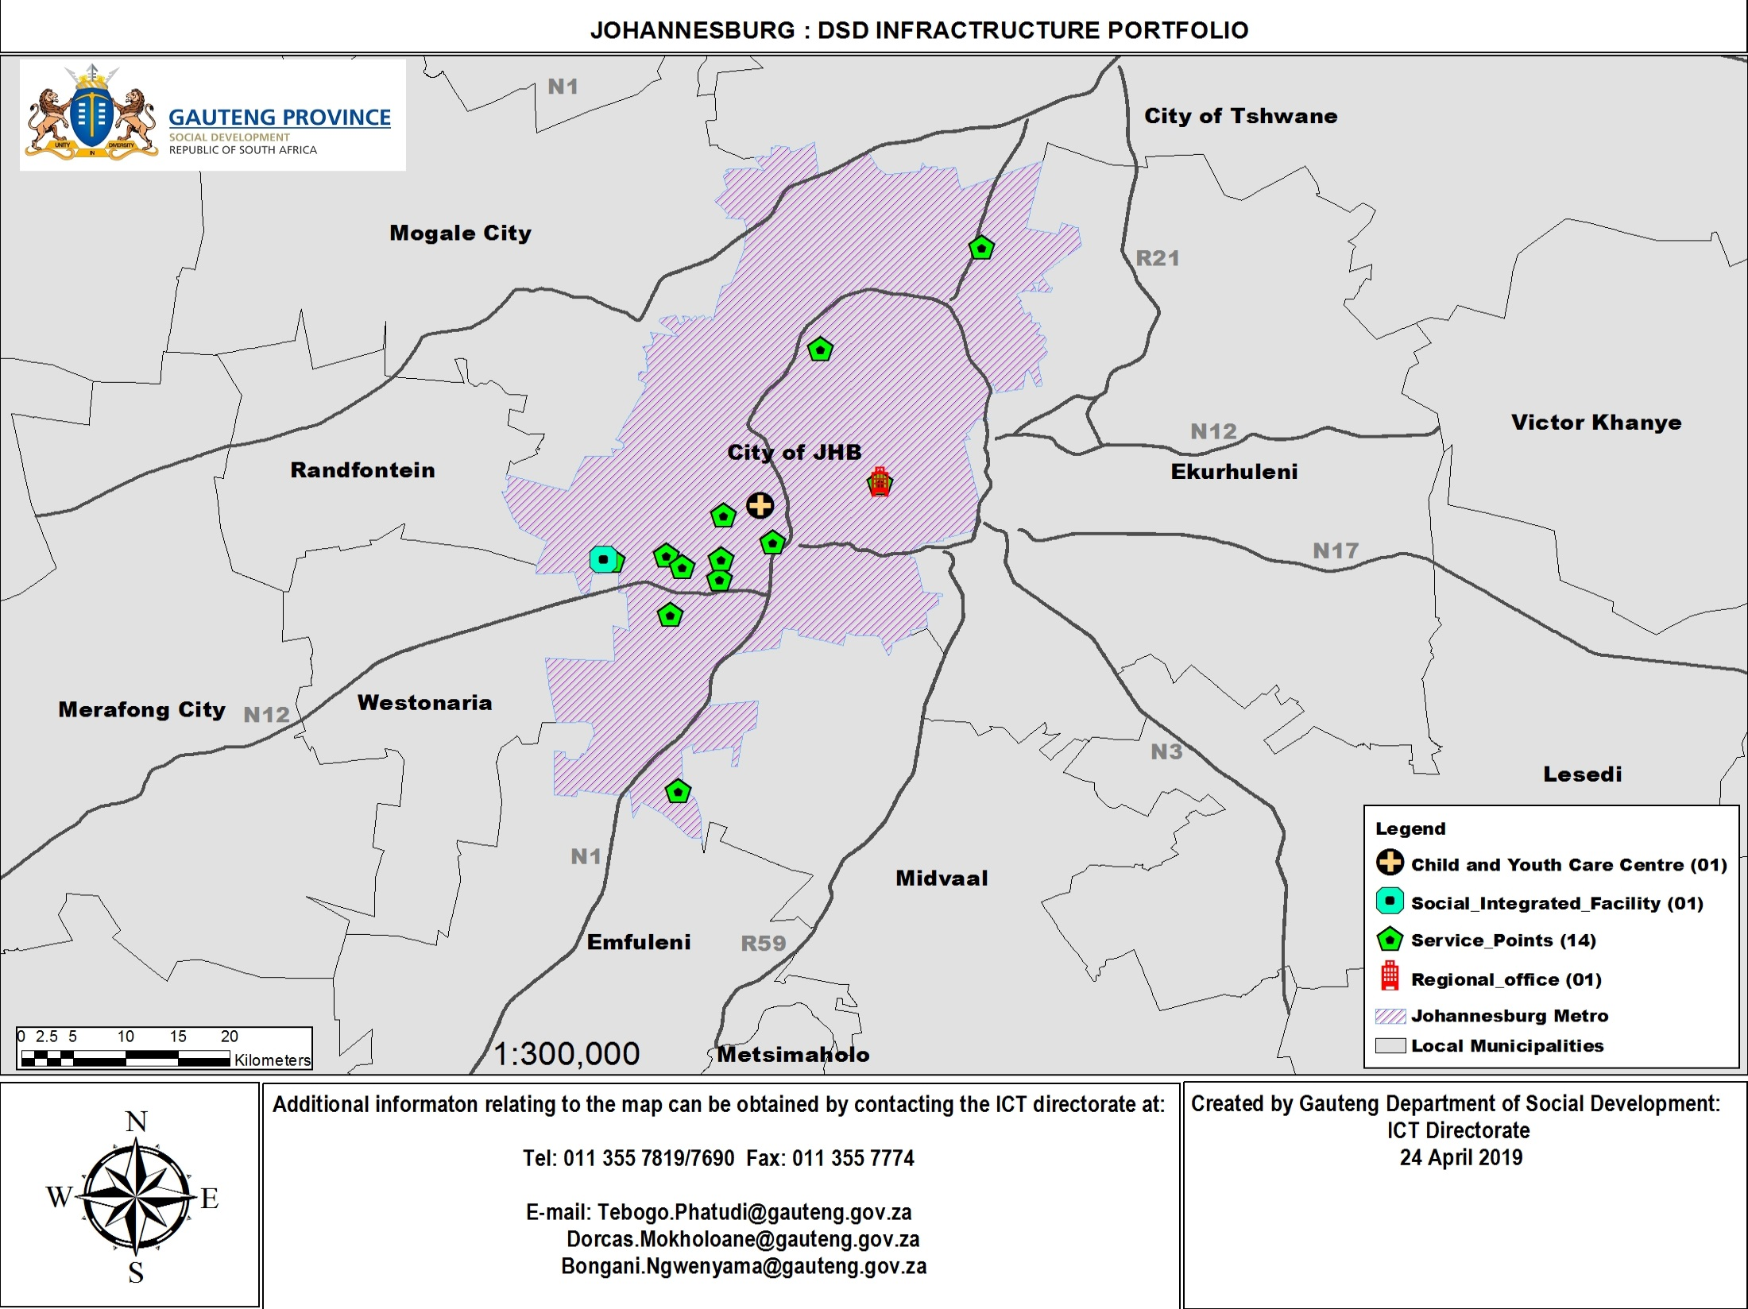
JHB
GDE JN District Office
GDE JW District Office
GDE JN District Office
GDE JC District Office
GDE JS District Office

Slide 33
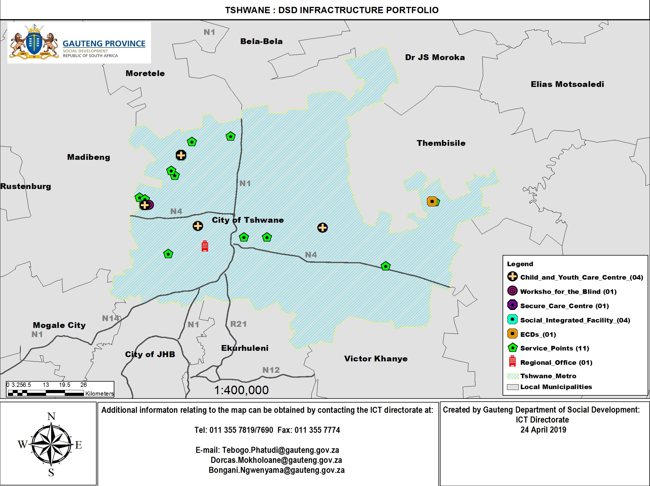
TSHW
GDE TN District Office
GDE TN District Office
GDE TW District Office
GDE TS District Office

Slide 34
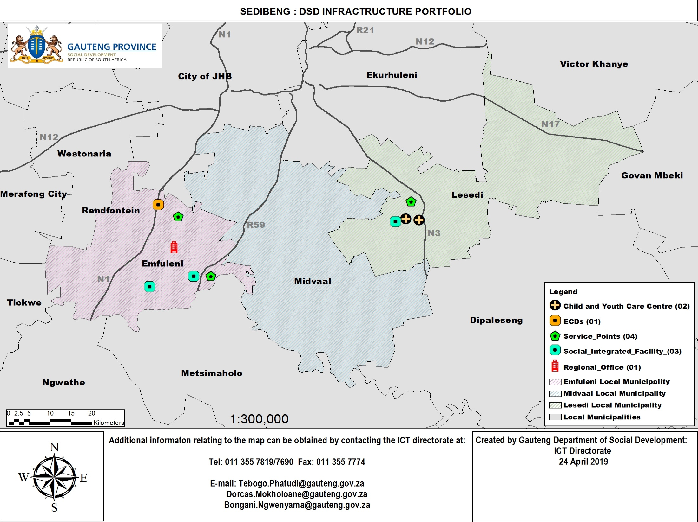
SEDIBENG
GDE SE District Office
GDE SW District Office

Slide 35
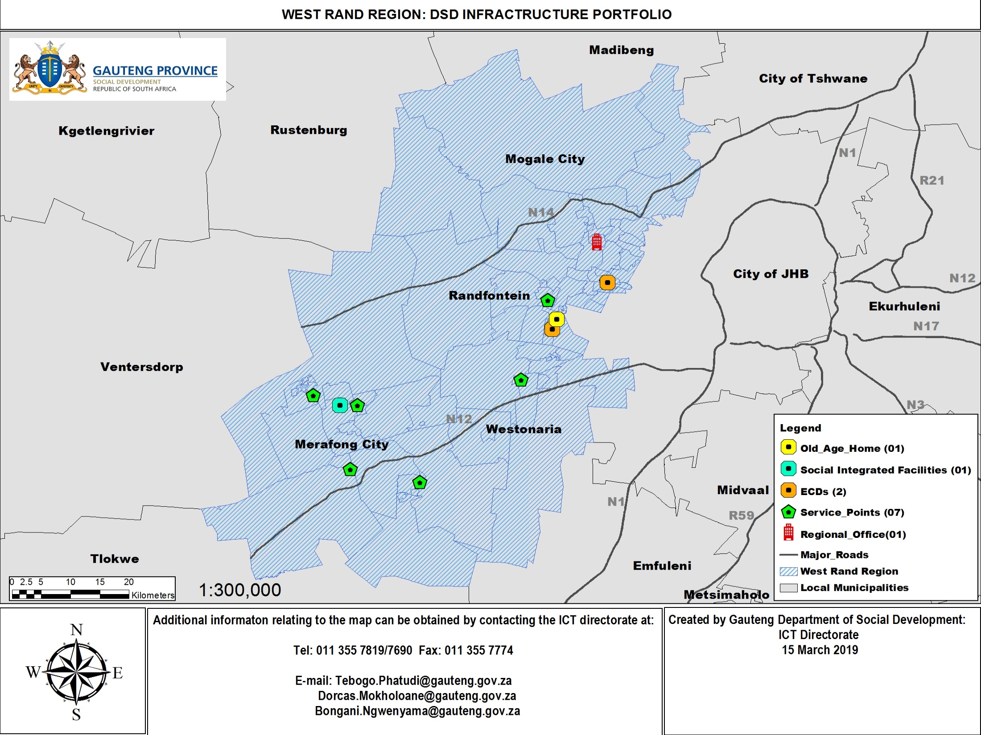
WEST R.
GDE GW District Office

Slide 36
GDE District: Space Calculations (desktop exercise)
 | HQ | EN | ES | GE | GN | GW | JC | JE | JN | JS | JW | SE | SW | TN | TS | TW
Lease Expiry |  | 2023-08-30 | 2018-03-31 | 2023-11-30 | 2018-09-30 | Permanent | Permanent | Temporary | 2024-05-31 | 2021-02-28 | 2023-09-30 | 2019-06-30 | Permanent | 2019-11-30 | 2014-10-31 | Permanent
District Posts | ~ | 327 | 342 | 330 | 251 | 271 | 368 | 298 | 309 | 276 | 295 | 262 | 297 | 305 | 318 | 311
GDSD Posts | 7 | 7 | 13 | 2 | 3 | 19 | 13 | 8 | 6 | 8 | 14 | 4 | 17 | 1 | 8 | 25
GDSD Space | ~ | 92,4 m2 | 171,6 m2 | 26,4 m2 | 39,6m2 | 250,8 m2 | 171,6 m2 | 105,6 m2 | 79,2m2 | 105,6 m2 | 184,8 m2 | 52,8 m2 | 224,4 m2 | 13,2 m2 | 105,6 m2 | 330m2
Existing Space | ~ | 5000 m2 | 8344 m2 | 5000 m2 | 4364 m2 | 6027 m2 | 5000m2 | Temporary | 5000 m2 | 5830 m2 | 5000 m2 | 4009 m2 | 11100 m2 | 6844 m2 | 8500 m2 | 8000 m2
Calc. (excl. GDSD) | ~ | M 4364,80 R 6066,14 X 6730,00 | M 4580,40 R 6369,26 X 7070,00 | M 4422,00 R 6151,01 X 6830,00 | M 3379,20 R 4732,39 X 5290,00 | M 4369,20 R 6078,26 X 6750,00 | M 4928,00 R 6854,26 X 7610,00 | M 3990,80 R 5544,76 X 6150,00 | M 4140,40 R 5756,95 X 6390,00 | M 3700,40 R 5144,64 X 5710,00 | M 3955,60 R 5502,33 X 6110,00 | M 3515,60 R 4890,01 X 5430,00 | M 3982,00 R 5538,70 X 6150,00 | M 4074,40 R 5666,01 X 6290,00 | M 4686,00 R 6514,76 X 7230,00 | M 4166,85 R 5793,32 X 6430,00
New Min Space |  | 4457,2 m2 | 4752 m2 | 4448,4 m2 | 3418,6m2 | 4620 m2 | 5099,6m2 | 4096,4 m2 | 4219,6 m2 | 3805,6 m2 | 4140,4 m2 | 3568,4 m2 | 4206,4 m2 | 4087,6 m2 | 4791,6 m2 | 4496,85 m2
Excess / Deficit | ~ | 542,8m2 | 3592m2 | 551,6m2 | 945,4m2 | 1407m2 | -99,6m2 |  | 780,4m2 | 2024,4m2 | 859,6m2 | 440,6m2 | 6793,6m2 | 2756,4m2 | 3708,4m2 | 3503,15m2
Cal. Space | ✓ | ✗ | ✓ | ✗ | ✓ | ✓ | ✗ | ✗ | ✓ | ✓ | ✓ | ✗ | ✓ | ✓ | ✓ | ✓
Alt. Solution |  | ES |  | ES |  |  | JS = ? | HQ |  |  |  | SW
Space Plan. | TBC | TBC | TBC | TBC | TBC | TBC | TBC | TBC | TBC | TBC | TBC | TBC | TBC | TBC | TBC | TBC

Slide 37
GDE District: Space Calculations (desktop exercise)
 | HQ | EN | ES | GE | GN | GW | JC | JE | JN | JS | JW | SE | SW | TN | TS | TW
Lease Expiry |  | 2023-08-30 | 2018-03-31 | 2023-11-30 | 2018-09-30 | Permanent | Permanent | Temporary | 2024-05-31 | 2021-02-28 | 2023-09-30 | 2019-06-30 | Permanent | 2019-11-30 | 2014-10-31 | Permanent
District Posts | ~ | 327 | 342 | 330 | 251 | 271 | 368 | 298 | 309 | 276 | 295 | 262 | 297 | 305 | 318 | 311
GDSD Posts | 7 | 7 | 13 | 2 | 3 | 19 | 13 | 8 | 6 | 8 | 14 | 4 | 17 | 1 | 8 | 25
GDSD Space | ~ | 92,4 m2 | 171,6 m2 | 26,4 m2 | 39,6m2 | 250,8 m2 | 171,6 m2 | 105,6 m2 | 79,2m2 | 105,6 m2 | 184,8 m2 | 52,8 m2 | 224,4 m2 | 13,2 m2 | 105,6 m2 | 330m2
Existing Space | ~ | 5000 m2 | 8344 m2 | 5000 m2 | 4364 m2 | 6027 m2 | 5000m2 | Temporary | 5000 m2 | 5830 m2 | 5000 m2 | 4009 m2 | 11100 m2 | 6844 m2 | 8500 m2 | 8000 m2
Calc. (excl. GDSD) | ~ | M 4364,80 R 6066,14 X 6730,00 | M 4580,40 R 6369,26 X 7070,00 | M 4422,00 R 6151,01 X 6830,00 | M 3379,20 R 4732,39 X 5290,00 | M 4369,20 R 6078,26 X 6750,00 | M 4928,00 R 6854,26 X 7610,00 | M 3990,80 R 5544,76 X 6150,00 | M 4140,40 R 5756,95 X 6390,00 | M 3700,40 R 5144,64 X 5710,00 | M 3955,60 R 5502,33 X 6110,00 | M 3515,60 R 4890,01 X 5430,00 | M 3982,00 R 5538,70 X 6150,00 | M 4074,40 R 5666,01 X 6290,00 | M 4686,00 R 6514,76 X 7230,00 | M 4166,85 R 5793,32 X 6430,00
New Min Space |  | 4457,2 m2 | 4752 m2 | 4448,4 m2 | 3418,6m2 | 4620 m2 | 5099,6m2 | 4096,4 m2 | 4219,6 m2 | 3805,6 m2 | 4140,4 m2 | 3568,4 m2 | 4206,4 m2 | 4087,6 m2 | 4791,6 m2 | 4496,85 m2
Excess / Deficit | ~ | 542,8m2 | 3592m2 | 551,6m2 | 945,4m2 | 1407m2 | -99,6m2 |  | 780,4m2 | 2024,4m2 | 859,6m2 | 440,6m2 | 6793,6m2 | 2756,4m2 | 3708,4m2 | 3503,15m2
Cal. Space | ✓ | ✗ | ✓ | ✗ | ✓ | ✓ | ✗ | ✗ | ✓ | ✓ | ✓ | ✗ | ✓ | ✓ | ✓ | ✓
Alt. Solution |  | ES |  | ES |  |  | JS = ? | HQ |  |  |  | SW
Space Plan. | TBC | TBC | TBC | TBC | TBC | TBC | TBC | TBC | TBC | TBC | TBC | TBC | TBC | TBC | TBC | TBC

Slide 38
GDE District SD ECD Function: Way Forward
Confirmation of filled and vacant posts at each District as per the new organogram list, as well as any other occupants using workspaces within the District Offices (HR & OD to assist, with sign-off from the District Directors). Appointment of Space Planner for drafting of existing layouts and proposed redistributed space to accommodate officials transferred from GDSD (Under-utilised space / Vacant desks due to vacant posts) (Infrastructure to assist). Furniture: type and size of desks etc.: GDSD – immovable assets 4. IT: data points & telecoms: data points etc. - ITSM Parking: – District Directors Confirmation of how many staff members will be transferring from GDSD to GDE on 31 March 2022.

Slide 39
Data, Information, Monitoring & Evaluation

Slide 40
NATIONAL MILESTONES:
Data, Information, Monitoring & Evaluation
Activity | Timeframe | Responsibility | Progress
1. Integrating new indicators in DBE's strategic plans
Identify new standardised indicators for ECD | September | DBE | Standardised indicators identified.
Include new standardised indicators in APPs | October | DBE | Two standardised indicators identified and are currently being refined
Align MTSF to reflect function shift and new responsibilities | October | DBE | Alignment currently being pursued
2. Integrating ECD data and information into DBE data systems
Preparation of transfer of datasets and systems to DBE and PEDs | Oct - Feb 2022 | DSD & DBE | Being undertaken at provincial level
Transfer datasets, information and systems to DBE and PEDs | Oct - Feb 2022 | DSD & DBE | Datasets shared, database set up and data being verified

Slide 41
Preparing for the function:
Data, Information, Monitoring & Evaluation
Activity | Timeframe | Responsibility | Progress
1. Integrating new indicators in DBE's strategic plans
Identify new standardised indicators for ECD | September | DBE | The GDE has identified 2 standardised indicators for ECD
Include new standardised indicators in APPs | October | DBE | The 2 proposed standardised indicators have been included in the draft 2022/23 APP
Align MTSF to reflect function shift and new responsibilities | October | DBE | The GDE in collaboration with the DBE is working towards aligning the MTSF to reflect the function shift and new responsibilities
2. Integrating ECD data and information into DBE data systems
Preparation of transfer of datasets and systems to DBE and PEDs | Oct - Feb 2022 | DSD & DBE | GDE EMIS has developed an ECD 0-4 Masterlist utilising the data provided by GDSD. The dataset is currently being verified against GDSD documentary sources
Transfer datasets, information and systems to DBE and PEDs | Oct - Feb 2022 | DSD & DBE | The ECD 0-4 Masterlist once fully populated will require sign-off from both the GDSD and the GDE before being adopted. Documentary Information prepared for transfer to the GDE is currently being assembled and storage being sought. The SAP ECD Payment Module will be adopted by the GDE. Licencing and preparations for the training of relevant staff is currently being discussed so that the transition will be seamless.

Slide 42
Workstream Sub-Units
Sub-Unit | Update
EMIS | Data completeness, from Spread Sheets into Access Data Sets, Master List for 0 – 4
Oversight, Monitoring & Reporting (OMR) | Audit information, HR Information, ECD Indicators
Records Management | Dealing with transfer of Records and space across all Districts
IT | Looking at Transfer of Systems, Licencing
ECD | ECD Readiness Assessment and Monitoring systems
Research | ECD Research Coordination

Slide 43
EMIS Action Plan
MILESTONE | KEY ACTIVITIES | RESPONSIBILITY | TIME FRAMES | PROGRESS
Develop ECD 0-4 Masterlist | Assemble all available spreadsheet data into relevant data fields in an Access Database: Incorporate all GDE Relevant Fields (Complete) Add all Fields Unique to GDSD (Complete) Study and Create Data fields from current GDSD Application Forms (Complete) Finalise and Adopt GDE ECD 0-4 Masterlist (In Progress) Issue of EMIS Numbers for each Registered Site (Not yet Started) | GDE EMIS | August-October 2021 | Access Database created. Currently being refined. Once data fully populated will advance to data verification and sign-off process
Data Verification | Check and verify assembled data against complementary GDSD sources: SAP (In Progress – updated data requested) GIS Data (In Progress – updated data requested) Registration Certificates (In Progress – Full Tshwane set requested) SLAs (In Progress – 5% GDSD pending) File all electronic and hard copy Registration Certificates and SLAs (In Progress) GDE Data Completion (In Progress) GDSD Verification Confirmation (Not yet Started) GDE Sign-Off and Adoption (Not yet Started) | GDE EMIS & GDSD (Regions) | September 2021 | Partial Data confirmation completed using Registration Certificates. All registration certificates received, digitised and filed. M&E forwarded 1256 (fully registered) registration certificates in their possession. GDSD supplied a further 507 SLAs for the Johannesburg Region. GDSD Supplied 258 Tshwane SLAs. M&E will forward full set of Tshwane Registration Certificates for Term 2. GIS corrections and inputs still pending from GDSD.

Slide 44
EMIS Action Plan
MILESTONE | KEY ACTIVITIES | RESPONSIBILITY | TIME FRAMES | PROGRESS
Data Completeness | Develop and deploy a data capture tool for GDSD to complete all missing fields in the database: Draft database and capture tool prepared (Completed) Capture tool tested (Completed) and being refined (Ongoing) GDE staff using tool to capture available data from reliable data sources (In Progress) | GDSD | October 2021 | Capture tool under construction and tied to current ECD Masterlist database
Active Masterlist | Deploy solution for the capture of data following the registration of all new ECD Centres (In Progress) | GDSD-GDE | November 2021
Data Audit and Sign-off | Final check against all inputted data in active Masterlist and Sign-off by GDSD | GDSD-GDE | December 2021 -February 2022
Pre-Grade R Survey | Develop and Deploy an ECD Pre-Grade R Survey | GDE-GDSD | January-February 2022

Slide 45
EMIS Data Verification Registration Certificates
A. Regions | B. Baseline DB | C. No Certificate but in DB | D. In DB but certificate still to be verified | E. Certificate Available and in DB | F. Certificate Available but not in DB | G. Grand Total | H. Possible 2021 GDSD DB (G-C)
Ekurhuleni | 300 | 26 |  | 274 | 118 | 418 | 392
Johannesburg | 514 | 112 | 3 | 399 | 166 | 680 | 568
Sedibeng | 202 | 36 |  | 166 | 42 | 244 | 208
Tshwane | 418 | 134 |  | 303 | 31 | 468 | 334
West Rand | 173 | 22 |  | 151 | 26 | 199 | 177
Grand Total | 1607 | 330 | 3 | 1293 | 383 | 2009 | 1679

Slide 46
EMIS DATA Completion & Secondary Verification: SLAs
A. REGION | B. CENTRES IN Baseline GDSD DATABASE | C. REGISTRATION CERTIFICATES | D. No. of CLOSED / UNFUNDED / UNREGISTERED CENTRES | E. No. of SLAs SIGNED | F. SLAs SUPPLIED | G. SLAs OUTSTANDING (C-F)
Ekurhuleni | 300 | 457 |  |  | 301 | 156
Johannesburg | 514 | 565 |  |  | 507 | 58
Sedibeng | 202 | 207 |  |  | 204 | 3
Tshwane | 418 | 336 |  |  | 258 | 160
West Rand | 173 | 175 |  |  | 137 | 38
Total | 1607 | 1736 |  |  | 1407 | 415

Slide 47
Database Development Summary
Consolidated dataset of all baseline sites plus all newly registered (with registration certificates) created – dataset needs to be verified by GDSD to identify all closed sites
Require a detailed report from GDSD in respect of Closed Sites, Unfunded Sites and Unregistered Sites by Region
GDE committed to developing database with GPS Coordinates for ALL ECD Centres:
  Submitted Full Baseline database (1606) for IKM team to validate, correct and input GPS Coordinates of all REGISTERED and FUNDED Sites – feedback from GDSD IKM still outstanding
In respect of Registration Certificates (1736): Ekurhuleni (457), Johannesburg (565), Tshwane (336), West Rand (175) and Sedibeng (207)
In respect of SLAs (1407): Ekurhuleni (301), Johannesburg (507), Tshwane (258), West Rand (137) and Sedibeng (204)
GDE still awaiting an electronic format (Word version) of the SLA from GDSD

Slide 48
Database Development Summary (cont.)
Data cleaning underway.
Key observations in this regard:
    Spelling of ECD Centres different in Database, Registration Certificates and SLAs (Will utilise Registration Certificate as most accurate data source).
    Serious Risk: There are many centres with exactly the same names and without a unique identifier may be considered duplicates
    Expired Registration Certificates
    Centres with Signed 2021/22 SLAs but missing/invalid Registration Certificates

Slide 49
Updated Data Request
Given that status of the work currently and in the quest to finalise our data verification exercise, GDE EMIS will require the following updated datasets from GDSD:
  The latest (up to end of Quarter 2) dataset of all ECD Centres from ALL Regions
  ALL the 2021 Tshwane Region Registration Certificates issued.
  The list of all certificates issued per region for 2021
  The updated list of all GIS Coordinates linked to item 1
  A list of all closed centres from each of the regions
  A list of all unfunded centres from each of the regions
  A list of all newly registered centres from each of the regions
  A list of all centres with whom SLAs have been signed for 2021/22
  The latest SAP extract (up to the end of the second quarter)
  A list of all unregistered centres (if available)
  SAP and BAS Payment schedules for the last 3 financial years

Slide 50
OMR Action Plan
MILESTONES | KEY ACTIVITIES | RESPONSIBILITY | TIME FRAMES | PROGRESS
AG Walkthrough information | GDSD to submit AG Walk through information | GDSD | September 2021 | In Progress - In line with the envisaged timeframe. GDSD to provide samples of evidence for all ECD reported indicators viewed during the site visit reported on in the below row.
Sharing of Verification Reports | GDSD to submit Verification Reports on all indicators with primary & Secondary Evidence (From 19/20 FY) | GDSD | April 2022 (Timeframe will be revised after the site visit) | Completed – Site visit to GDSD was scheduled and conducted on the 25th August 2021 at Heidelberg – (Central Records) Samples of audit evidence was scanned to establish the evidence base for reported indicators (Refer: Next Slide) Completed – Site visit to GDSD (JHB Region) was scheduled and conducted on the 27th September 2021 at 41 Fox Street GDSD Offices. 11 ECD related Indicators were identified by GDSD for the 2021/22 FY. Of the 11 indicators, all were supplied by GDSD to GDE on the 30th September 2021 (datasets/excel sheets and some samples (primary evidence)) and was verified. The process that was witnessed at GDSD was intended to observe the method of retrieving the evidence and samples related to ECD indicators.

Slide 51
OMR Action Plan
MILESTONE | KEY ACTIVITIES | RESPONSIBILITY | TIME FRAMES | PROGRESS
Sharing of HR and Labour Relations Information | To receive the Approved Organogram (Macro and Micro) with functions and staffing allocations Macro: H/O – Directorates and above Micro: Sub-directorates, Units, Districts, Regions, Clusters, Satellites etc. | GDSD - HR Workstream | August 2021 | Completed – Initial request submitted to Chairpersons of HR Workstream on 28/07/2021, reminder was sent on 19/08/2021. A detailed and approved Organogram as well as a revised post establishment as per ECD Shift Approved Organisational structure was submitted on 19/08/2021.
Sharing of Audit Information | GDSD to share: the GAS Audit Report on Performance Information (Word/PDF) the GAS Audit Report on the ECD sector, if any. RFI from the AG with Responses in respect of ECD | GDSD - Finance Workstream | August 2021 | Completed – Request was sent to chairpersons of the Finance Workstream on 27/07/2021. Received the following on the 30/07/2021 : -GAS Audit Report on Performance Information. -No ECD GAS Audit Reports for the past 3 years was reported -RFI from the AG with Responses in respect of ECDs.

Slide 52
OMR Action Plan
MILESTONE | KEY ACTIVITIES | RESPONSIBILITY | TIME FRAMES | PROGRESS
Sharing of Programme Implementation Information | GDSD to share relevant Source Documents related to NPO Service Points, Regions, Institutions, Business Units GDSD to share relevant ECD Policy Documents (Legislation, Frameworks, Acts, National Gazettes, Provincial Gazettes, Memos and Circulars GDSD to share Approved Statutory Reports to National DSD | GDSD - Programme Workstream | Aug 2021 | Request was sent to GDSD HOD to appeal for the outstanding ECD Information on 07/09/2021. DDG: Bengtson (GDE) and DDG: Kabasia (GDSD) responded via email on 08/09/2021 supporting the release of the information (except for Performance Contracts) It is anticipated that the Provincial Steercom Secretariat will: Facilitate the signing of the letter Process the requested data from GDSD and forward it to the Data, Information and M&E Workstream Secretariat once received. - Letter from HOD:GDE to HOD:GDSD requesting data was approved on 5th October 2021 – still awaiting feedback
Sharing of Stakeholder Management and Communications Information | To receive the Contact Details of all relevant stakeholders, institutions, officials. Municipality: Environmental, Health, Social development MMCs and counsellors | GDSD Programmes and Communications Workstream | Aug 2021

Slide 53
OMR Action Plan
MILESTONE | KEY ACTIVITIES | RESPONSIBILITY | TIME FRAMES | PROGRESS
Sharing of Oversight, Monitoring and Reporting Information | GDSD to share Portfolio Committee Oversight Reports To receive the Responses to Questions and House Resolution on the Quarterly and Annual Reports to the Provincial Legislature To receive the Responses to Questions and Resolutions posed by SCOPA on the Annual Reports to the Provincial Legislature To receive the Responses to Parliamentary Questions from National and Provincial structures | GDSD – Provincial Steercom | Aug 2021 | Request was sent to GDSD HOD requesting the outstanding ECD Information on 07/09/2021. DDG: Alison Bengtson (GDE) and DDG: Onkemetse Kabasia (GDSD) supported the request. It is anticipated that the Provincial Steercom Secretariat will: Facilitate the signing of the letter Process the requested data from GDSD and forward it to the Data, Information and M&E Workstream Secretariat once received. Letter from HOD:GDE to HOD:GDSD requesting data was approved on 5th October 2021 - still awaiting feedback
Sharing HR and Labour Relations Information | To receive the Performance management contracts/mid-year, reviews/annual reviews/Performance Reports of MEC, HOD & all DDGS. | GDSD – Provincial Steercom | Aug 2021 | The requested information was not deemed critical for the ECD Function Migration to proceed. The GDE agreed was this position and has agreed to withdraw this request.

Slide 54
ECD Indicator 1: Number of Children in Registered ECD sites
Indicator title | OI5.1: Number of children in registered ECD sites
Definition | The ECD programme is to ensure equitable access to, early childhood development services through a provincial integrated system that identifies, enables and compels the fulfilment of early childhood development roles and responsibilities of relevant role players. The purpose of the indicator is to enable the Department to determine the number of children provided with early stimulation and communication development to enable them to have the best start in life that is necessary for preparation for successful schooling in all ECDs.
Source of data | Provincial Warehouse/Database
Method of calculation/assessment | Record all children enrolled in registered ECD sites. (ECD Survey) (Public Ordinary, Special Schools, registered Independent Schools, ECD Community sites- centre based and non-centre based, funded and unfunded.)
Means of verification | Signed-off declaration by Principal/ECD centre manager or District manager (electronic or hardcopy) or other formal record as determined by the Province. Deployment Reports and signed Survey Forms (Registration Certificates/SLAs)
Assumptions | There is demand for services and department has capacity to deliver on the services required in liaison with critical stakeholders (Municipalities).
Disaggregation of beneficiaries (where applicable) | Boy and girl children
Spatial transformation (where applicable) | All 0-6-year-old children have access to the registered ECD programme in the Province.
Calculation type | Non-Cumulative
Reporting cycle | Annual
Desired performance | All 0-6-year-old children have access to the registered ECD programme Target for the year to be met or exceeded.
Indicator responsibility | EMIS Directorate / Chief Directorate: Education Planning and Research (EMIS). Chief Directorate: Coordination of Curriculum Implementation (Early Childhood Development).

Slide 55
ECD Indicator 1: Number of Fully Registered ECD sites
Indicator title | OI5.2: Number of fully registered ECD sites
Definition | The ECD programme is to ensure equitable access to, early childhood development services through a provincial integrated system that identifies, enables and compels the fulfilment of early childhood development roles and responsibilities of relevant role players. The purpose of the indicator is to enable the Department to determine that all ECD centres that fully comply with the norms and standards and requirements for registration in terms of Chapter 5 Children’s Act 38 of 2005
Source of data | Provincial data warehouse/Database/Masterlist
Method of calculation/assessment | Count the total number of fully registered ECD sites
Means of verification | Signed-off declaration by Principal/ECD centre manager or District manager (electronic or hardcopy) or other formal record as determined by the Province. Deployment Reports and signed Survey Forms/Registration Certificates/SLAs
Assumptions | There is demand for services and department has capacity to deliver on the services required in liaison with critical stakeholders (Municipalities).
Disaggregation of beneficiaries (where applicable) | Boy and girl children/Owner Profile
Spatial transformation (where applicable) | There is a need to register all ECD sites to ensure all sites comply with the norms and standards and requirements for registration in terms of Chapter 5 Children’s Act 38 of 2005
Calculation type | Non-Cumulative
Reporting cycle | Annually
Desired performance | All ECD sites are registered and comply with the norms and standards and requirements for registration in terms of Chapter 5 Children’s Act 38 of 2005. Target for year to be met or exceeded.
Indicator responsibility | EMIS Directorate / Chief Directorate: Education Planning and Research (EMIS). Early Childhood Development Directorate (ECD)

Slide 56
Records Management Action Plan
MILESTONE | KEY ACTIVITIES | RESPONSIBILITY | TIME FRAMES | PROGRESS
Undertake Regional Site Visit/S | Visit Krugersdorp regional office to: View physical records in place Undertake an audit of what is available Confirm availability of records for transfer across all GDSD regions | GDE & GDSD (Records Management) | 4 August 2021 | Completed
Physical Transfer of Records from GDSD to GDE | Audit all records (physical and electronic) hosted in respect of ECD by GDSD (Outstanding) Plan and execute transfer of records as per specifications and NARS legislations (in Progress) Securing Storage Space to house new records (Outstanding) Secure transport to facilitate transfer from all GDSD Regions to GDE Sites (Outstanding) | GDE & GDSD (Records Management) | August – October 2021 | GDSD provided final list of all records that are less than 5 years old. These will be labelled and stored in GDSD Heidelberg Repository until GDE advises around transfer. GDSD letter to Provincial Archives advising of the transfer concluded and GDE provided with a copy. GDE still engaging internally around storage.
Incorporation of ECD series / functions on GDE File Plan | Conclude discussions on the functions performed by GDSD Records Management in respect of the ECD function (In Progress) Audit and amend what GDE has in place and adapt to include what we do not cater for (In Progress) | GDE & GDSD (Records Management) | August–November 2021 | In line with the timeframe

Slide 57
Summary of Non-Active Files as at 17 September 2021
REGION | NUMBER OF FILES | NO. OF BOXES | TRANSFER LIST RECEIVED
SEDIBENG | 1029 | 114 BOXES | YES
TSHWANE | 10 | 1 BOX | YES
WEST RAND | 75 | 15 BOXES | YES
EKURHULENI | 19 | 2 BOXES | YES
JOHANNESBURG | 11 | 1 Box | YES
HEAD OFFICE | 08 | 1 BOX | NO

Slide 58
Forthcoming Records Management Activities
Pending Engagements:
  GDE ECD (follow-up engagements) – to determine ECD records management needs and processes
  GDE Finance Section - to secure funding for offsite storage for the uptake of ECD files from GDSD. Submission routed for approval

Slide 59
IT Action Plan
MILESTONES | KEY ACTIVITIES | RESPONSIBILITY | TIME FRAMES | PROGRESS
Staff members migrating to GDE (and vacancies) | Determining the number. Determining the names. Determining migration date. Determining their GDE offices. | IT HR – OD | August-December 2021 | 175 posts to be spread between GDE Head Office & Districts. Names & number of incumbents to migrate is still to be determined. User Accounts will be migrated on the migration date, 1 April 2022.
Assets (to be migrated to GDE & provisioning by GDE) | Date of assets migration Receival of assets. Assessment of assets Outcome of assessment. Configuring the assets Procuring assets | IT Asset Finance | Pending Labour engagement outcomes October-November 2021 | Assessment of IT assets will unfold once consultation has been concluded by Labour and the name list for warm bodies moving over to GDE has been provided

Slide 60
IT Action Plan
MILESTONES | KEY ACTIVITIES | RESPONSIBILITY | TIME FRAMES | PROGRESS
3. Microsoft Licensing | Provisioning of Microsoft Licenses for migrating staff. | IT | March 2022 | Meeting was held on 30/09/21 between GDSD, GDE and eGov. It was noted that GDE is operating on a different Microsoft EA licensing model and GDSD EA agreement comes to an end by Feb.2022. Officials moving to GDE will only be covered while still in GDSD. GDE to liaise with eGov to make provision for the procurement of additional software licences w.e.f. 01 April 2022.
4. SAP Licenses | Determining SAP Licenses requirements and costs. Determine the number of users from Finance and ECD | IT | August 2021 | eGov to cover licensing costs.

Slide 61
IT Action Plan
MILESTONES | KEY ACTIVITIES | RESPONSIBILITY | TIME FRAMES | PROGRESS
5. Training of GDE Finance officials on SAP ECD | Determining officials to be trained. Request training from SAP trainers. Set training date. | IT Finance eGov | February 2022 | Arrangements will be made once the development of the Grantor (NPO) module has been completed.
5.1 Training of Trainers | Finalization of Grantor Module Project implementation. | IT Finance eGov | January 2022 | The project has run into System design issues, that have caused project implementation delays. However, these project issues are being addressed by the GDSD Project team, eGov, and the implementing Service Provider under a revised project plan.

Slide 62
IT Action Plan
MILESTONES | KEY ACTIVITIES | RESPONSIBILITY | TIME FRAMES | PROGRESS
5.2. System Migration | Technical Configuration in relation to creating a new System instance for GDE. | IT | January 2022 | eGov will facilitate the migration of the standard Grantor Module being developed for GDSD. Any additional requirements for system enhancements / customization by GDE will have budget implications.. There will be no SAP software licensing cost implications as these licenses are centralized at eGov. for the Province.
6* Online System (ECD Management System) | Meeting with ECD team (to understand current processes from Application to register an ECD until Approval & Funding stage, any other stages, and business requirements) Determining whether the ECD Management System is to be developed in-house or otherwise. Development of an ECD Management System. | IT ECD | April 2022 | Two workstreams to meet with all necessary team resources available.

Slide 63
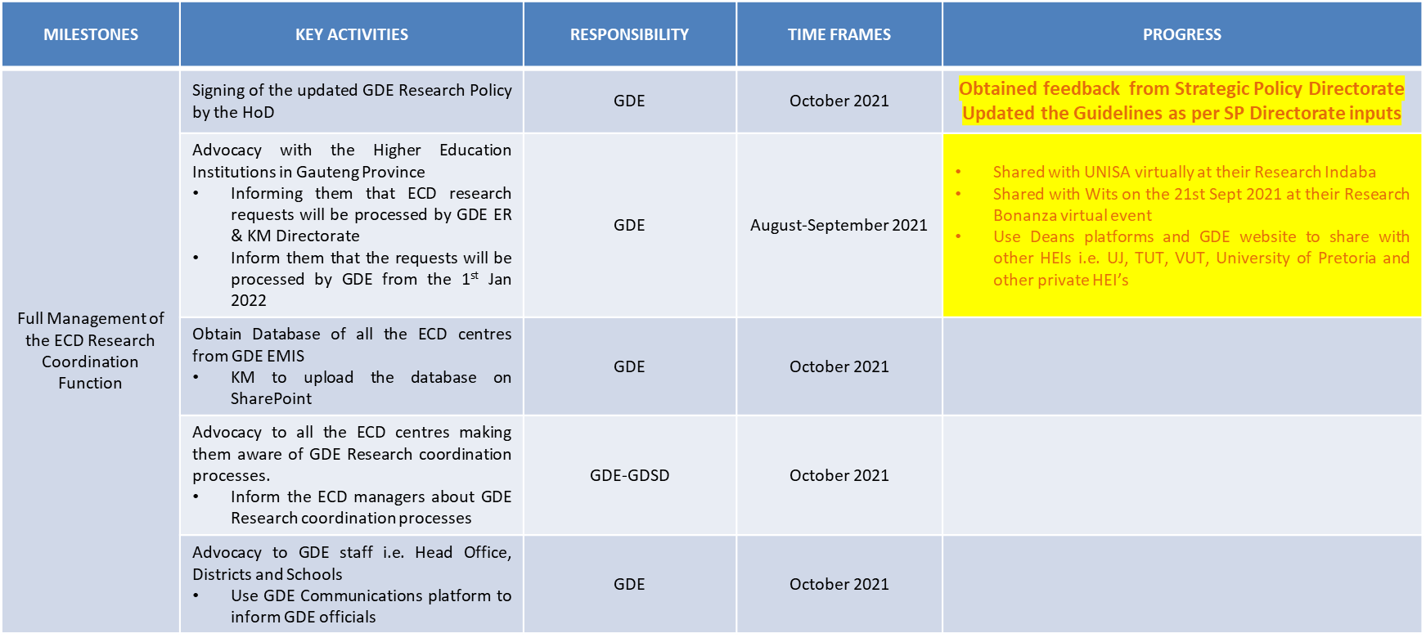
Research Action Plan

Slide 64
Programme Implementation

Slide 65
Preparing for the function:
Programme Implementation
Activity | Timeframe | Responsibility | Progress
Identify processes and collect tools used to assess registration of ECD centres | August | DSD & DBE | Processes identified and Tools collected
Orientation of National and PED officials on Vangasali and the Registration Management Framework | October - November | DSD & DBE | 1st phase completed
2nd phase forVangasali and the Registration Management Framework GP | 18 November | DSD & DBE | Venue for 2nd Phase secured at MGSL Vrededorp - JHB
Finalise, consult and workshop the ECD Concept Note and the Service Delivery Model | September | DSD & DBE | National ECD Concept note and Service Delivery Model received, shared with all Work streams for input Collated input and shared with National
Participate in HR process on the Service Delivery Model for the province | November | DSD & DBE | In progress

Slide 66
Preparing for the function:
Programme Implementation
Activity | Timeframe | Responsibility | Progress
Capacity building on DBE readiness for Conditional Grant management (Infrastructure) | October | DSD & DBE | Workshops in progress at National
Process presented to GDE by DSD |  |  | Completed
Develop a plan for assessing new applications for registration with the DBE | Oct - Feb 2022 | DSD & DBE | In progress
NPO Funding Business process | Oct-Feb 2022 | DSD & DBE | NPO Funding Management Value Chain presented to GDE by GDSD Input on calls for proposals provided Adverts done

Slide 67
Preparing for the function:
Programme Implementation
Activity | Timeframe | Responsibility | Progress
Identify all on-going ECD projects: | September | DSD & DBE | ECD Census South African Early Years Index Presidential Stimulus Relief Package ECD Massification Vangasali Online Registration Framework
Capacity building on current ECD projects | Oct 2021 - Feb 2022 | DSD & DBE | NCF Training Supatsela Demonstration Session Presentation on Children’s Amendment Bill
 | In progress | DSD & DBE | Vangasali Online Registration Workshop NPO Funding and Partnerships Conditional Grant Workshop Review of ECD Registration and Monitoring Tools Workshop NQF L4 Training

Slide 68
Preparing for the function:
Programme Implementation
Activity | Timeframe | Responsibility | Progress
Transfer of coordination of governance structures | Oct - Feb 2022 | DSD & DBE | In progress Provincial Interdepartmental Committee, Intersectoral Stakeholder Forum (National) Integrated ECD Stakeholder Engagement (Provincial) , Provincial ECD Coordinators Forum, ECD NPO Forums, Provincial Inter Governmental Relations (HOD Office), Regional IGR
Engagement with the ECD sector on ECD Function shift: | Aug - Feb 2022 | DSD & DBE | MEC Engagements GPG Special ECD Summit Municipality Engagements ECD Provincial Stakeholder Engagement Regional ECD Summits (5 Regions) GDE Curriculum Branch Other Departments – Sports Arts and Culture (SRAC) , Agriculture- (GDAD), Cooperative Governance and Traditional Affairs – (COGTA) Education Portfolio Committee
 | Aug - Feb 2022 | DSD & DBE | Health and Social Portfolio Committee

Slide 69
Preparing for the function:
Programme Implementation
Activity | Timeframe | Responsibility | Progress
Conduct readiness assessment of ECD registration by DBE | February 2022 | DSD & DBE | Conducted site visits in: - City of Tshwane (Hammanskraal, Fairie Glen) - Ekurhuleni - Daveyton Integrated ECD Facility
 | February 2022 | DSD & DBE | Forms/Tools in the process of being reviewed

Slide 70
Preparing for the function:
Programme Implementation
Activity | Timeframe | Responsibility | Progress
Conduct readiness assessment of ECD registration by DBE | February 2022 | DSD & DBE | Conducted site visits in: City of Tshwane (Hammanskraal, Fairie Glen Ekurhuleni - Daveyton Integrated ECD Facility
Review of Forms/Tools for Registration and Monitoring: |  | DSD & DBE | Application for registration of a Partial Care facility Application for registration of an ECD Programme Assessment of an Early Childhood Development Programme Inspection report for registration of a partial care facility
 | February 2022 | DSD & DBE | Assessment of non-centre based ECD programme

Slide 71
Communication & Stakeholder Engagement

Slide 72
Preparing for the function:
Communication & Stakeholder Engagement
communication
Activity | Timeframe | Responsibility | Progress
Media Partnership (both print and electronic) | August | GDE and GDSD | Discussions with GCIS, Sunday World and News24 (educational supplement)
Customised Local IGRs Media Plan | august | GDE and GDSD | Municipal stakeholder engagements took place per plan
Media Products: Advisories/Interviews, statements per activity i.e. Signing of Proclamation | SEPTEMBER | GDE and GDSD | Media statement on Premier signing Proclamation developed and circulated to media
Poster | SEPTEMBER | GDE and GDSD | The poster has been circulated for internal comm and Social Media
Media interview | SEPTEMBER | GDE and GDSD | Secured an interview with Lekoa, Jozi and Mams FM to unpack the ECD function shift
Opinion Piece | SEPTEMBER | GDE and GDSD | An Opinion Piece has been circulated to various media house, awaiting publishing
Promos | SEPTEMBER | GDE and GDSD | Promos have been done in English, Zulu and Sotho to be aired in Lekoa, Heidelburg, Sedibeng, Thetha, Jozi, Cosmo, Alex,Eldos, Mams, Sosh, TUT, EK, Kasie, Westside FM from 16 Sept – 5 Oct

Slide 73
Preparing for the function:
Communication & Stakeholder Engagement
communication
Activity | Timeframe | Responsibility | Progress
Content Development | SEPTEMBER | GDE and GDSD | Messages have been developed for interviews, infographics and posters FAQ is developed, also to be designed and shared in internal comms an social media
Social media campaign | SEPTEMBER | GDE and GDSD | Content has bEen shared with social media service provider, first posts sent out.
News articles | SEPTEMBER | GDE and GDSD | Articles on Sedibeng Region written and published weekly on internal news bulletin and website
Internal Communication with affected employees | SEPTEMBER 2021 – MARCH 2022 | GDE and GDSD | In progress, working with HR & LR & OOP on Change Management
Internal Communication /Change Management to staff Rollout to affected staff members in both departments | OCTOBER | GDE and GDSD | In progress, working with HR & LR & OOP on Change Management
Media statement, interviews and opinion pieces following staff engagements | OCTOBER | GDE and GDSD | In progress, working with HR & LR & OOP on Change Management

Slide 74
Preparing for the function:
Communication & Stakeholder Engagement
communication
Activity | Timeframe | Responsibility | Progress
Social media posts on staff engagements on ECD | OCTOBER | GDE and GDSD | To follow outcomes of Bargaining Chamber and subsequent staff engagements
Newsflashes through bulk emails | OCTOBER | GDE and GDSD | To follow outcomes of Bargaining Chamber and subsequent staff engagements
Advertorials – mainstream print adverts outlining all milestones achieved on the journey of ECD function shift | NOVEMBER | GDE and GDSD | To be activated closer to the time
Interactive community media engagement on ECD function shift | NOVEMBER | GDE and GDSD | To be activated closer to the time
Social media posts on milestones achieved on ECD journey to date | SEPTEMBER - NOVEMBER | GDE and GDSD | To be activated closer to the time
Newsflashes through bulk emails | NOVEMBER | GDE and GDSD | To be activated closer to the time

Slide 75
Stakeholder and Communications Action Plan
ACTIVITY | RESPONSIBILITY | DATE | STATUS
Promos | Media Relations | 18 -31 Oct | To place promos in local radio stations again
Media interview | Media Relations Team | 4– 8 Oct | Kasie FM Alex FM
Advertorials | Media Relations Team | 20 OCT | To begin media buy for adverts on ECD moving from Social Development to Education
MEC ECD Function Shift School Visit | Media Relations Team | 20 OCT | Seattle Primary School - ECD Function Shift Readiness - School runs an ECD Programme which the MEC visited. An Article will be shared with internal publics on preparedness at the school.
Social Media | Marketing Team | 1st -31st October | Running the campaign that has already rolled out, with all the social media posters presented. This will run concurrently with Social Development month

Slide 76
Preparing for the function:
Communication & Stakeholder Engagement
Stakeholder engagement
Activity | Timeframe | Responsibility | Progress
Virtual ECD Summit | 24 June 2021 | GDE and GDSD | Done and resolutions are being implemented
ECD Extended Summit targeting 1000\1500 participants | 29 July 2021 | GDE and GDSD | Done and resolutions processed and implemented
MECs Virtual ECD Stakeholder Engagement (with political heads and structures) | 15 July 2021 | GDE and GDSD | Completed
ANC Social Cluster Engagement | 21 July 2021 | GDE and GDSD | Completed
Joint Oversight Committees Engagement (Social Development and Education) | 26 July 2021 | GDE and GDSD | Completed
MEC – MMC IGR Forums | 5 August 2021 – September 2021 | GDE and GDSD | Completed
Engagements with Other Workstreams | 6 August 2021 – December 2021 | GDE and GDSD | Ongoing
Regional ECD Summits/Roadshows (i.e. Summit Resolution) | 24 August 2021 – September 2021 | GDE and GDSD | Completed

Slide 77
Preparing for the function:
Communication & Stakeholder Engagement
Stakeholder engagement
Activity | Timeframe | Responsibility | Progress
Engagements with other departments: Health, COGTA, Sports | August | GDE and GDSD | Completed
ECD Function Shift Signing Agreement | Dec/Jan | GDE and GDSD | To be attended by Premier, MECs and Mayors

Slide 78
Thank you

