Slide 1
VOTER ONLINE SELF-REGISTRATION
GPL in collaboration with IEC

Slide 2
INTRODUCTION
The Gauteng Provincial Legislature (GPL) conducts voter education in partnership with critical institutions such as Department of Home Affairs (DHA), all Municipalities in Gauteng, Electoral Commission of South Africa (IEC), South African Local Government Association (SALGA) and the South African United Students (SAUS).
South Africa specifically Gauteng province with its growing influx or in-migration is investing in public and voter education to enable young people to understand the significance of voting and what it means for our democracy and to also register the legible people of South Africa to acquire an Identity Document (ID).

Slide 3
FUNCTIONS OF THE GPL
The Gauteng Provincial Legislature has four mandates to execute which is that of law-making, oversight, public participation and cooperate governance. These mandates are discussed in more detail below:
LAW MAKING
OVERSIGHT
PUBLIC PARTICIPATION
COOPERATIVE GOVERNANCE
CLICK TO PROCEED

Slide 4
LAW MAKING
Law-making entails considering, passing, amending or rejecting any Bill. This mandate includes monitoring the implementation of the provincial legislation that has been passed. After a law or bill has been passed, the executive is expected to execute it in terms of the implementation process.

Slide 5
OVERSIGHT
Oversight entails the informal and formal, watchful, strategic and structured scrutiny exercised by legislatures, including Parliament, in respect of the implementation of laws, the application of the budget, and the strict observance of statutes and the Constitution.

Slide 6
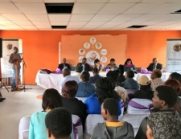
PUBLIC PARTICIPATION
The Legislature allows the people of Gauteng to participate in law-making and oversight processes. The public participation mandate consists of various participation mechanisms such as House sittings, public hearings, Bua Le Sechaba, public education workshops, budget process, annual report and petitions etc.

Slide 7
COOPERATIVE GOVERNANCE
Cooperative governance is the co-ordination of efforts across the different spheres of government. One of the principles states that different spheres must consciously collaborate with each other by:
Fostering friendly relations.
Assisting and supporting one another.
Informing one another of and consulting one another on matters of common interest.
Co-ordinating their actions and legislation with one another.

Slide 8
WHAT IS THE IEC?
The IEC is the Electoral Commission of South Africa, which is an organisation established in terms of Chapter 9 of the Constitution of the Republic of South Africa, 1996 and is charged with ensuring free and fair elections.
The IEC has developed a new voter self-registration portal. Your one-stop shop where you can register to vote, or – if you are already registered – view and update your address, request a special vote, find your correct voting station, and view important election dates.

Slide 9
ONLINE SELF-REGISTRATION PROCESS
Self-registration will take you less than two minutes. You will need one of these devices.

Slide 10
6 EASY STEPS TO REGISTER
NOTE: Click on the text boxes to see the process for each step
1
Get your SA ID card/book ready and go to the link www.registertovote.elections.org.za.
2
Enter your personal information: ID number, name and surname, and mobile number.
3
Insert the One-Time PIN (OTP) sent to your mobile number.
4
Capture your home address.
5
Review and acknowledge your information.
6
Take a photo or upload a scan of your SA ID.

Slide 11
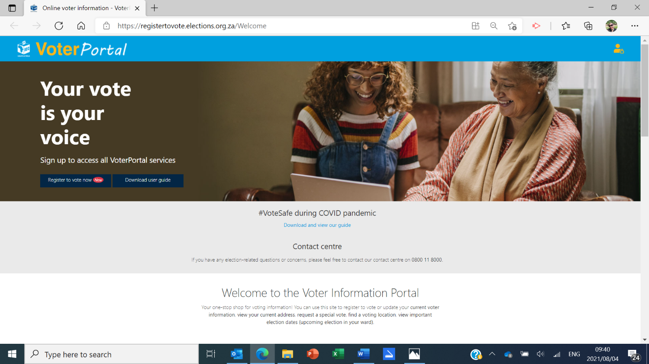
Step 1 – Access the Home page https://registertovote.elections.org.za/Welcome and click on “Register to vote now”.

Slide 12
Step 2 – Tick the “I accept the terms of use box” and click on “Begin application process”.
Enter your personal information: ID number, name and surname, and mobile number (your own mobile number, even if you’re registering from someone else’s device). Click “Continue”.

Slide 13
Step 3 – One-Time-Pin (OTP)
A One-Time-Pin will be sent to your mobile number.
Insert the One-Time PIN (OTP) and click on “Confirm OTP”.

Slide 14
Step 4 – Capture your home address
OPTION 1
OPTION 2
OPTION 3
CLICK TO PROCEED

Slide 15
Step 4 – Capture your home address
Option 1: Locate me.
The system asks permission to “Know your location”, click on “Allow”. Set the “Use my current location” toggle to “On”.
NEXT SCREEN

Slide 16
The address form will pop-up to allow for further address input. Once captured click on “Continue”.
Note: Your voting station details will be displayed at the bottom.

Slide 17
Option 2: Type in your full address, select the correct address from the dropdown menu, or click search. The screen will show auto-filled entries found with your search.
Notes: Addresses that are complete and known.
Examples: Town, city or suburb areas.
*Tip: If you live in a housing complex, please search with the street name for the entrance to your complex – street names inside complexes are not always mapped by the municipality.
NEXT SCREEN

Slide 18
The address you have searched for will be displayed. Click on “Select Address”.

Slide 19
Option 3: Type in your full address, select from dropdown, or click search. The screen will show a zoomed map of the area you have searched for. Continue to zoom in, looking for landmarks, your voting station, local community hall, river or nearby main road, for example. Once you locate your street and house, click on it to select.
Notes: Addresses that cannot be readily populated from a search
Examples: Rural address example
NEXT SCREEN

Slide 20
A form will pop-up that allows you to further complete your address. Once completed click on “Continue”.
Notes:
Make certain of your Ward and Voting district.
Suburb / Zone / Section / Village / Farm name is compulsory.
Town / City / Traditional authority name is compulsory.

Slide 21
Step 5 – Review and acknowledge your information.
Accept the declaration by ticking the box. Click on ‘Verify your ID document”.

Slide 22
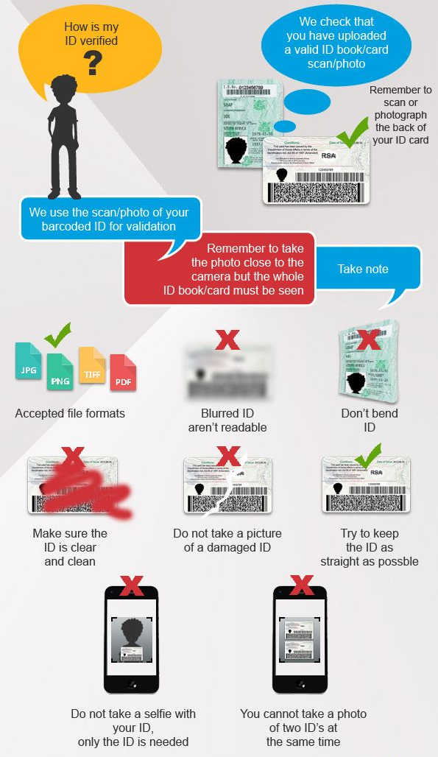
Step 6 – Upload a photo or file of your SA ID.
If you select “I want to scan using my camera” follow the below process.
NEXT SCREEN

Slide 23
If you select “I want to upload a file”, click on “Choose File” and select a photo from your pictures folder. Click on “Continue”.
NEXT SCREEN

Slide 24
ID document verification – successful
Click on “Sign up now”. A sms will be sent to your mobile number, acknowledging the successful registration application.
NEXT SCREEN

Slide 25
ID document verification – not successful
A sms will be sent to your mobile number, notifying you of the unsuccessful registration application.
Notes: A reference number will accompany the sms notification.
NEXT SCREEN

Slide 26
Use the reference number to resubmit your ID document. Click on “I have reference number” and follow the steps.
NEXT SCREEN

Slide 27
CONTACT DETAILS
If you have any further questions about the online self-registration process, you can reach the Electoral Commission at:
Helpline 0800 11 8000
email info@elections.org.za.
Chat on Facebook or Twitter at @IECSouthAfrica
 | Johannesburg City Hall, Corner of Helen Joseph (formerly President) and City Hall (formerly Loveday) Streets
 | 011 498 5555
 | 086 273 1921
 | www.gpl.gov.za
 | ppp@gpl.gov.za
 | @GPLegislature
 | Gauteng Provincial Legislature
NEXT SCREEN

Slide 28
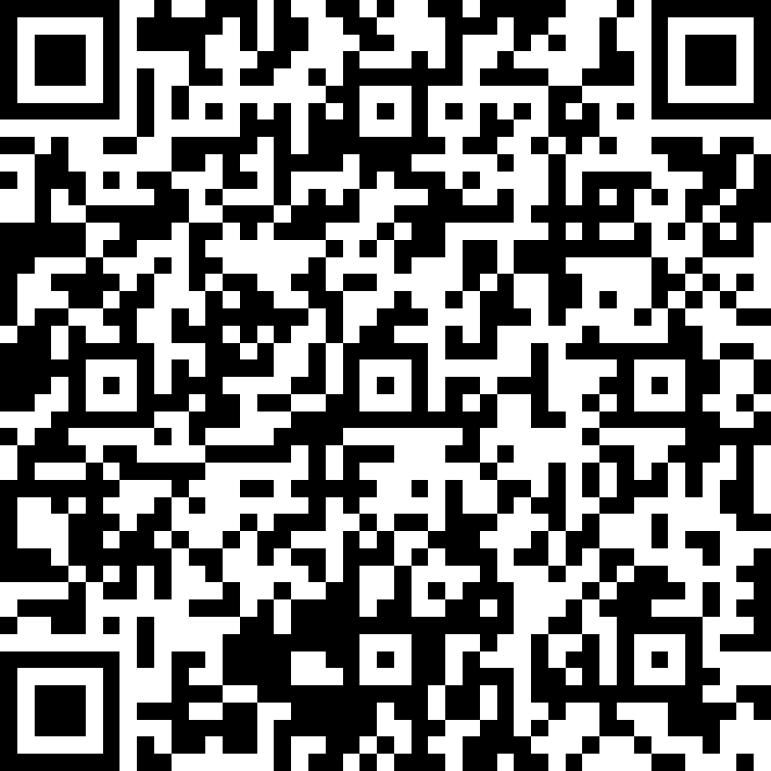
Survey
Click on the icon to complete the survey
Scan the QR code with your mobile device to complete the survey
OR

